Slide 1
Machine Learning K Nearest Neighbor Classification
by
Dr Jyostna Devi Bodapati
Associate Professor, ACSE, VFSTR

Slide 2
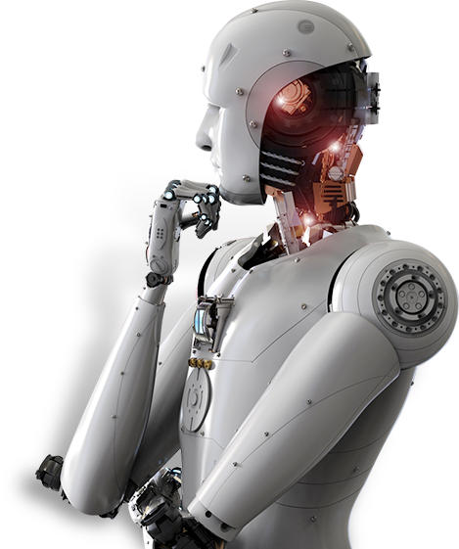
Outline
Nearest-Neighbor Classifiers
Distance Measures
K- Nearest-Neighbor Classifiers

Slide 3
Lazy vs. Eager Learning
Lazy learning (eg, instance-based learning):
Simply stores training data (or only minor processing)
Do not construct any model during training
Ex: KNN, Case-Based Reasoning
Eager learning:
Given training set, constructs a classification model
Uses this model for prediction of test samples
Ex: Decision Trees, SVMs

Slide 4
Instance-Based Classifiers
Set of Stored Cases
Store the training records
Use training records to predict the class label of unseen cases
Atr1 | ……... | AtrN | Class
 |  |  | A
 |  |  | B
 |  |  | B
 |  |  | C
 |  |  | A
 |  |  | C
 |  |  | B
Unseen Case
Atr1 | ……... | AtrN

Slide 5
Instance Based Classifiers
Examples:
Rote-learner
Memorizes entire training data and performs classification only if attributes of record match one of the training examples exactly
Can classify only the previously seen data, unseen data can not be classified
Nearest neighbor
Uses k “closest” points (nearest neighbors) for performing classification

Slide 6
Nearest Neighbor Classifiers
Basic idea:
If it walks like a duck, quacks like a duck, then it’s probably a duck
Compute Distance
Test Record
Training Records
Choose k of the “nearest” records

Slide 7
Basic Idea
k-NN classification rule is to assign a test sample the majority category label of its k nearest training samples
In practice, k is usually chosen to be odd, so as to avoid ties
The k = 1 rule is generally called the nearest-neighbor classification rule

Slide 8

Nearest-Neighbor Classifiers
Unknown record
* Requires three things
The set of stored records
Distance Metric to compute distance between records
The value of k, the number of nearest neighbors to retrieve
* To classify an unknown record, the algorithm includes the following basic steps :
Calculating distances
Finding K closest neighbors
Taking the majority vote

Slide 9

Definition of Nearest Neighbor
X
X
X
(a) 1-nearest neighbor (b) 2-nearest neighbor (c) 3-nearest neighbor
K-nearest neighbors of a record x are the k data points that have the smallest distance to x

Slide 10
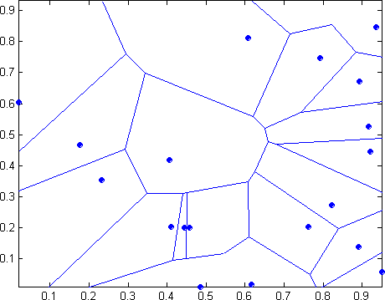
1 Nearest-neighbor
Properties:
All possible points within a sample's Voronoi cell are the nearest neighboring points for that sample
For any sample, the nearest sample is determined by the closest Voronoi cell edge

Slide 11
The KNN classification algorithm
Let k be the number of nearest neighbors and D be the set of training examples.
Step1: for each test sample z = (x', y') do
Step2: Compute d(x, x'), the distance between z and every example, (x,y) ϵ D
Step3: Select D_{z} ⊆ D, the set of k closest training samples to z.
Step4: y' = argmax ∑ (_{𝒙𝑖,𝑦𝑖} )_{ϵ 𝐷𝑧} 𝐼( 𝑣 = 𝑦_{𝑖} )
𝑣
Step5 : end for

Slide 12






KNN Classification
$2,50,000
$2,00,000
$1,50,000
Loan$
Non-Default Default
$1,00,000
$50,000
$0
0
10
20
30
40
50
60
70
Age

Slide 13
K Nearest-Neighbor Classifiers: Issues

Slide 14
K Nearest-Neighbor Classifiers: Issues
The value of k, the number of nearest neighbors to retrieve
Choice of Distance Metric to compute distance between records
Computational complexity
Size of training set
Dimension of data

Slide 15
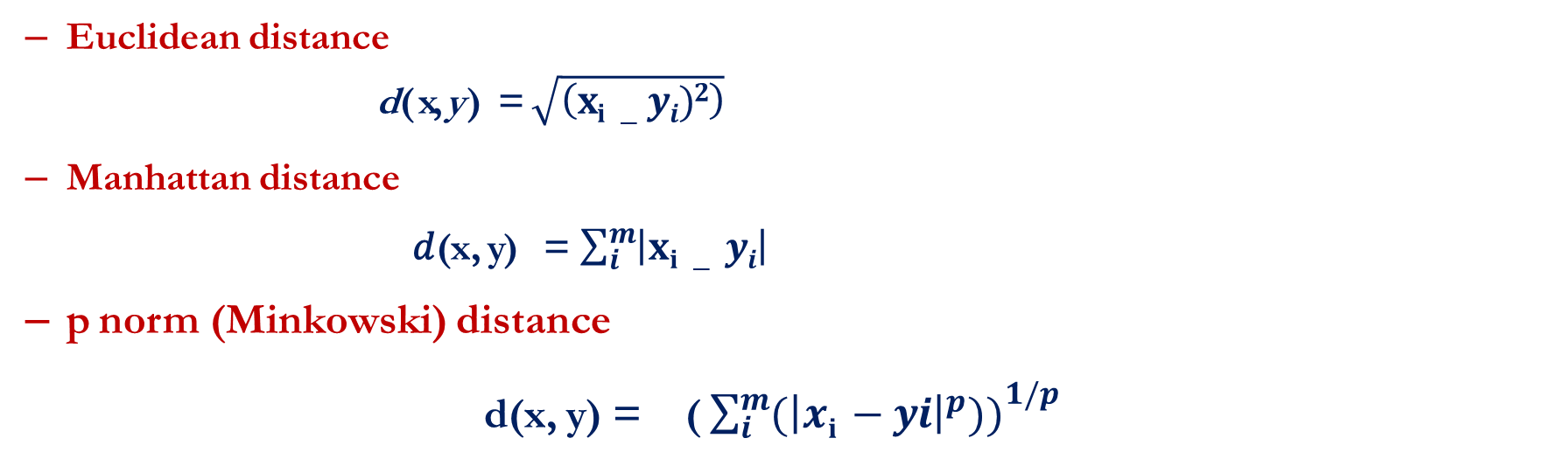
Distance Metrics
Compute distance between two points: x = [ x₁, x₂ ….x_{m} ] and y = [ y₁, y₂ ….y_{m} ]
Euclidean distance
d ( x, y) = $\sqrt{\left(xi −yi)2\right)}$
Manhattan distance
𝑑(x, y) = $\sum_{i}^{m}{\left|xi − yi\right|}$
p norm (Minkowski) distance
d(x, y) = ( ${\sum_{i}^{m}{{(\left|xi −yi\right|}^{p}))}}^{1/p}$

Slide 16
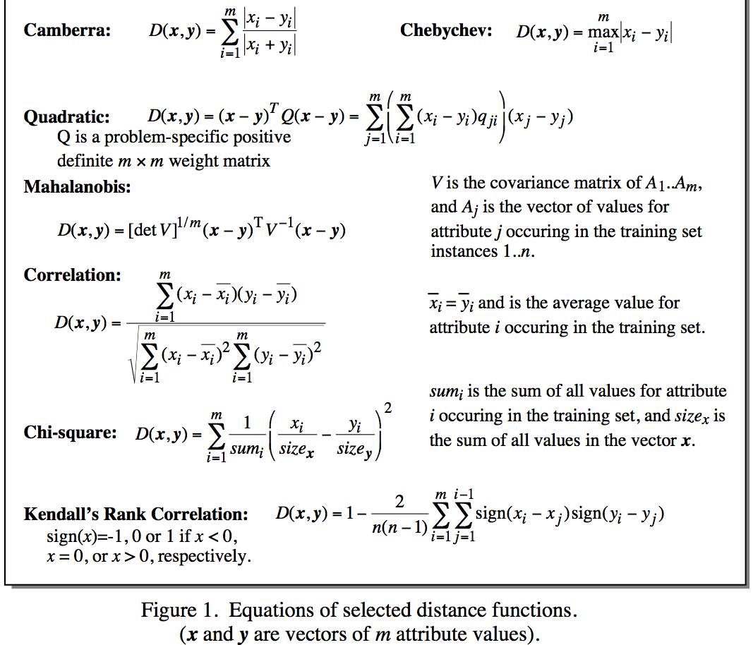
Distance Metrics
Notes:
Minkowsky = l-norm

Slide 17
KNN: Choosing K
Choosing the value of k:
If k is too small, sensitive to noise points
If k is too large, neighborhood may include points from other classes
X
Rule of thumb:
K = sqrt(N)
N: number of training points

Slide 18
KNN: Feature Scaling Issues
Scaling issues
Attributes may have to be scaled to prevent distance measures from being dominated by one of the attributes
Example:
height of a person may vary from 1.5m to 1.8m
weight of a person may vary from 60 KG to 100KG
income of a person may vary from Rs10K to Rs 2 Lakh
* Income have a much greater influence on the distance between samples
* May bias the performance of the classifier

Slide 19
Standardization of features
Transform raw feature values into z-scores
x_{ij} is the value for the i^{th} sample and j^{th} feature
μ_{j} is the average of all x_{ij} for feature j
σ_{j} is the standard deviation of all x_{ij} over all input samples
Range and scale of z-scores should be similar (providing distributions of raw feature values are alike)

Slide 20
K Nearest Neighbor: Dimensionality
Problem with Euclidean measure:
High dimensional data
curse of dimensionality: all vectors are almost equidistant to the query vector
Can produce counter-intuitive results
Shrinking density – sparsification effect
1 1 1 1 1 1 1 1 1 1 1 0
1 0 0 0 0 0 0 0 0 0 0 0
vs
0 1 1 1 1 1 1 1 1 1 1 1
0 0 0 0 0 0 0 0 0 0 0 1
d = 1.4142
d = 1.4142
Solution: Normalize the vectors to unit length

Slide 21
Nearest neighbor Classification…
k-NN classifiers are lazy learners
It does not build models explicitly
Unlike eager learners such as decision tree induction and rule-based systems
Classifying unknown records are relatively expensive

Slide 22
KNN Numerical Example
Height (in cms) | Weight (in kgs) | T Shirt Size
158 | 58 | M
158 | 59 | M
158 | 63 | M
160 | 59 | M
160 | 60 | M
163 | 60 | M
163 | 61 | M
160 | 64 | L
163 | 64 | L
165 | 61 | L
165 | 62 | L
165 | 65 | L
168 | 62 | L
168 | 63 | L
168 | 66 | L
170 | 63 | L
170 | 64 | L
170 | 68 | L
Let k be 5.
New customer named 'Monica' has height 161cm and weight 61kg
Suggest the most suitable shirt size
For the following cases:
Euclidean distance
Manhattan Distance

Slide 23
Time complexity
Training time complexity: 0(1)
Training space complexity: O(n*d)
Prediction time complexity: O(k * n* d)
Prediction space complexity: O(1)
n: number of points in the training dataset
d: data dimensionality
k: number of neighbours that we consider for voting

Slide 24
Advantages and disadvantages of KNN
Advantages:
K-NN is pretty intuitive and simple
K-NN has no assumptions:
No Training Step
It constantly evolves
Very easy to implement for multi-class problem
Can be used both for Classification and Regression
One Hyper Parameter
Variety of distance criteria to be choose from
Disadvantages:
K-NN slow algorithm
Curse of Dimensionality
K-NN needs homogeneous features
Optimal number of neighbors
Imbalanced data causes problems
Outlier sensitivity
Missing Value treatment
Notes:
Below is the list of few of the reasons to choose K-NN machine learning algorithm:
K-NN is pretty intuitive and simple: K-NN algorithm is very simple to understand and equally easy to implement. To classify the new data point K-NN algorithm reads through whole dataset to find out K nearest neighbors.
K-NN has no assumptions: K-NN is a non-parametric algorithm which means there are assumptions to be met to implement K-NN. Parametric models like linear regression has lots of assumptions to be met by data before it can be implemented which is not the case with K-NN.
No Training Step: K-NN does not explicitly build any model, it simply tags the new data entry based learning from historical data. New data entry would be tagged with majority class in the nearest neighbor.
It constantly evolves: Given it’s an instance-based learning; k-NN is a memory-based approach. The classifier immediately adapts as we collect new training data. It allows the algorithm to respond quickly to changes in the input during real-time use.
Very easy to implement for multi-class problem: Most of the classifier algorithms are easy to implement for binary problems and needs effort to implement for multi class whereas K-NN adjust to multi class without any extra efforts.
Can be used both for Classification and Regression: One of the biggest advantages of K-NN is that K-NN can be used both for classification and regression problems.
One Hyper Parameter: K-NN might take some time while selecting the first hyper parameter but after that rest of the parameters are aligned to it.
Variety of distance criteria to be choose from: K-NN algorithm gives user the flexibility to choose distance while building K-NN model.
Euclidean Distance
Hamming Distance
Manhattan Distance
Minkowski Distance
Even though K-NN has several advantages but there are certain very important disadvantages or constraints of K-NN. Below are listed few cons of K-NN.
K-NN slow algorithm: K-NN might be very easy to implement but as dataset grows efficiency or speed of algorithm declines very fast.
Curse of Dimensionality: KNN works well with small number of input variables but as the numbers of variables grow K-NN algorithm struggles to predict the output of new data point.
K-NN needs homogeneous features: If you decide to build k-NN using a common distance, like Euclidean or Manhattan distances, it is completely necessary that features have the same scale, since absolute differences in features weight the same, i.e., a given distance in feature 1 must means the same for feature 2.
Optimal number of neighbors: One of the biggest issues with K-NN is to choose the optimal number of neighbors to be consider while classifying the new data entry.
Imbalanced data causes problems: k-NN doesn’t perform well on imbalanced data. If we consider two classes, A and B, and the majority of the training data is labeled as A, then the model will ultimately give a lot of preference to A. This might result in getting the less common class B wrongly classified.
Outlier sensitivity: K-NN algorithm is very sensitive to outliers as it simply chose the neighbors based on distance criteria.
Missing Value treatment: K-NN inherently has no capability of dealing with missing value problem.

Slide 25
KNN: Further Study
Distance for Nominal, ordinal Attributes and heterogenous data
Reduction in Computational Complexity- Condensation
KNN Optimization - K-D Tree

Slide 26
Thank You

