Slide 1
Sales Forecasting Using Machine Learning
Internship Project
Hemasri Koluturi
Machine Learning Domain
Google Colab Implementation

Slide 2
Introduction
Sales forecasting helps businesses predict future demand.
  Supports inventory management and marketing planning.
  Machine Learning improves prediction accuracy.

Slide 3
Problem Statement
Uncertainty in predicting future sales.
  Traditional methods lack accuracy.
  Need for data-driven predictive models.

Slide 4
Dataset Overview
24 months of sales data.
  Features: Month, Advertising Spend, Price.
  Target Variable: Sales.

Slide 5
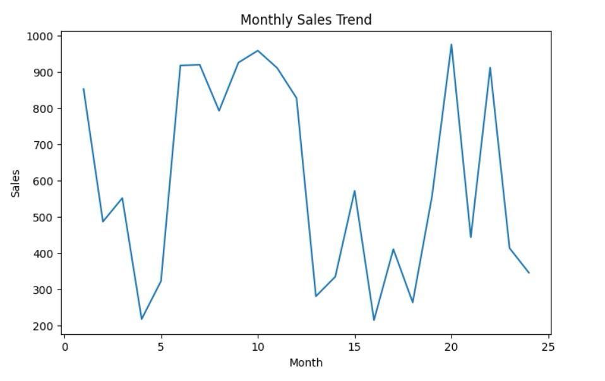
Monthly Sales Trend Analysis

Slide 6
Model Used - Linear Regression
Simple and interpretable regression model.
  80% training data, 20% testing data.
  Predicts sales based on advertising spend and price.

Slide 7
Model Performance
Mean Absolute Error (MAE): 224.19
  Mean Squared Error (MSE): 69843.81
  Indicates moderate prediction accuracy.

Slide 8
Business Insights
Advertising spend positively impacts sales.
  Pricing influences demand levels.
  Forecasting helps optimize inventory.

Slide 9
Strategic Recommendations
Increase marketing during low-demand months.
  Optimize pricing strategies.
  Continuously retrain model with updated data.

Slide 10
Conclusion
Machine Learning enables data-driven forecasting.
  Model achieved MAE: 224.19 and MSE: 69843.81.
  Supports informed strategic business decisions.

