Slide 1
INSTRUCTIONS
Use Font size 22 to 28 and Font Style Times New Roman (body)
Do not change the Template: Heading / Title of the slides
Do not change font style or colours
Do not copy paste paragraphs: use only Bullet Points
Maximum slide Limit is 20 only
As per the number of supervisor allotted adopt slide-2 or slide-3
Please display the required meaningful Content or images or tables
Change the footer accordingly using insert tab then click on header & footer tab and edit it
Save the PPT with Register No, Dept and Review no, example: 23xxxxxxxxx_CSE

Slide 2

Title: DAILY SMART BREAKDOWN
Student Name:B.Hema Sri
Student ID: 2520030159 Cluster:4
Section:14
Under the Guidance
of
Supervisor Name: JAYARAM
Assistant Professor
Department of CSE

Slide 3
OUTLINE
Abstract
Existing System
Proposed System
System Architecture
Project Modules
Objectives
Co’s Attainments - FWD
Co1
Co2 …….. 5. Co5
Co’s Attainments - DSA
Co1
Co2 …….. 5. Co5
Screen Shots for FWD & DSA
Conclusion
Geo-Tagged Photos

Slide 4
Abstract
Students often struggle to manage their study schedules effectively, especially when large portions of syllabus must be covered within limited time. This project introduces a web-based study planning system designed to transform weekly learning goals into structured daily study tasks. Users can enter multiple topics for a given week, and the system intelligently divides these topics across seven days. Any remaining portions are distributed evenly to maintain a balanced workload each day. By breaking down topics into smaller, manageable sections, the platform promotes consistent learning and better understanding of concepts. The system helps reduce academic stress and prevents last-minute cramming by providing a clear daily learning plan. With a simple and user-friendly interface, this website supports students in developing disciplined study habits and achieving steady academic progress.

Slide 5
Existing System
Most students plan their studies manually using notebooks or simple to-do lists.
There is no proper structure for dividing large topics into daily tasks.
Students often overestimate or underestimate the time required for each topic.
Study plans are usually not balanced across the week.
This leads to poor time management and irregular study habits.

Slide 6
Proposed System
The proposed system is a web-based study planning platform.
Students can enter weekly study topics in the system.
The system automatically divides topics into daily study tasks.
Remaining topics are distributed evenly across the week.
This helps students follow a structured and organized study schedule.

Slide 7
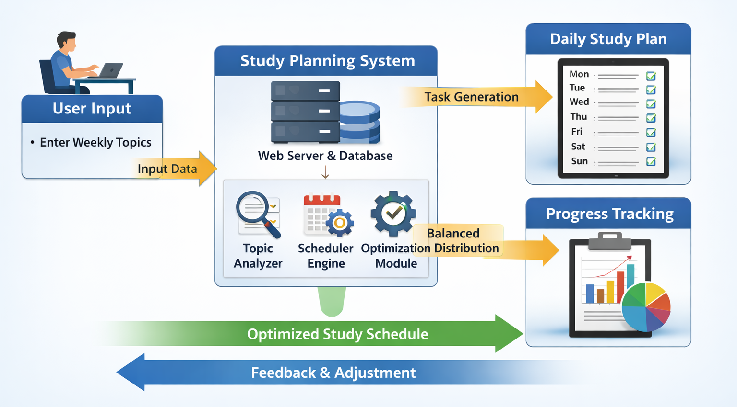
System Architecture

Slide 8
Project Modules
User Interface Module
Provides a simple interface where students can enter weekly study topics and interact with the system.
Topic Input Module
Allows users to add, edit, or delete study topics they want to complete during the week.
Study Plan Generation Module
Automatically divides the entered topics into daily study tasks across seven days.
Schedule Management Module
Ensures balanced distribution of workload and organizes the weekly study schedule.
Progress Tracking Module
Allows students to mark completed tasks and track their study progress.
Database Module
Stores user data, study topics, and generated study plans securely.

Slide 9
Objectives
To develop a web-based study planning system that helps students organize their weekly study schedule.
To allow users to enter study topics and automatically generate a daily study plan.
To divide large topics into smaller, manageable tasks for better understanding.
To ensure balanced distribution of study workload across the week.
To help students manage time effectively and maintain consistent study habits.
To reduce academic stress and avoid last-minute exam preparation.
To provide a simple and user-friendly interface for easy study planning.

Slide 10
Co’s Attainments - FWD
CO1: Understanding HTML structure and CSS styling.
CO2: Designing responsive layouts using CSS.
CO3: Implementing JavaScript logic and functions.
CO4: Using DOM manipulation for dynamic content.
CO5: Building complete interactive web applications

Slide 11
Co’s Attainments - DSA

Slide 12
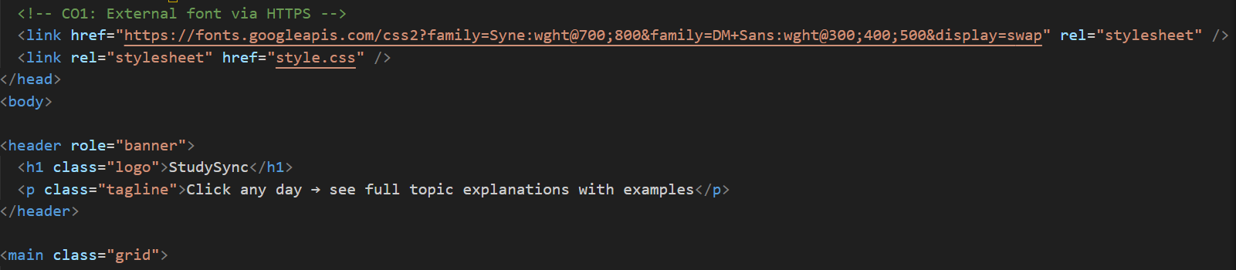
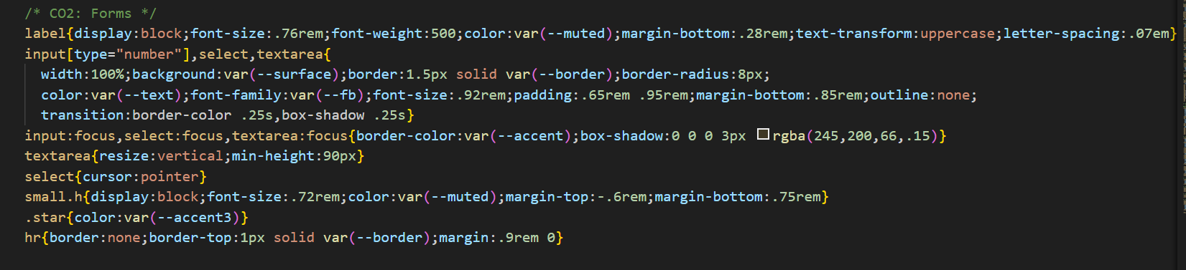
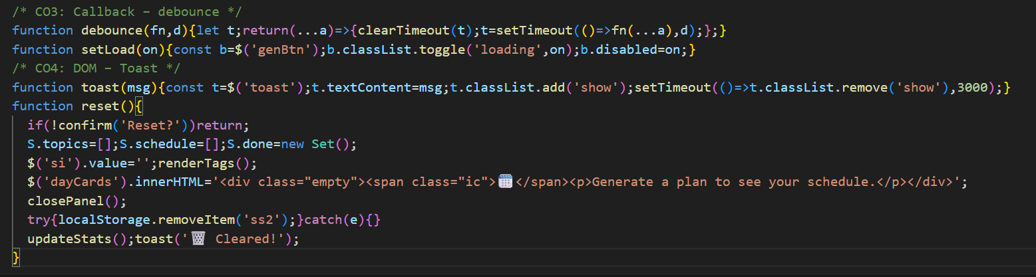
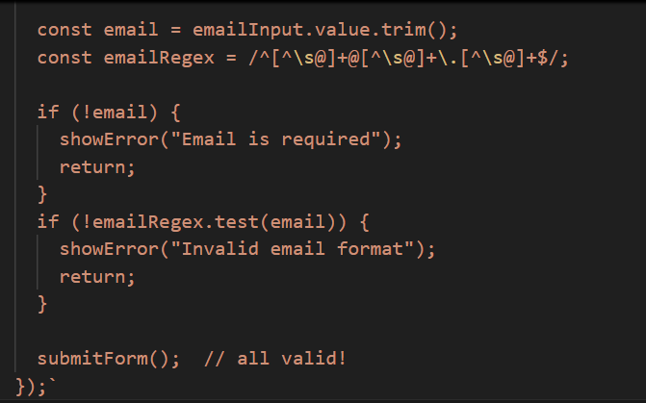
Screenshots for FWD

Slide 13
Screenshots for DSA

Slide 14
Conclusion
The Study Planning System helps students organize their weekly study schedule effectively.
It converts weekly topics into structured daily study tasks.
The system ensures balanced distribution of workload throughout the week.
It encourages consistent learning and better time management.
This platform helps reduce academic stress and prevents last-minute exam preparation.
Overall, the system supports students in developing disciplined study habits and improving academic performance.

Slide 15
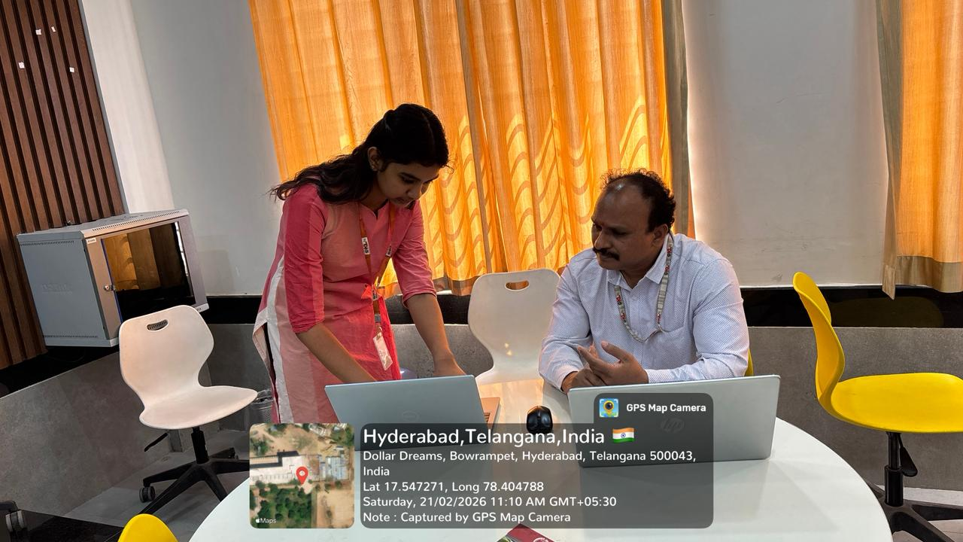
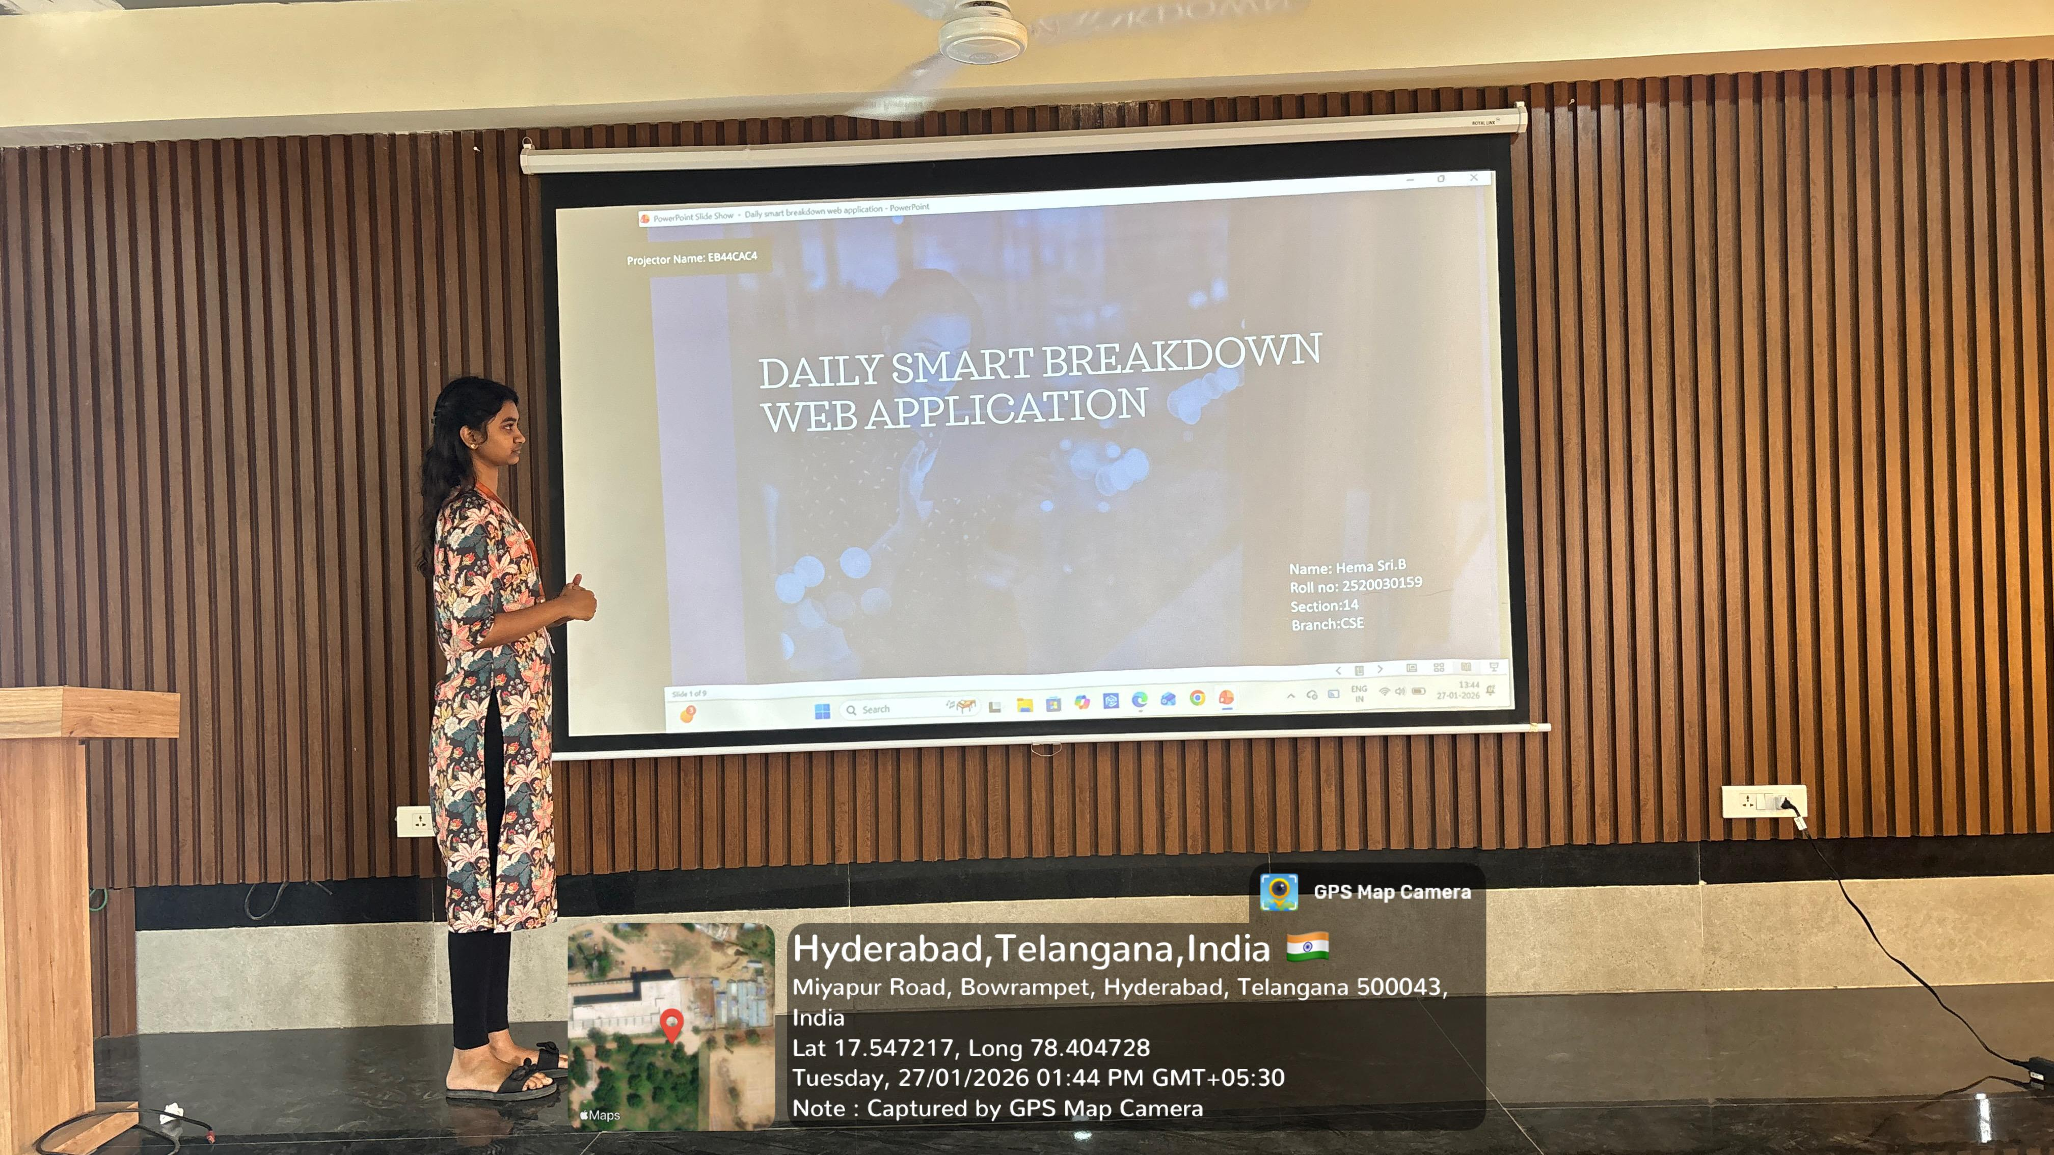
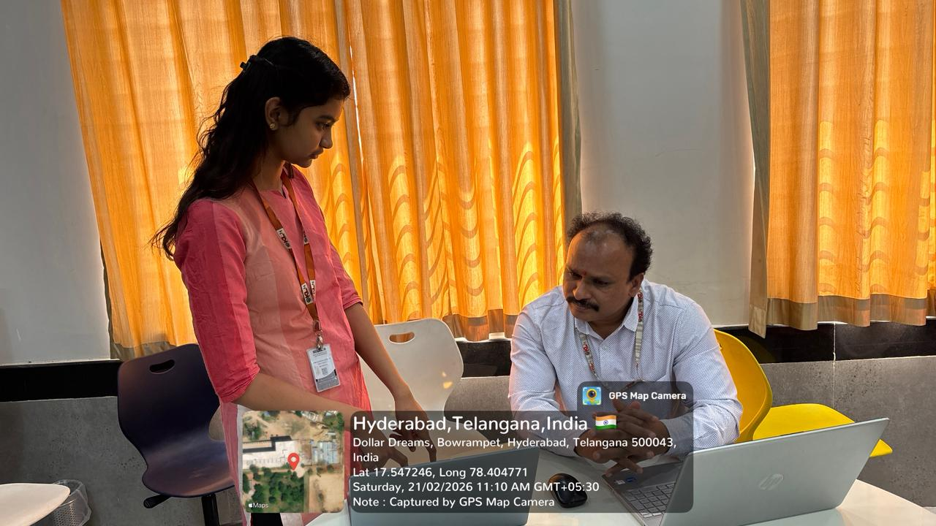
Geo- Tag Photos

Slide 16
THANK YOU

