Slide 1
Marisetti HemaSri
Final Project
3/21/2024 Annual Review

Slide 2
PROJECT TITLE
Keylogger and Security
3/21/2024 Annual Review

Slide 3


AGENDA
Introduction to Keyloggers and Security
Understanding the problem statement
Overview of the Project
Identifying the End Users
Introducing your solution
Highlighting the unique value proposition
Discussing the key Modelling Approaches
Presenting results and findings
3/21/2024 Annual Review

Slide 4

PROBLEM STATEMENT
Develop a robust and secure keylogger software that accurately logs keystrokes on a target system while ensuring strong encryption and access controls to protect the logged data. This will prevent unauthorized access and ensure privacy and data integrity.
3/21/2024 Annual Review

Slide 5

PROJECT OVERVIEW
The project aims to develop a secure keylogger that accurately logs keystrokes on a target system. It will include strong encryption and access controls to protect the logged data from unauthorized access. Ethical usage features, such as user consent and transparency, will be implemented to ensure compliance with legal standards. The keylogger will provide reliable and secure monitoring while respecting user privacy. Comprehensive documentation and testing will ensure the tool's effectiveness and ethical use
3/21/2024 Annual Review

Slide 6

WHO ARE THE END USERS?
Parents: To monitor their children's computer usage for safety and appropriate content.
Employers: To oversee employee activity on work computers, ensuring productivity and preventing data breaches.
Educational Institutions: For monitoring student activity on school-provided devices to maintain a safe and focused learning environment.
Security Professionals: To analyze and understand user behavior on systems, enhancing security protocols and detecting unauthorized access.
Researchers: To study human-computer interaction and collect data for usability studies, with participant consent.
3/21/2024 Annual Review

Slide 7

VALUE PROPOSITION
To avoid keyloggers
Use anti virus program
Use password manager
Use multi factor authentication
Use a firewall
Avoid suspicious links and downloads
Change password periodically
Update your system
Use Virtual Keyboard to type passwords and sensitive
information
3/21/2024 Annual Review

Slide 8

THE WOW IN YOUR SOLUTION
Architecture Overview:
Modular Design: The keylogger code is structured into modular functions for better readability and maintenance.
Event Handling: Utilizes the pynput library to capture and handle keyboard events.
Data Logging: Implements functions to log captured data into text and JSON files.
3/21/2024 Annual Review
8

Slide 9
MODELLING
Architecture Overview:
Modular Design: The keylogger code is structured into modular functions for better readability and maintenance.
Event Handling: Utilizes the pynput library to capture and handle keyboard events.
Data Logging: Implements functions to log captured data into text and JSON files.
3/21/2024 Annual Review
9

Slide 10
Components:
Key Press Handling: Function: on_press(key)
Description: Captures and logs the pressed keys.
Details: Appends key press events to a list and updates the JSON log file.
Key Release Handling: Function: on_release(key)
Description: Captures and logs the released keys.
Details: Appends key release events to a list, updates the JSON log file, and accumulates keys for the text log.
Logging Functions:
Text Logging: generate_text_log(key)
Description: Writes the recorded keys to key_log.txt.
JSON Logging: generate_json_file(keys_used)
Description: Dumps the list of key events to key_log.json.

Slide 11
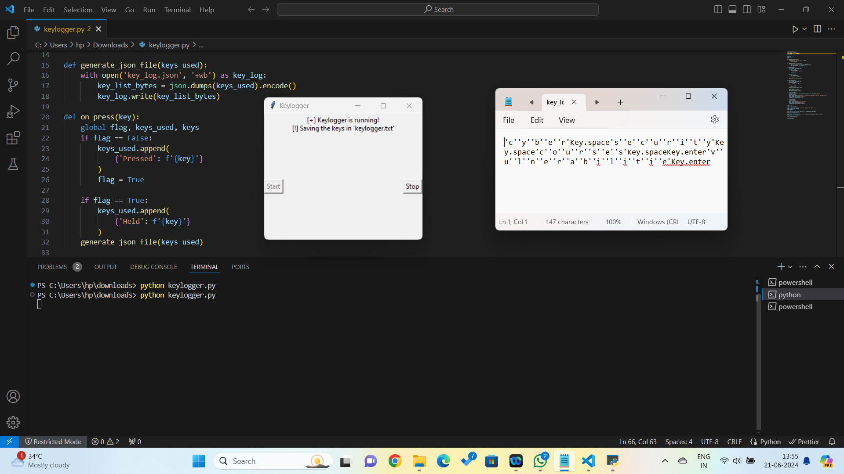
RESULTS
3/21/2024 Annual Review
11

