Slide 1

SMART WEATHER MONITORING SYSTEM

Slide 2
Humidity, Temperature and moisture are three basic parameters to build any Weather Station and to measure environmental condition.We are introducing Weather Station using ESP12E NodeMCU. In this project, we will measure Humidity, Temperature and moisture parameters and display them on the web server, which makes it a IoT based Weather Station where the weather conditions can be monitored from anywhere using the Internet.

Slide 3
REQUIREMENTS:
→NodeMcu(ESP12E)module
→Basic Shield
→connecting wires

Slide 4
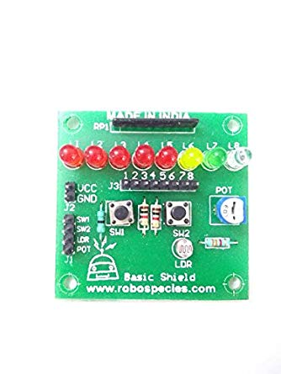
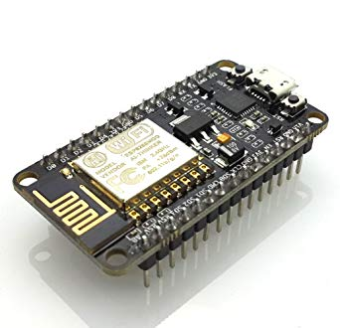


Slide 5


How people suffer:
CLIMATE CHANGE WILL WRECK OUR HOLIDAY

Slide 6
normal body temperature =37 degrees Celsius
Normal humidity=50%
Every homeowner should own a hygrometer that measures temperature and relativehumidity (RH). The ideal relative humidity for health and comfort is about 40–50%. In the winter months, it may have to be lower than 40% RH to avoid condensation on the windows.

Slide 7
Thank you

