Slide 1


MATHEMATICS FOR AI
ALM-4
CO-3
Section-6

Slide 2

GROUP MEMBERS:
NAME | ROLL NUMBERS
S Svara Haasini | 2520090170
Likhita Sri. C | 2520040067
Guttikonda Gayathri | 2520030465
Poojitha M | 2520030541
Angela Jose | 2520030365
Sri Vaishnavi | 2520090117
Kavya Sree | 2520090143

Slide 3
WEEK-6 PROJECT
CASE STUDY-1
Problem statement
Production Cost Minimization (Economics):
A factory manufactures two products using resources 𝑥and 𝑦with cost function: 𝐶(𝑥, 𝑦) = 5𝑥 2 + 3𝑦 2 + 4𝑥𝑦. Compute the gradient of 𝐶(𝑥, 𝑦)and analyze the conditions to determine the resource values that minimize the production cost.

Slide 4
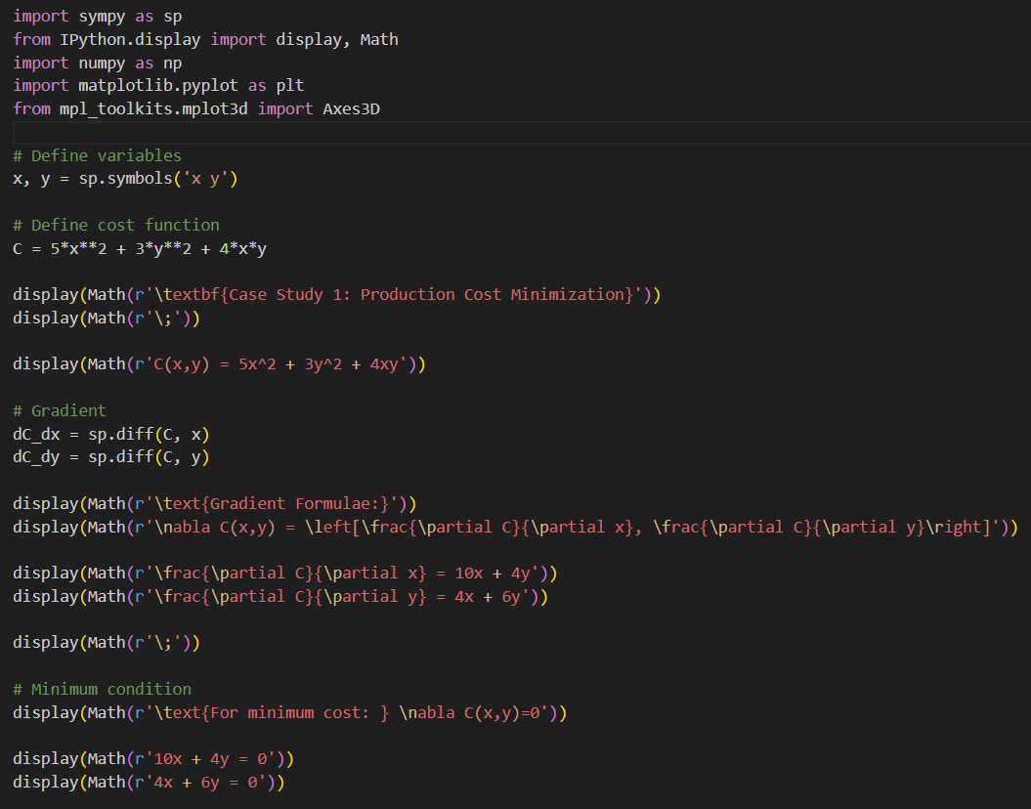
CODE:

Slide 5
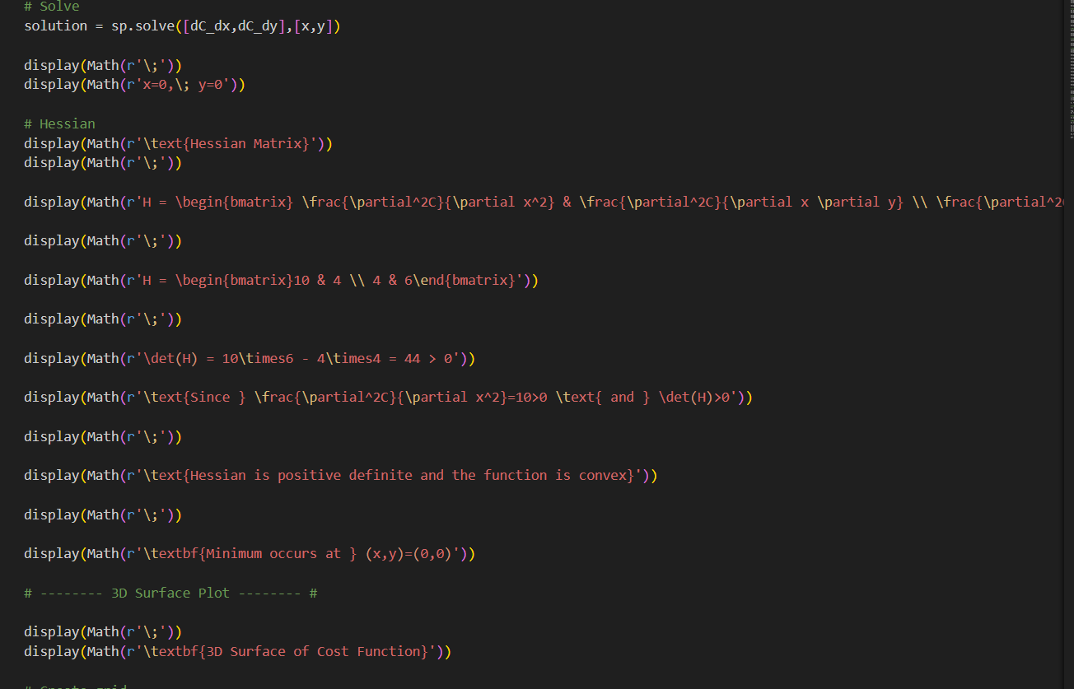

Slide 6
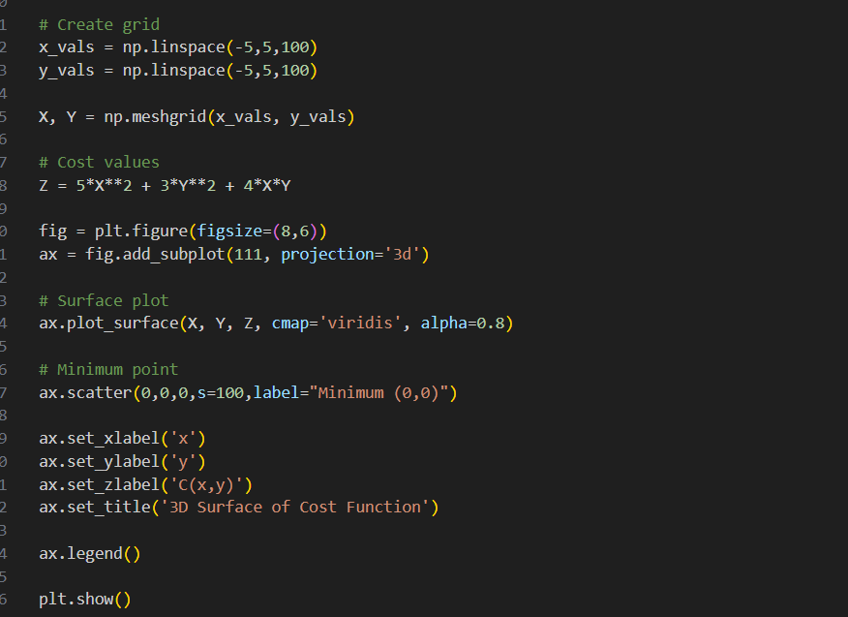

Slide 7
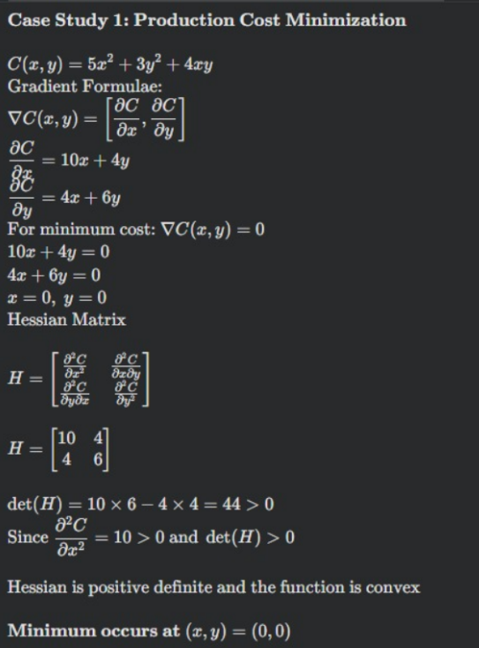
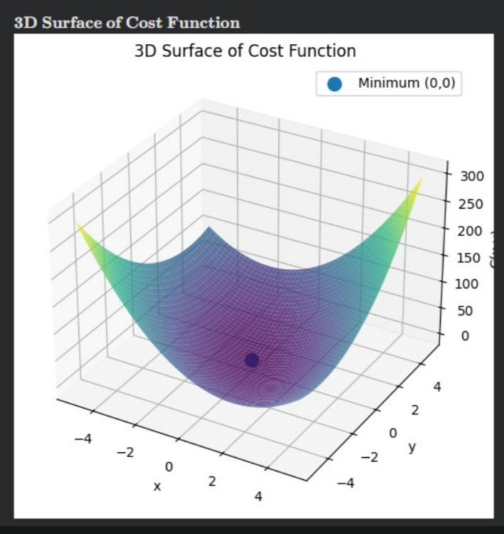
OUTPUT:

Slide 8
THANK YOU

