Slide 1
NEIGHBORHOOD SELECTION
CAPSTONE PROJECT
Submitted By
T.Hema

Slide 2
Introduction:
The Project aims to dertermine the suitable neighborhood in Scarborough considering the various amentities therein. This will enable decision making for people looking out for a house in Scarborough, Toranto.
This project analyses the various features like housing price and better school according to ratings, crime rates of that particular area, road connectivity, weather conditions, good management for emergency, water resources both fresh and waste water, recreation etc.

Slide 3
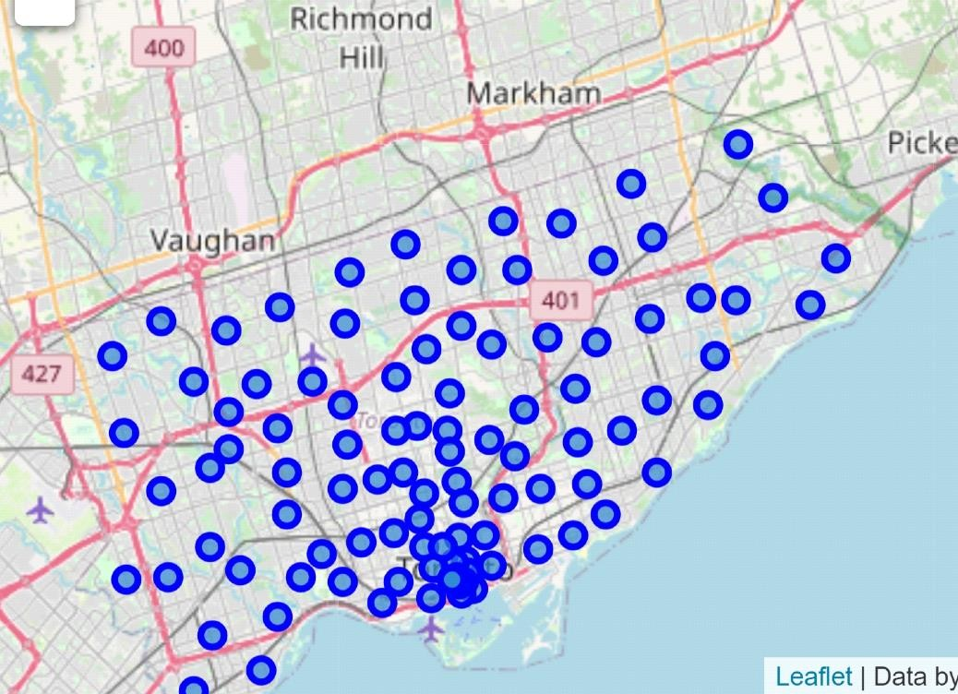
Map of Scarborough, Toronto
Scarborough has been chosen for neighborhood selection based on housing prices and schools located there.

Slide 4
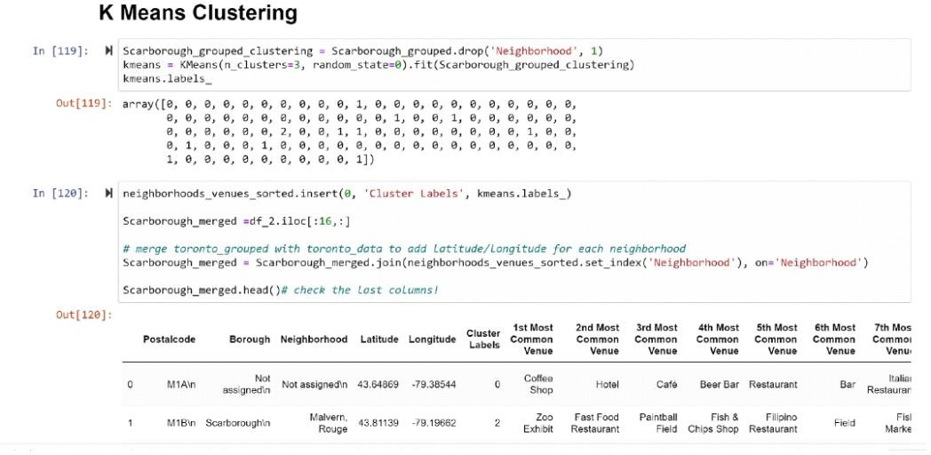
Methodology Section
Clustering Approach:
To compare the similarities of two cities, we explore neighborhoods, segment them, and group them into clusters to find similar neighborhoods in a big city like New York and Toronto.

Slide 5
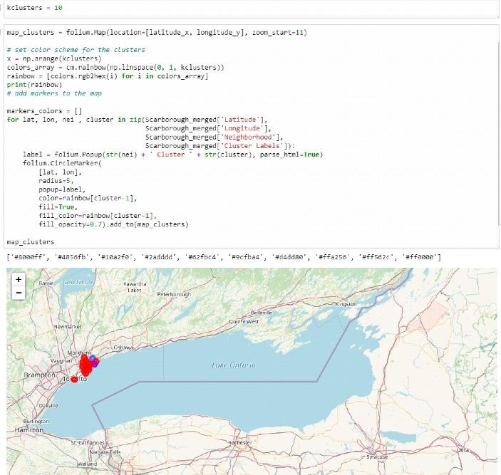
Results Section
Map of Clusters in Scarborough

Slide 6
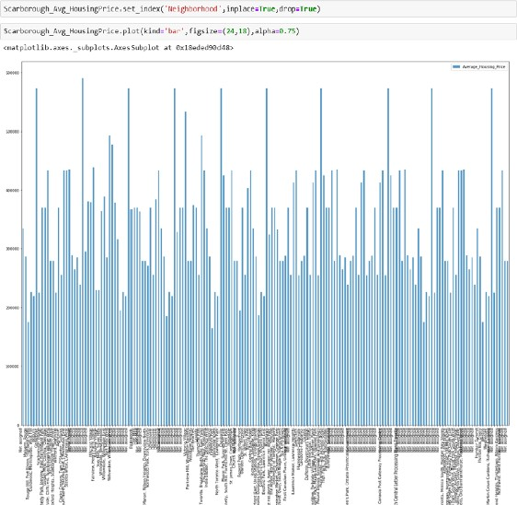
Average Housing Price by Clusters in Scarborough

Slide 7
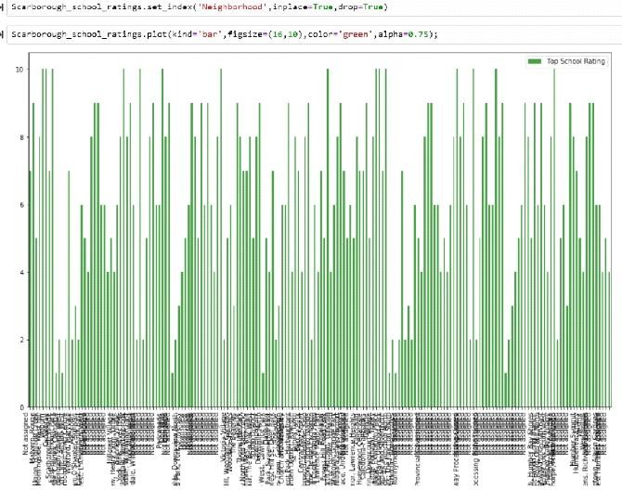
School Ratings by Clusters in Scarborough

