Slide 1
SOCIAL IMPACTS OF USING IOT AND DATA ANALYTICS ON ACCIDENT DATASETS
TO PREDICT AND REDUCE THE IMPACT OF ACCIDENTS
TEAM MEMBERS
GUIDE
Abhinav Shikhar
Naveen JS
Sandeep Kumar
T Hema
1MS12CS002
1MS13CS416
1MS12CS097
1MS12CS139
Sowmya BJ
Assistant Professor
Dept. of CSE, MSRIT

Slide 2
Agenda
Introduction
Problem Definition
System Requirements
Literature Survey
Design
Remaining Work
Conclusion
References

Slide 3
Introduction
Problem Definition
System Requirements
Literature Survey
Design
Remaining Work
Conclusion
References

Slide 4
Introduction
Accident is an unfortunate incident that happens unexpectedly and unintentionally, typically resulting in damage or injury to the lives of human beings, animals as well as economic losses. A case study states that Indian roads were at their deadliest in 2014 claiming more than 16 lives every hour on average. Over 1.41 lakh people died in crashes, 3% more than the number of fatalities in 2013.
Road traffic injuries are the leading cause of death among young people, aged 15–29 years.

Slide 5
Introduction
90% of the world's fatalities on the roads occur in low & middle income countries, even though these countries have half of the world's vehicles. Without action, road traffic crashes are predicted to rise drastically and become the 7th leading cause of death by 2030.

Slide 6
Introduction
Reasons for Accidents
Distracted, Drunk and Reckless Driving
Potholes
Fog
Deadly Curves
Animal Crossings
Absence of traffic light
Tire Blowouts and Vehicle Breakdown
Consequences of Accidents
Deaths
Injuries
Mental Imbalance
Economic losses
Loss of Wildlife

Slide 7
Introduction
Problem Definition
System Requirements
Literature Survey
Design
Remaining Work
Conclusion
References

Slide 8
Problem Definition
1) A very recent headline in an English daily revealed “Only 3 of the 32 ambulance services reach a large majority of 'immediately life-threatening' calls within eight minutes”. How to improve this ? 2) Many of the hospitals and schools are located at some random places which are more and less prone to the accidents respectively. How to ensure that they are located at the most suitable places in the city ? 3) In the present scenario, the process of notifying the police entirely relies on a third person who witnesses the accident and informs. How to solve this ?

Slide 9
Problem Definition
4) An article dated November 22 in 2011, published in The Hindu says, “70% of the road accidents in India in 2011 was due to drunken driving”. How to control / reduce this ? 5) How to automate the process of notifying the concerned car insurance agents and life insurance agents after the occurrence of accidents and solidify the evidences ? 6) How to notify the blood banks and the emergency contacts in case of medical emergencies ?

Slide 10
Introduction
Problem Definition
System Requirements
Literature Survey
Design
Remaining Work
Conclusion
References

Slide 11
System Requirements
HARDWARE REQUIREMENTS
Raspberry pi Model-2
Vibration Sensor
Tilt Sensor
Impact Sensor
Wi-Fi Dongle
GPS Module
Pressure Sensor
SOFTWARE REQUIREMENTS
Amazon Web Services
Python
Android
Google Maps API
R-Analytical Tool
Microsoft Azure

Slide 12
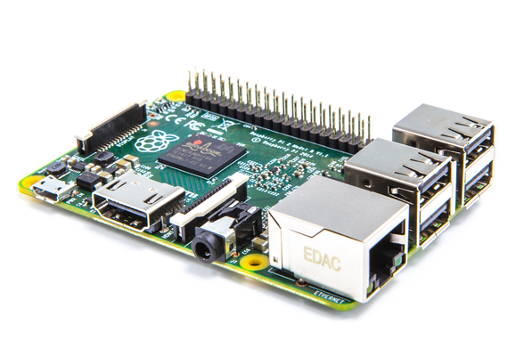
System Requirements
System On Chip
Memory : 512 MB SDRAM memory
Processor : Broadcom BCM2835 SoC full high
definition multimedia processor
USB : Single 2.0 USB connector
HDMI : HDMI and Composite RCA , HDMI Audio Out
SD Card : SD and SDIO Card slot on board storage
OS : Linux Operating system
Dimensions : Dimensions are 8.6cm*5.4cm*1.7cm
Ethernet : On board 10/100 Ethernet RJ45 jack
Raspberry Pi 2

Slide 13
System Requirements
The raspberry pi model A board is designed with 256MB of SDRAM and model B is designed with 51 MB. Raspberry pi is a small size PC. The Central processing unit is the brain of the raspberry pi board and that is responsible for carrying out the instructions of the computer through logical and mathematical operations. The raspberry pi uses ARM11 series processor The GPU is a specialized chip in the raspberry pi board and that is designed to speed up the operation of image calculations. This board designed with a Broadcom video core IV and it supports OpenGL The Ethernet port of the raspberry pi is the main gateway for communicating with additional devices. The raspberry pi Ethernet port is used to plug your home router to access the internet. These pins can accept input & output commands based on programming raspberry pi. The raspberry pi affords digital GPIO pins. These pins are used to connect other electronic components.

Slide 14
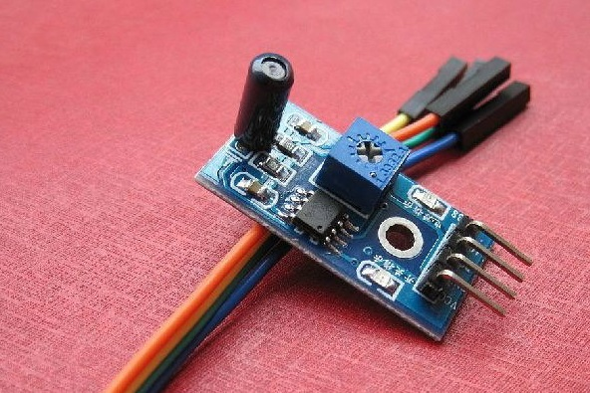
System Requirements
Purpose : Detects the vibration of the surrounding environment
Sensitivity : Adjustable by the potentiometer
Operating voltage : 3.3V-5V
Output form: Digital switching output (0 and 1)
With fixed bolt hole for easy installation
Small board PCB size: 3cm * 1.6cm
Vibration Sensor
( LM393 )

Slide 15
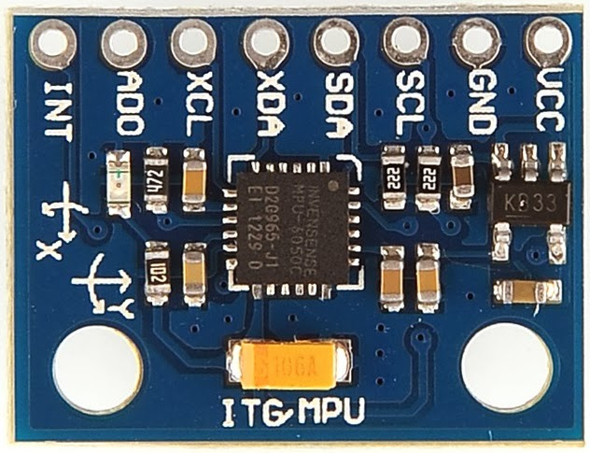
System Requirements
Tri-Axis accelerometer with a programmable full scale range
Digital-output
Programmable interrupt supports
10,000g shock tolerant
Tilt Sensor (MPU-6050)

Slide 16
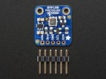
System Requirements
Vin: 3 to 5VDC
Logic: 3 to 5V compliant
Pressure sensing range: 300-1100 hPa (9000m to -500m above sea level)
Resolution : Up to 0.03hPa / 0.25m
Operational Range : -40 to +85°C
Pressure Sensor (BMP 180)

Slide 17
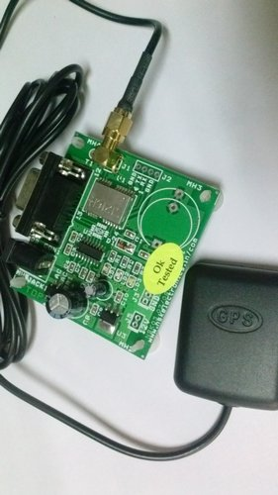
System Requirements
Operational Limits : Altitude < 18,000m or velocity < 515m/s, not exceeding both Protocol : NMEA-0183 V3.01, 9600 baud Input Voltage : 3.3V DC
Operating Temperature : -40 to +85 C Humidity : 5% to 95%
GPS Module ( s1216 – R1)

Slide 18
Introduction
Problem Definition
System Requirements
Literature Survey
Design
Remaining Work
Conclusion
References

Slide 19
Literature Survey
1) Reza Raji [1] described the concept in IEEE Spectrum as "moving small packets of data to a large set of nodes, so as to integrate and automate everything from home appliances to entire factories". 2) C.Prabha et al [2] states that every vehicle should have vehicle unit. The vehicle unit consists of a vibration, controller, MEMS sensor, GPS system, GSM module. The vehicle unit installed in the vehicle senses the accident and sends the location of the accident the main server. 3) Aishwarya S.R [3] et al implemented EBM (Eye Blink Monitoring Technique) to detect drowsiness of night drivers and preventing accidents. 4) K-nearest-neighbor [4] was suggested to measure the distance between a query scenario and a set of scenarios in the data set.

Slide 20
Literature Survey
5) Abellan et al. [5] analyzed two lane rural highway data of Granada, Spain using decision rules extracted from decision tree method
6) Caliendo et al [6] grouped crashes by total, fatal and injury crashes on curves and tangent roadways sections, and compare them using Poisson, Negative Binomial and Negative Multinomial regression models. In their study, rain was found to be a highly significant variable increasing the expected number of severe crashes for curves by a factor of 3.26. 7) Karlaftis and Tarko [7] used cluster analysis to categorize the accident data into different categories and further analyzed cluster results using Negative Binomial (NB) to identify the impact of driver age on road accidents.

Slide 21
Literature Survey
8) Kumar and Toshniwal [8] used clustering as their first step to group the data into different segments and further they used Probit model to identify relationship between accident characteristics.
9) Malyshkina and Mannering [9] explained unobserved heterogeneity related to variant weather conditions over time for single- and two-vehicle crash severity potentials using a Markov switching multinomial logit model. 10) Hill and Boyle [10] used a logistic regression model in the fatality and injury prediction. In their study, females in the older age groups (age of 54 or older) were more likely to suffer severe injuries in poor weather Driver characteristics such as age or gender also play important roles in the likelihood of injury severity associated with weather conditions.

Slide 22
Introduction
Problem Definition
System Requirements
Literature Survey
Design
Remaining Work
Conclusion
References

Slide 23
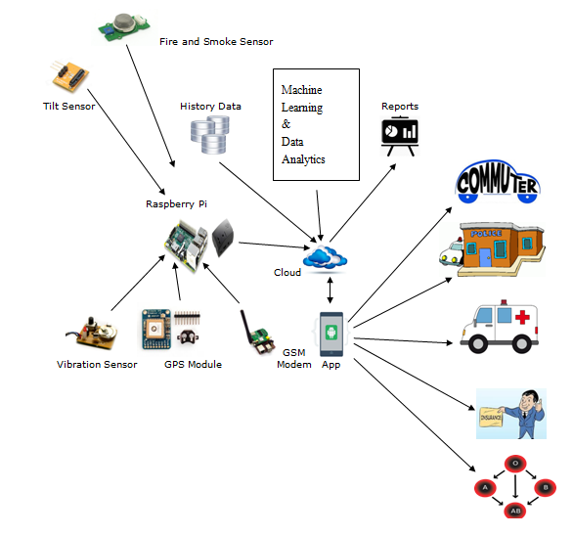
Architecture Diagram

Slide 24
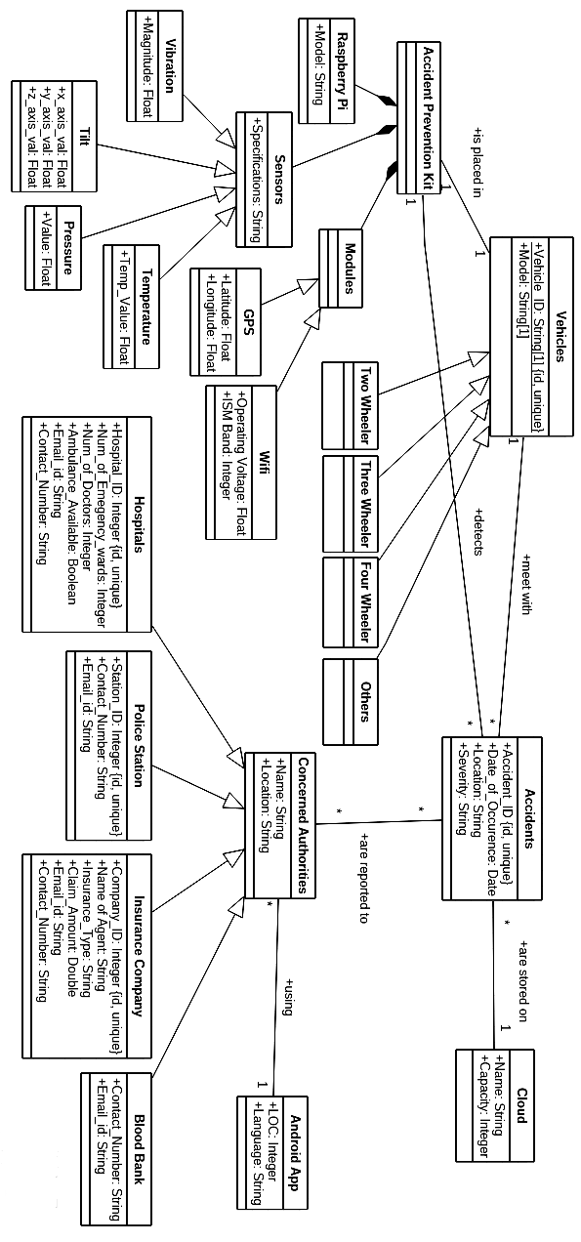
Class Diagram

Slide 25
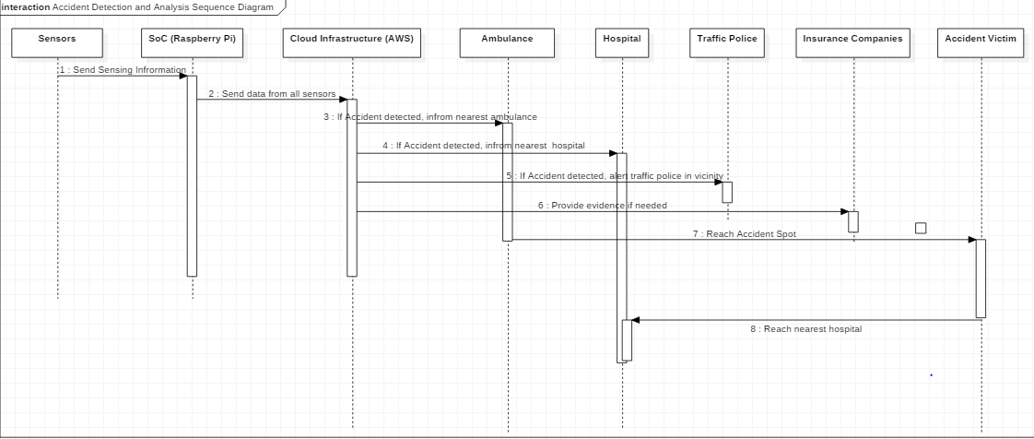
Sequence Diagram

Slide 26
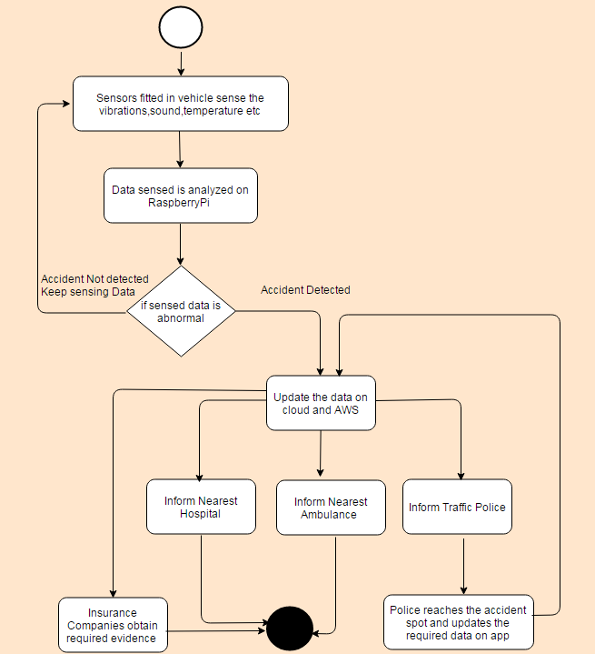
Data Flow Diagram

Slide 27
Introduction
Problem Definition
System Requirements
Literature Survey
Design
Project Plan for the remaining work
Conclusion
References

Slide 28
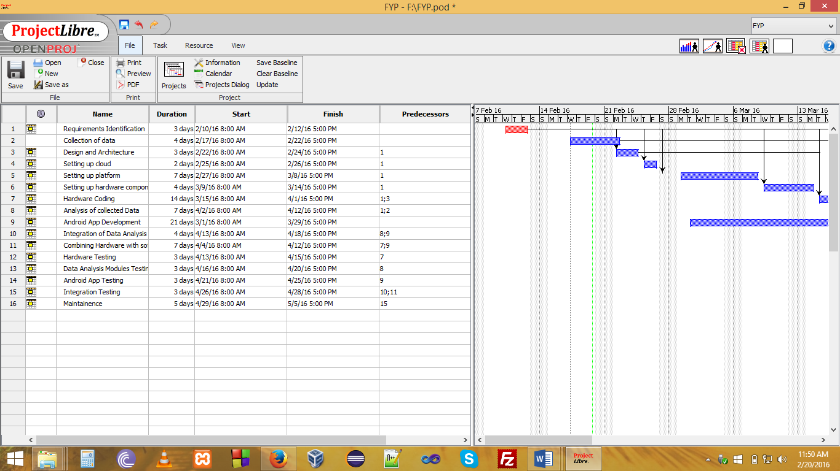
Project Plan

Slide 29
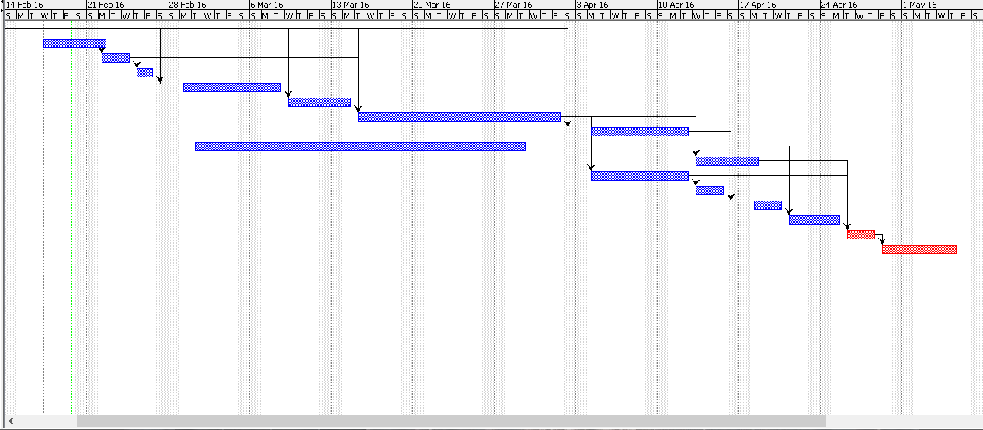
Project Plan

Slide 30
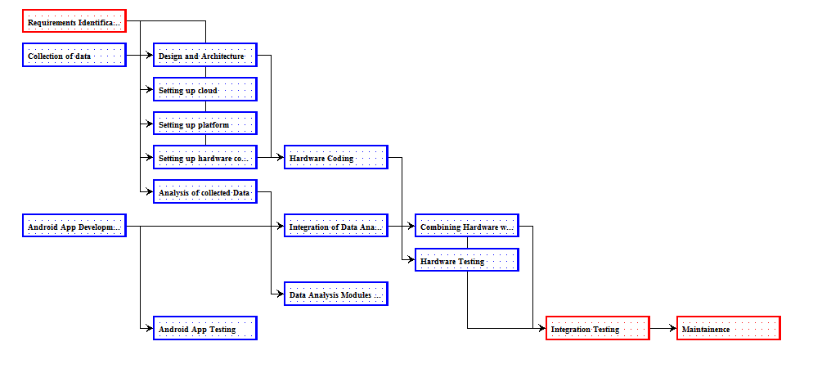
Project Plan

Slide 31
Introduction
Problem Definition
System Requirements
Literature Survey
Design
Remaining Work
Conclusion
References

Slide 32
Conclusion
Accidents are one of the most devastating global tragedies with the ever-rising trends and these trends have to be necessarily uncovered in order to mine the factors adding severity to them.
Our project carries a lot of social impacts, because it :
Helps to save more lives Attempts to reduce the number of drunk and drive cases Helps the hospitals and schools to get the most suitable place for construction Ensure timely arrival of the ambulances to the spots Help save wildlife
Notify the insurance agents Ease the process of blood donation at blood banks

Slide 33
Conclusion
It is very much important to use technology to deal with such issues. Our project is an attempt to analyze of the collected data and provide the prediction for various areas along with the technical solution for vehicles through IoT sensors which detect the accidents and notify them to the concerned entities. The solution proposed is eco-friendly and cost effective and hence, proves to be an optimal solution. The solution is user friendly, durable and fault tolerant.

Slide 34
About this Project
This project has got funding by the Karnataka State Council for Science and Technology (KSCST), Govt. of Karnataka in association with Indian Institute of Science (IISc Bengaluru). This project has also obtained funding by the. MSRIT Alumni Association.
The total funds obtained till date is 10,000 INR.
The paper on the Data Analytics part of it is about to be published in International Conference on Advanced Computing and Intelligent Engineering organised by Springer. It has got very positive reviews while the demonstration at ACE Hackathon in Ad Hoc, Annual Fest of Dept. of CSE, 2016.

Slide 35
Introduction
Problem Definition
System Requirements
Literature Survey
Design
Remaining Work
Conclusion
References

Slide 36
References
[1] http://www.ijarcce.com/upload/2014/february/IJARCCE3H__s_sonika_Intelligent.pdf
[2] http://www.ijareeie.com/upload/2014/july/33_Automatic.pdf
[3] http://www.projectsof8051.com/vehicle-accident-detection-with-gps-and-gsm-modem/
[4] Design of vehicle positioning system based on arm---- IEEE-2011. Zhang Wen ; Dept. of Phys.& Electron. Inf. Eng., Neijiang Teachers Coll., Neijiang, China ; Jiang Meng may 2011.
[5] www.ijircce.com/upload/2015/april/105_49_Accident.pdf
[6] gyti.techpedia.in/project-detail/...accident-detection-and...system.../2741
[7] http://gyti.techpedia.in/project-detail/automatic-vehicle-accident-detection-and- messaging-system-using-gsm-and/2741
[8] http://www.ijsrp.org/research_paper_apr2012/ijsrp-apr-2012-83.pdf
[9] http://www.ijarcce.com/upload/2014/march/IJARCCE6I%20%20%20S%20%20nit in%20Design%20and%20Development%20of%20Automatic.pdf
[10] http://Saf Res Elsevier.2005;36.www.ijerd.com/paper/vol10-issue4/Version_4/B1042528.pdf
[11] http://link.springer.com/article/10.1186%2Fs40537-015-0035-y

Slide 37
References
[12] Heinz Hautzinger, Claus Pastor, Manfred Pfeiffer, Jochen Schmidt, Analysis Methods for
Accident and Injury Risk Studies.
[13] Chang LY, Chen WC. Data mining of tree based models to analyze freeway accident frequency. J
[14] Chen Lei, Xu Nuo, Analyzing Method of Traffic Accident Causation through Experts
Method and Statistical Analysis http://www.whiznets.com/iot-solution/iot-device- cloud.html/
[15] "Internet of Things Global Standards Initiative". ITU. Retrieved 26 June 2015.
[16] "A list of IoT and M2M platforms http://monblocnotes.com/node/1979
[17] https://en.wikipedia.org/wiki/Internet_of_Things#cite_ref-1
[18] http://www.automotiveworld.com/analysis/interview-elliot-garbus-president-internet- things- solutions-group-general-manager-automotive-solutions-int
[19] http://www.informationweek.com/iot/microsoft-partnerships-drive-connected-cars-ces-2016/d/d-id/1323768
[20] http://www.telegraph.co.uk/finance/newsbysector/industry/engineering/11372205/How-connected-cars-are-driving-the-Internet-of-Things.html el-corporation/

Slide 38
Thank You

