Slide 1

TaskMate
Design Home Page
Submit Report
Creative Task Management App
Today
Revise Maths Unit 3
Plan Smart. Work Better. Achieve More.
Physics Internal Exam
Football Practice
Mini Project | Team of 6 members
HTML · CSS · JavaScript
Overall progress
33%
Build Dashboard
Team Meeting
Notes:
MEMBER 1 (slides 1-2). Welcome everyone. We are Team TaskMate, six members, and this is our mini project: TaskMate, a creative task management app built with HTML, CSS and JavaScript. The tagline says it all: Plan smart, work better, achieve more. The card on the right is a tiny preview of what the app feels like: tasks, a progress bar and a clean glass look.

Slide 2
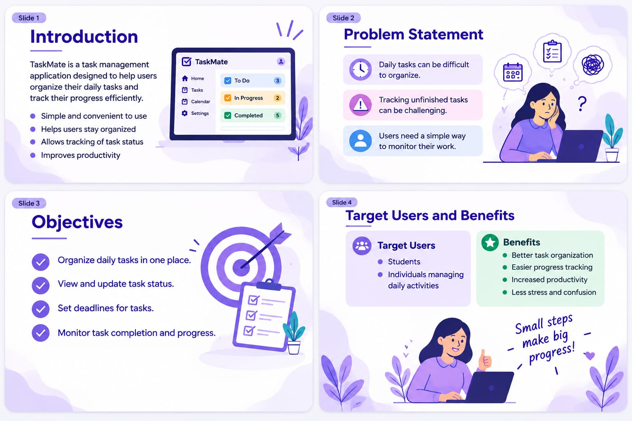
Project overview

Slide 3
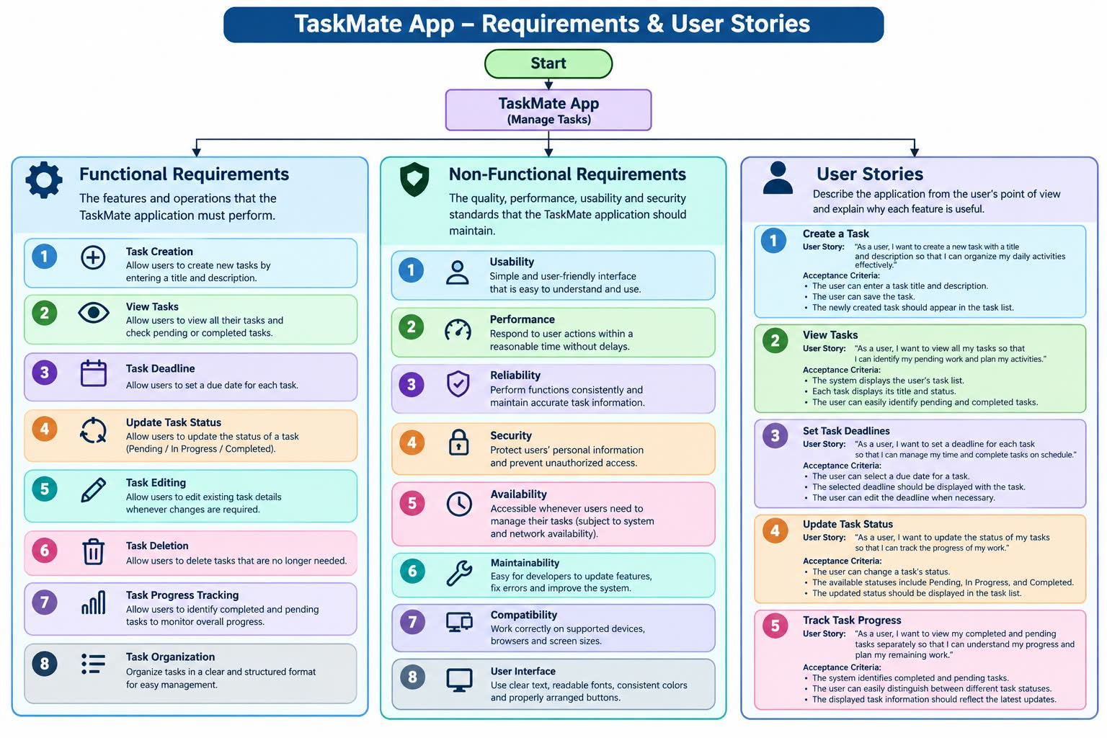
Requirements and user stories

Slide 4








SDLC MODEL
1
2
3
4
Planning
Requirement Analysis
System Design
Development
Identify the problem and project objectives
Identify user needs and system requirements
Design the user interface, database and workflow
Develop task creation, assignment and tracking features
5
6
7
Testing
Deployment
Maintenance
Check features and fix errors
Launch the application for users
Update features and fix issues after launch
Notes:
MEMBER 6 (slide 8). We followed a seven step development lifecycle. Planning: identify the problem and project objectives. Requirement analysis: identify user needs and system requirements. System design: design the user interface, database and workflow. Development: develop task creation, assignment and tracking features. Testing: check features and fix errors. Deployment: launch the application for users. Maintenance: update features and fix issues after launch.

Slide 5
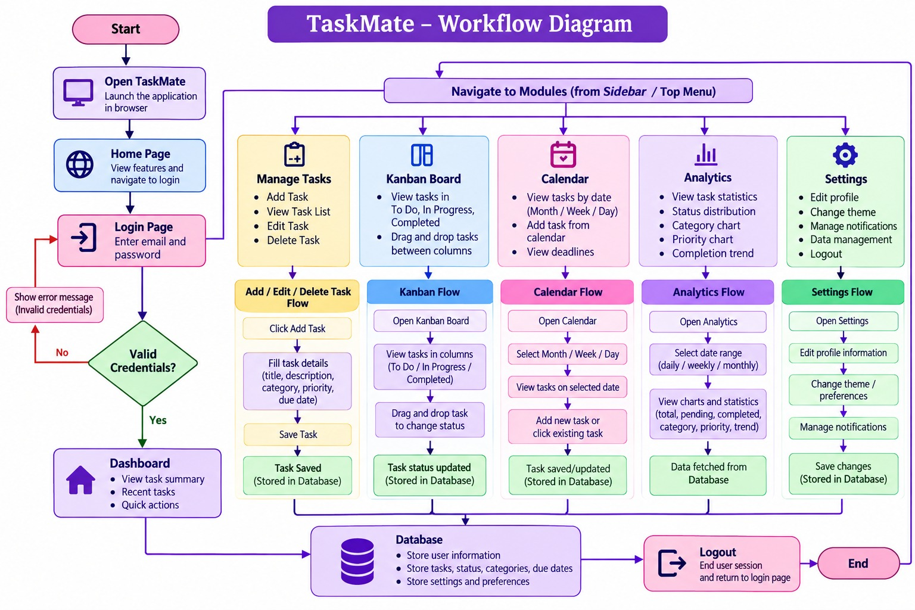
TaskMate workflow diagram

Slide 6
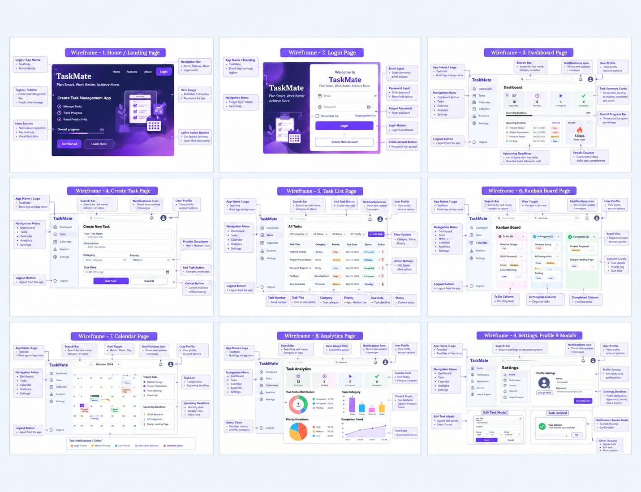
TaskMate wireframes

Slide 7







Why we built TaskMate
The problem
TaskMate
Tasks live in notebooks, chats and memory
One workspace to organise tasks by category and priority
Deadlines for exams and assignments get missed
Dashboard and calendar keep every deadline visible
No clear picture of what is done and what is pending
Charts and streaks show progress at a glance
Notes:
MEMBER 1. Students and small teams juggle studies, exams, sports and workouts. Tasks end up scattered, deadlines slip, and it is hard to see progress. TaskMate puts everything in one workspace: organised by category and priority, with deadlines on a dashboard and calendar, and charts that show how far you have come.

Slide 8






Features and tech stack
Smart Dashboard
Kanban Board
Task Calendar
Live counts and progress that update automatically
To Do, In Progress and Completed, drag to move
See due dates, today and overdue tasks
Analytics
Search & Filter
Dark Mode
Category charts and completion percentage
Find tasks by name, category, status or deadline
Switch theme and accent colour to suit your style
Built with
HTML
CSS
JavaScript
No backend: tasks are saved in the browser
Notes:
MEMBER 2 (slide 3). These six features are also listed on our landing page: a smart dashboard, a Kanban board, a calendar, analytics, search and filter, and dark mode with accent colours. TaskMate is built with plain HTML, CSS and JavaScript and has no backend server; every task is saved in the browser. HTML builds the 10 screens, CSS gives the gradient and glass look and the responsive layout, JavaScript handles tasks, filters, drag and drop, charts and the timer. Under the hood, every action updates one list of tasks, saves it to localStorage and redraws all views, so they always stay in sync.

Slide 9



Dashboard at a glance
9
5
Overall progress
33%
Total tasks
Pending
Smart banner: warns about tasks due today or overdue
1
3
Streak counter: counts consecutive days with a completed task
In progress
Completed
Upcoming deadlines: next five open tasks, overdue shown in red
Sample data from the demo tasks
Notes:
MEMBER 3 (slide 4). The dashboard is the first screen after login. Four live counters show total, pending, in-progress and completed tasks, and the progress bar updates automatically. A banner warns about tasks due today or overdue, a streak counter rewards daily completion, and the upcoming deadlines list shows the next five open tasks. The numbers here come from the demo data that ships with the app. Good moment for a short live demo.

Slide 10



Create and manage tasks
Edit: change any detail in a pop-up window
Create Task
Task Title
Delete with Undo: removed by mistake? bring it back within 5 seconds
e.g. Revise Maths Unit 3
Description
Short details...
Search, filter, sort: by name, category, status or deadline
Category
Priority
Studies
Medium
Complete: tick a task to finish it with a confetti burst
Due Date
Pick a date
Add Task
Priority tags
High
Medium
Low
Notes:
MEMBER 4 (slides 5-6). Creating a task takes five inputs: title, description, category, priority and due date. Every task can be edited in a pop-up, deleted with a five-second Undo, searched, filtered by category and status, and sorted by deadline. Priority is colour coded red, amber and green. Ticking a task complete triggers a small confetti celebration.

Slide 11
Kanban board
TO DO
IN PROGRESS
COMPLETED
Football Practice
Physics Internal Exam
Revise Maths Unit 3
Medium
High
High
Cricket Match
Drop a task here
English Assignment
Medium
Medium
Chemistry Lab Exam
Run 5 km
High
Low
Drag a card to another column. On a phone, use the status dropdown on each card.
Notes:
MEMBER 4. The Kanban board has three columns: To Do, In Progress and Completed. Cards can be dragged between columns using the browser drag and drop feature. On phones, where dragging is awkward, each card has a status dropdown instead. Moving a card to Completed records the completion date, which feeds the streak and the analytics. Cards shown here are from the demo data.

Slide 12

Calendar, analytics, focus
Calendar
33%
of sample tasks completed
Month view, today highlighted
Overdue tasks shown in red
Tasks by category (sample data)
Analytics
Completion % and tasks by category
Bar chart of the last 7 days
Focus Timer
25, 5 and 15 minute modes
Pick the task you are working on
Notes:
MEMBER 5 (slide 7). The calendar shows each task on its due date, highlights today and marks overdue tasks in red. Analytics shows the completion percentage, tasks per category, completed versus pending, and what was finished in the last seven days; the chart here uses the sample data. The focus timer has a 25 minute focus mode, a 5 minute break and a 15 minute long break, and counts completed sessions for the day. Settings also allow dark mode, four accent colours and exporting or importing tasks as a JSON backup.

Slide 13


Testing and test results
Test results
Test cases
Record expected and actual results
Mark each test Pass or Fail
Verify task creation
Bug reporting
Verify task list display
Document errors found in testing
Note untested or missing features
Verify task status updates
Testing documentation
Verify deadline setting
Prepare a testing report
Keep TESTING.md in GitHub if needed
Notes:
MEMBER 6 (slide 9). We tested four main things: creating a task, showing the task list, updating task status, and setting a deadline. For each test we record the expected result and the actual result, then mark it Pass or Fail. Any errors are documented as bugs, and we note any feature that was not implemented or not tested. Finally we prepare a testing report and, if the team needs it, keep a TESTING.md file in our GitHub repository.

Slide 14
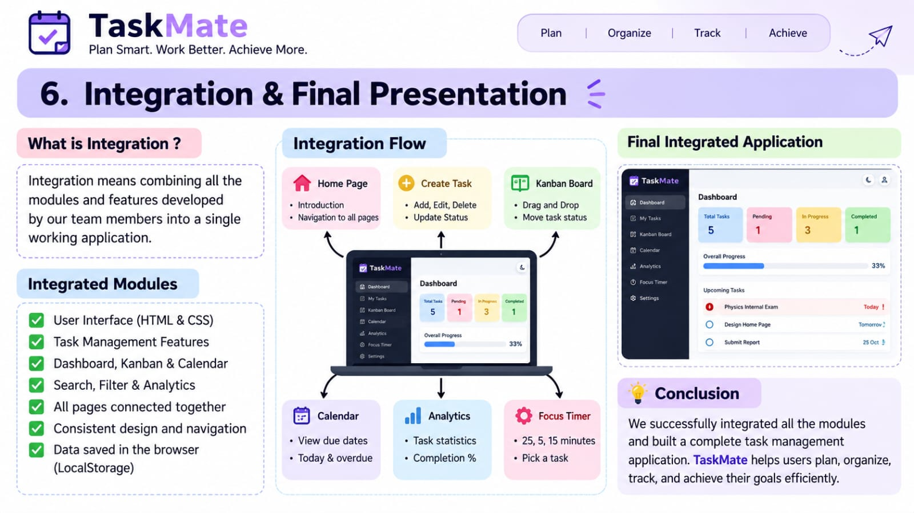

Slide 15
Thank you
Next version
Cloud accounts
Reminders
Team sharing
Mobile app
Notes:
MEMBER 6 (slide 10). TaskMate today is a complete front-end project: plan smart, work better, achieve more. For the next version we would add a real backend with accounts so tasks sync across devices, reminders before deadlines, team sharing and task assignment, and an installable mobile app. Thank you for listening. We are happy to take questions or run the live app.

