Slide 1

XAI FOR ACADEMIC RISKS AND PLACEMENT SUCCESS
Utilizing Explainable Artificial Intelligence to predict student success and mitigate academic risks.
Focus: enhancing transparency and trust in AI-driven student outcome predictions for faculty-driven interventions.

Slide 2
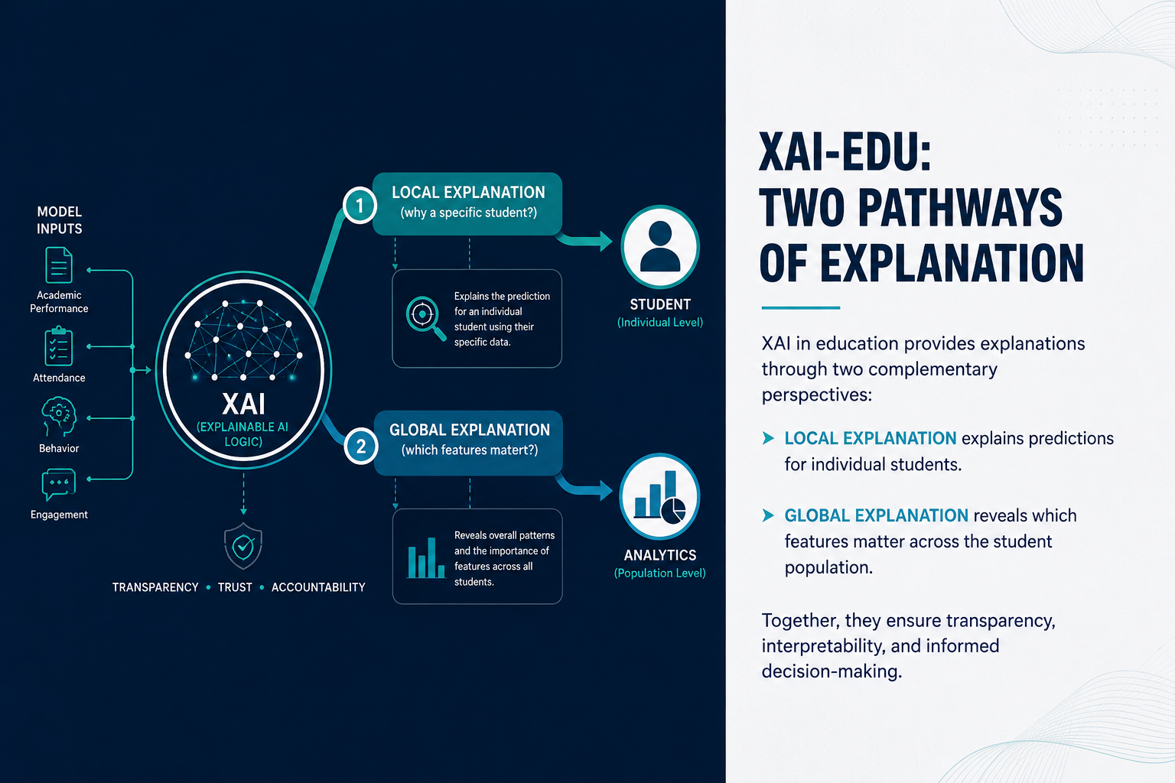
Problem Statement & Requirement Gathering
The Problem
The Need
Traditional ML models act as black boxes, leaving faculty without clear reasons for why a student is flagged at risk — reducing trust and slowing intervention.
An XAI system that delivers clear, local explanations (why this student?) and global model insights (what features drive risk) to power timely, evidence-based faculty actions.
Data Requirements
Student academic history, technical skill assessments, attendance, behavioral indicators, placement outcomes, and relevant metadata (program, cohort).

Slide 3
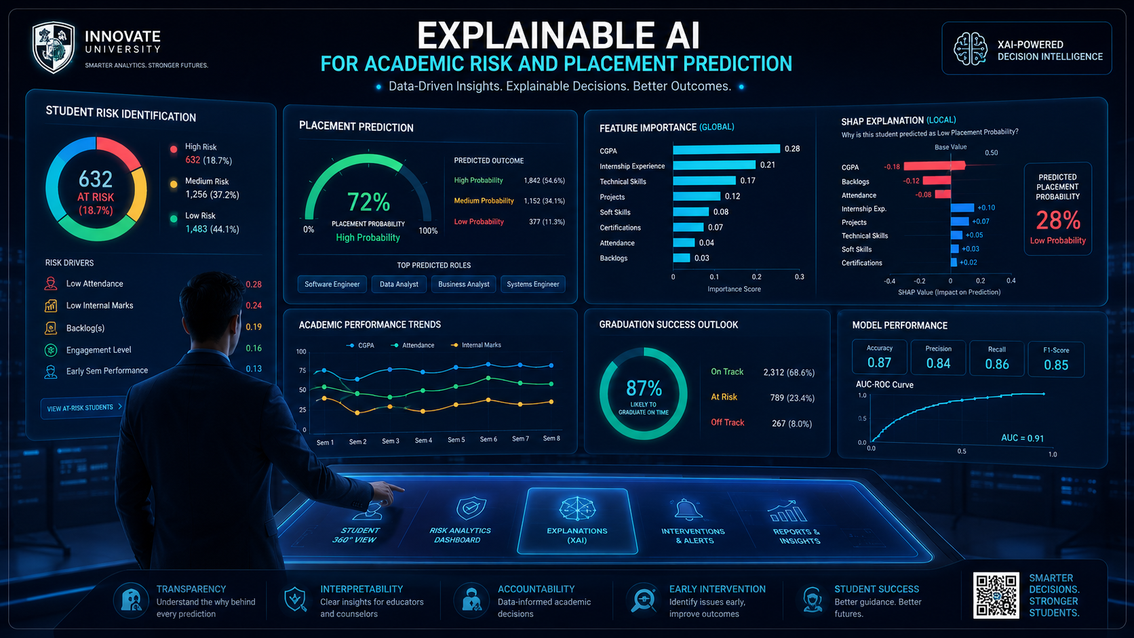




Project Objectives
Risk Identification
Develop an XAI-integrated model (e.g., XGBoost) to identify students at academic risk with high sensitivity and interpretable outputs.
Placement Prediction
Predict placement success using multidimensional features to guide placement assistance and tailored coaching.
Explainability
Provide local explanations using SHAP/LIME and global feature importance to justify individual predictions and model behavior.
Faculty Dashboard
Build an intuitive dashboard surfacing risk alerts, explanations, and recommended interventions for faculty action.

Slide 4
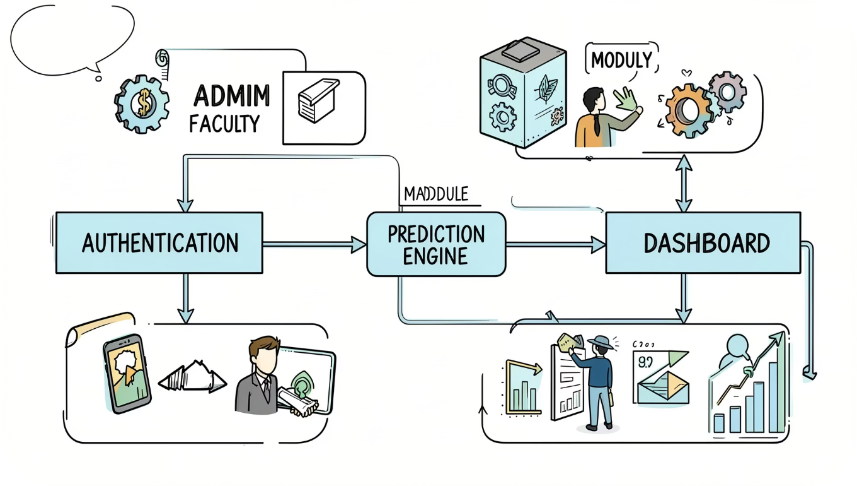
User & Module Identification
Primary users: System Admin (management, configuration) and Faculty (monitoring, intervention).
User Authentication — secure login/logout with role-based access.
Data Ingestion — batch and incremental import of student datasets with validation.
XAI Prediction Engine — XGBoost model plus explanation layer (SHAP/LIME) and logging.
Faculty Dashboard — visualization of at-risk cohorts, individual explanations, and intervention tracking.

Slide 5
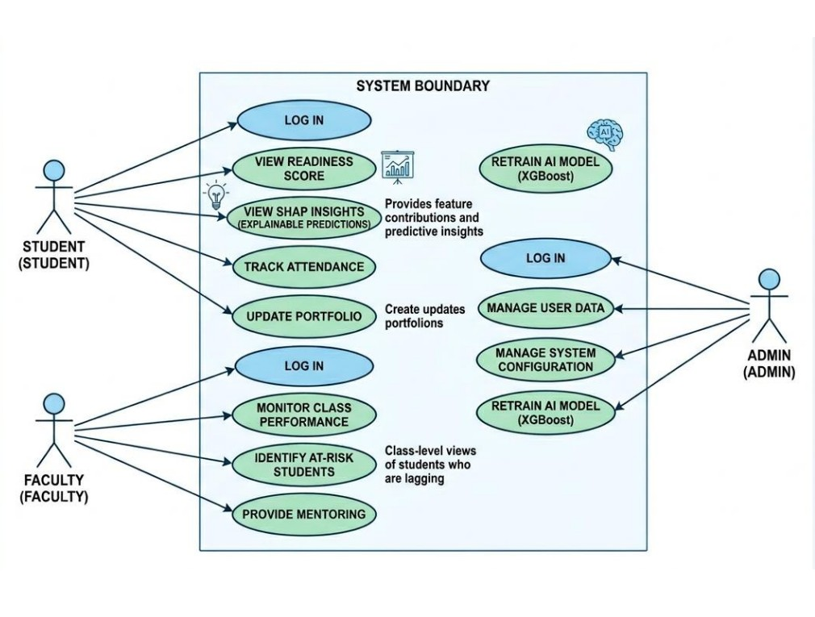
Use Case Diagram
This diagram outlines functional requirements and system interactions. It clarifies responsibilities: Admin configures data and permissions; Faculty uploads/inspects data, triggers predictions, reviews local explanations, and initiates interventions or reports.

Slide 6
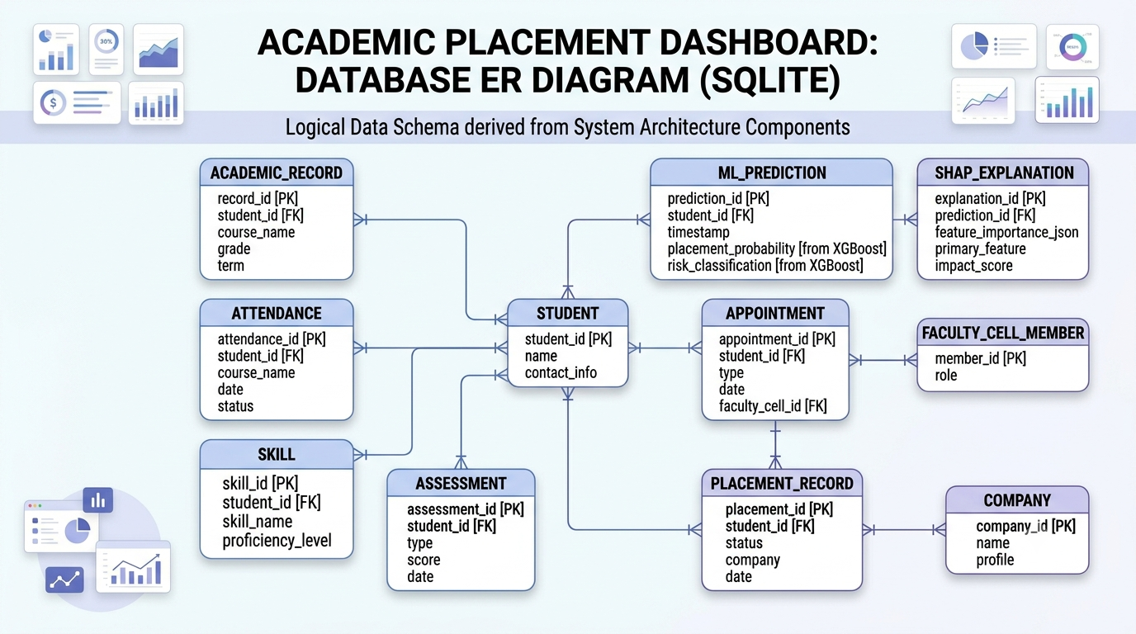
Database Analysis & ER Diagram
Key tables and relationships designed for traceability and auditability:
User — authentication, role, audit trails.
Student_Profile — unique identifiers, demographics, program.
Academic_Records — term grades, course-level performance.
Placement_History — interviews, offers, placements, employer feedback.
Prediction_Results — model outputs, SHAP values, timestamped logs.
Relationship logic maps temporal performance to placement eligibility and stores explanation vectors for retrospective analysis.

Slide 7


Database Schema (SQL)
Schema designed for efficient retrieval and integrity:
Student_Profile: student_id (PK), program, cohort, cgpa, technical_scores.
Auth_Table: user_id (PK), username, password_hash (bcrypt/argon2), role, last_login.
Normalized tables separate time-series academic records from static profile data to optimize prediction queries and storage of feature snapshots.
Ensure encryption-at-rest for sensitive fields and role-based data access to comply with institutional privacy policies (FERPA-aware).

Slide 8


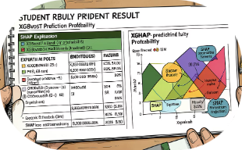
UI Wireframes & Page Layouts
Design philosophy: minimalist, data-first, and faculty-centric. Key pages:
Login Portal
Dashboard
Result Details
Secure, role-aware entry point with MFA option and audit logging.
At-a-glance metrics, cohort filters, and prioritized risk queue for rapid triage.
Individual prediction probability, top contributing features, recommended interventions, and exportable report.

Slide 9
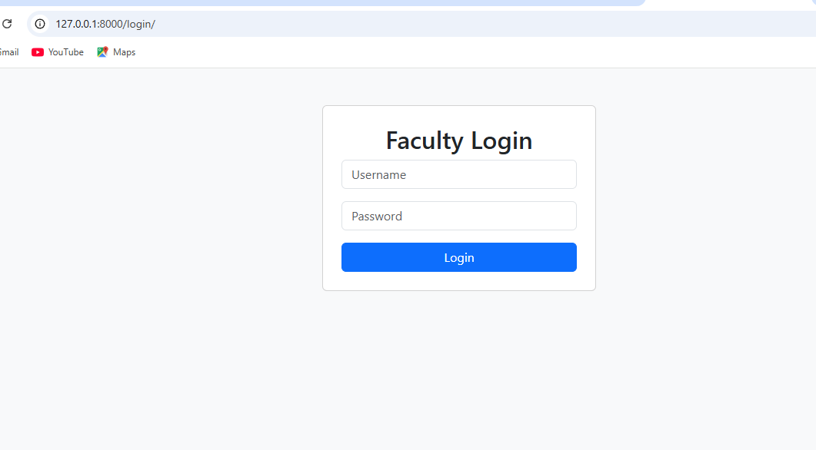
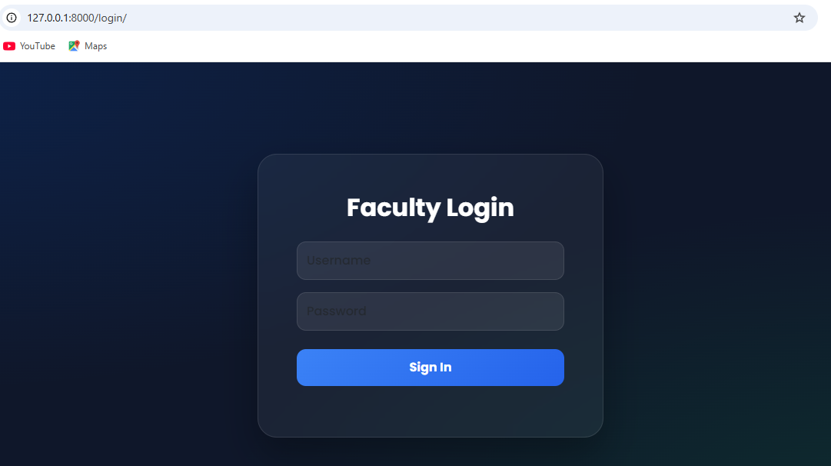
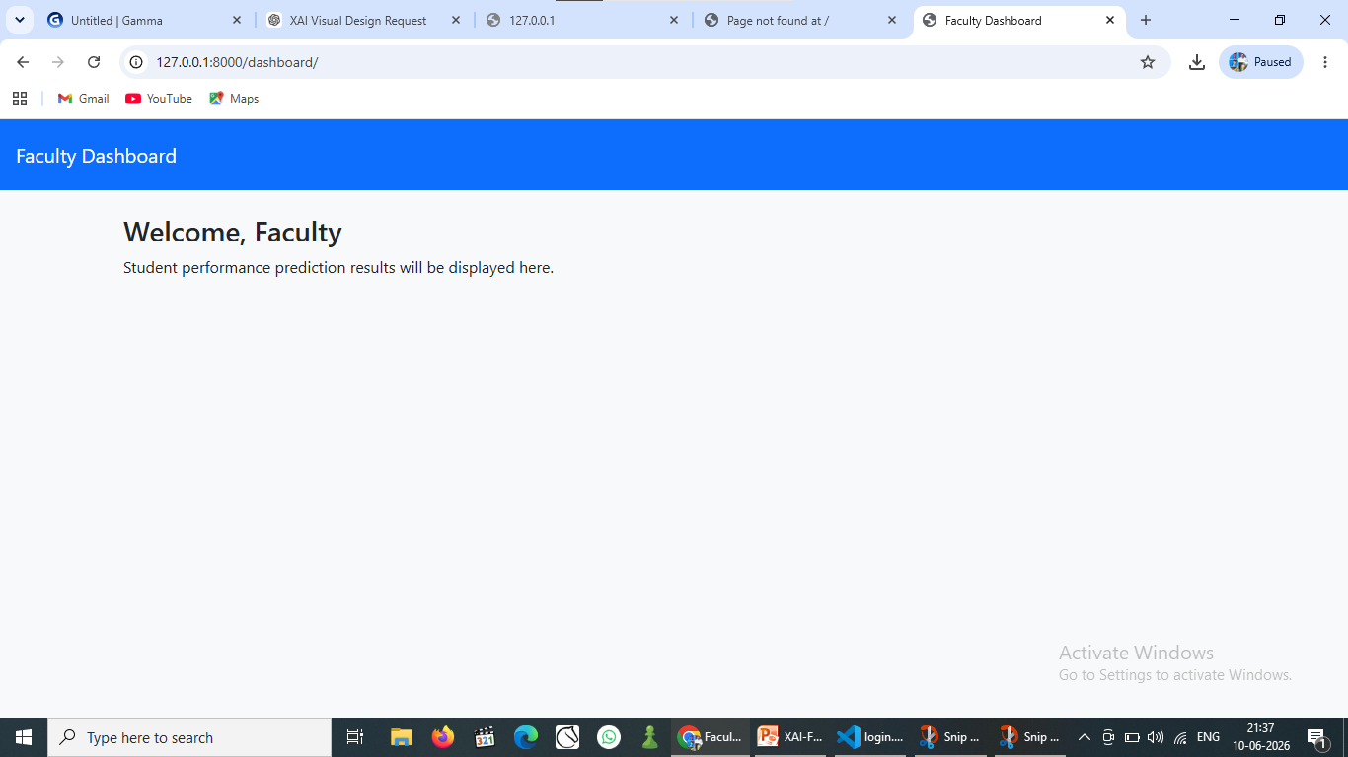
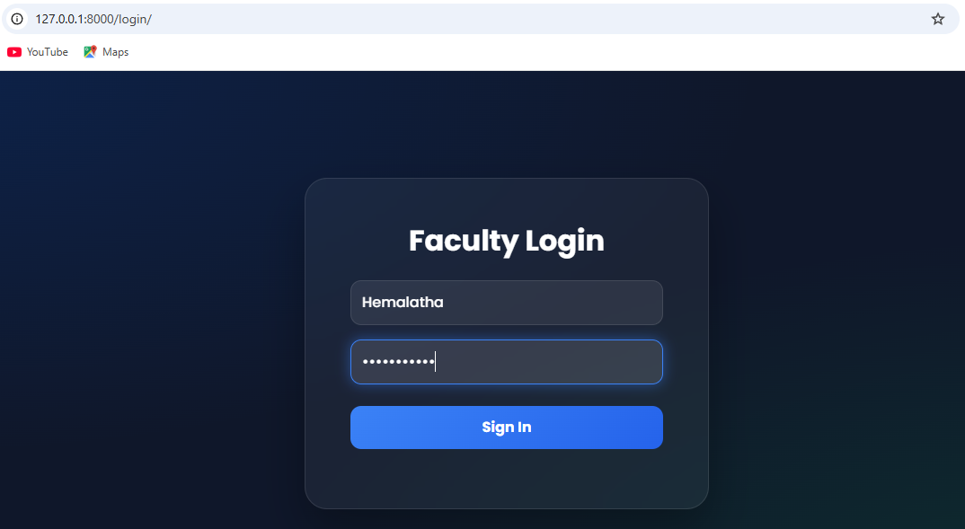

Implementation: Login & Faculty Dashboard
Current status and tech choices:
Status: Authentication and dashboard UI developed; integration with backend in progress.
Tech Stack: Django templates, Django REST endpoints, Bootstrap 5 for responsive layout, PostgreSQL for relational storage.
Integration: Backend prediction pipeline (batch & API) linked to frontend; CI/CD via GitHub; unit tests for data ingestion and model inference.
Next: instrument explainability logs, refine SHAP visualizations, and run pilot with a faculty cohort for feedback.

Slide 10

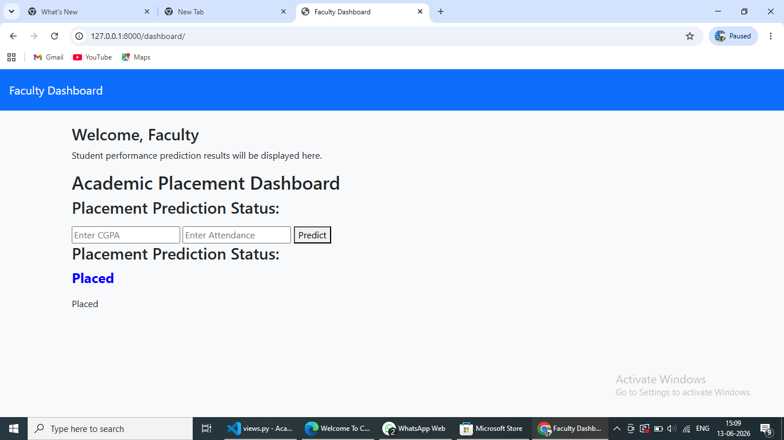

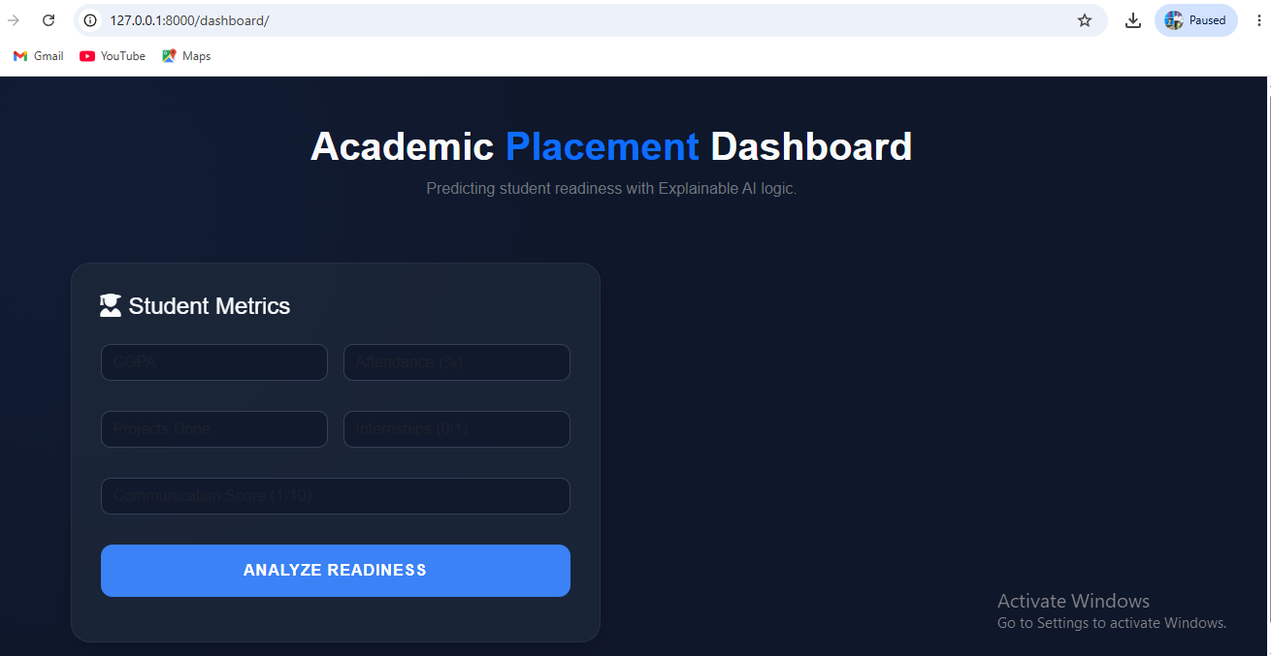







Phase II — ML Integration & Real-time Prediction
Model Training & Design
Backend & Deployment
Model Implementation
Tech Stack
Finalized predictive model using optimized algorithms (Random Forest / XGBoost)
Quick Implementation Notes
Model API: load .pkl at app start, cache for low-latency inference
Input validation: normalize CGPA & Attendance; reject out-of-range values
Monitoring: log predictions + input features for model drift detection
Rollback: keep previous model commit tag for safe rollback
Model Persistence
Serialized trained model with joblib into a .pkl for production loading
UI/UX Refinement
Polished navigation, input forms and layout for the Student Placement Dashboard
Design Review
Comprehensive review for input consistency and usability
Deployment priorities: reliability, real-time latency, and reproducibility. Use CI to run inference smoke tests on each push.
Environment
Inference Logic
Configured Django venv with required ML libraries
Integrated real-time inference in views.py — processes CGPA & Attendance inputs
Live Dashboard
Version Control
Dynamic placement prediction (Placed / Not Placed) surfaced on web UI
Final build synchronized to GitHub — deployable snapshot
Python
Django
Scikit-Learn
Joblib
GitHub
HTML / CSS

Slide 11
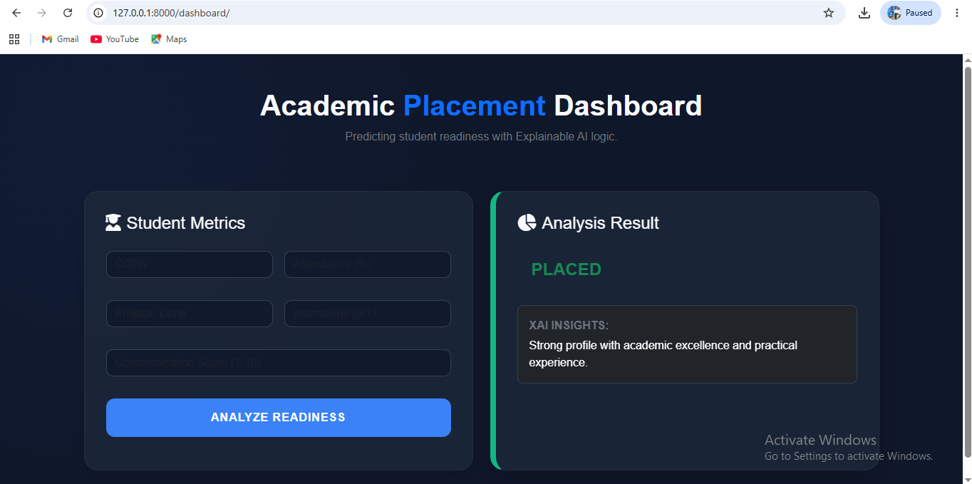





PHASE 1
Backend Architecture & ML Integration
A secure Django MVT foundation paired with real-time ML inference and an Explainable AI reasoning layer, built to transform student metrics into actionable placement predictions.
Secure MVT Architecture
Real-Time ML Inference
Django Model-View-Template handles student data input with built-in authentication, CSRF protection, and role-based access control.
The model.pkl engine is loaded via Joblib, delivering instant placement predictions from academic and performance metrics.
The pipeline moves from raw student data through Django's secure backend into the Joblib-loaded model, finally enriched by a custom XAI layer that converts predictions into human-readable guidance.
Explainable AI Engine
Persistent Data Sync
A custom rule-based reasoning layer transforms complex ML outputs into mentorship advice — e.g., "Improve communication skills to boost placement probability."
Database connections track student performance history, enabling longitudinal analytics and trend identification across cohorts.

Slide 12
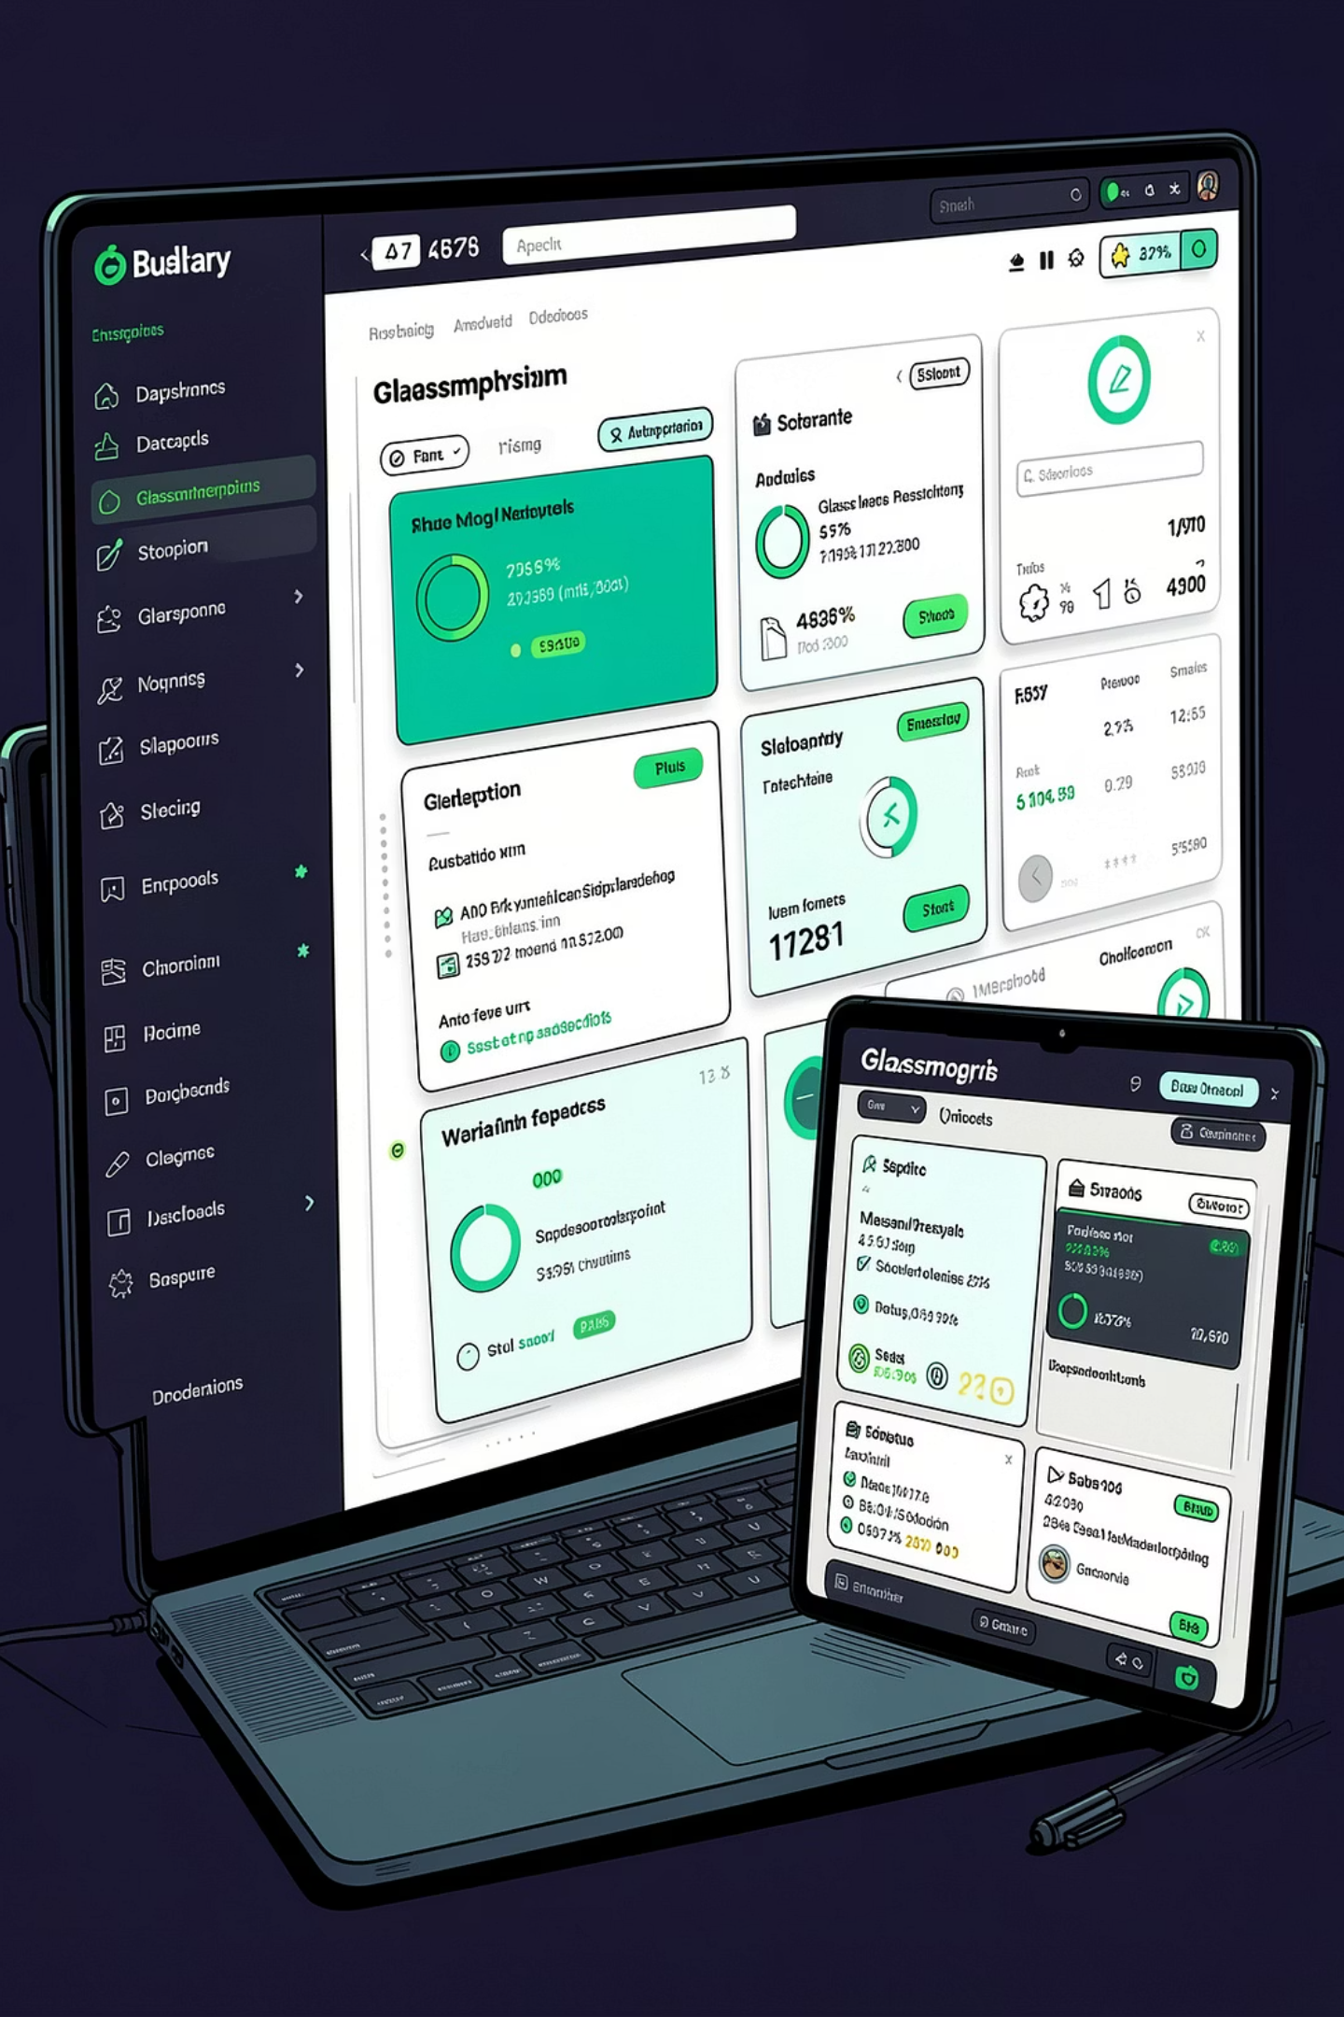




PHASE 2
Professional UI Overhaul & API Connectivity
A premium Glassmorphism frontend with seamless RESTful API integration, delivering instantaneous visual feedback across every device class.
Glassmorphism Design
Migrated from basic HTML to a high-end frosted-glass interface tailored for faculty and mentors, featuring translucent panels and layered depth.
RESTful API Flow
AJAX endpoints connect directly to the prediction engine, returning results instantaneously without page reloads or interruption.
Dynamic Color Feedback
Real-time indicators signal readiness at a glance: Green = Placed readiness, Red = Critical areas requiring attention.
Fully Responsive
Layout optimized to function flawlessly across laptops, tablets, and mobile devices, ensuring mentor access anywhere on campus.

Slide 13
PHASE 3
Quality Assurance & Project Readiness
Rigorous validation across model performance, bug resolution, and API reliability — the application is fully optimized, stable, and ready for institutional demonstration.
94%
Bug Resolution
API Validation
Final Documentation
Exhaustive smoke testing resolved all critical logic, navigation, and input-handling errors before final submission.
Verified backend reliability and request handling via Postman for both single-student and bulk-data scenarios.
Compiled the project report, finalized demo slides, and packaged the entire codebase for formal submission.
Prediction Accuracy
Achieved through rigorous testing and fine-tuning of the Random Forest classifier across diverse student profiles and edge cases.
Deployment Status
Fully optimized, stable, and ready for institutional demonstration.

