Slide 1
Loading Data and Packages¶ load train and test set Analyzing the Test variable(Sale price) Multivariable analysis Let's check out all the variables! There are two types of features in housing data, categorical and numerical # Correlation Matrix Heatmap

Slide 2
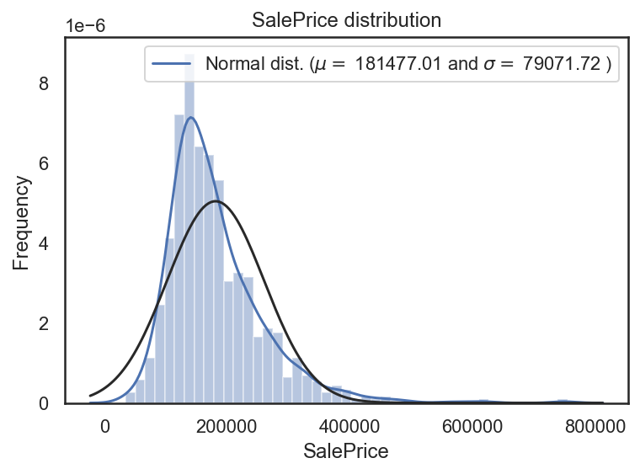
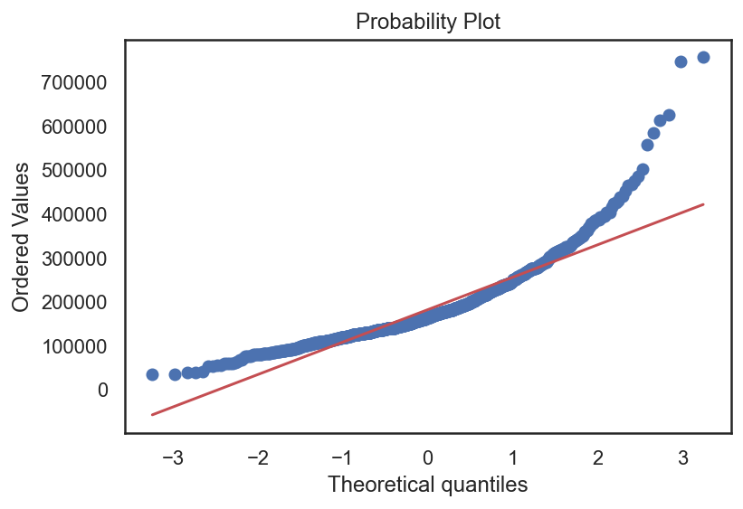

Slide 3
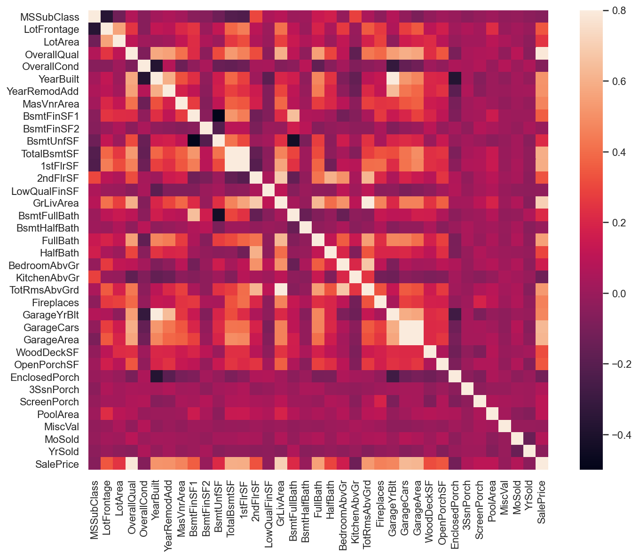

Slide 4
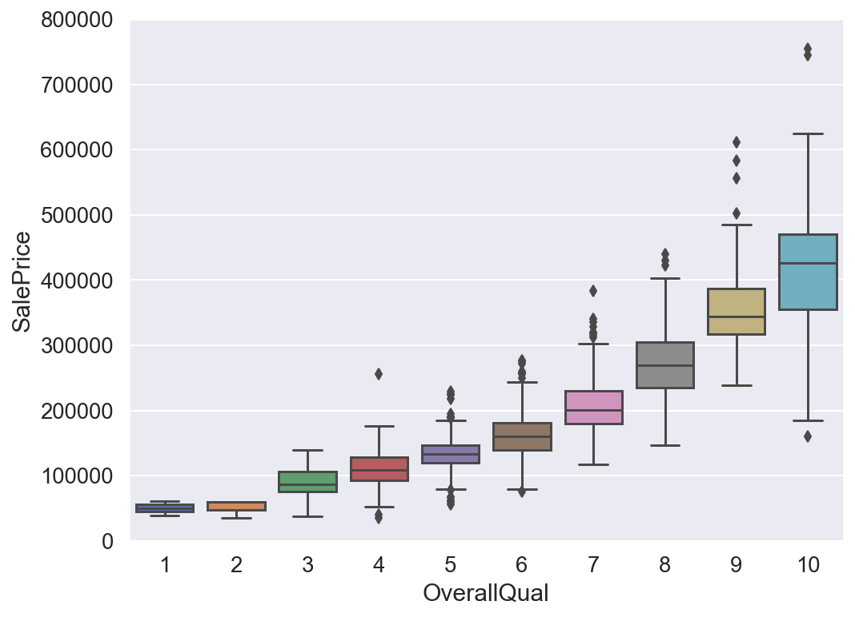
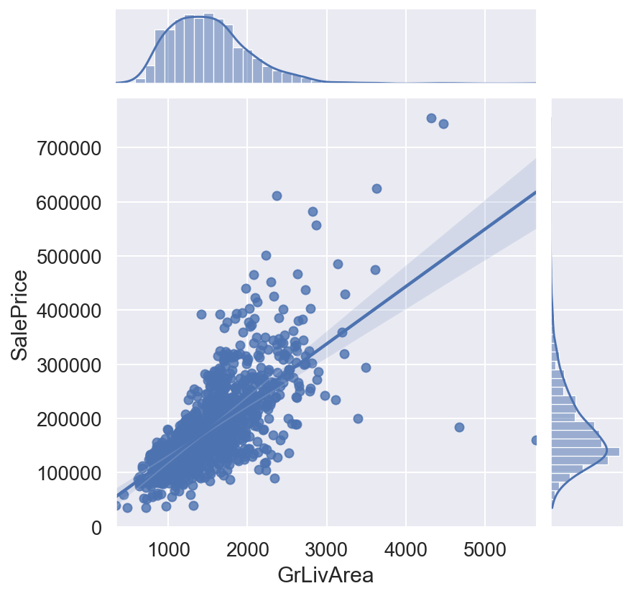
# Living Area vs Sale Price
# Overall Quality vs Sale Price

Slide 5
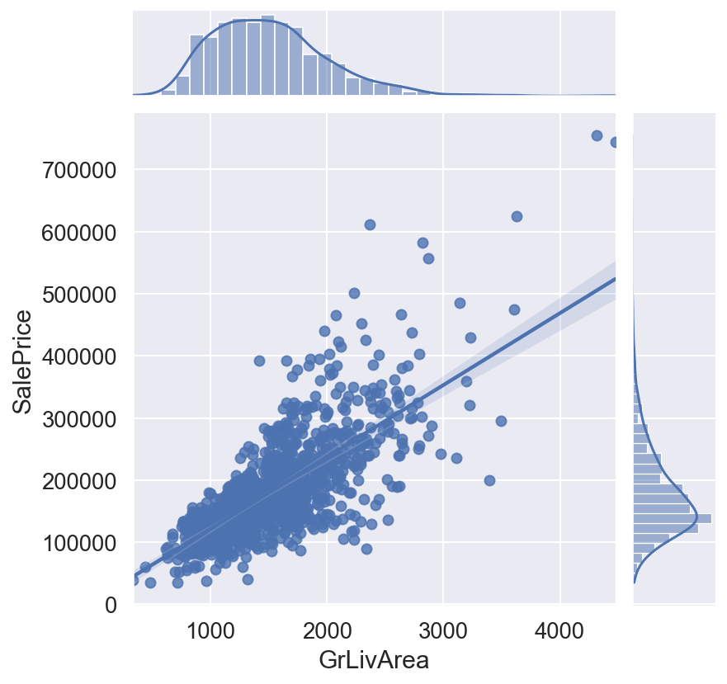
# Living Area vs Sale Price

Slide 6
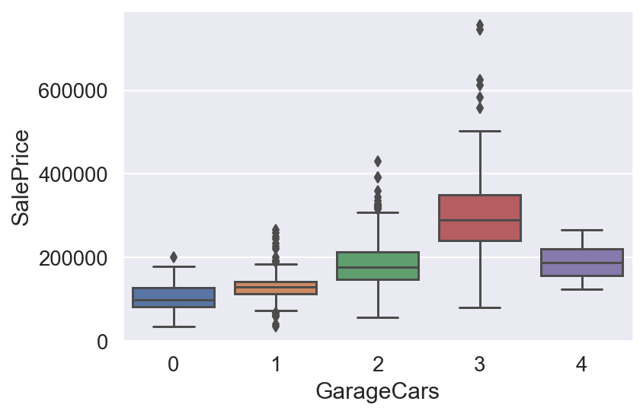
# Garage Area vs Sale Price
# Removing outliers manually (More than 4-cars, less than $300k)

Slide 7
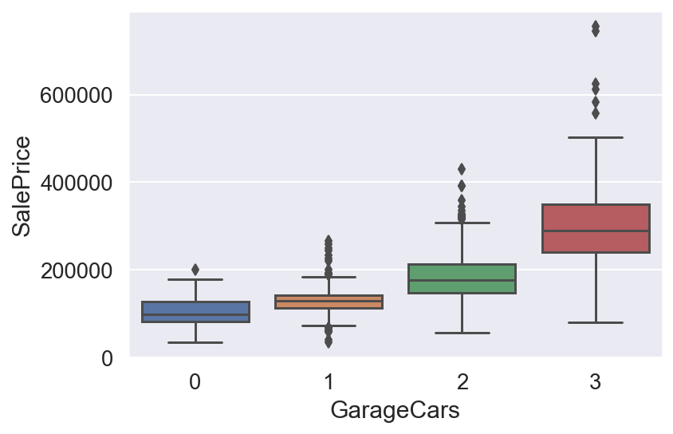
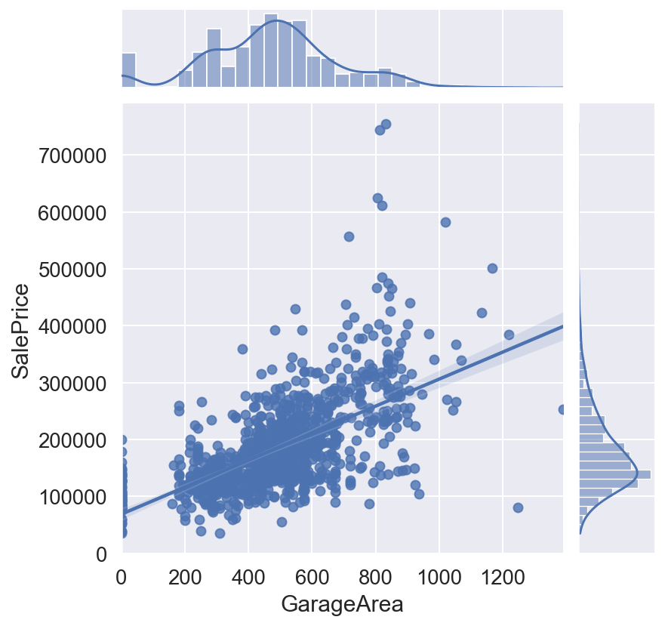
# Garage Area vs Sale Price
# Garage Area vs Sale Price

Slide 8
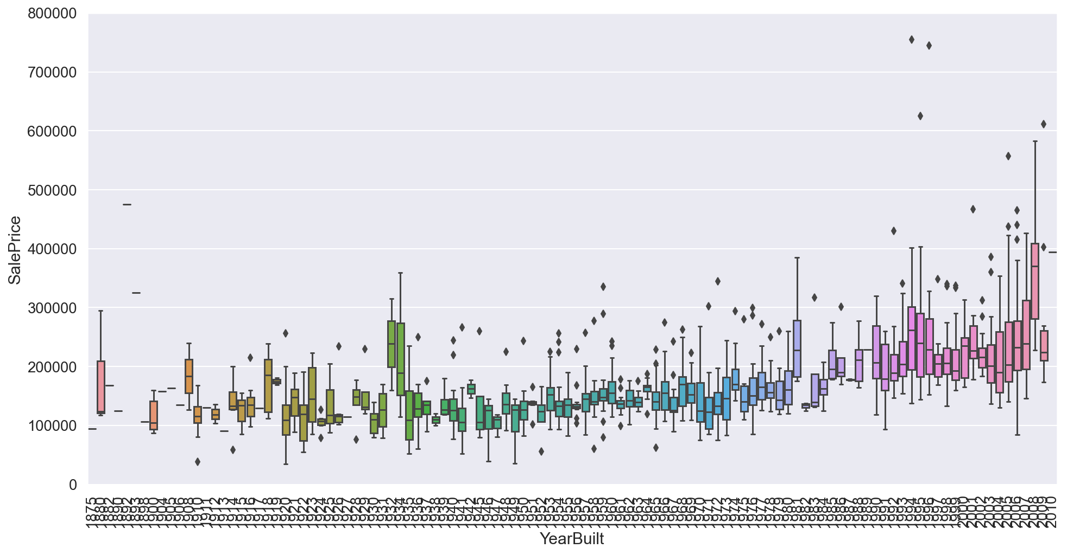
# Total Rooms vs Sale Price

Slide 9
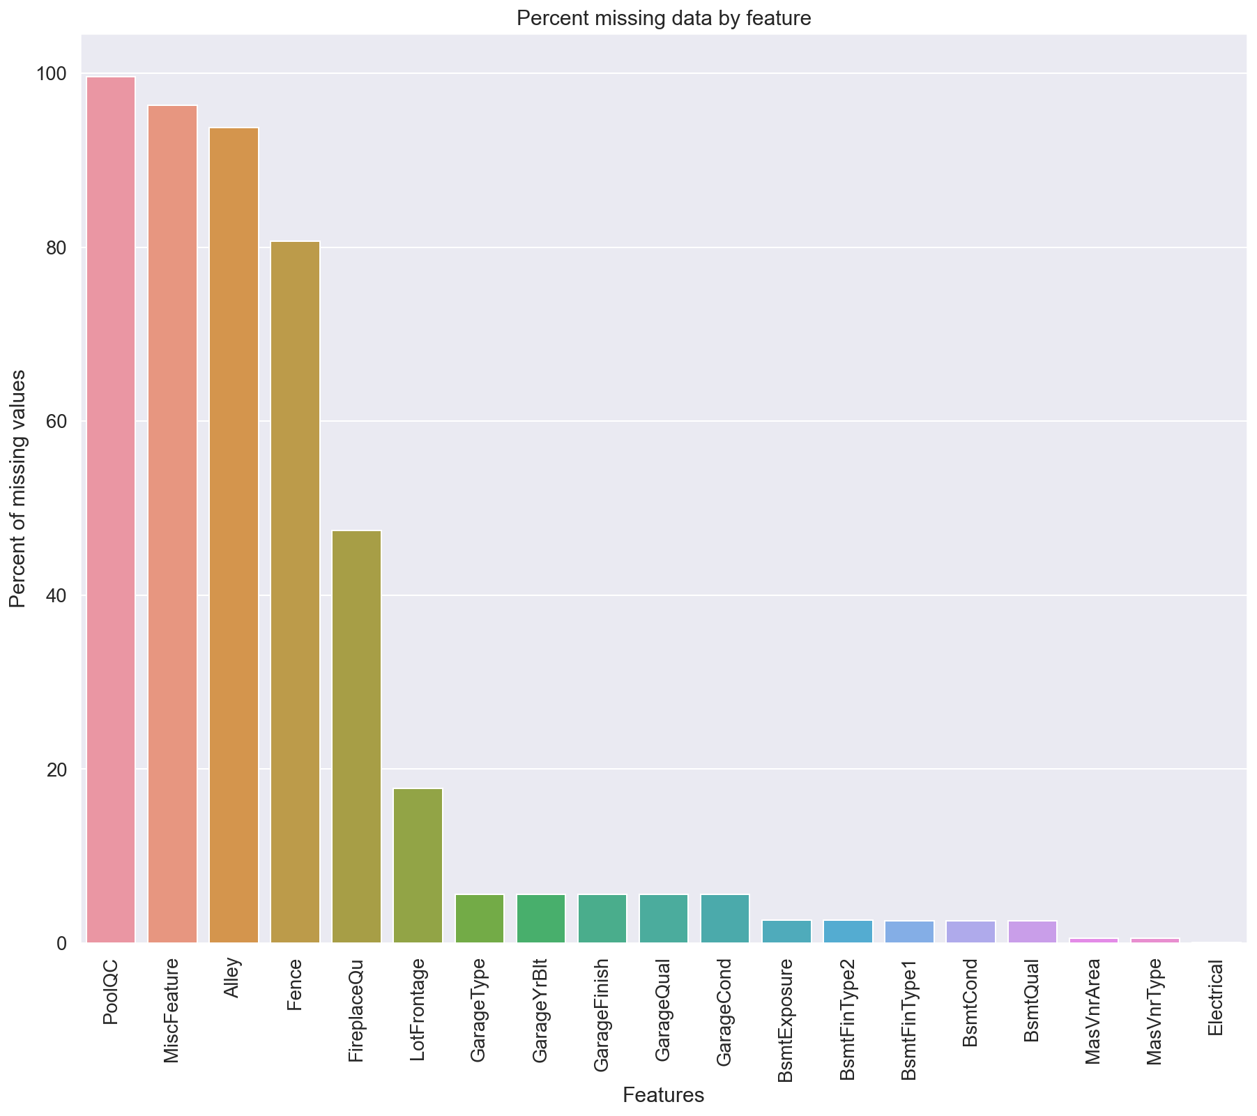
Impute Missing Data and Clean Data
# Percent missing data by feature

Slide 10
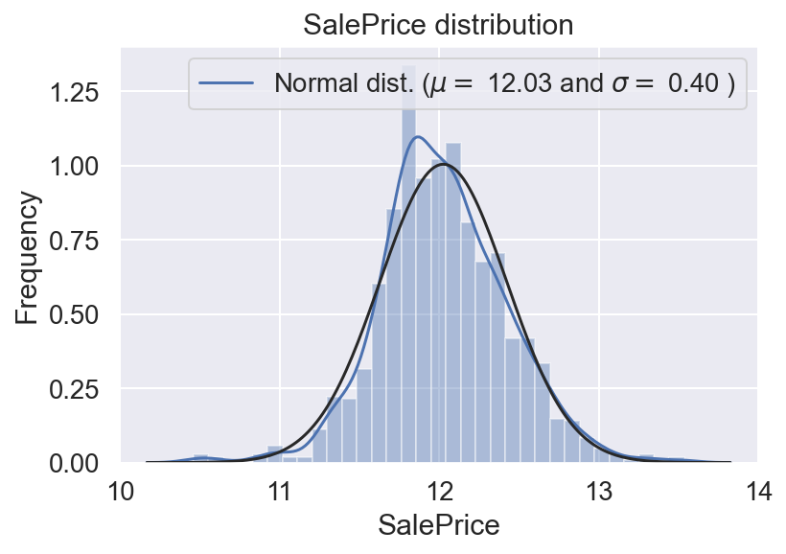
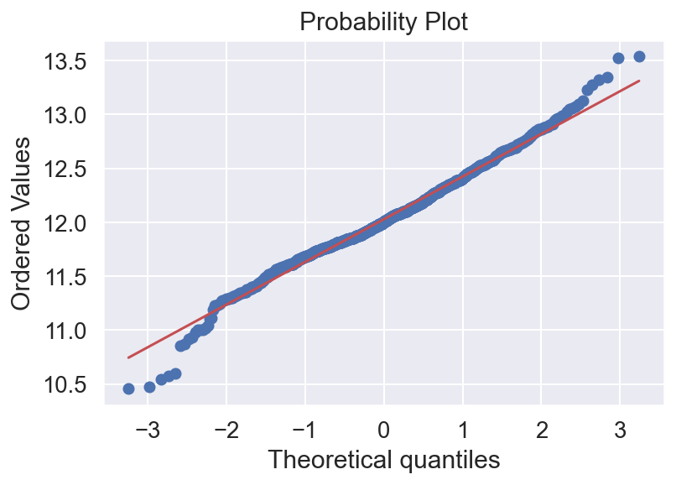
Imputing Missing Values
all_data_na = (all_data.isnull().sum() / len(all_data)) * 100
all_data_na = all_data_na.drop(all_data_na[all_data_na == 0].index).sort_values(ascending=False)
missing_data = pd.DataFrame({'Missing Ratio' :all_data_na})
missing_data.head()
Feature Transformation/Engineering
all_data['MSSubClass'].describe()
Fixing "skewed" features.

Slide 11
Modeling and Predictions
Stacked models
XGBoost
LightGBM
Ensemble Prediction
Submission

