Slide 1
Important aspects Of Database Synchronization
Lecture 5

Slide 2
Types of Tables from the point of Synchronization
Synchronizable – the tables where the users can add/edit/delete the data.
Non-synchronizable – the tables containing static datasets, which are not subject to any changes made by the users.

Slide 3
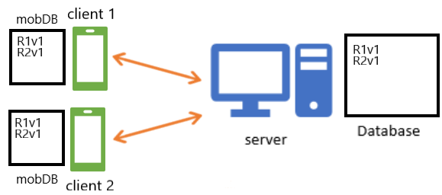
Mobile databases Synchronization
Main goal: maintaining state of consistency
State of consistency: every database in the system contains the same data

Slide 4
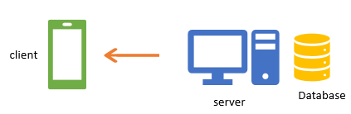


Synchronization directions:
Client $←$ Server
Receiving the records added/updated/deleted by the other clients
Client $→$ Server
Adding a new record by a client
Updating an existing record by a client
Deleting an existing record by a client

Slide 5

Client $←$Server synchronization
Every change of synchronizable table on the server side must be registered in an auxiliary table, containing the history of changes made with the rows of the tables. Every change, that causes insertion/update/delete of any record should be registered by insertion of a record to the auxiliary table.
Local DB
Table1 |  |  | Modifications
Id | name |  | Id | Table_name | Record_id | Modification_type
Local DB
Table1 |  |  | Modifications
Id | name |  | Id | Table_name | Record_id | Modification_type
1 | Val1 |  | 1 | ‘Table1’ | 1 | ‘Insert’
Local DB
Table1 |  |  | Modifications
Id | name |  | Id | Table_name | Record_id | Modification_type
1 | Val1 |  | 1 | ‘Table1’ | 1 | ‘Insert’
2 | Val2 |  | 2 | ‘Table1’ | 2 | ‘Insert’
Local DB
Table1 |  |  | Modifications
Id | name |  | Id | Table_name | Record_id | Modification_type
1 | Val1_1 |  | 1 | ‘Table1’ | 1 | ‘Insert’
2 | Val2 |  | 2 | ‘Table1’ | 2 | ‘Insert’
 |  |  | 3 | ‘Table1’ | 1 | ‘Update’

Slide 6
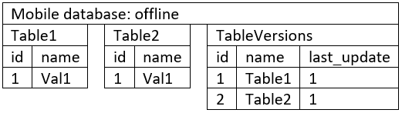

Synchronization Client $←$ Server.
A mobile database has to contain special table containing the table names and the version of the corresponding table at the local database. Table 2 is not shown for the local db for simplicity.
1) Inconsistent state
Local DB
Table1 |  |  | Modifications
Id | name |  | Id | Table_name | Record_id | Modification_type
1 | Val1_1 |  | 1 | ‘Table1’ | 1 | ‘Insert’
2 | Val2 |  | 2 | ‘Table1’ | 2 | ‘Insert’
 |  |  | 3 | ‘Table1’ | 1 | ‘Update’

Slide 7
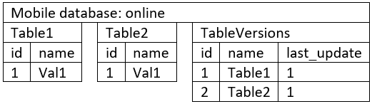
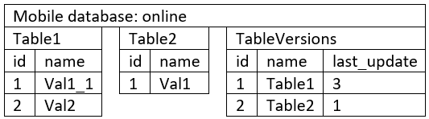

Synchronization Client $←$ Server Request - response
2) Sending request with last_update of the Table1
Local DB
Table1 |  |  | Modifications
Id | name |  | Id | Table_name | Record_id | Modification_type
1 | Val1_1 |  | 1 | ‘Table1’ | 1 | ‘Insert’
2 | Val2 |  | 2 | ‘Table1’ | 2 | ‘Insert’
 |  |  | 3 | ‘Table1’ | 1 | ‘Update’
synch_metadata:
{name:Table1,
last_update: 1}
3) Receiving response with updated data from the Table1
{update: {id: 1, name: Val1_1},
insert: {id:2, name: Val2},
synch_metadata : {name:Table1, last_update:3}}
Local DB
Table1 |  |  | Modifications
Id | name |  | Id | Table_name | Record_id | Modification_type
1 | Val1_1 |  | 1 | ‘Table1’ | 1 | ‘Insert’
2 | Val2 |  | 2 | ‘Table1’ | 2 | ‘Insert’
 |  |  | 3 | ‘Table1’ | 1 | ‘Update’

Slide 8

Synchronization. special case: delete
Some client deleted the row 1 in the Table1.
Note: record is not deleted, only “Delete” in “Modification_type” is written.
The synchronization request is sent.
Local DB
Table1 |  |  | Modifications
Id | name |  | Id | Table_name | Record_id | Modification_type
1 | Val1_1 |  | 1 | ‘Table1’ | 1 | ‘Insert’
2 | Val2 |  | 2 | ‘Table1’ | 2 | ‘Insert’
 |  |  | 3 | ‘Table1’ | 1 | ‘Update’
 |  |  | 4 | ‘Table1’ | 1 | ‘Delete’
Synchronization_metadata:
{name:Table1,
last_update: 3}
2) Receiving response with id of the records to be deleted
Local DB
Table1 |  |  | Modifications
Id | name |  | Id | Table_name | Record_id | Modification_type
1 | Val1_1 |  | 1 | ‘Table1’ | 1 | ‘Insert’
2 | Val2 |  | 2 | ‘Table1’ | 2 | ‘Insert’
 |  |  | 3 | ‘Table1’ | 1 | ‘Update’
 |  |  | 4 | ‘Table1’ | 1 | ‘Delete’
{update:{}, insert: {},
delete: {id: 1},
Synchronization_metadata : {name:Table1, last_update:4}}

Slide 9

Client $→$Server synchronization
Every record added to a mobile database table has to be later sent to the local database. The fact, that the record was/was not sent to the local database is stored as logic value in the field synch_status.
Upon adding/updating a record, the value of the field has to be set to false.
A special Synchronization singleton class has to be defined: its instance periodically selects all the rows with synch_status==false and performs synchronization. After obtaining response from the server, the Synchronization singleton marks the records as synchronized.

Slide 10
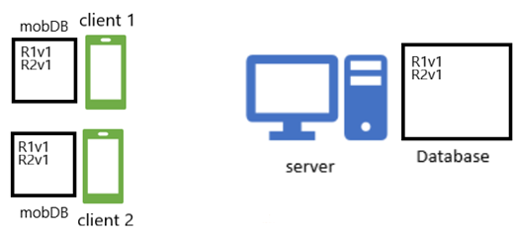
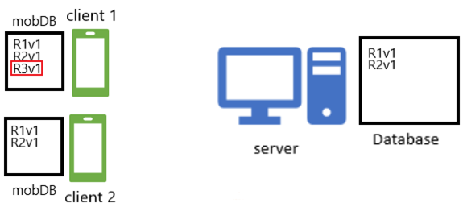
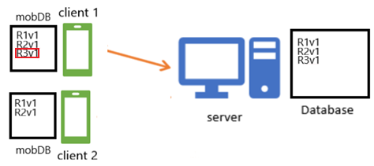
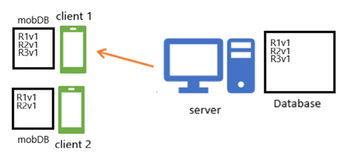
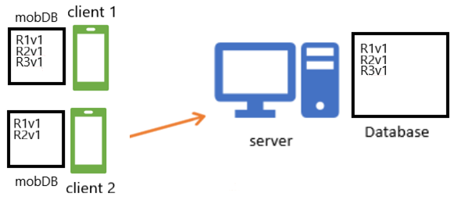

Data synchronization timeline: Insert
Inconsistent state: a record is added by a client to mobDB
New record added to local DB
State of consistency
Server confirms the
new data were added
Sending request for update
by the second client
Getting new record by the second client:
state of consistency

Slide 11
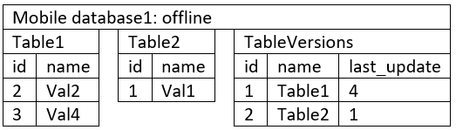
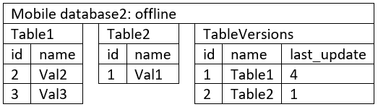


Insert implementation
Problems:
Generating primary keys in the way, that allows avoiding collisions
1) Two clients independently added a value to the table 1 in offline mode.
2) After establishing internet connection they try to synchronize the data.
{id: 3, name: Val4}
Local DB
Table1 |  |  | Modifications
Id | name |  | Id | Table_name | Record_id | Modification_type
1 | Val1_1 |  | 1 | ‘Table1’ | 1 | ‘Insert’
2 | Val2 |  | 2 | ‘Table1’ | 2 | ‘Insert’
 |  |  | 3 | ‘Table1’ | 1 | ‘Update’
 |  |  | 4 | ‘Table1’ | 1 | ‘Delete’
Collision!
{id: 3, name: Val3}
Primary key constraint failed!

Slide 12
Disadvantages of autoincrementing PK
Complicated synchronization process prone to errors due to lost connection problems
Exposing important data about your company, that you would not want to expose (for example, if you have low values of order_id, it means, that your company is not doing well, having little orders)
Causing system vulnerability. If the PK is autoincremental and you know that there exists some id n, it is easy to get records with id = n+1, n+2...
Solution: UUID

Slide 13
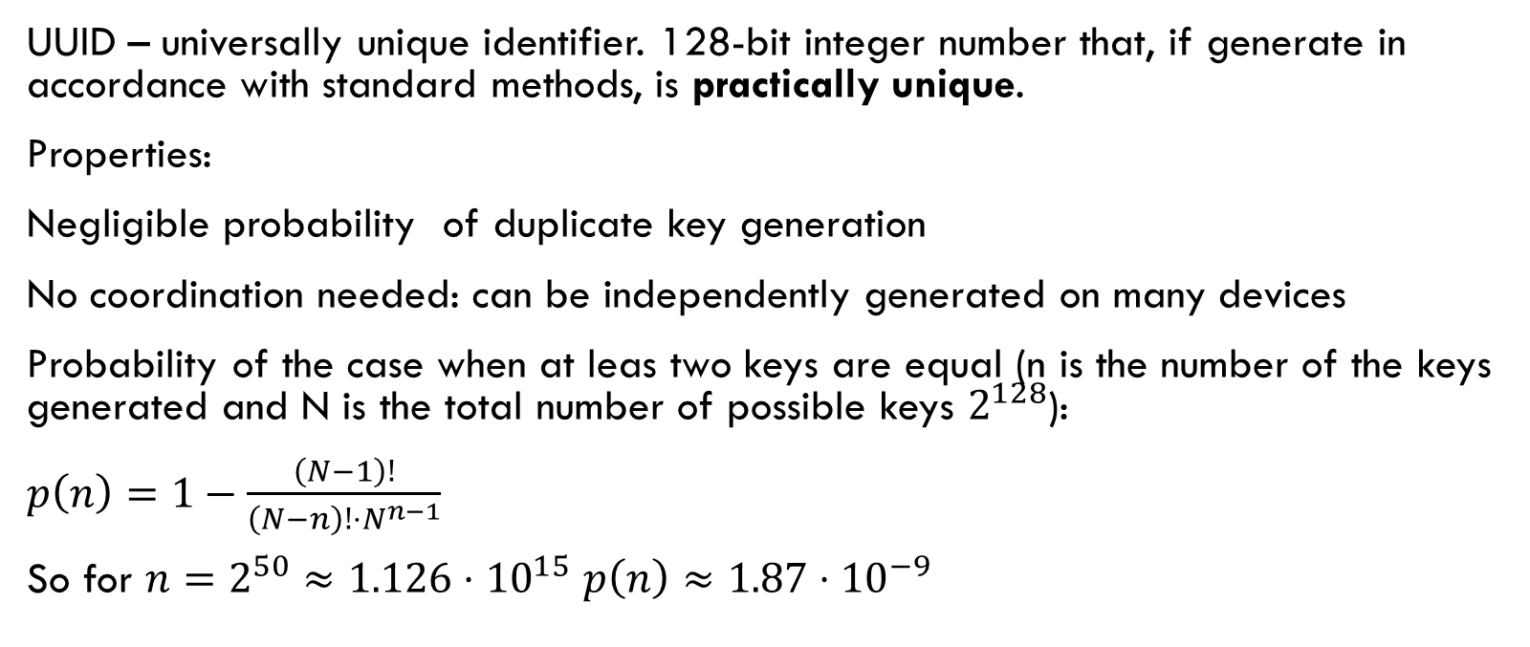
UUID
UUID – universally unique identifier. 128-bit integer number that, if generate in accordance with standard methods, is practically unique.
Properties:
Negligible probability of duplicate key generation
No coordination needed: can be independently generated on many devices
Probability of the case when at leas two keys are equal (n is the number of the keys generated and N is the total number of possible keys $2^{128}$):
$p\left(n\right)=1−\frac{\left(N−1\right)!}{\left(N−n\right)!⋅N^{n−1}}$
So for $n=2^{50}≈1.126⋅{10}^{15}$ $p\left(n\right)≈1.87⋅{10}^{−9}$

Slide 14
Using UUID in Sqlite and MySQL
Unlike Postgres or MSSQL, neither SQLite nor MySQL have 128 bit integer datatype, so it is a usual solution to store the primary key generated with UUID in the field of type VARCHAR(36).
The UUID keys are usually expressed in hexadecimal format in the following way:
123e4567-e89b-12d3-a456-426655440000
Generation in Android Studio:
String myRandomUUID = randomUUID().toString();
The result stored in myRandomUUID is 36-character string, so the primary key has to be, correspondingly, of type VARCHAR(36).
Other possible, but less convenient solutions:
BLOB
Two fields of long datatype

Slide 15

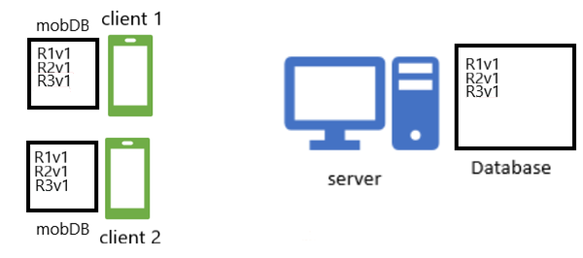
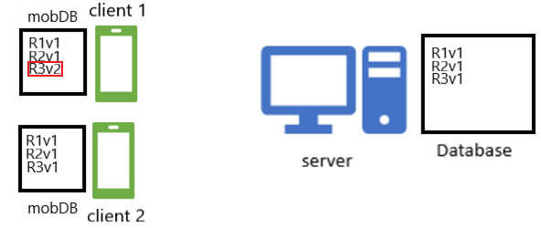
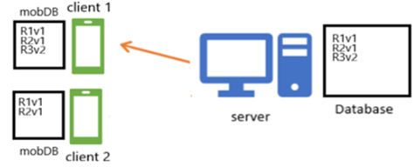
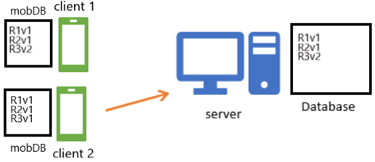
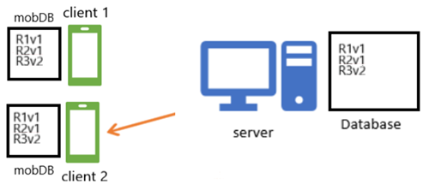
Data synchronization timeline: UPDATE
Inconsistent state: a client changes a record
Corresponding record updated in local DB
State of consistency
Server confirms the
data were updated
Sending request for update
by the second client
Updating the record by the second client:
state of consistency

Slide 16
Synch_status in case of update
Updating any record has to cause its field synch_status to be set to false (red rectangle means that synch_status is false).
Only after server’s response, signalizing, that the data were successfully added to the local database, the synch_status field value can be set to true.

Slide 17
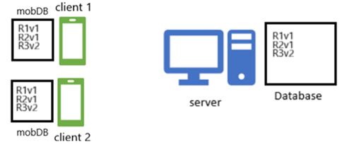
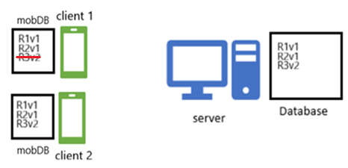
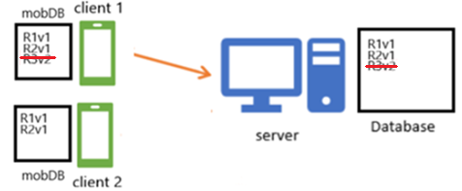
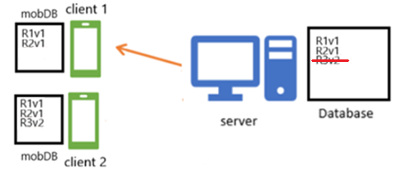
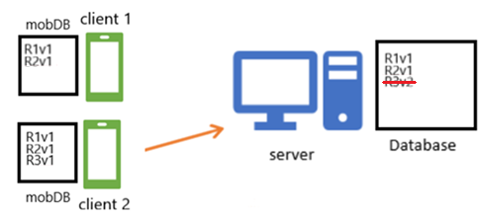

Data synchronization timeline: Delete
Inconsistent state: a client deletes a record
Corresponding record marked as deleted in local DB
State of consistency
Server confirms the
data were marked as deleted
Sending request for update
by the second client
Deleting the record by the second client:
state of consistency

Slide 18
Registering table modifications
Every modification has to be registered in auxiliary table similarly to local database
As for record can be deleted immediately after user chooses the “delete” option, but the id of the deleted record has to be stored in the auxiliary table table.
Every synchronizable table must have such a table.

Slide 19
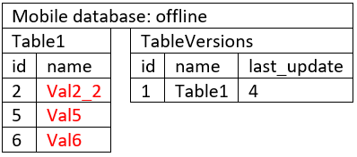
General Synchronization timeline
1) Both mobile DB and local DB have some data for synchronization
Client prepares the data for sending by selecting the records marked as inserted, updated and deleted
Local DB
Table1 |  |  | Modifications
Id | name |  | Id | Table_name | Record_id | Modification_type
1 | Val1_1 |  | 1 | ‘Table1’ | 1 | ‘Insert’
2 | Val2 |  | 2 | ‘Table1’ | 2 | ‘Insert’
3 | Val3 |  | 3 | ‘Table1’ | 1 | ‘Update’
4 | Val4 |  | 4 | ‘Table1’ | 1 | ‘Delete’
 |  |  | 5 | ‘Table1’ | 3 | ‘Insert’
 |  |  | 6 | ‘Table1’ | 4 | ‘Insert’
Modifications
Id | Table_name | Record_id | Modification_type
1 | ‘Table1’ | 2 | ‘Update’
2 | ‘Table1’ | 5 | ‘Insert’
3 | ‘Table1’ | 6 | ‘Insert’
2) Client sends synch request:
{synch_metadata: {name:Table1,
last_update: 4},
Update:{{id:2, name:Val2_2}},
Insert: {{id:5, name:Val5},
{id:6, name:Val6}},
Delete:{}
}

Slide 20
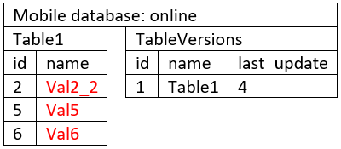
General Synchronization timeline
3) The server prepares new data from local DB.
Insert: {{id: 3, name: Val3},
{id:4, name: Val4}}
Update:{}
Delete:{}
Local DB
Table1 |  |  | Modifications
Id | name |  | Id | Table_name | Record_id | Modification_type
1 | Val1_1 |  | 1 | ‘Table1’ | 1 | ‘Insert’
2 | Val2 |  | 2 | ‘Table1’ | 2 | ‘Insert’
3 | Val3 |  | 3 | ‘Table1’ | 1 | ‘Update’
4 | Val4 |  | 4 | ‘Table1’ | 1 | ‘Delete’
 |  |  | 5 | ‘Table1’ | 3 | ‘Insert’
 |  |  | 6 | ‘Table1’ | 4 | ‘Insert’
Modifications
Id | Table_name | Record_id | Modification_type
1 | ‘Table1’ | 2 | ‘Update’
2 | ‘Table1’ | 5 | ‘Insert’
3 | ‘Table1’ | 6 | ‘Insert’

Slide 21
General Synchronization timeline
4) The server adds/updates/marks as deleted the data to the local DB, registering the modifications
Local DB
Table1 |  |  | Modifications
Id | name |  | Id | Table_name | Record_id | Modification_type
1 | Val1_1 |  | 1 | ‘Table1’ | 1 | ‘Insert’
2 | Val2_2 |  | 2 | ‘Table1’ | 2 | ‘Insert’
3 | Val3 |  | 3 | ‘Table1’ | 1 | ‘Update’
4 | Val4 |  | 4 | ‘Table1’ | 1 | ‘Delete’
5 | Val5 |  | 5 | ‘Table1’ | 3 | ‘Insert’
6 | Val6 |  | 6 | ‘Table1’ | 4 | ‘Insert’
 |  |  | 7 | ‘Table1’ | 5 | ‘Insert’
 |  |  | 8 | ‘Table1’ | 6 | ‘Insert’
 |  |  | 9 | ‘Table1’ | 2 | ‘Update’
Update:{{id:2, name:Val2_2}},
Insert: {{id:5, name:Val5},
{id:6, name:Val6}}
deleted:{}
Modifications
Id | Table_name | Record_id | Modification_type
1 | ‘Table1’ | 2 | ‘Update’
2 | ‘Table1’ | 5 | ‘Insert’
3 | ‘Table1’ | 6 | ‘Insert’
5) The server takes the max value of Id from the table Table1_modifications – the latest version
synch_metadata: {name:Table1,
last_update: 9},

Slide 22
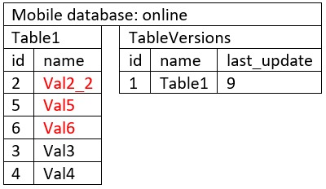
General Synchronization timeline
7) The server sends the data and the synchronization metadata to the client
{synch_metadata: {name:Table1,
last_update: 9},
Insert: {{id: 3, name: Val3},
{id:2, name: Val4}},
Update:{}
Deleted:{}}
Local DB
Table1 |  |  | Modifications
Id | name |  | Id | Table_name | Record_id | Modification_type
1 | Val1_1 |  | 1 | ‘Table1’ | 1 | ‘Insert’
2 | Val2_2 |  | 2 | ‘Table1’ | 2 | ‘Insert’
3 | Val3 |  | 3 | ‘Table1’ | 1 | ‘Update’
4 | Val4 |  | 4 | ‘Table1’ | 1 | ‘Delete’
5 | Val5 |  | 5 | ‘Table1’ | 3 | ‘Insert’
6 | Val6 |  | 6 | ‘Table1’ | 4 | ‘Insert’
 |  |  | 7 | ‘Table1’ | 5 | ‘Insert’
 |  |  | 8 | ‘Table1’ | 6 | ‘Insert’
 |  |  | 9 | ‘Table1’ | 2 | ‘Update’
8) The data are inserted/updated
Modifications
Id | Table_name | Record_id | Modification_type
1 | ‘Table1’ | 2 | ‘Update’
2 | ‘Table1’ | 5 | ‘Insert’
3 | ‘Table1’ | 6 | ‘Insert’

Slide 23
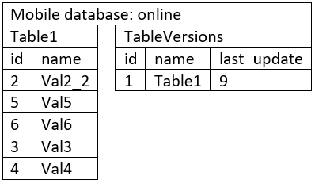
General Synchronization timeline
8) Synch status is set to true, the Modifications table is empty
State of consistence
Local DB
Table1 |  |  | Modifications
Id | name |  | Id | Table_name | Record_id | Modification_type
1 | Val1_1 |  | 1 | ‘Table1’ | 1 | ‘Insert’
2 | Val2_2 |  | 2 | ‘Table1’ | 2 | ‘Insert’
3 | Val3 |  | 3 | ‘Table1’ | 1 | ‘Update’
4 | Val4 |  | 4 | ‘Table1’ | 1 | ‘Delete’
5 | Val5 |  | 5 | ‘Table1’ | 3 | ‘Insert’
6 | Val6 |  | 6 | ‘Table1’ | 4 | ‘Insert’
 |  |  | 7 | ‘Table1’ | 5 | ‘Insert’
 |  |  | 8 | ‘Table1’ | 6 | ‘Insert’
 |  |  | 9 | ‘Table1’ | 2 | ‘Update’
Modifications
Id | Table_name | Record_id | Modification_type

Slide 24
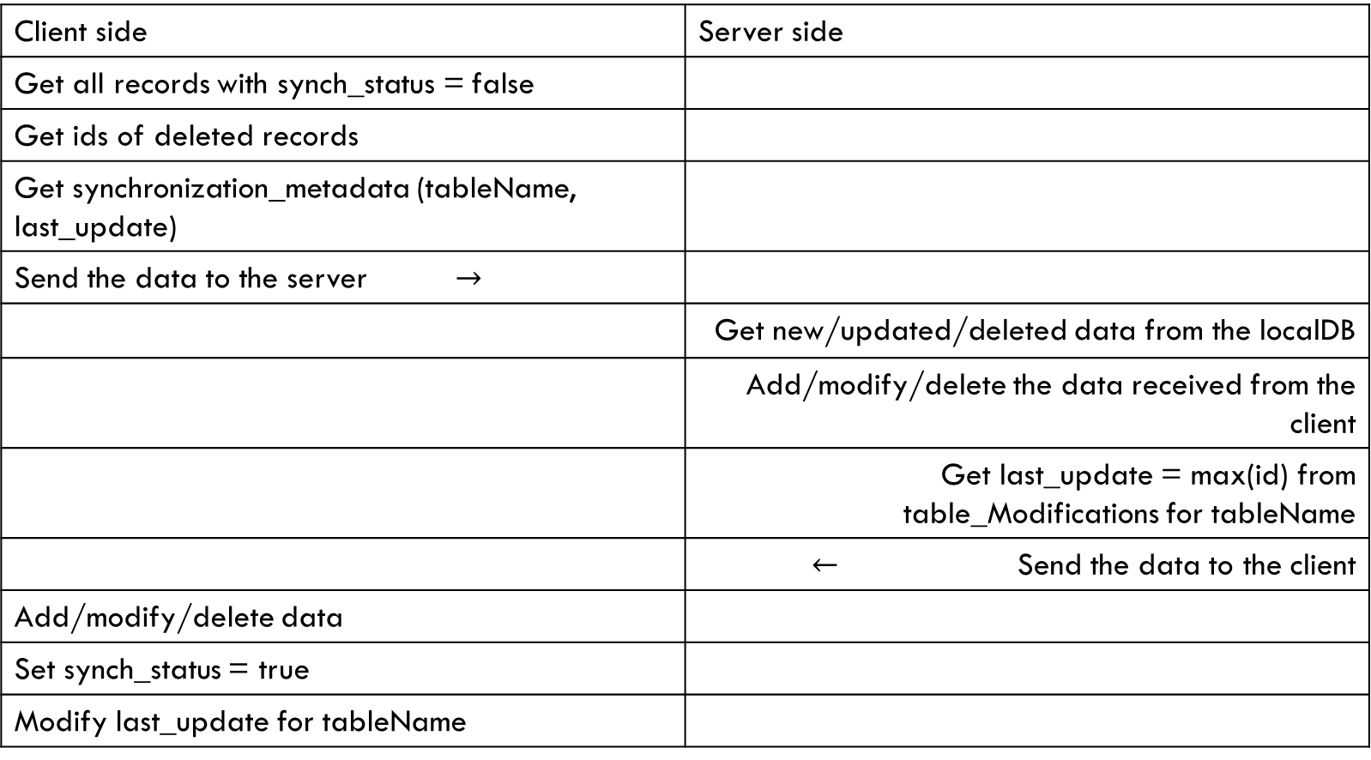
General Synchronization timeline
Client side | Server side
Get all records with synch_status = false
Get ids of deleted records
Get synchronization_metadata (tableName, last_update)
Send the data to the server $→$
 | Get new/updated/deleted data from the localDB
 | Add/modify/delete the data received from the client
 | Get last_update = max(id) from table_Modifications for tableName
 | $←$ Send the data to the client
Add/modify/delete data
Set synch_status = true
Modify last_update for tableName

Slide 25
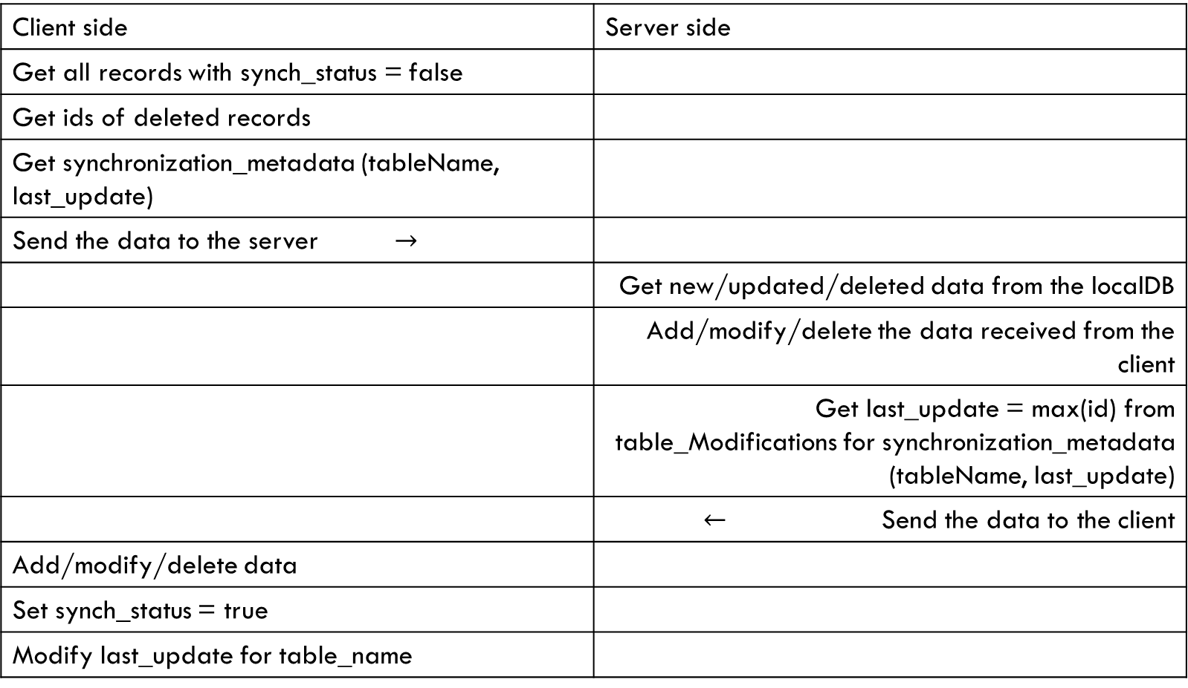
General Synchronization timeline
Client side | Server side
Get all records with synch_status = false
Get ids of deleted records
Get synchronization_metadata (tableName, last_update)
Send the data to the server $→$
 | Get new/updated/deleted data from the localDB
 | Add/modify/delete the data received from the client
 | Get last_update = max(id) from table_Modifications for synchronization_metadata (tableName, last_update)
 | $←$ Send the data to the client
Add/modify/delete data
Set synch_status = true
Modify last_update for table_name
Conflict possible!

Slide 26
Conflicts
Conflict – the state of the system, when two incoming update request from two clients received.
Conflicts do not arise in case of insert – UUID takes care of it.
In contrast with insertion update can cause conflicts:
Update-update
Update-delete

Slide 27
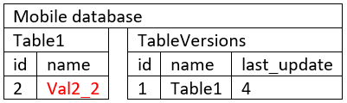
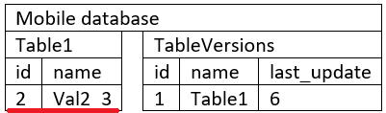
Update-update conflict
But while the client was offline someone has already updated the record with id = 2
The clients has an update to be submitted to the server
Local DB
Table1 |  |  | Modifications
Id | name |  | Id | Table_name | Record_id | Modification_type
1 | Val1_1 |  | 1 | ‘Table1’ | 1 | ‘Insert’
2 | Val2_3 |  | 2 | ‘Table1’ | 2 | ‘Insert’
 |  |  | 3 | ‘Table1’ | 1 | ‘Update’
 |  |  | 4 | ‘Table1’ | 1 | ‘Delete’
 |  |  | 5 | ‘Table1’ | 2 | ‘Update’
So, if the databases are synchronized in accordance with the procedure described on the slide 25, the conflict will occur: the databases will exchange the data, but still will be in inconsistent state.
Local DB
Table1 |  |  | Modifications
Id | name |  | Id | Table_name | Record_id | Modification_type
1 | Val1_1 |  | 1 | ‘Table1’ | 1 | ‘Insert’
2 | Val2_2 |  | 2 | ‘Table1’ | 2 | ‘Insert’
 |  |  | 3 | ‘Table1’ | 1 | ‘Update’
 |  |  | 4 | ‘Table1’ | 1 | ‘Delete’
 |  |  | 5 | ‘Table1’ | 2 | ‘Update’
 |  |  | 6 | ‘Table1’ | 2 | ‘Update

Slide 28
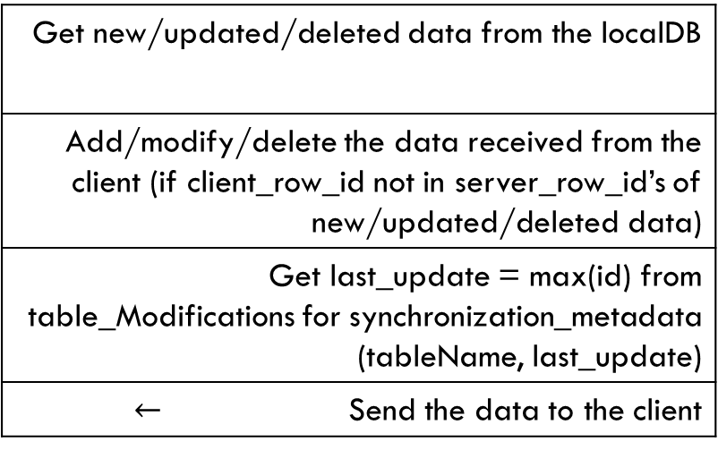
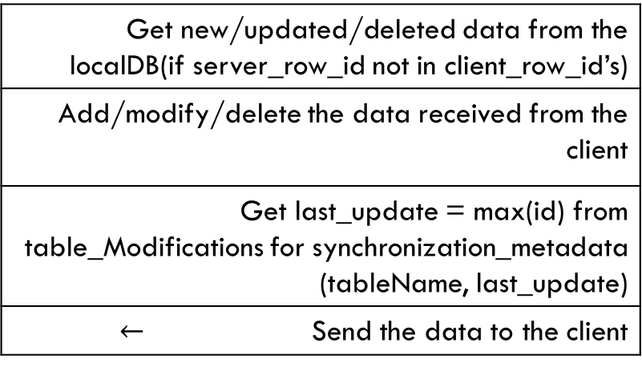
Update-Update, Delete-update, update-delete conflict: possible resolutions
Priority for the Client
Priority for the Server
Get new/updated/deleted data from the localDB(if server_row_id not in client_row_id’s)
Add/modify/delete the data received from the client
Get last_update = max(id) from table_Modifications for synchronization_metadata (tableName, last_update)
$←$ Send the data to the client
Get new/updated/deleted data from the localDB
Add/modify/delete the data received from the client (if client_row_id not in server_row_id’s of new/updated/deleted data)
Get last_update = max(id) from table_Modifications for synchronization_metadata (tableName, last_update)
$←$ Send the data to the client

Slide 29
Task
Modify your databases for implementing synchronization:
Change ids from autoincrementing int to varchar(36), modify ORM correspondingly
Add table tableVersions at the mobile database
Add tables Modifications at the mobile database
Add tables Modifications at the local Database.

