Slide 1

CUSTOMER
Wenhua’s zone
WEB
CUSTOMER
Wenhua’s zone
WEB
Welcome to wuwenhua powerpoint
Study Plan
Share
Good Websites
Video
HOME
ON
Music 00:15—00:22

Slide 2
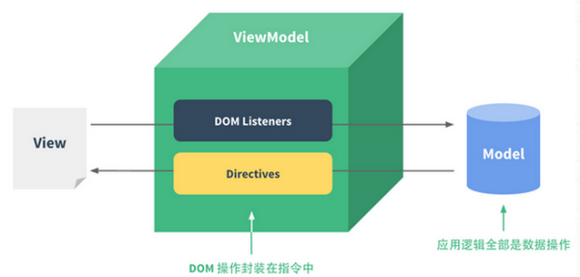
CUSTOMER
Wenhua’s zone
WEB
简单介绍
Vue是基于MVVM（非严格）模式构建用户界面的渐进式框架，Vue的核心库关心视图层，用户只需关注自己数据的变化，剩下的工作就交给Vue去完成了。其中很重要的一部分工作就是数据驱动！
Welcome to wuwenhua powerpoint
Study Plan
Share
Good Websites
Video
HOME
ON
Music 00:15—00:22

Slide 3
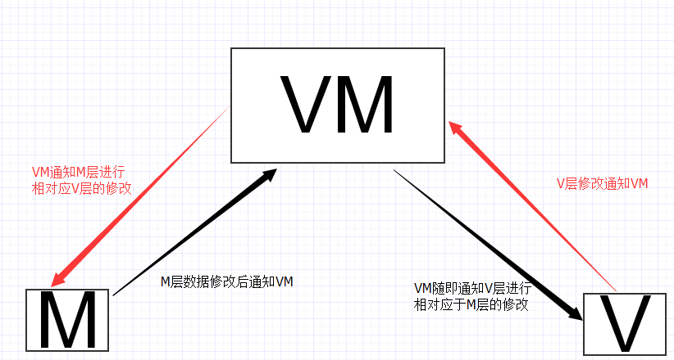
CUSTOMER
Wenhua’s zone
WEB
MVVM
MVVM分为三个部分：分别是M（Model，模型层 ），V（View，视图层），VM（ViewModel，V与M连接的桥梁，也可以看作为控制器）
Welcome to wuwenhua powerpoint
Study Plan
Share
Good Websites
Video
HOME
ON
Music 00:15—00:22

Slide 4
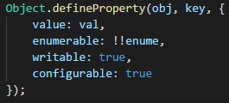
CUSTOMER
Wenhua’s zone
WEB
原理
把一个普通的 JavaScript 对象传给 Vue 实例的 data 选项，Vue 将遍历此对象所有的属性，并使用 Object.defineProperty 把这些属性全部转为 getter/setter。用户看不到 getter/setter，但是在内部它们让 Vue 追踪依赖，在属性被访问和修改时通知变化。
Welcome to wuwenhua powerpoint
Study Plan
Share
Good Websites
Video
HOME
ON
Music 00:15—00:22

Slide 5
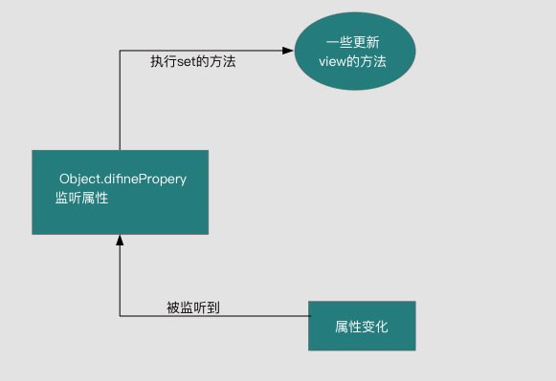
CUSTOMER
Wenhua’s zone
WEB
首发
Observer
Welcome to wuwenhua powerpoint
Study Plan
Share
Good Websites
Video
HOME
ON
Music 00:15—00:22

Slide 6
CUSTOMER
Wenhua’s zone
WEB
Do it
实现Observer（监听器）-v1
1、Object.defineProperty
Welcome to wuwenhua powerpoint
Study Plan
Share
Good Websites
Video
HOME
ON
Music 00:15—00:22

Slide 7
CUSTOMER
Wenhua’s zone
WEB
question
还缺什么呢？怎样去更好的管理我们的初始数据，而不是一上来就强制把所有初始数据更新到视图？
Welcome to wuwenhua powerpoint
Study Plan
Share
Good Websites
Video
HOME
ON
Music 00:15—00:22

Slide 8
CUSTOMER
Wenhua’s zone
WEB
Do it
Dep（订阅器）-v2
1、setter中push自身实例dep
2、getter中循环执行更新
Welcome to wuwenhua powerpoint
Study Plan
Share
Good Websites
Video
HOME
ON
Music 00:15—00:22

Slide 9
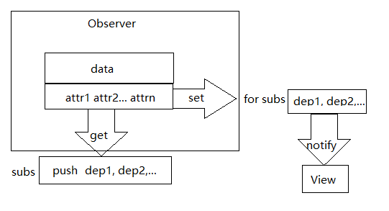
CUSTOMER
Wenhua’s zone
WEB
Chart
Welcome to wuwenhua powerpoint
Study Plan
Share
Good Websites
Video
HOME
ON
Music 00:15—00:22

Slide 10
CUSTOMER
Wenhua’s zone
WEB
question
还是没有真正实现，在初始化的时候就强行塞到订阅器里，然后立即执行视图更新，然而根据实际渲染视图需要从初始模板数据得到数据，怎么解决？
Welcome to wuwenhua powerpoint
Study Plan
Share
Good Websites
Video
HOME
ON
Music 00:15—00:22

Slide 11
CUSTOMER
Wenhua’s zone
WEB
Do it
Watcher（订阅者）-v3
1、setter中push Watcher到subs，完成对订阅者的收集
2、getter中循环执行更新
Welcome to wuwenhua powerpoint
Study Plan
Share
Good Websites
Video
HOME
ON
Music 00:15—00:22

Slide 12
CUSTOMER
Wenhua’s zone
WEB
question
从视图出发的数据，怎么收集或者分离出来？
Welcome to wuwenhua powerpoint
Study Plan
Share
Good Websites
Video
HOME
ON
Music 00:15—00:22

Slide 13
CUSTOMER
Wenhua’s zone
WEB
Do it
Compile（编译器）-v4
1、DOM节点转化成DocumentFragments
2、提取出文本节点跟data属性绑定
Welcome to wuwenhua powerpoint
Study Plan
Share
Good Websites
Video
HOME
ON
Music 00:15—00:22

Slide 14
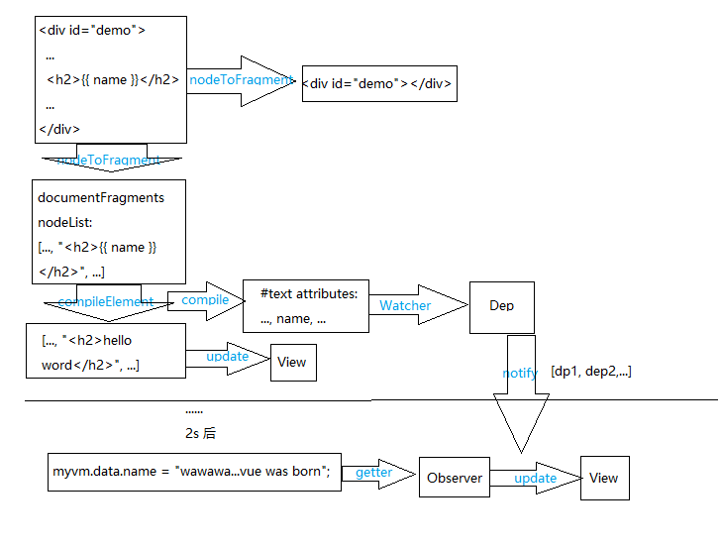
CUSTOMER
Wenhua’s zone
WEB
Chart
Welcome to wuwenhua powerpoint
Study Plan
Share
Good Websites
Video
HOME
ON
Music 00:15—00:22

Slide 15
CUSTOMER
Wenhua’s zone
WEB
question
说好的，我们的双向数据绑定呢？
Welcome to wuwenhua powerpoint
Study Plan
Share
Good Websites
Video
HOME
ON
Music 00:15—00:22

Slide 16
CUSTOMER
Wenhua’s zone
WEB
Do it
v-xxx的实现-v5
1、双向数据绑定v-model:xxx的实现
2、常用的指令v-bind:xxx（:xxx），v-on:xxx（@xxx）的实现
Welcome to wuwenhua powerpoint
Study Plan
Share
Good Websites
Video
HOME
ON
Music 00:15—00:22

Slide 17
CUSTOMER
Wenhua’s zone
WEB
question
1、每次调用vm.data.attribute用获取数据，不免有些麻烦，如何实现直接vm.attribute？
2、目前修改data，只能获取到一层，如何实现修改任意层？
3、我们上面讨论的都是属性的修改，对于属性的增加，又该怎样呢？
Welcome to wuwenhua powerpoint
Study Plan
Share
Good Websites
Video
HOME
ON
Music 00:15—00:22

Slide 18
CUSTOMER
Wenhua’s zone
WEB
Do it
关于三点补充问题-v6
1、Object.defineProperty代理data属性到vue对象上
2、循环读取属性
3、监听属性时，对于数组对象添加_ob_属性，记录当前对象属性变化
Welcome to wuwenhua powerpoint
Study Plan
Share
Good Websites
Video
HOME
ON
Music 00:15—00:22

Slide 19
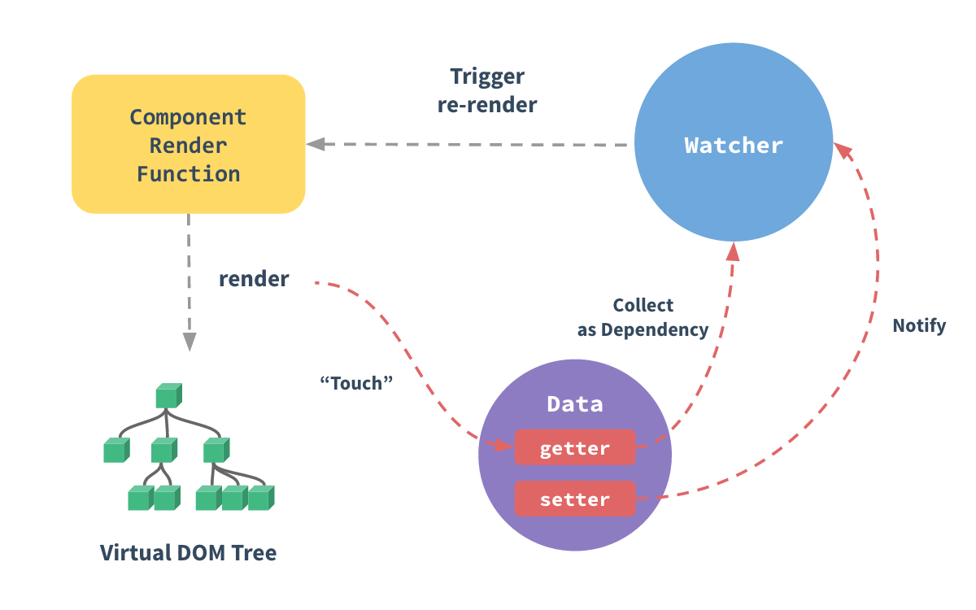
CUSTOMER
Wenhua’s zone
WEB
lookback
再回首，回顾Vue官方+走读源码
Welcome to wuwenhua powerpoint
Study Plan
Share
Good Websites
Video
HOME
ON
Music 00:15—00:22

Slide 20
CUSTOMER
Wenhua’s zone
WEB
Thank You
Thank You
Welcome to wuwenhua powerpoint
Study Plan
Share
Good Websites
Video
HOME
ON
Music 00:15—00:22

