Slide 1
Frontend Engine
Rapid UI & UX Development Framework
Frontend as a Service
Md. Sadhan Sarker
Software Engineer
Analytics & Innovation And Mobile Apps

Slide 2


Contents
Frontend Engine
Why Frontend Engine
Frontend Engine Development
OLM Workflow tool
Discussion about NGES UI Engines
High Level Architecture
Engine Meta Configuration

Slide 3

Frontend Engine
- Rapid UI/UX development and microservice adoptable.
- Base on predefined resource libraries and components - UI/UX easily implementable.
- Purpose of this engine making application lightweight.
- Base on customer need it can easily configurable.
- Through meta configuration fronted development will be rapid.

Slide 4
Frontend Engine Potentiality
- Frontend engine consumes data from different microservices and integrate those information into single view.
- Rapid UI & UX Development by providing resource libraries.
- Making Applications cloud ready, so that microservices look like monolith from externally.
- Easily Configurable Customer features subscription. (Like SaSS).
- Goal to Provide enterprise grade quick start skeleton, like ( Odoo Erp, Salesforce Erp).
- Engine Provide Workflow tools so that business flows can easily configurable. (Ex. Base on Drag and Drop we can define business flow)

Slide 5
Frontend Engine Development
- NGES team maintain central Frontend Framework Skeleton and it’s versioning.
- Individual Team clone framework from central repository. They have guidelines and documentation base on versions.
- Pre Define meta configured into framework. So developer just need to focus on services and features development.
- Individually they can maintain their services and features.
- Framework features will be updated and developer will be benefited and their life will be easier.

Slide 6
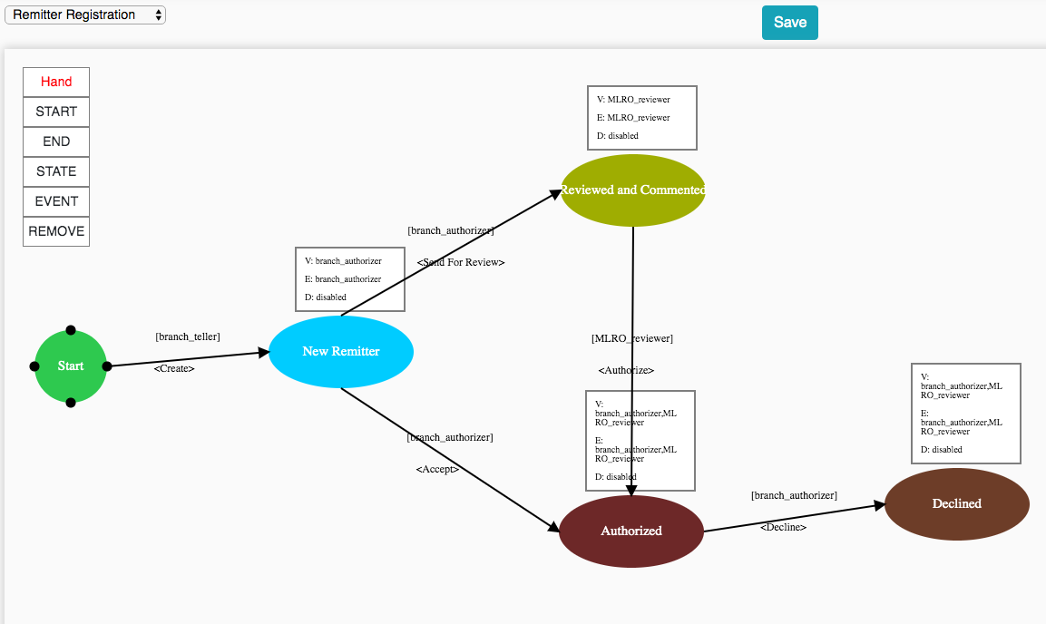
Frontend Engine Workflow tool
- Base on Select OLM Object we can define flow or path for that object.
- Define Object State User accessibility and actions through Role and Event

Slide 7
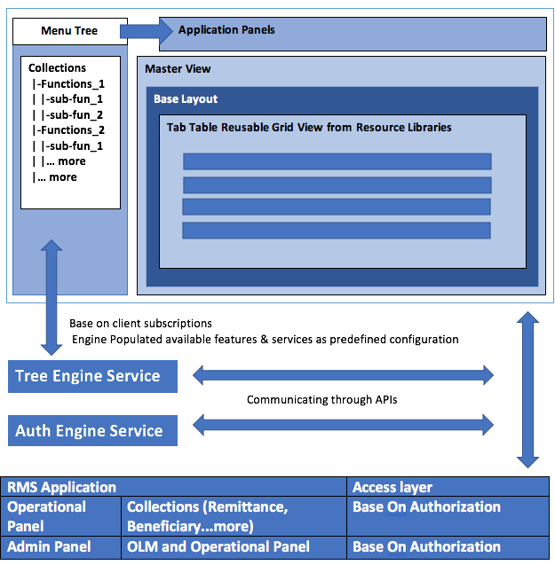
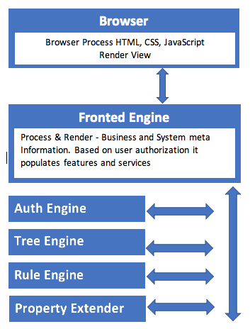
High Level Architecture

Slide 8
Engine Meta Configuration
→ Design Meta
→ Business Meta
Design Meta:
When components were developed their Look and Feel or UI & UX meta information defined into Frontend Engine. Developed components must be isolated so that easily business meta can be consumable.
Notes: Components UI & UX meta will be given as resource libraries.
Business Meta:
For populating components Look and Feel, Interact with Business meta information. Business meta provided by services.
Notes:
- Business meta processed by “Base layout” through consuming service API endpoints then UI will be populated.
- Needs “Base layout” and objects mapping configuration into service, so based on user selection that View can render.

Slide 9
Thanks! Everyone.

