Slide 1
MD. KHALID HASAN HAIDAR
151-35-955

Slide 2
Inheritance
Inheritance can be defined as the process where one class acquires the properties (methods and fields) of another. With the use of inheritance the information is made manageable in a hierarchical order.
The class which inherits the properties of other is known as subclass (derived class, child class) and the class whose properties are inherited is known as superclass (base class, parent class).

Slide 3
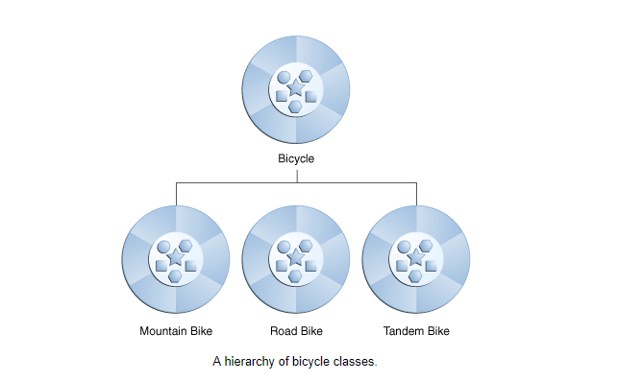

Slide 4
Polymorphism
Polymorphism means to process objects differently based on their data type.
In other words it means, one method with multiple implementation, for a certain class of action. And which implementation to be used is decided at runtime depending upon the situation (i.e., data type of the object)
This can be implemented by designing a generic interface, which provides generic methods for a certain class of action and there can be multiple classes, which provides the implementation of these generic methods.

Slide 5
Example:
A car have a gear transmission system. It has four front gears and one backward gear. When the engine is accelerated then depending upon which gear is engaged different amount power and movement is delivered to the car. The action is same applying gear but based on the type of gear the action behaves differently or you can say that it shows many forms (polymorphism means many forms)

Slide 6
Encapsulation
Binding the data with the code that manipulates it.
It keeps the data and the code safe from external interference

Slide 7
class Box {
public: double getVolume(void) {
return length * breadth * height;
}
private:
double length; // Length of a box
double breadth; // Breadth of a box
double height; // Height of a box
};

Slide 8
The variables length, breadth, and height are private. This means that they can be accessed only by other members of the Box class, and not by any other part of your program. This is one way encapsulation is achieved.

Slide 9
Abstraction
Abstraction refers to the act of focusing on important details or characteristics and filtering out the unwanted details or explanations.

