Slide 1
collaborative robot to help old and disabled people
By : Ch.Hemesh 8th grade

Slide 2



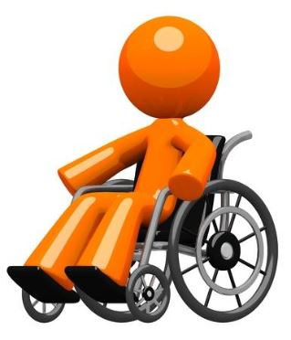
Problem :-
Old and Disabled people need assistance to complete their daily tasks and for moving. They even forget taking the right medicines at the right time.
I have realized the problem when my Grandmother was sick for almost 6 months. She needed assistance for moving and taking the right medicines.
Hiring a caretaker was too costly for 24/7 or he/she may not be available in a particular area.

Slide 3
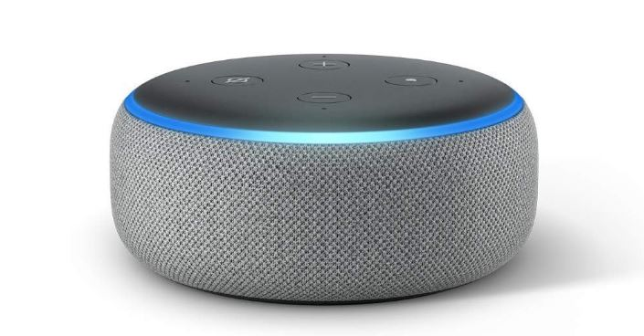
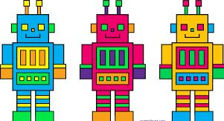
Solution:
So I created a prototype of an Amazon echo assisted collaborative robot wheelchair to help old and disabled people.
So this robot as the name suggests has Amazon Alexa functionality which can be a companion for the person.
We can even turn on and off lights and fans with our voice commands.
This robot has a line following robot capability so that the robot can come to various rooms of the house with the lines drawn around the house with our voice command.
This robot has arms so it can hold or push any object just like a human.

Slide 4
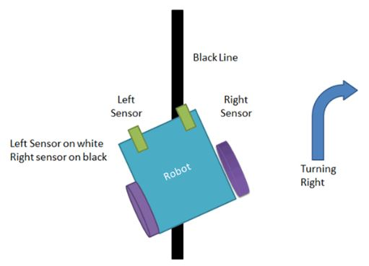
Solution :-
This robot has also alarms and detectors like a fire alarm, smoke alarm and motion detectors.
This has also a smart pillbox. So this is a pillbox, it will alarm us at the right time to take a particular medicine.
There is also a digital stethoscope to check the person’s heart rate.
There are also automatic fans and lights which turn on only if it is hot and dark respectively.

Slide 5

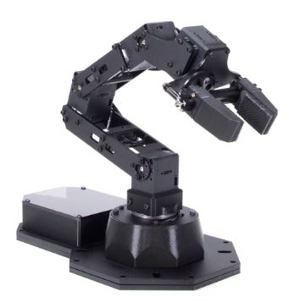
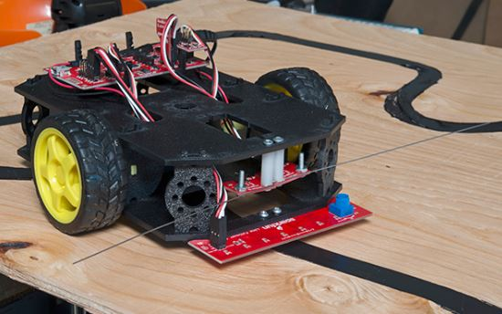
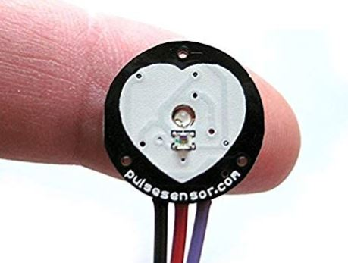
Functionality of the robot :-
Amazon Alexa Functionality
Automatic Lights
Line follower
Smoke detectors
Smart Pillbox
Fire alarm
Motion detector
Phone Charger
Digital Stethoscope
Robotic Arm
Automatic Fan

