Slide 1
Unified Mentor Internship
Animal Object Detection
&
Vehicle Price Prediction
BY:
Hemesh M
III year B.Tech AI & DS

Slide 2
What is AI Engineering?
Builds smart systems using Machine Learning (ML) Mix of coding, data, and model building Focus on solving real-world problems Works with ML lifecycle: data → model → deploy

Slide 3
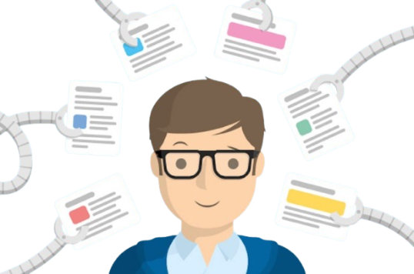
what is Machine learning?
A part of AI that learns from data Makes predictions without being explicitly programmed
Used in: recommendations, fraud detection, self-driving cars

Slide 4
About the Project
Animal object detection
Wildlife Monitoring
Cameras in forests detect and classify animals (e.g., using YOLO, SSD models). Helps in studying animal behavior and preventing poaching

Slide 5
Autonomous Vehicles
Autonomous Vehicles Detec ts stray animals on the road to prevent accidents.
Zoo and Conservation Tech
Tracks
efforts.
endangered
species
for
conservation

Slide 6
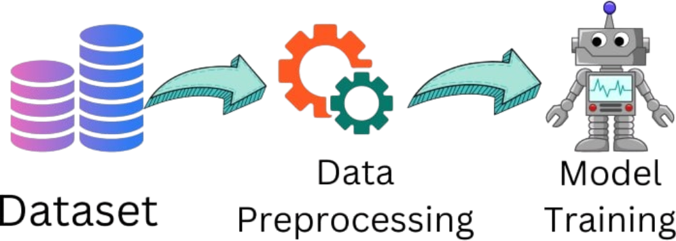
ML Project steps
Data Collection
Data Preprocessing
Model Training
Get car data from CSV or website
Cleandata Convertcategoriesto numbers Normalize values
UseMLalgorithms(e.g., Linear
Regression) Fit model to data Check accuracy using test data Predict prices of new vehicles

Slide 7




Tools Used
Pandas, NumPy
for data manipulation
Scikit-learn
Python
ML models
main language
Matplotlib, Seaborn
object detection
for graphs
yolov8 model
for code

Slide 8
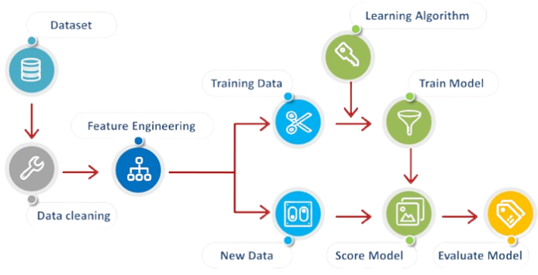
Role of AI Engineer in This Project

Slide 9

Career in AI Engineering
Job Roles: AI Engineer, ML Developer, Data Scientist Skills: Python, ML libraries, problem-solving Growing demand in tech, automotive, healthcare

Slide 10
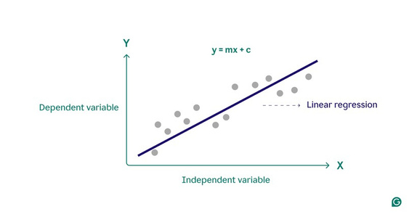
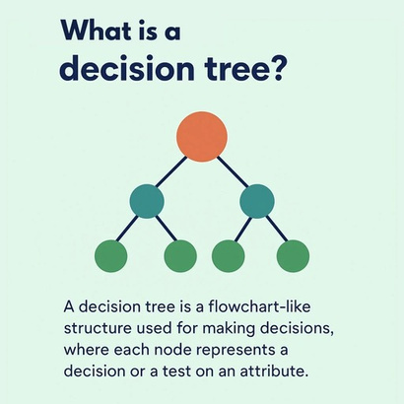
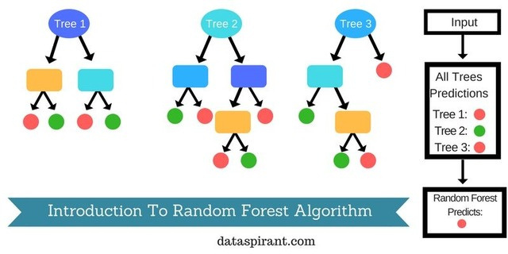
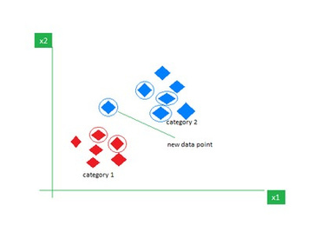
Common ML Algorithms
Linear Regression
for predicting continuous values (like car prices)
Decision Trees
KNN (K-Nearest Neighbors)
uses similaritybetween data points
Random Forest
easy to interpret,works
combination of trees for
well for classification
better accuracy

Slide 11
Challenges in Projects
Insufficient or poor-quality data Overfitting / Underfitting Model explainability (black box models) Deployment & scaling issues

Slide 12
Real-World Applications
Healthcare – disease prediction, drug discovery Finance – fraud detection, credit scoring Retail – product recommendations, inventory forecasting Automotive – self-driving, predictive maintenance

Slide 13
Thank you

