Slide 1

Sentiment Analysis for Social Media
In the digital age, social media platforms generate vast amounts of unstructured text data in real time. Sentiment analysis provides a way to understand and interpret user emotions and public sentiment from this data. This project focuses on building a comprehensive sentiment analysis system that analyzes user-uploaded documents, social media chats, and web pages in real time.

Slide 2
Understanding Sentiment Analysis
The Importance of Sentiment Analysis
What is Sentiment Analysis?
The exponential growth of social media and online communication has resulted in vast amounts of text data, reflecting public opinion, emotions, and attitudes. Understanding this data is crucial for businesses, policymakers, and individuals to gain insights into user behavior and market trends.
Sentiment analysis is the process of analyzing text data to determine whether it reflects positive, negative, or neutral sentiments. It has gained prominence in natural language processing (NLP) for its ability to extract valuable insights from unstructured text.

Slide 3
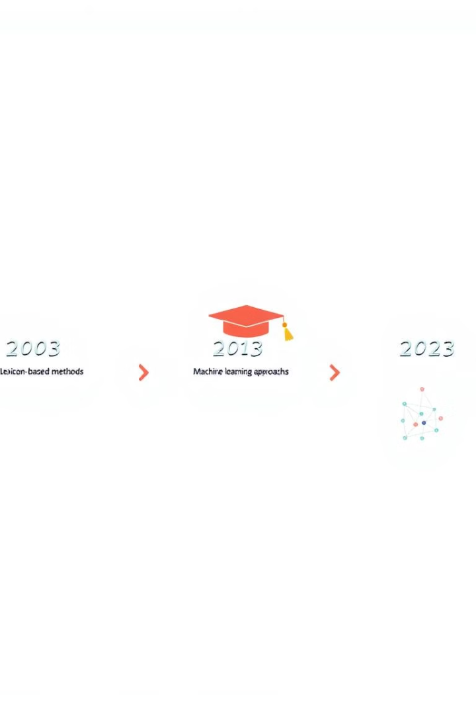
Evolution of Sentiment Analysis Techniques
1
Lexicon-Based Methods
Early approaches utilized predefined sentiment dictionaries like VADER and Text Blob to classify text. These methods often failed to capture complex emotions and required extensive manual effort.
2
Machine Learning Models
Models like Naive Bayes and Support Vector Machines (SVM) offered more scalable solutions, improving accuracy over lexicon-based methods.
3
Deep Learning Approaches
Using Recurrent Neural Networks (RNN) and Long Short-Term Memory (LSTM) models further improved accuracy in sentiment analysis.
4
Transformers like BERT and GPT
BERT's contextual embeddings enable it to understand the meaning of words in context, significantly improving sentiment classification and emotion detection.

Slide 4

Challenges in Sentiment Analysis
Diversity in Language
Unstructured Data
Social media texts contain slang, abbreviations, emojis, and informal language, which traditional models struggle to interpret accurately.
Text data is often noisy and requires significant preprocessing to remove irrelevant information and prepare it for analysis.
Real-Time Analysis Needs
Existing systems do not effectively analyze sentiment in real time, particularly from dynamic sources like web pages that are constantly changing.

Slide 5

Objectives of the Sentiment Analysis System
1
Real-Time Sentiment Analysis
Perform real-time sentiment analysis on social media data, documents, and web content to provide immediate insights.
2
Emotion Identification
Identify and visualize emotions in the text, such as joy, sadness, and anger, to understand the emotional context.
3
Multi-Format Support
Develop a system that supports multi-format inputs, including social media chat files, documents, and web scraping data.
4
Visual Insights
Provide visual insights through charts, graphs, and word clouds to make sentiment analysis results more accessible and understandable.

Slide 6
Sentiment Analysis Techniques
Naive Bayes for Sentiment Classification
BERT for Emotion Detection
The Naive Bayes algorithm is used for initial sentiment classification, leveraging the assumption that words in a document are independent. It calculates the probability of a document being classified as positive or negative.
BERT (Bidirectional Encoder Representations from Transformers) captures contextual information by reading text bidirectionally. Fine-tuned BERT models are used to detect complex emotions like joy, anger, sadness, etc.

Slide 7
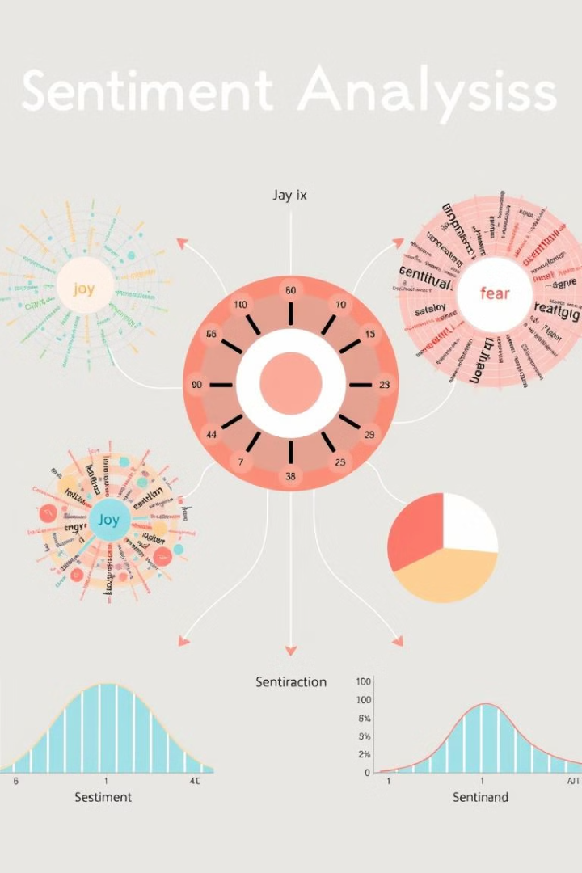



Visualization and Insights
Word Cloud
Highlights the most frequent words used in the text, providing insights into topics of interest and common themes.
Sentiment Distribution Graph
Displays the proportion of positive, negative, and neutral sentiments, giving an overview of the overall sentiment.
Emotion Radar Chart
Depicts the strength of various emotions detected in the text, providing a detailed emotional profile.

Slide 8
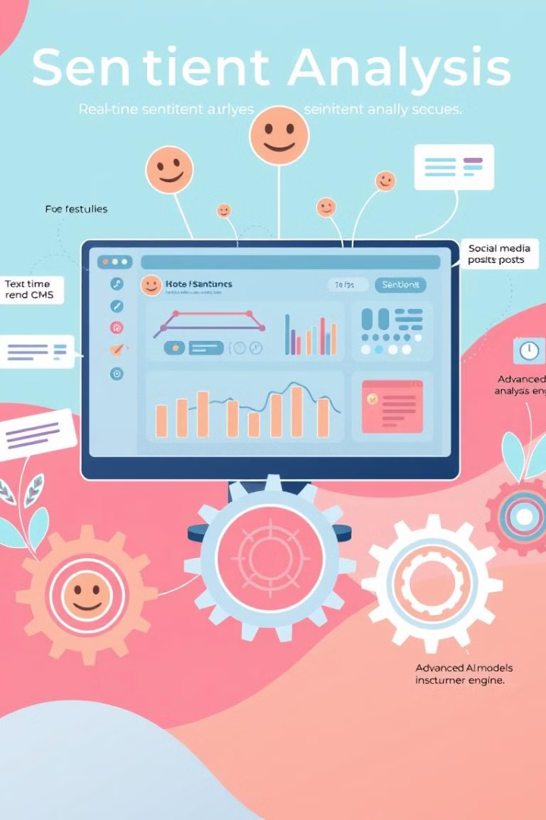
Advantages of the System
Multi-format Support
The system can handle social media chats, documents, and web pages, providing comprehensive analysis across different sources.
Real-time Sentiment Analysis
Web scraping allows real-time sentiment tracking on dynamic content, providing up-to-date insights.
Advanced Models
BERT's contextual understanding enhances the accuracy of emotion detection, capturing nuanced emotional expressions.
User-Friendly Visualization
Visual insights (charts, word clouds) make complex data easier to understand, facilitating informed decision-making.

Slide 9
Conclusion and Future Work
This project successfully develops an advanced system for sentiment and emotion analysis of text data across multiple formats. By utilizing machine learning algorithms like Naive Bayes and transformer models like BERT, the system provides accurate and real-time sentiment analysis. The integration of real-time web scraping and interactive visualizations ensures the system's practicality for a wide range of applications in social media analysis, document analysis, and web sentiment tracking.
Future developments could include the incorporation of more advanced deep learning models, support for multiple languages and dialects, and greater integration with other platforms for even more comprehensive social media analytics. Additionally, efforts could be made to improve the system's ability to interpret images, videos, and other multimedia content, which are often a large part of social media communication.

