Slide 1
STUDENT NAME: HEMANATHAN R
REGISTER NO AND NMID:
DEPARTMENT: BCA
COLLEGE: COLLEGE/ UN

Slide 2
PROJECT TITLE
Digital Portfolio

Slide 3


AGENDA
Problem Statement
Project Overview
End Users
Tools and Technologies
Portfolio design and Layout
Features and Functionality
Results and Screenshots
Conclusion
Github Link
3/21/2024 Annual Review

Slide 4

PROBLEM STATEMENT
Need for a personal digital portfolio to showcase skills and projects.
Traditional resumes are static and less interactive.
A web-based portfolio gives better visibility and professional presentation.

Slide 5

PROJECT OVERVIEW
Designed and developed a digital portfolio website.
Built using HTML, CSS, and JavaScript.
Showcases About Me, Skills, Projects, and Contact Information.

Slide 6

WHO ARE THE END USERS?
Recruiters and Employers
Teachers and College Mentors
Peers and Developers
Anyone interested in my work

Slide 7

TOOLS AND TECHNIQUES
HTML – Structure of the website
CSS – Styling and layout design
JavaScript – Interactivity and animations
GitHub – Code hosting and project sharing

Slide 8
POTFOLIO DESIGN AND LAYOUT
Dark Theme with neon green accents
Header Section with name and tagline
Sections: About, Skills, Projects, Contact
Contact Form for direct communication
‹#›

Slide 9
FEATURES AND FUNCTIONALITY
Smooth scroll and responsive design
Animated skill progress bars
Interactive project cards with hover effects
Contact form with validation
GitHub link for project access

Slide 10
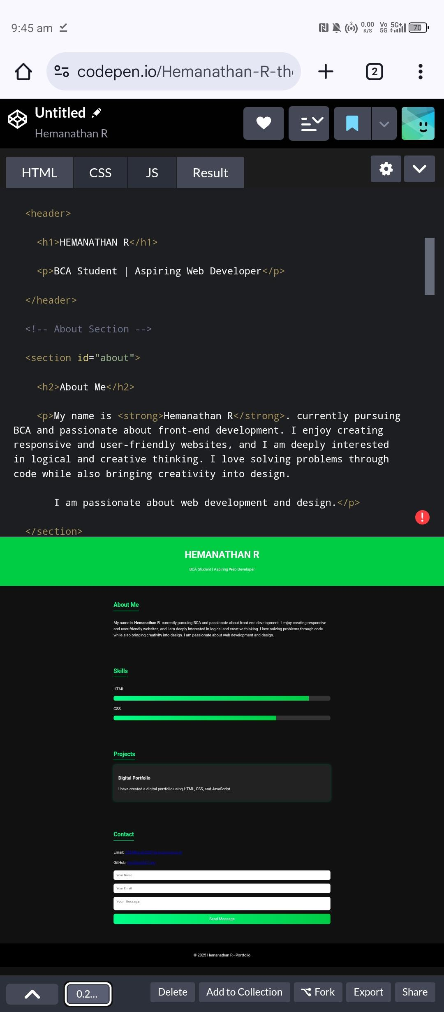

RESULTS AND SCREENSHOTS
3/21/2024 Annual Review
‹#›

Slide 11
CONCLUSION
Built a professional portfolio from scratch.
Improved web development skills in HTML, CSS, and JS.
Portfolio serves as a personal brand identity.
‹#›

