Slide 1


Understanding of high school students grades from socio-economic factors
The Eliminators
Batch: RBA2 2021-23
Group Members:
Hemil Desai – 85
Rounak Ghosh -101
G Abhishek - 79
Hardik Khimani - 83
Dipanwita Bishnu - 78
Problem Statement:
To study the performance of students pursuing mathematics and Portuguese language course on various socio-economic factors such as gender, age, location or address, alcohol consumption, failures, study time hours, internet connectivity, etc.

Slide 2
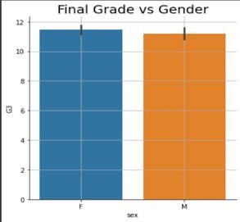
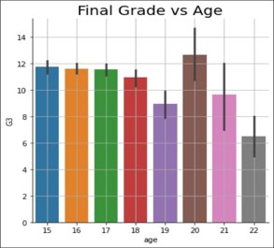
Storyline and Insights:
Gender
The graph illustrates the patterns of student's grades based on the gender. Overall, both male and female students are performing good but female students are doing little better.
Age
The graph illustrates the patterns of student's grades based on their age. From this we can say that students whose age is 20 are performing better compared to others.
Insight: Usually, increase in age is impacting the grade of the student maybe because of increasing responsibilities, etc.

Slide 3
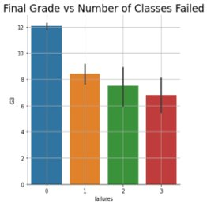
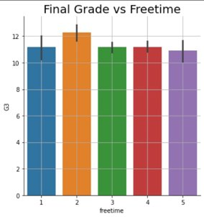
Number of times failed
The graph illustrates the patterns of student's grades based on the number of times they failed. From the graph we can say that Students who never failed in any class scored higher than other.
Insight: Increase in number of failures is impacting the grades of the students.
Free-time
The graph illustrates the patterns of student's grades based on the free time they get after school. From this we can say that students those have less amount free time are performing better compared to others.
Insight: There is hardly any significant impact of free time on the grades of students.

Slide 4
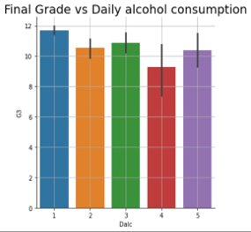
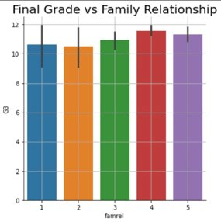
Daily Alcohol Consumption Rate
The graph illustrates the patterns of student's grades based on their daily alcohol consumption rate. We can say that students whose alcohol consumption rate is very low grades are high.
Insight: Increase in alcohol consumption is impacting the grades of the students.
Family Relationship
The graph illustrates the patterns of student's grades based on the family relationship. The graph represents that healthy family relation effect the student’s grades positively.
Insight: Healthy relationship leads to improve the grades of the students.

Slide 5
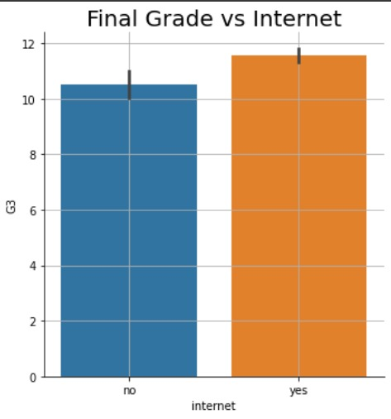
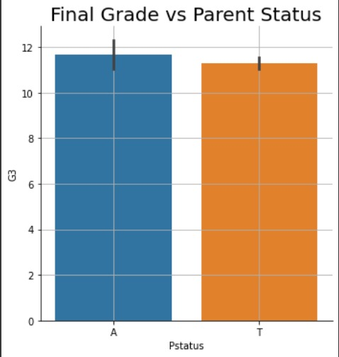
Internet Connection
The graph illustrates the patterns of student's grades based on they have internet connection or not. If students have internet access at their house, then they are performing better.
Insight: Internet connectivity tends to improve the grades of the student.
Parent’s cohabitation Status
The graph illustrates the patterns of student's grades based on the parent's cohabitation status. If parents are separated students are performing better with a small margin compared to those whose parents are living together.
Insight: Parent’s cohabitation status has little impact on the grades of the students.

Slide 6
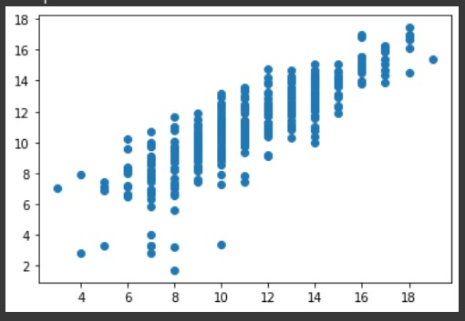
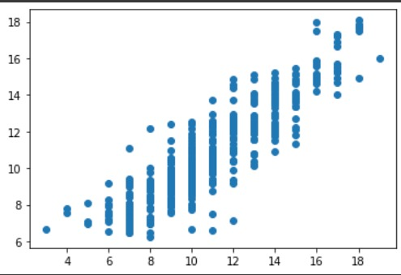
Linear Regression Model
R² = 0.7929 which mean 79.29% of variation (change in Student grades) is explained by the independent variables .
MAE : 1.053
MSE : 3.133
Random Forest Regression Model
R² = 0.8283 which mean 82.83% of variation (change in Student grades) is explained by the independent variables .
MAE : 0.959
MSE : 2.597
Conclusion: Though both models are looking perfect but Random Forest Regression model appears to be a better than Linear Regression Model.

Slide 7




Thank You

