Slide 1
Text mining and analytics from unstructured data for investment management firms
Dissertation and Seminar
Masters of Technology in Data science (School of Technology),
Pandit Deendayal Energy University
Industry Name : DiligenceVault
Project Review
Dr. Hiren Thakkar(Assistant Professor)
School of Technology
Pandit Deendayal Energy University
Hemil Parmar(21MDS004)
M.Tech Data Science
Pandit Deendayal Energy University
Nitin Khosla
CTO
DiligenceVault

Slide 2
contents
Abstract
Introduction
Literature Review
Motivation & Objective
Work Methodology
Future Scope
References

Slide 3
abstract
All asset management firms are required to submit fund brochures to SEC(US govt regulatory body). Using technology, we are trying to determine material changes in every brochure as submitted by respective firms. Clients/Legal counsels are interested to know any material changes to evaluate risks and compliance purposes. With the help of some NLP techniques like sentiment analysis, we classify the firm has made any changes or not. Based on that data we will also implement the text summarization technique based on that our model will give the summary of text.

Slide 4
introduction
Investment management refers to the handling of financial assets and other investments—not only buying and selling them.
Management includes devising a short- or long-term strategy for acquiring and disposing of portfolio holdings.
It can also include banking, budgeting, and tax services and duties, as well.
Investment management firms handling over $25 million in assets must register with the SEC and accept fiduciary responsibility toward clients.

Slide 5
Literature review
No | Authors | Title | Methods | Year
[1] | Twinkle Svadas1, Jasmin Jha2 | Document Cluster Mining on Text Documents | Tokenization, Text Clustering, Ontology | 2015
[2] | K. Anusha1 and A. Murugan2 | Stock Market Risk Assessment Using Data Mining Techniques | Beta, Sharpe Ration, Treynor Ratio, Jensen’s Alpha, Naive byes Algorithm | 2020

Slide 6
Continue..
No | Authors | Title | Methods | Year
[3] | G Ravi Kumar, S Rahamat Basha, Surya Bhupal Rao | A Summarization on Text Mining Techniques For Information Extracting From Applications and Issues | Text Clustering, Natural Language Processing and Name Entity Recognition, Information Extraction | 2020
[4] | Ramzan Talib, Muhammad Kashif Hanif, Shaeela Ayesha, and Fakeeha Fatima | Text Mining: Techniques, Applications and Issues | NLP and Text Clustering | 2016

Slide 7
motivation
We know that if we want to do investment in anything first thing come in out mind is risk.
Is it risky to invest in this company ? Is it worth it? Will I get profit or loss?

Slide 8
objective
Our objective to provide the solution of investment that can tell us should we invest in particular firm or not?
To get the summary of changes made by particular investment management firm.

Slide 9
Work Methodology
Data Gathering
Document Clustering
Text Mining
Sentiment Analysis
Text Summarization

Slide 10
Data gathering
We have collected data from US Government Website called Investment Advisor Public Disclosure. Link
Common sections (features) present in Document:
Material Changes (desired section)
Advisory Business
Performance Based Fees and Side By Side Management
Type of Clients
Methods of Analysis
Review of Accounts
Investment Discretion
Financial Information

Slide 11
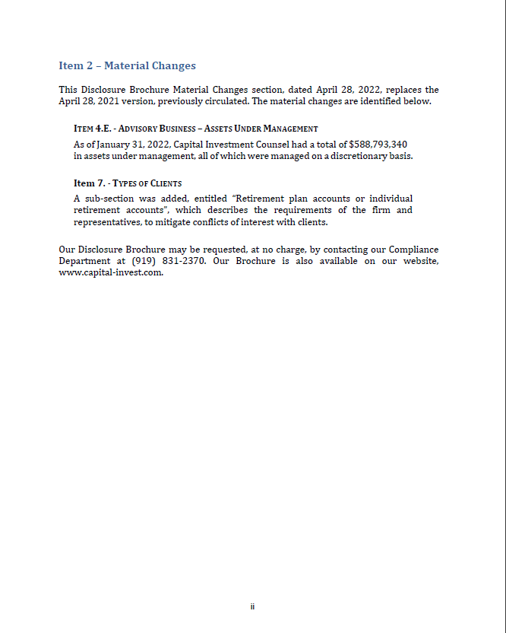
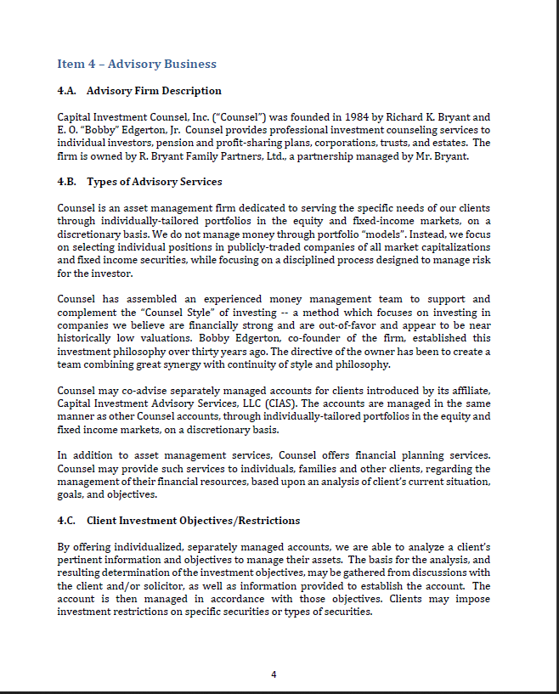
document

Slide 12
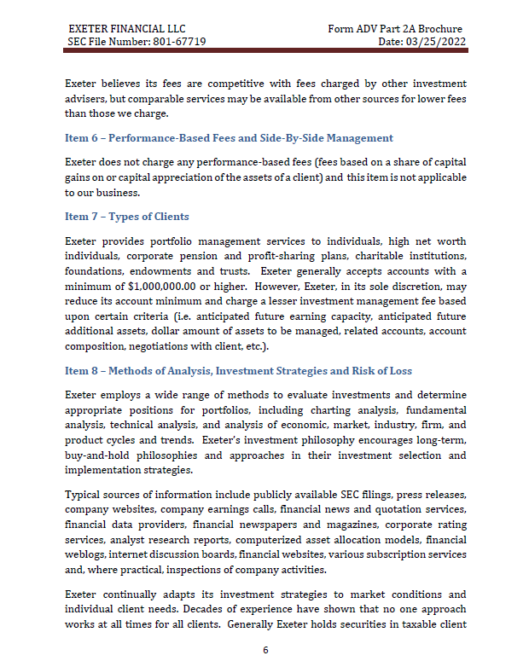
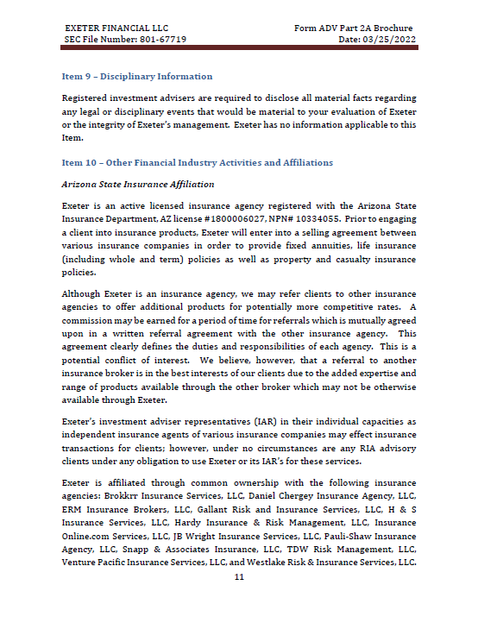

Slide 13
Document clustering
All the documents have different pattern so we need grouping of documents.
Based on that grouping we can analyze the document and mine the desired text.
We have applied the K-Means clustering to random 100 Documents
We get the 3 optimal Clusters.

Slide 14
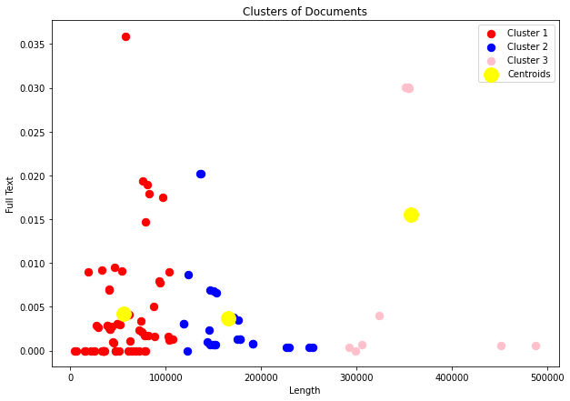
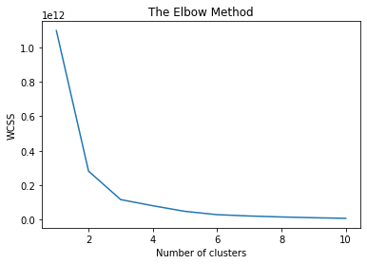

Slide 15
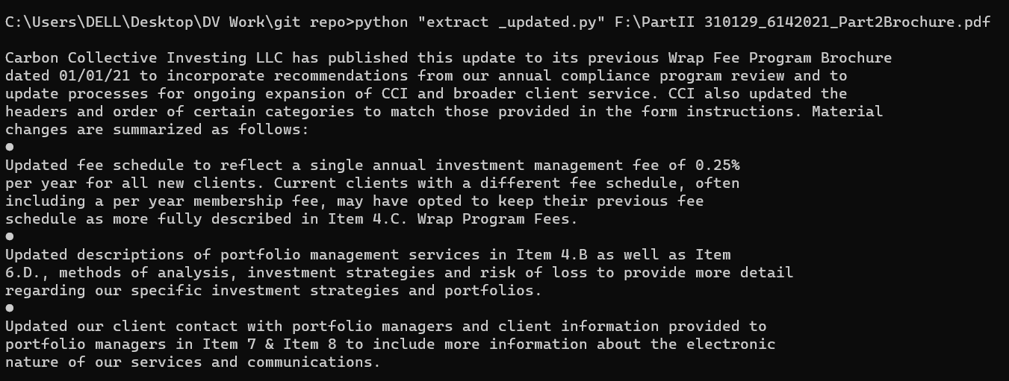
Text mining
We have parsed all the documents to get the desired data from the documents for further analysis. In below example one document is parsed and applied the process to get the desired data.

Slide 16
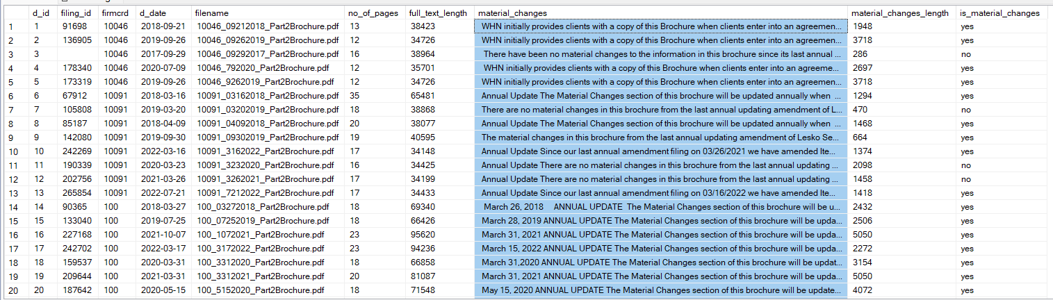
We have run the process of mining through all the documents and stored in the database.

Slide 17
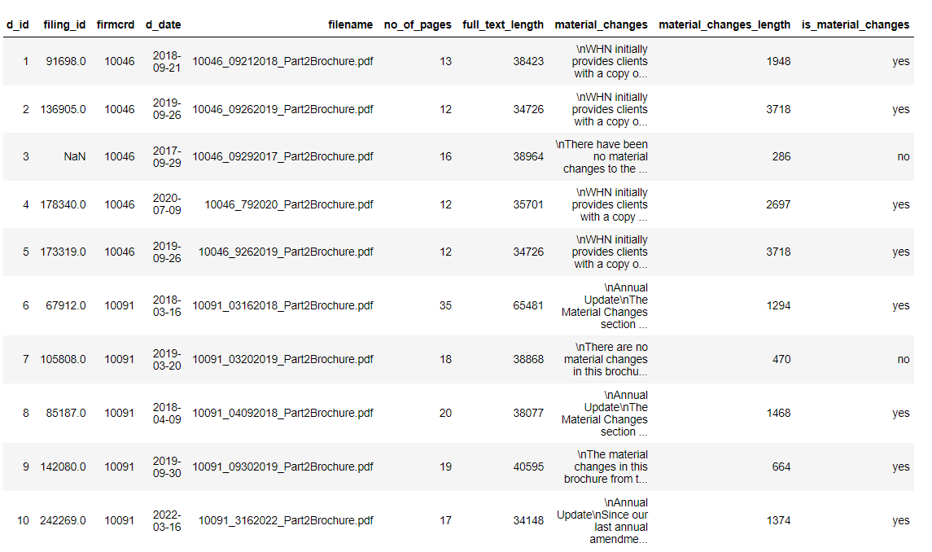
We have converted the that sql database table into .csv format for further analysis.

Slide 18
Statistics
We have applied some statistics technique to verify whether data are extracted correctly or not. We checked the length of extracted data and full document.
Average Full text Length: 67124.54498840618
Maximum Full text Length: 1010098
Median Full text Length: 54832.0
Average Material Changes Length: 840.8424727654548
Maximum Material Changes Length: 163490.0
Median Material Changes Length: 596.0

Slide 19
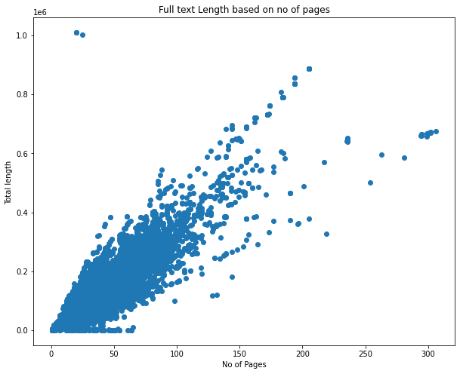
Full document length based on no of pages.

Slide 20
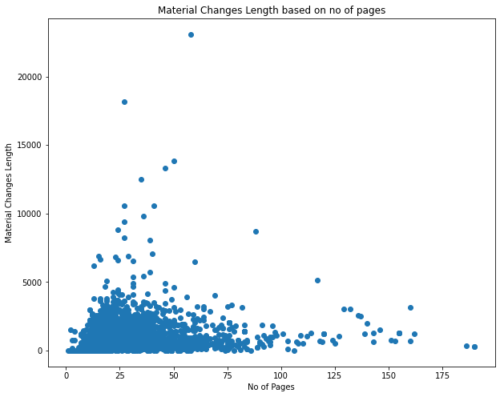
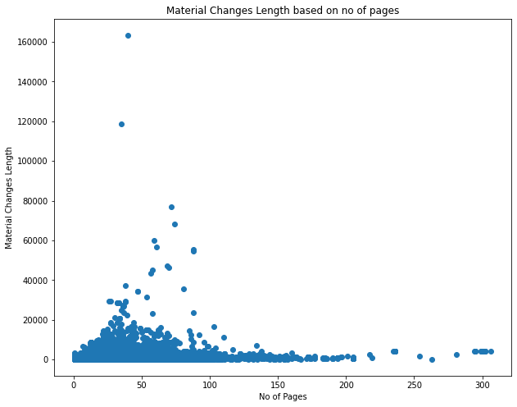
Manually checked data (5000 docs)
1,14,285 docs

Slide 21
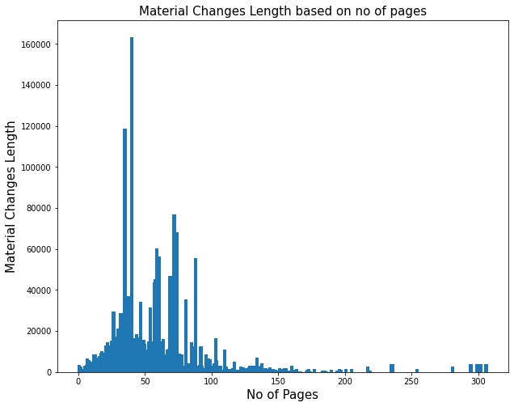

Slide 22
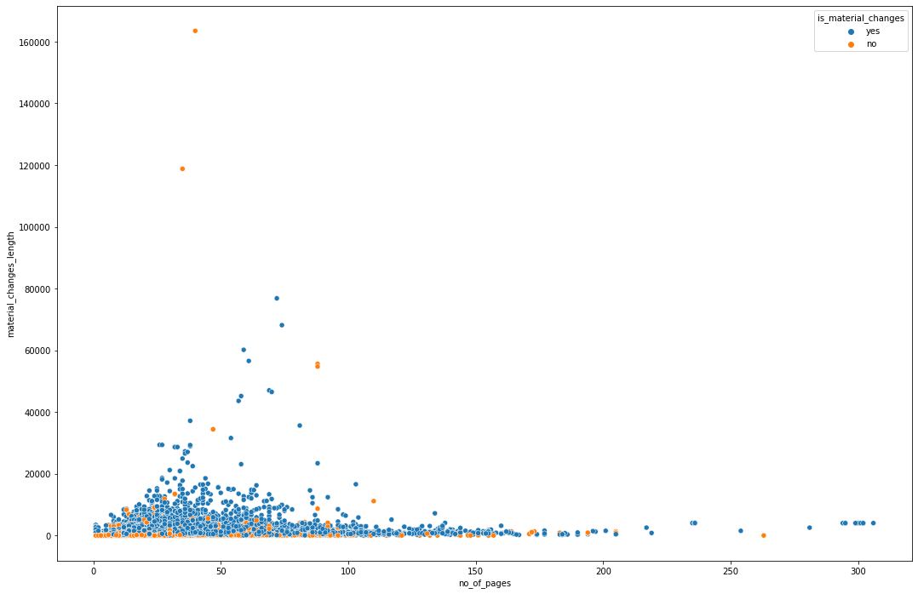

Slide 23
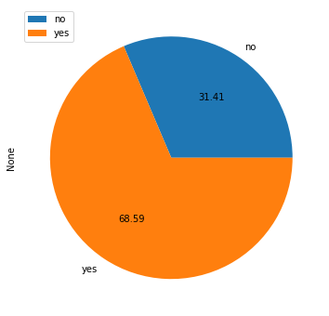
As we can see in pie chart, 68.59% firms have made the changes in their frim in last past years and 31.41% have made not.
Based on this data we have predict which firm has made the changes.

Slide 24
Sentiment Analysis (is_material_changes)
In above pie chart we have to find the changes in mined data that is there any change made by firm in last year or not. This will be binary classification.
Dataset Shape : (5000, 10)
Train-Test data split ratio : 20%
Train Data : 4000
Test Data : 1000

Slide 25
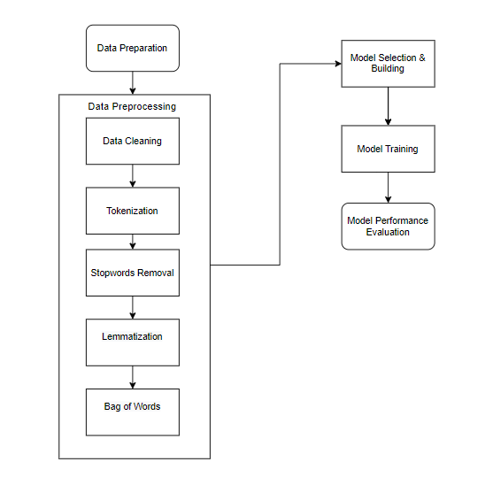
Work flow

Slide 26
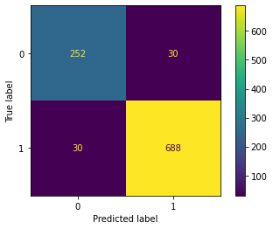
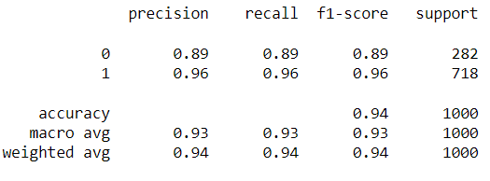
Results
1. Logistic Regression
Confusion Matrix | Classification Report

Slide 27
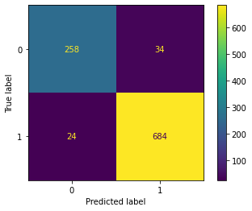
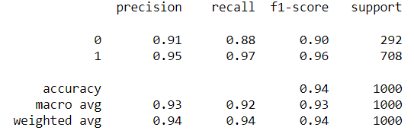
Cont..
2. Decision Tree
Confusion Matrix | Classification Report

Slide 28
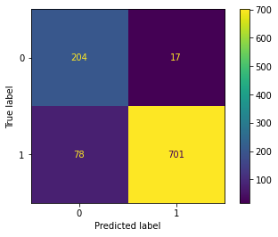
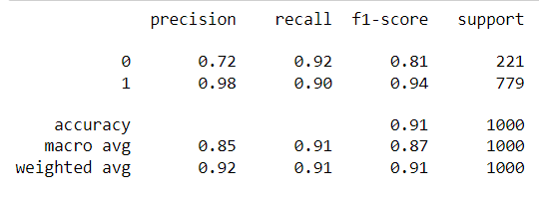
Cont..
3. Random Forest
Confusion Matrix | Classification Report

Slide 29
Future scope
Collect the data of different parameters/attributes/feature/section.
Get the insights of data.
Will be implemented the text summarization model to get summary of text.
Implement the UI to show the summary of text data.

Slide 30
references
Twinkle Svadas1, Jasmin Jha2: Document Cluster Mining on Text Documents, Computer Engineering, L.J.I.E.T, India, 2015. https://www.ijcsmc.com/docs/papers/June2015/V4I6201599a49.pdf
K. Anusha1 and A. Murugan2 : Stock Market Risk Assessment Using Data Mining Techniques, J H A Agarsen College, Madhavaram, Dr. Ambedkar Government Arts College (Autonomous), Chennai, India, 2020. https://www.researchgate.net/publication/343229583_Stock_Market_Risk_Assessment_Using_Data_Mining_Techniques
G Ravi Kumar, S Rahamat Basha, ,Surya Bhupal Rao : A Summarization on Text Mining Techniques For Information Extracting From Applications and Issues, Department of Computer Science, Rayalaseema University, Kurnool, Andhra Pradesh, India Department of CSE,RGMCET, Kurnool, Andhra Pradesh India, 2020. https://www.researchgate.net/publication/342145532_A_SUMMARIZATION_ON_TEXT_MINING_TECHNIQUES_FOR_INFORMATION_EXTRACTING_FROM_APPLICATIONS_AND_ISSUES
Ramzan Talib, Muhammad Kashif Hanif, Shaeela Ayesha, and Fakeeha Fatima : Text Mining: Techniques, Applications and Issues, Department of Computer Science, Government College University, Faisalabad, Pakistan, 2016. https://thesai.org/Downloads/Volume7No11/Paper_53Text_Mining_Techniques_Applications_and_Issues.pdf

Slide 31
Thank you

