Slide 1

Multi-dimensional Parallel Training Systems for Big AI Models
Speaker: Dr. Heming Cui
Associate Professor, Dept of Computer Science,
the University of Hong Kong (HKU)

Slide 2
My Students and Papers Written by Them
HKU prof. since 2015, independently built a parallel & distributed systems research group
Now I directly supervise about 20 ongoing PhD students and 10 ongoing Mphil students in HKU
Distributed consensus & transactional systems, and VM systems
[Crane SOSP '15], [Apus SOCC '17], [Plover NSDI '18], [vMigrator ATC '18], [Fulva SRDS '19], [vSMT-IO ATC '20], [Eges Performance '21], [Dast EuroSys '21], [Bidl SOSP '21]
Parallel AI training/serving systems
[Hams DSN '20], [Vpipe TPDS '21], [Naspipe ASPLOS '22] (accepted)
TEE-powered secure distributed big-data computing systems → secure OS (future plan)
[kakute ACSAC '17] (best paper award), [Upa DSN '20], [Uranus AsiaCCS '20], [Daenet TDSC '21]
Uranus: core of Huawei’s Trusted&Intelligent Cloud Services (huaweicloud.com/product/tics.html)
Testing systems & software quality
[Owl DSN '20], [Program smoothing fuzzing, ICSE '22] (accepted), [HavocDMA ICSE '22] (accepted)
Wireless & distributed robotic operating systems → distributed robotic OS (future plan)
[Colored TDMA, MASS '20], [Muti-view robots, ICPADS '21], [Coorp IEEE IOT Journal '22] (accepted)

Slide 3
Trends of Machine Learning (ML) models
Large models succeed in tasks including NLP, Computer Vision, …
Transformer based: BERT, Vision Transformer, GPT-2, GPT-3
Huge mount of parameters => training exceeds a single GPU's capacity
GPT-3 175 billion parameters
CPM-Large 10+ billion parameters
GPT-2 workaround for Chinese
Complex architectures => expedites Exploratory and Dynamic training
E.g., Neural Architecture Search (NAS) => Evolved Transformer
DNN Architectures vary in minute level
Bring challenges to existing parallel training systems

Slide 4
Revisit DNN Training
Batch-based and Iterative data processing:
Forward Pass: compute loss and produces activations
Backward Pass: back-propagate loss, produces gradient and consumes activations
Optimizer Step: update parameters according to history and produced gradient
GPU memory consumption
Model Parameters (increase with model size)
Scratch space for computation (Transient usage, released immediately)
Activations (up to 70-80%, increase with batch size)

Slide 5
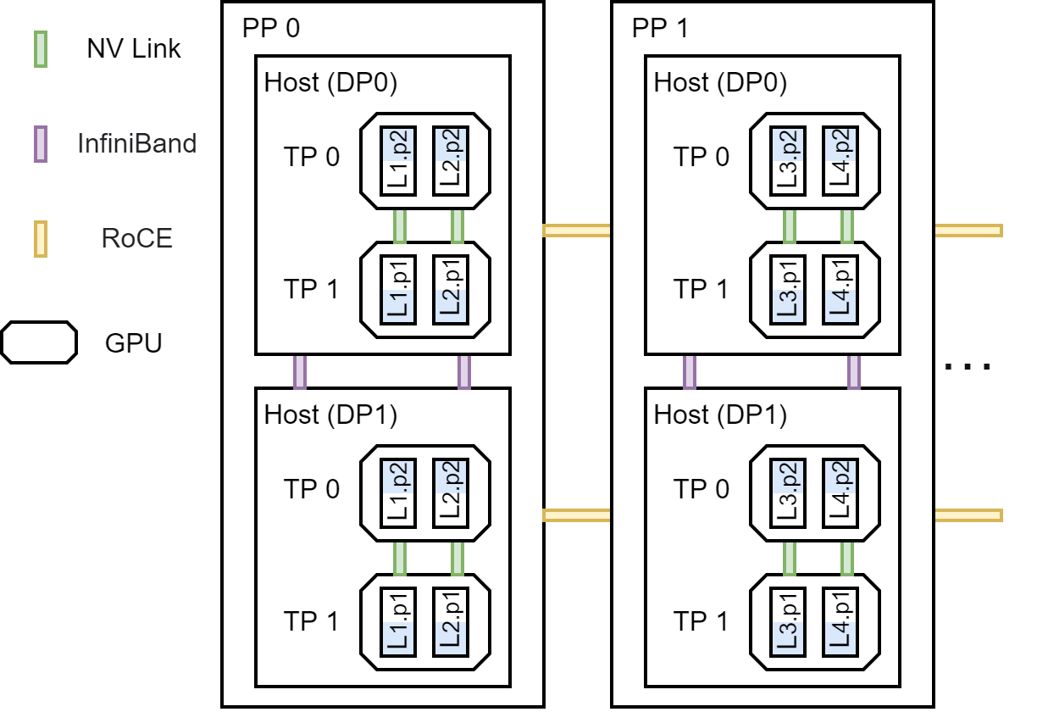
3D Parallelism Training [a term invented by Stanford, Matei Zaharia’s group]
Data parallelism
Replicate model across GPUs, all-reduce gradients
Major bottleneck: large communication volume (2 x parameter size)
Tensor model parallelism
Usually applied when a single layer cannot fit in a single GPU, split a layer across GPUs
Major bottleneck: large communication volume (sync of activations)
Pipeline model parallelism (backbone of all parallel training systems)
Accelerate training with more GPUs
Support larger DNNs that cannot be trained by a single GPU
 | PipeDream [SOSP '19] | Gpipe [NIPS '19] | DAPPLE [SC '21] | DeepSpeed 3D [SC '20] | DeepSpeed ZERO3 [SC '20] | Megatron-LM [SC '21] | Vpipe [TPDS '21] | NASPipe [ASPLOS '22]
DP | ✓ | ✓ | ✓ | ✓ | ✓ | ✓ | ✓ | ✓
TP | ✕ | ✕ | ✕ | ✓ | ✕ | ✓ | ✓ | ✓
PP | ✓ | ✓ | ✓ | ✓ | ✓ | ✓ | ✓ | ✓

Slide 6



vPipe: A Virtualized Acceleration System for Achieving Efficient and Scalable Pipeline Parallel DNN Training (IEEE TPDS 21)
Shixiong Zhao, Fanxin Li, Xusheng Chen, Xiuxian Guan, Jianyu Jiang, Dong Huang, Yuhao Qing, Sen Wang, Peng Wang, Gong Zhang, Cheng Li, Ping Luo, Heming Cui
The University of Hong Kong
Huawei Technologies
University of Science and Technology of China

Slide 7
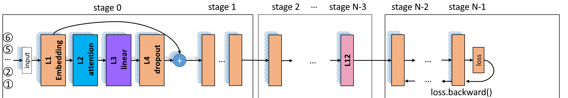
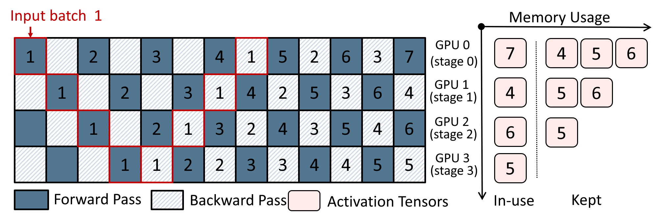
Pipeline Parallelism
Split a model's layer across GPUs, and inject multiple data batch to form a pipeline
GPU 0
GPU 1
GPU 2
GPU N-3
GPU N-2
GPU N-1
Host 0
Host 1
…
GPU 0
GPU 1
GPU 2
GPU 3

Slide 8
VPipe: our Pipeline Parallel Training System
Virtualized distributed CPU-GPU memory management layer
Achieved cutting-edge training throughput on big models (e.g., BERT)
2x throughput v.s. Pipedream (Microsoft, SOSP '19)
1.3x throughput v.s. GPipe (Google, NeurIPS ‘19)
1.2x throughput v.s. Megatron-LM & DeepSpeed on CPM2
Support extremely dynamic training processes (e.g., Evolved Transformer)
4x throughput compared with Pipedream and GPipe

Slide 9
Challenges for Pipeline Parallelism
Challenge 1: Imbalanced Memory Burden
Recall that -
Activations are the major memory consumption
Produced in Forward Pass and Consumed in Backward Pass

Slide 10
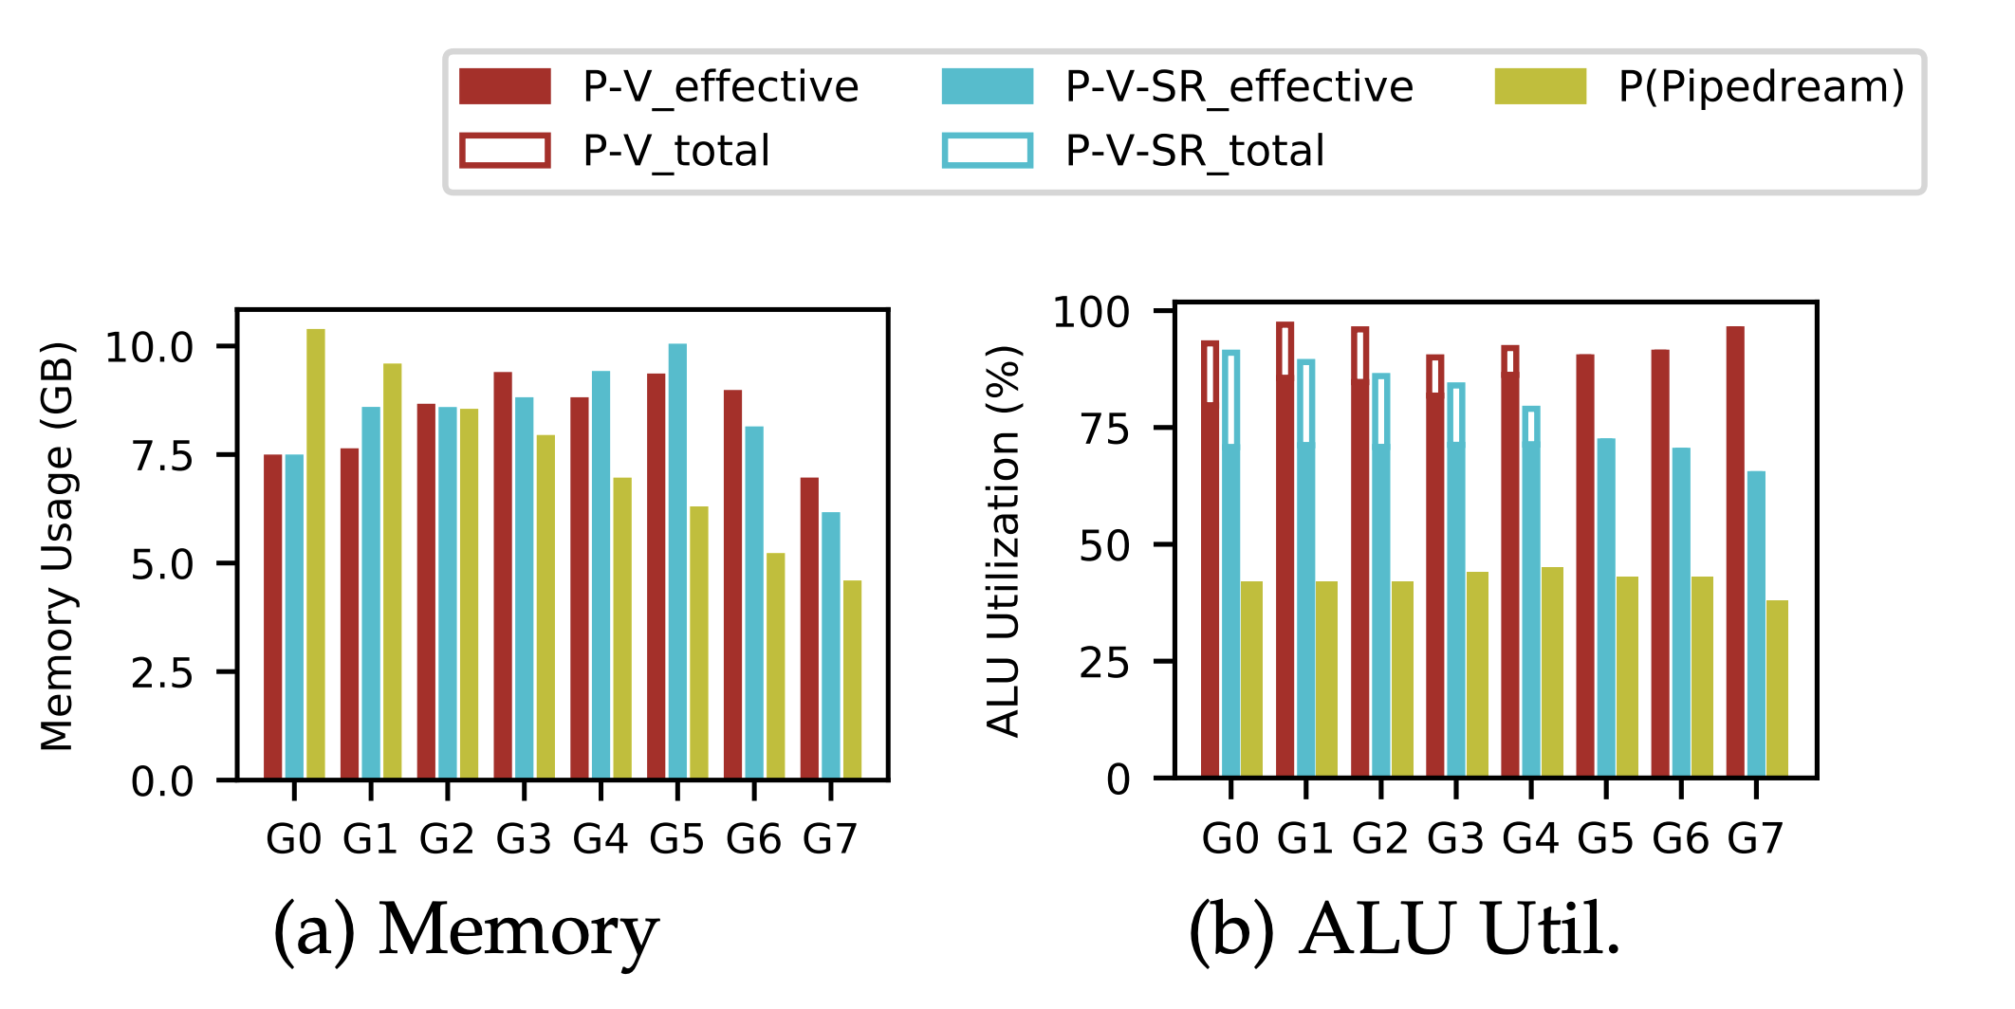
Challenges for Pipeline Parallelism
Challenge 1: Imbalanced Memory Burden
Problem caused:
The first GPU immediately reached limits
Limit the batch size when training large DNNs
Low batch size => Low GPU ALU utilization
GPU requires large enough batch size to use its hardware power

Slide 11
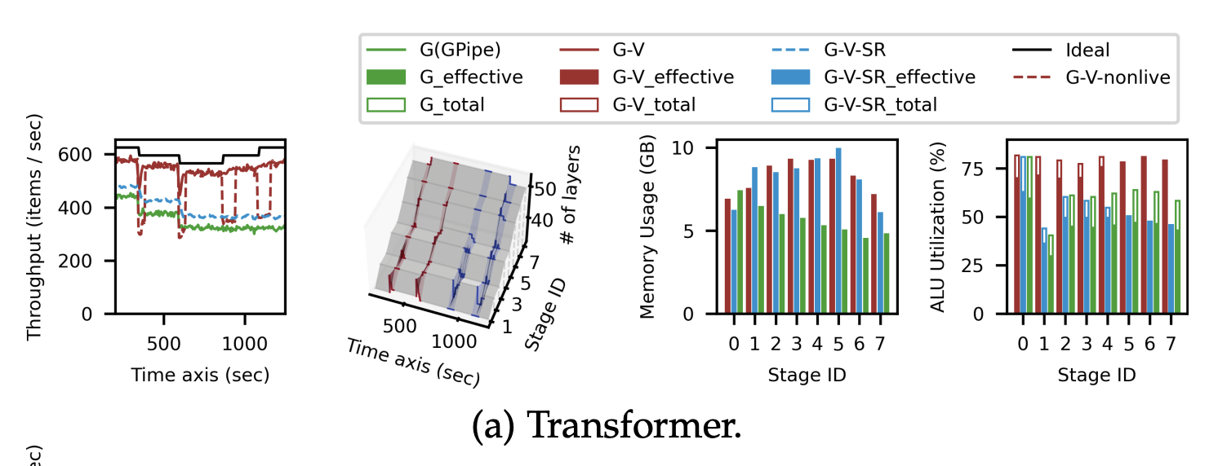
Challenges for Pipeline Parallelism
Challenges 2: Dynamic layer activate/de-activation when serving dynamic training processes
Problem caused:
Pipeline stage partition sometimes becomes imbalanced
Imbalanced stage partition => causes bubbles and lowers the throughput

Slide 12
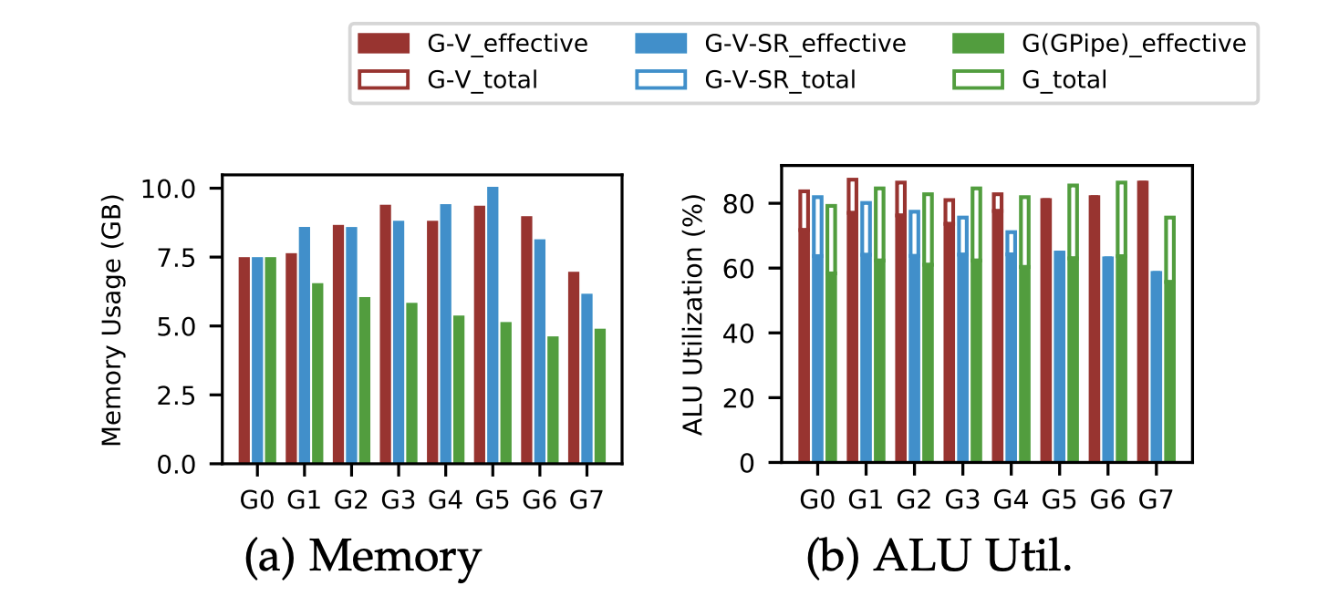
Existing systems
GPipe addresses challenge 1:
Drop activations in forward pass
Recompute all activations (i.e., perform another forward pass) in backward pass
Problem: all-recompute causes unnecessary overhead
Both Pipedream and GPipe neglects challenge 2:
Use static partition during whole training process

Slide 13
VPipe in a nutshell
Manage training Activations by incorporating intuitions from pipeline
Intuition 1: front stages have much heavier burden than the rear stages
A smart-recompute strategy: recompute more on front stages and recompute less on rear stages
Intuition 2: a time windows exists between each forward and backward pass of each data batch
Swap activations to CPU and pre-fetch them back before backward pass
Dynamic adjust layer partitions according to real time execution statistics
VPipe firstly introduce a non-stop live layer migration protocol to enforce new partition plan

Slide 14
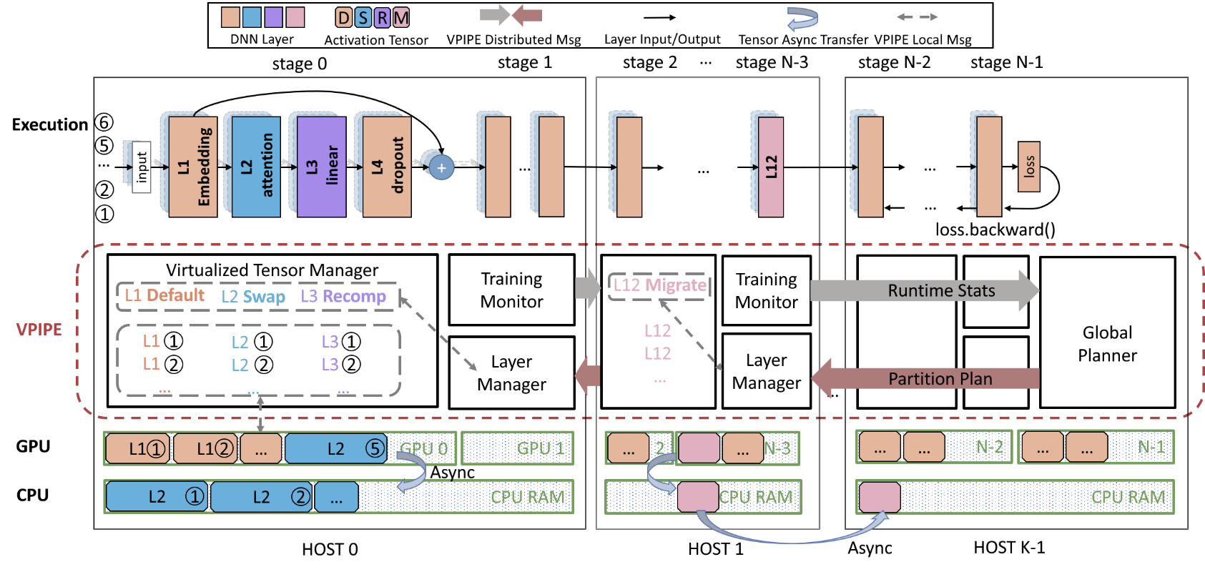
VPipe Architecture

Slide 15
Swap, recompute, and partition forms a combinatorial optimization problem
NP-complete
Solve each layer’s storage status and model’s partition strategy
Storage status: default, swap and recompute
VPipe solves it by decomposition and iteration
Iteration Process
(1) Find best partition for current swap & recompute strategy
(2) Reconfigure swap & recompute strategy for current partition
(3) Compute time of each partition changes
(4) Back to (1)
Detected imbalanced pipeline partition
[36, 40, 48, 56]
Multi-variable and combinatorial optimization problem
Layers increased due to dynamic training
[36, 40, 96, 56]
Sub-problem 1: select best storage status for all layers (memory management optimization)
Sub-problem 2: select best model partition (graph partitioning problem)
swap & recompute + partition
Iterative optimization through decomposition
[48, 54, 58, 68]
….
swap & recompute + partition
[44, 50, 60, 74]

Slide 16
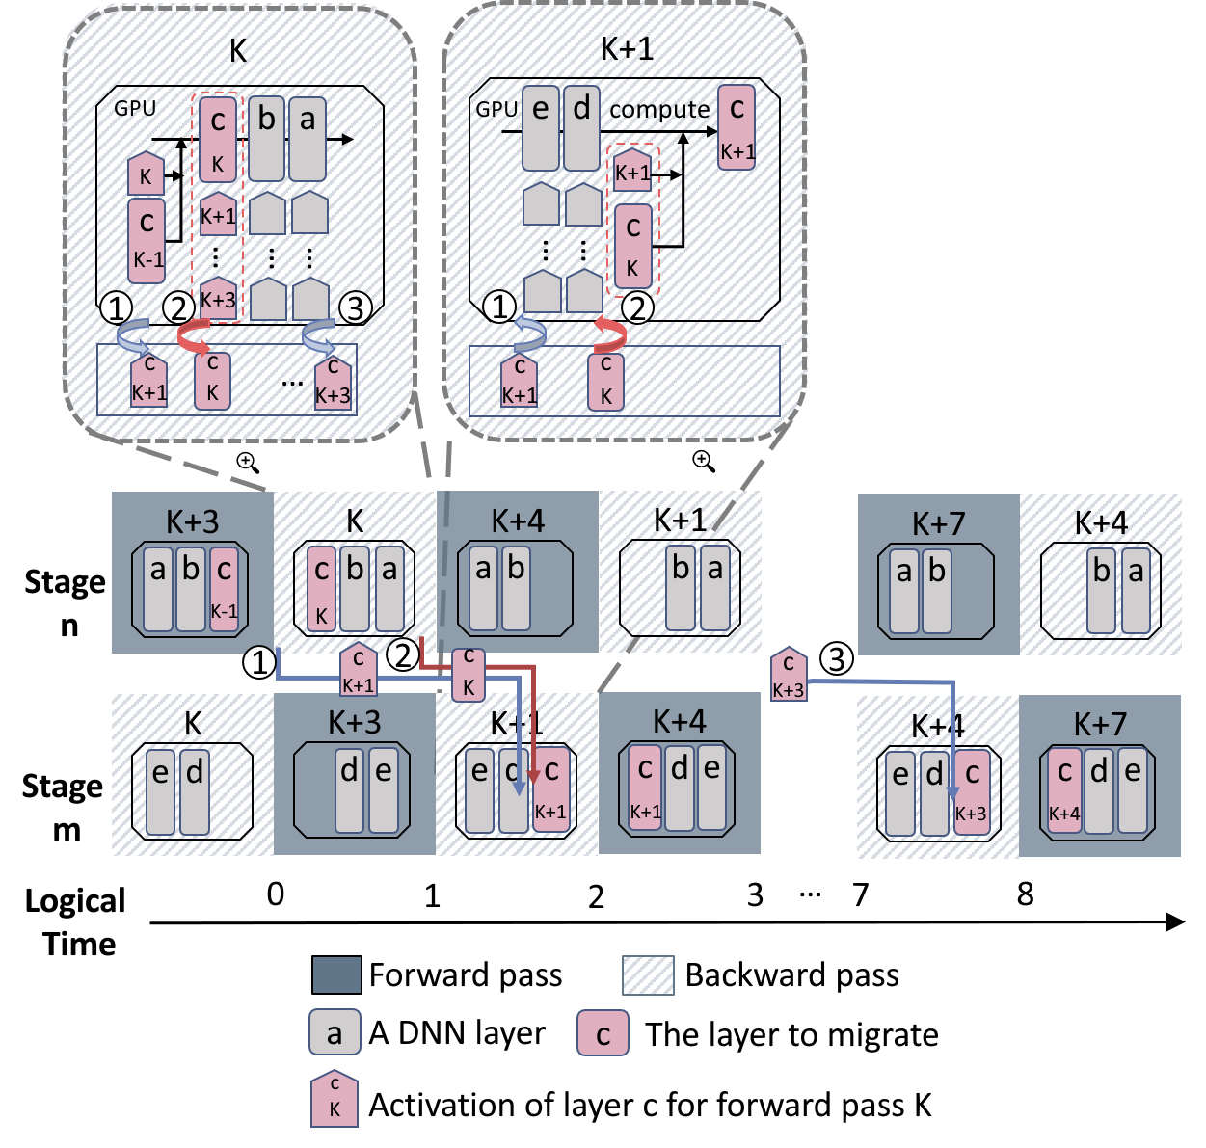
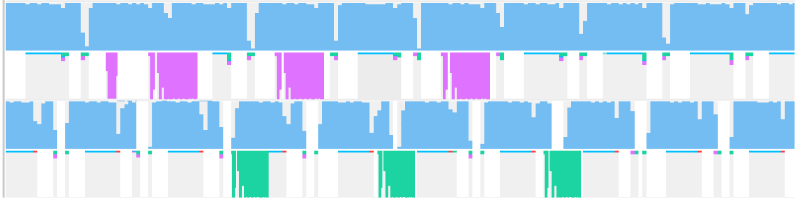
VPipe’s non-stop&transparent layer migration
Correctness: Pipedream ASP (1F1B)
Guarantee the parameter version on stage n is always k-p+n
k is the batch id and p is the partition number
Also ensure correctness for Gpipe, Megatron-LM and DeepSpeed’s BSP
Async activation migration
overlap communication with computation
Stage n
Stage m
①
②
③
NVIDIA Profiler trace

Slide 17
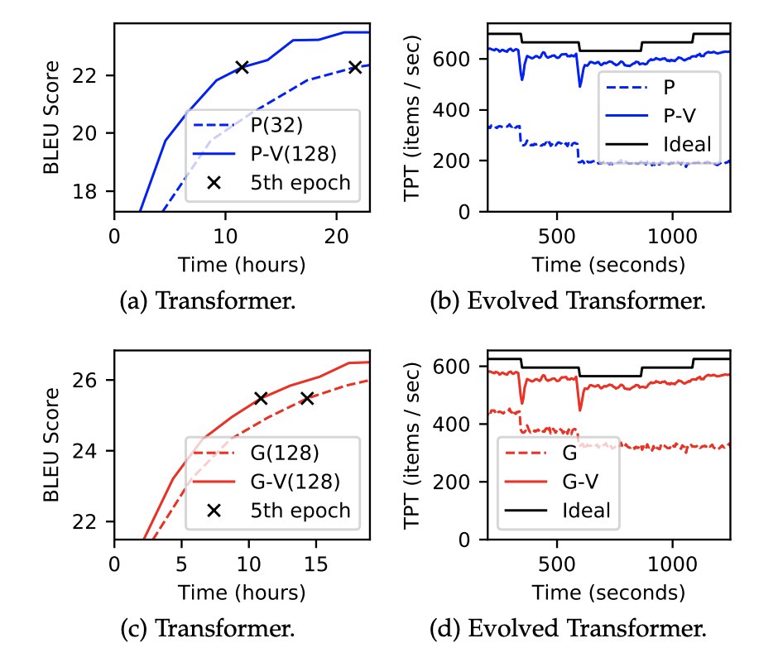
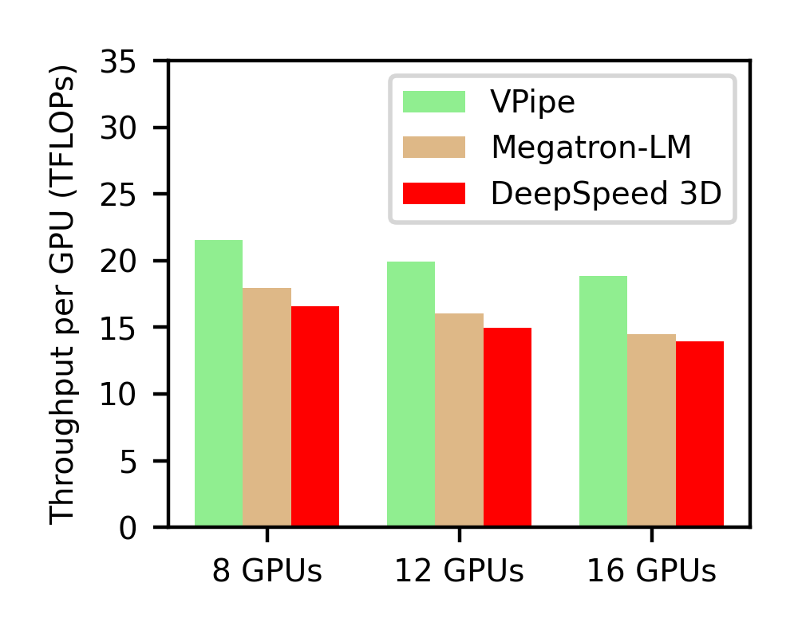
Evaluation Results
Large Model Training
E.g., Transformer
Dynamic Model Training
E.g., Evolved Transformer
VPipe achieved better performance than Megatron-LM and DeepSpeed 3D when training CPM2 on NVIDIA 2080 Ti cluster with 40Gbps network bandwidth

Slide 18
Evaluation Results
More detailed evaluations, refer to our paper

Slide 19
NASPipe: High Performance and Reproducible Pipeline Parallel Supernet Training via Causal Synchronous Parallel (ASPLOS 2022, accepted)
Shixiong Zhao, Fanxin Li, Xusheng Chen, Tianxiang Shen, Li Chen, Sen Wang, Gong Zhang, Cheng Li, Heming Cui
The University of Hong Kong
Huawei Technologies
University of Science and Technology of China

Slide 20
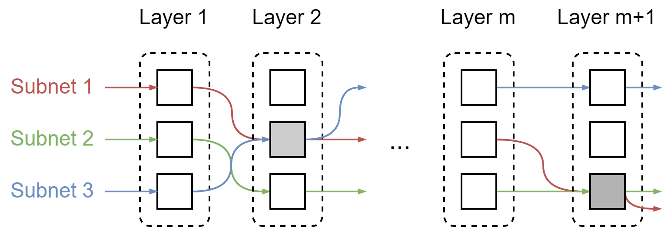
Big AI Model Training: 4-th (New) Dimension
Supernet-subnet training (e.g., Neural Arch Search, or NAS): more and more prevalent
Motivation: train multiple subnets in parallel on multiple GPUs -> better performance
Retiarii [OSDI '20] generates a sequence of subnets
Currently Retiarii supports only sequential subnet training
When letting Retiarii train subnets in parallel using BSP, causal dependency among subnets leads to low training accuracy (dropped from 22.17 to 21.03)
Open problem: how to deterministically resolve causal dependency

Slide 21
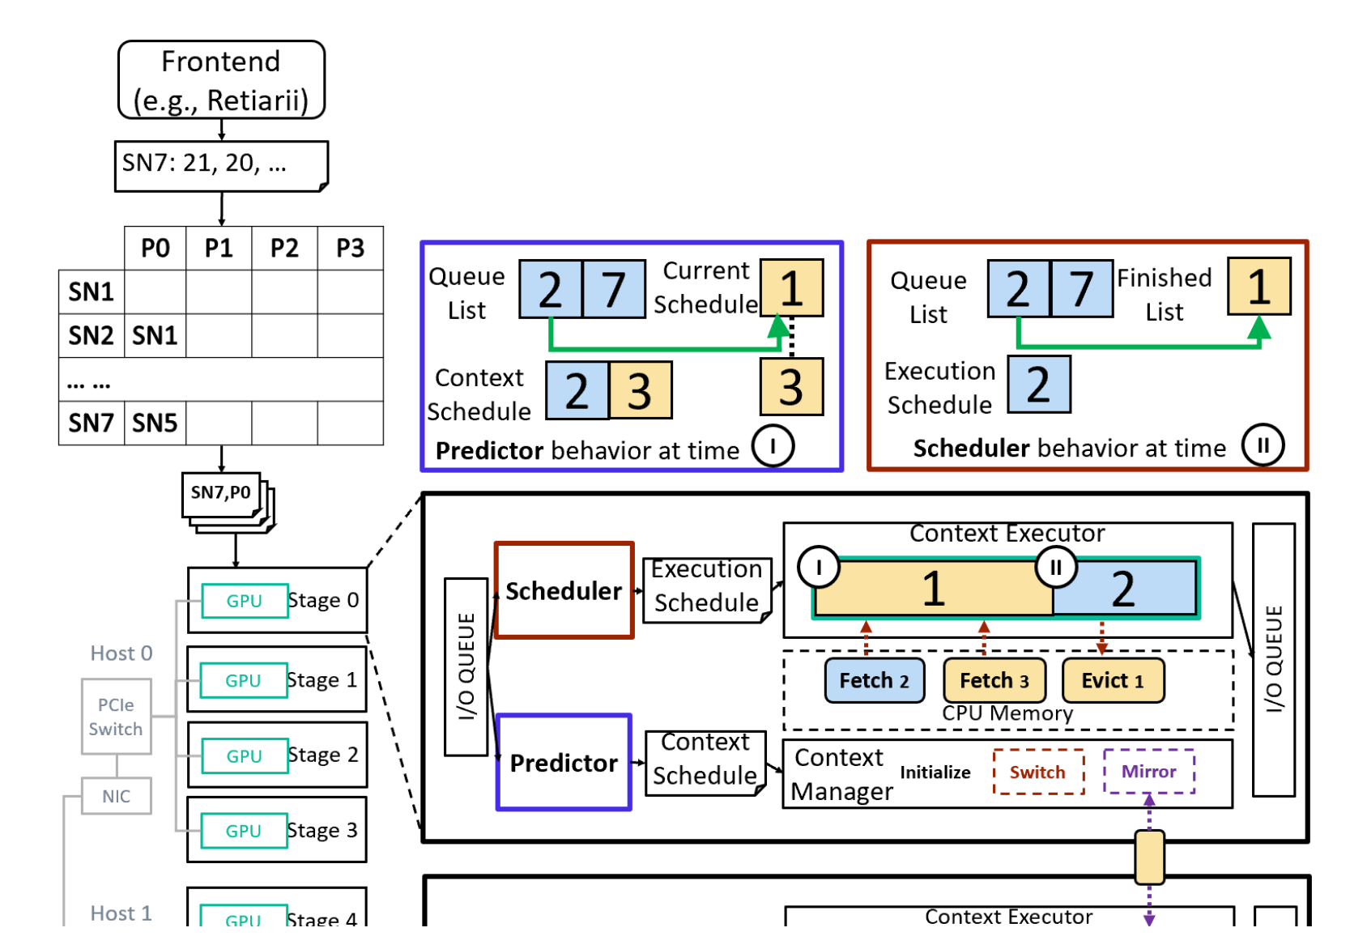
NASPipe Arch
NASPipe is the first pipeline parallel system for supernet training
A new abstraction (causal synchronous parallel, CSP) to resolve causal dependency
E.g., on stage 0, subnet 2’s forward depends on subnet 1’s backward
Phase 1: Scheduler schedules subnets that preserve causal dependency to context executor
Phase 2: Predictor simulates the pipeline run and forecasts the upcoming subnets to be scheduled
Phase 3: Context executor executes scheduled subnets
Phase 4: Context manager manages context switch, i.e., subnet eviction and pre-fetch, and operator parameter synchronization
Phase 5: NASPipe deterministically resolves any causal dependency to retain reproducibility and avoid training accuracy loss

Slide 22
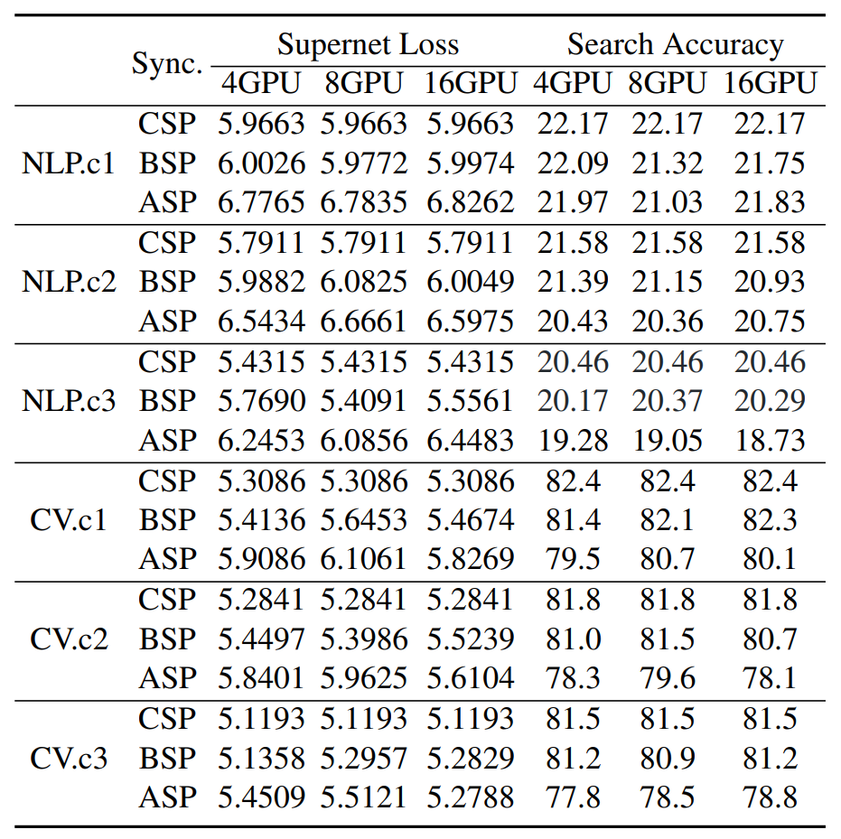
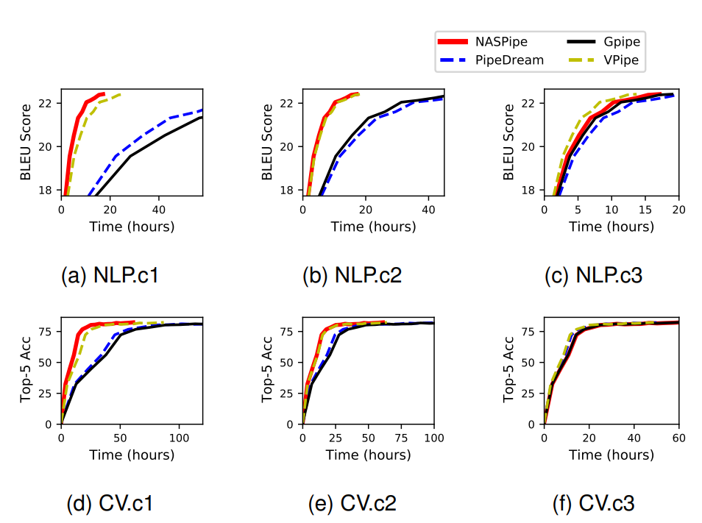
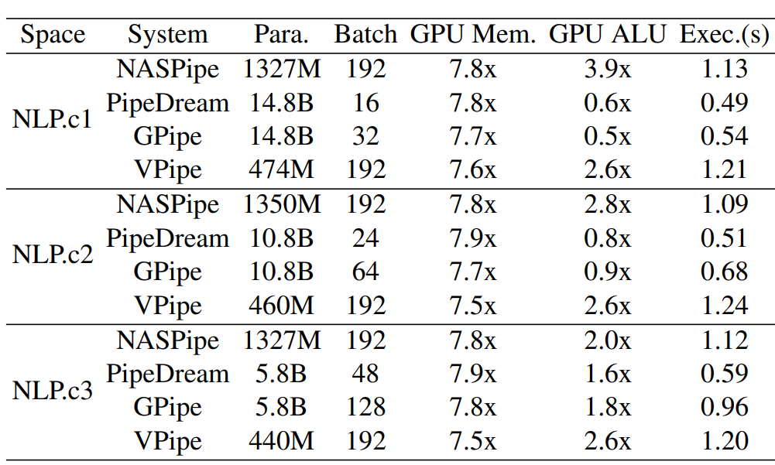
NASPipe Evaluation [to appear in ASPLOS '22]
CSP produced better results than ASP and BSP;
CSP produced same results under 4/8/16 PP GPUs.
NLP (Evolved Transformer), CV (AboebaNet with NAS); NASPipe achieved higher accuracy at the same training time; search space size decreases from c1 to c3; vPipe means “Naspipe without Naspipe’s predictor component (for perfecting subnets that comply with CSP)”.
Para. (GPU mem util.), 8 PP GPUs; all systems use Retiarii as front end; NASPipe has highest GPU ALU utilization, largest batch sizes, but longest fwd/bwd time.

Slide 23
Vpipe+Naspipe: 4D Parallel Training Platform for Complex & Dynamic Big AI Models
Vpipe [IEEE TPDS 2021] has already supported 3-D parallelism and in the process of tremendous optimizations
Trained a GPT-2 Large model on 32 V100 GPUs with cutting edge throughput
Used Data parallel, Intra-layer model parallel, and Pipeline parallel
Code link: github.com/hku-systems/vpipe
Naspipe [ACM ASPLOS 2022, accepted]: Supernet-subnet parallel & CSP
We take the first step to propose the 4-th dimension of parallel training in the world
Code link will be released soon (now participating in artifact evaluation)
Extend Naspipe for extreme dynamic training processes
E.g., one-shot neural architecture search, mixture of experts, dynamic routing
Co-design big model algorithms (e.g., CV) with training
Optimize compiler for dynamic training and inference

