Slide 1

UTEE: A Secure, Efficient, and Portable Distributed Bigdata Computing System on Heterogeneous Trusted Execution Devices
Heming Cui
Computer Science/HKU
Midterm Report, ITF ITSP Platform
(Ref: GHP/169/20SZ)

Slide 2

Trusted Execution Environment (TEE) Become Available in ARM/AMD/Intel CPUs, But Extremely Hard to Use
Security problems on public clouds (AWS/Huawei clouds) are severe
Cloud management software (e.g., Virtual Machine, VM) and Operating Systems (OS) have high privileges on tenants’ normal data server threads
VM and OS are developed by 1K+ diverse organizations worldwide
Software defects: Minnesota Linux Hypocrite Commits incidents in Apr 2021
Also, some admins of the clouds may be careless or malicious
TEE’s hardware-level strong isolation prevents privileged admin/software peeking data being queried by SQL/big-data engines
A thread running outside does complex assembly to transit into a TEE, decrypts sensitive data, processes it, encrypts result, and returns to outside
TEE’s hardware nature makes it extremely hard to use
TEE products in Arm/AMD/Intel supports software are in C/assembly
But cloud software is often written in Java (e.g., big-data engine, Spark)
Approaches: (1) shielding an entire server in a TEE (including server software defects and occupying too much TEE hardware resources), or (2) rewriting Java into C/assembly (error-prone) and run in TEE
A computer running OS, VM, and data servers on clouds
CPU
TEE: isolated
CPU & Mem
Cloud VM
thread
OS kernel
thread
Tenants’ data
server thread
Secured Data
server thread
Decrypted
Decrypted
Memory
Decrypted
Transit
Disk
Encrypted
…
Encrypted
Return

Slide 3
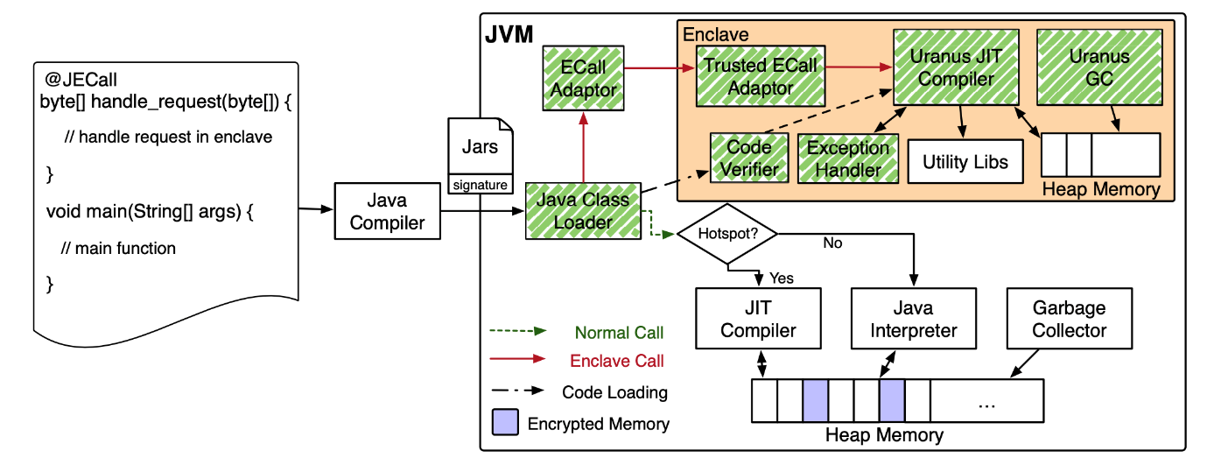
Ubiquitous TEE: A Synergistic Eco-system Between TEE & Java (UTEE’s own components are in green)
For cloud software’s JVM-compatible high-level languages (e.g., Java/Python/Scala)
JECall: annotate queries which processing sensitive data, and UTEE automatically splits the queries and places them to run inside a TEE
Secure: minimize the risk (Lines of Code) of including software defects in TEE
Portable: Can reuse the mature queries (algorithms) developed by SQL/big-data experts
Easy-to-use: Java type safety, UTEE invents new safe isolation techniques: “queries ← → outside”
Fast: UTEE invents new big-data query aware memory management, first among competitors

Slide 4
The Rest of My Talk
(a) Project team members
(b) Research progress
(c) Research results
(d) Achievements to-date
(e) Project dissemination
(f) Released software website & video demo

Slide 5
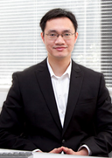
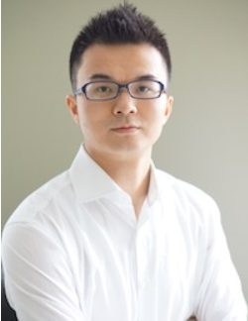
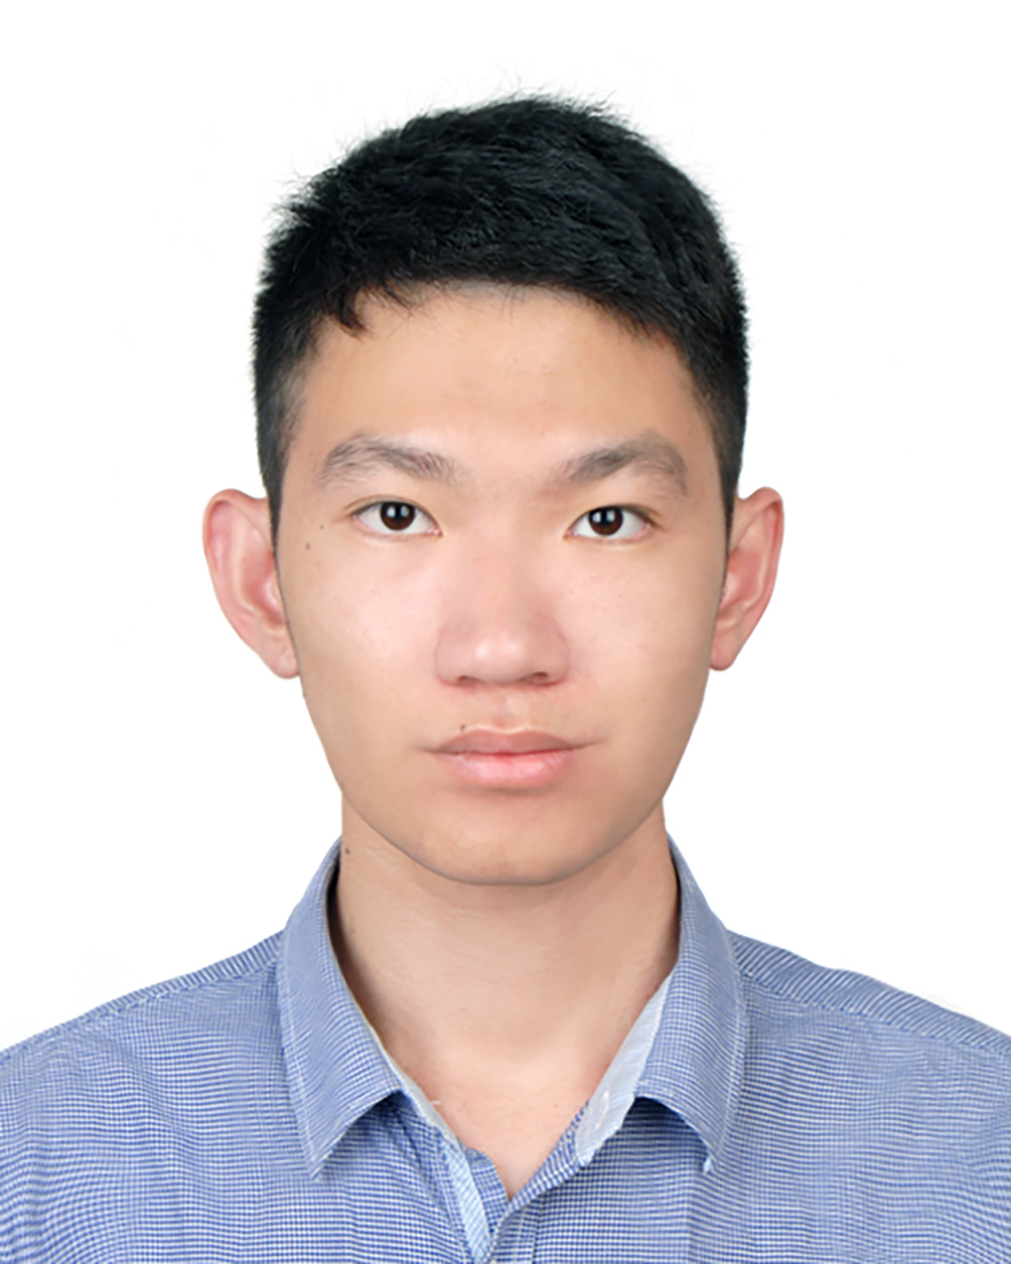
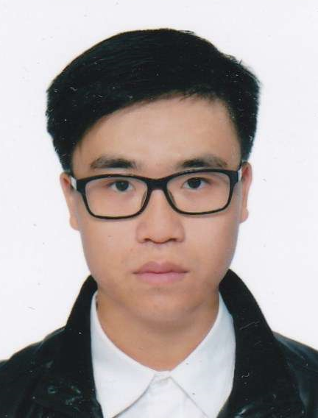
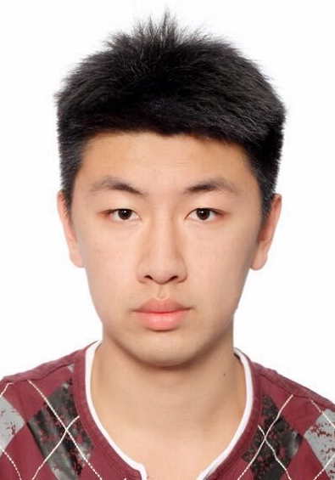
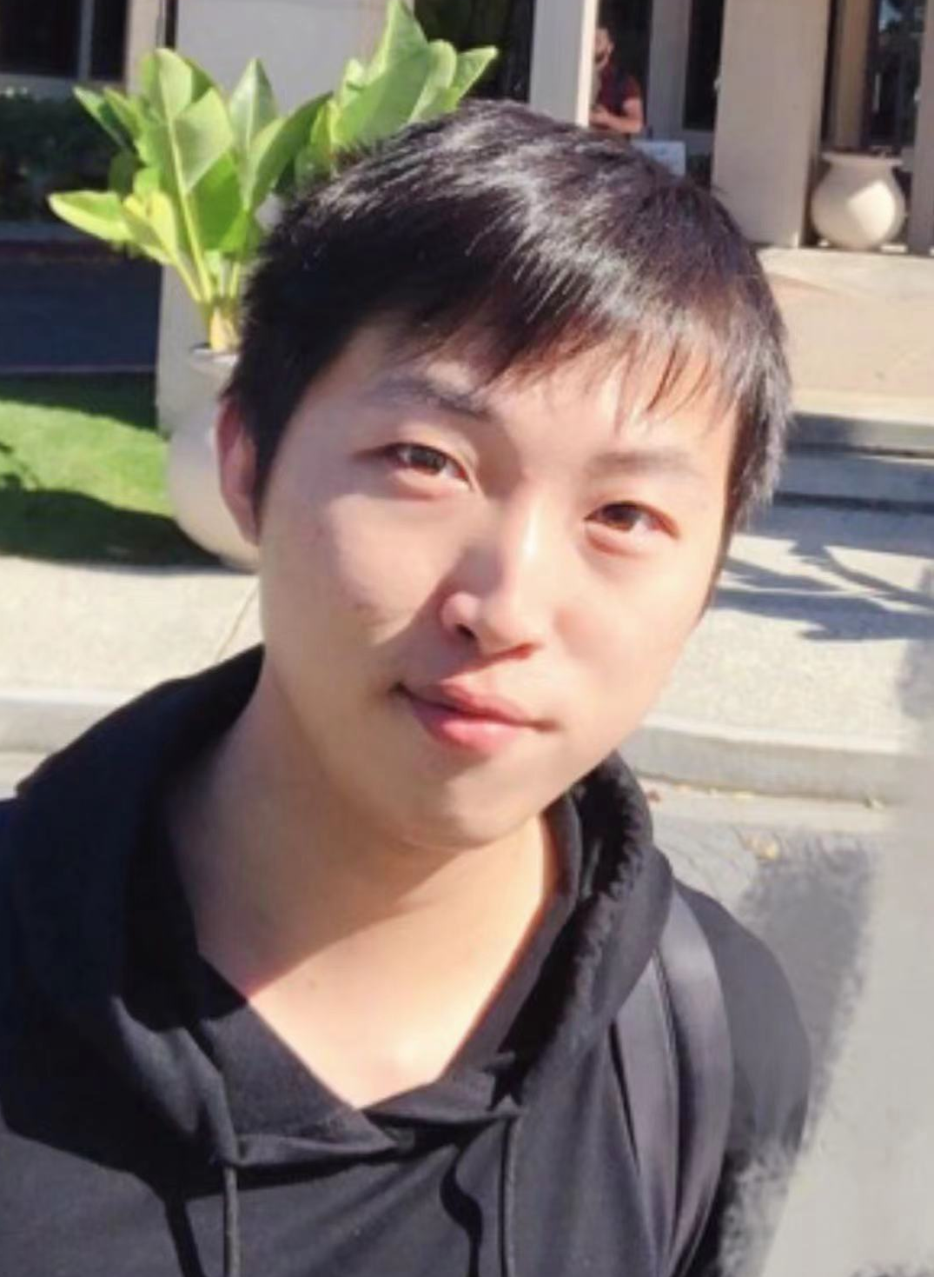
(a) The Project Team Members: PIs and My Four RPG students
Items | Total (HKD $3,300,000) | Note
Research postgraduate (RPG) students and RA | $2,400,000 | Hire 4 research postgraduate students and 2 research assistants
Equipment cost | $284,600 | Purchase computer servers and desktop computers
Other direct cost | $228,000 | Attend conferences, general expenses, external expert visitors, auditing
HKU admin cost | $387,400 | University overhead
Huawei donation | $330,000 | 10% matching
Dr. Heming Cui
PI, HK side
Dr. Fengwei Zhang
PI, Shenzhen side
Jianyu Jiang
Tsz On Li
Xusheng Chen
Tianxiang Shen

Slide 6
(b) Detailed Research Progress: Milestones, Workplans, Dates
（01/06/2022 -- 30/11/2022）
1. 基於高級編程語言（包括Java和Python），設計與實現UTEE可使“可信計算基礎”最小化、即安全性最大化的新型標註式編程技術及其安全協議，可僅將典型大數據引擎（包括Spark）的查詢算子代碼運行於可信執行環境中。
（01/12/2022 -- 31/05/2023）
2. 設計與實現可對典型大數據引擎運行在UTEE可信執行環境內部的大數據查詢算子及其相關代碼，以及大數據引擎運行在此環境外部的代碼，進行運行指令、數據等自動安全隔離算法和協議。

Slide 7
(b) Detailed Research Progress: Achieved Technical Targets with Dates
（01/06/2022 -- 30/11/2022）
（1）UTEE可自動將標註的、全球通用的大數據引擎（包括Spark，Storm和Flink）查詢算子代碼及其相關必需代碼庫，自動載入並運行於UTEE管理的可信執行環境內；（2）UTEE安全協議可對此載入代碼的完整性進行自動驗證；（3）運行於可信執行環境中的UTEE可信計算基礎，包括UTEE系統本身代碼，不超過四萬行，比全球其他競爭對手之可信計算基礎代碼總量，至少小一個數量級。
（01/12/2022 -- 31/05/2023）
（1）就算大數據查詢算子內代碼不慎嘗試將可信執行環境內部的任何數據寫到此環境外部，UTEE隔離算法可自動組織這些操作；（2）UTEE強隔離協議對運行於可信執行環境內的Java指令（比如大數據算子）的運行時性能開銷，不高於5%。

Slide 8
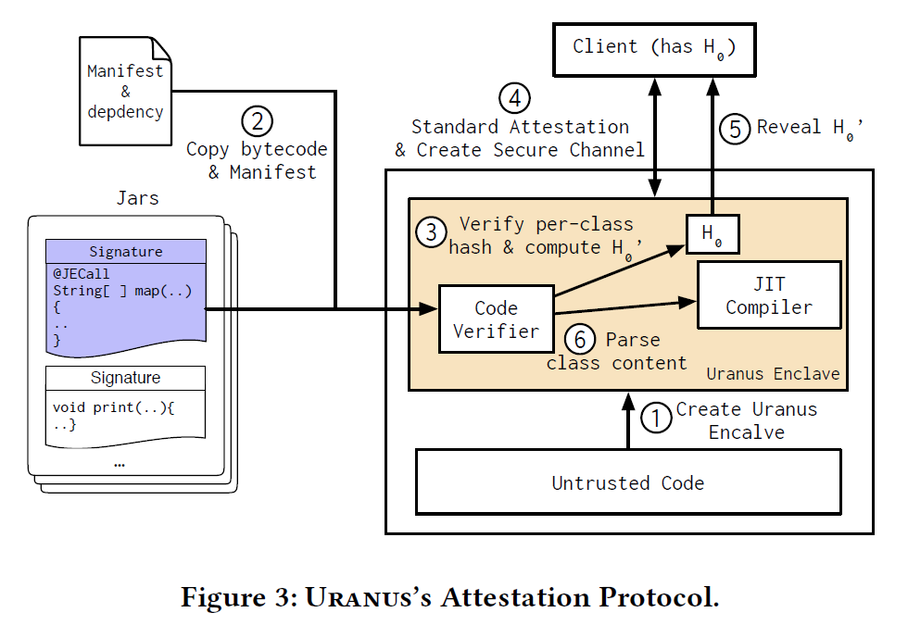
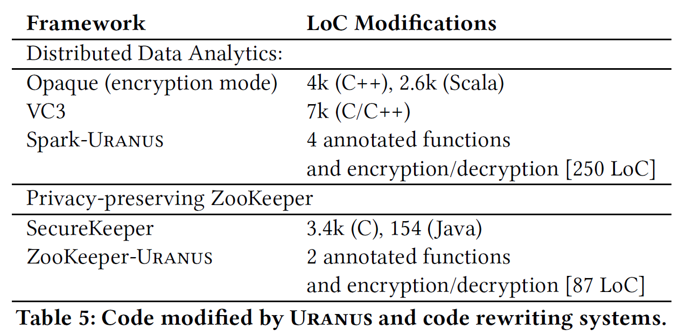
(c) Research Results: In Relation to Deliverables (Part 1/2)
（01/06/2022 -- 30/11/2022）
（1）UTEE可自動將標註的、全球通用的大數據引擎（包括Spark，Storm和Flink）查詢算子代碼及其相關必需代碼庫，自動載入並運行於UTEE管理的可信執行環境內；（2）UTEE安全協議可對此載入代碼的完整性進行自動驗證；（3）運行於可信執行環境中的UTEE可信計算基礎，包括UTEE系統本身代碼，不超過四萬行，比全球其他競爭對手之可信計算基礎代碼總量，至少小一個數量級。

Slide 9
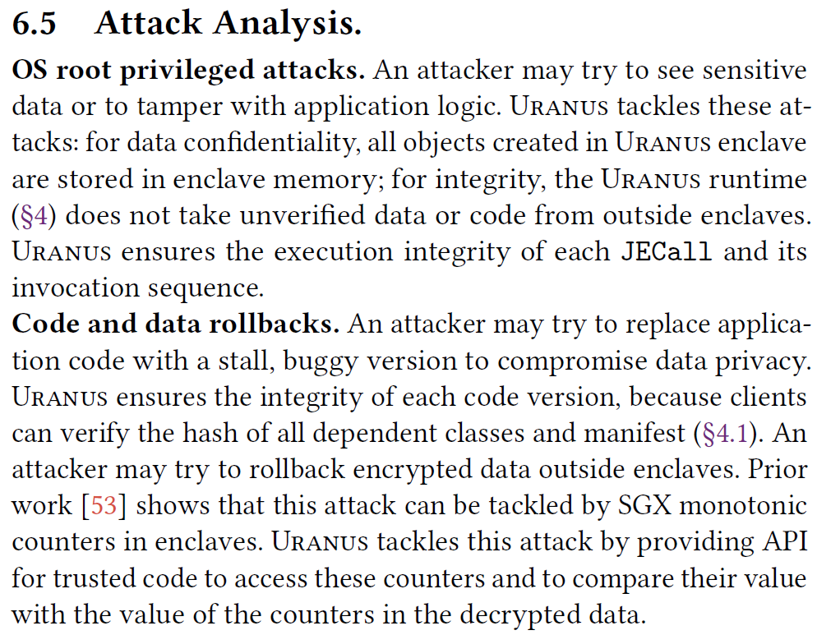
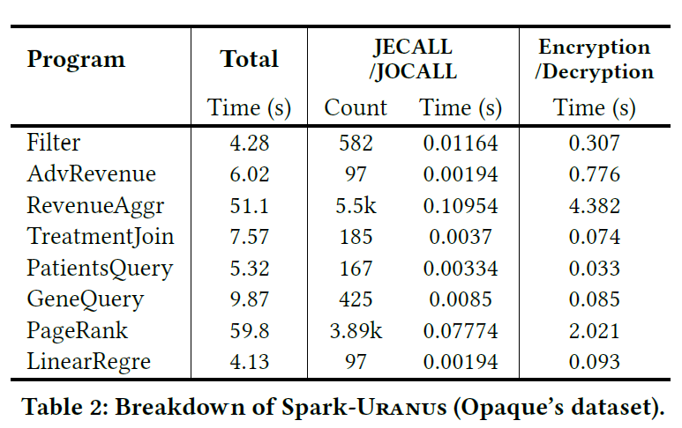
(c) Research Results: In Relation to Deliverables (Part 2/2)
（01/12/2022 -- 31/05/2023）
（1）就算大數據查詢算子內代碼不慎嘗試將可信執行環境內部的任何數據寫到此環境外部，UTEE隔離算法可自動組織這些操作；（2）UTEE強隔離協議對運行於可信執行環境內的Java指令（比如大數據算子）的運行時性能開銷，不高於5%。

Slide 10
(d) Achievements To-date: Publications
Published 14 international best-tiered papers (China Computer Federation, or CCF, A class journals or conferences)
First-author of most papers are Dr. Cui’s PhD students
CCF A papers are all good candidates for RGC RAE 4-stars

Slide 11
Publications
Jianyu Jiang, Qi Ji, Tianxiang Shen, Xusheng Chen, Shixiong Zhao, Sen Wang, Li Chen, Gong Zhang, Xiapu Luo, and Heming Cui*, CRONUS: Fault-isolated, Secure and High-performance Heterogeneous Computing for Trusted Execution Environments, Proceedings of the 55th ACM/IEEE International Symposium on Microarchitecture (MICRO '22). ACM results reproduced badge.
Haoran Qiu, Tao Ji, Shixiong Zhao*, Xusheng Chen*, Ji Qi, Heming Cui, and Sen Wang, A Geography-Based P2P Overlay Network for Fast and Robust Blockchain Systems, IEEE Transactions on Services Computing 2022 (TSC '22). Tianxiang Shen, Ji Qi, Jianyu Jiang*, Xian Wang, Siyuan Wen, Xusheng Chen, Shixiong Zhao, Sen Wang, Li Chen, Xiapu Luo, Fengwei Zhang, and Heming Cui, SOTER: Guarding Black-box Inference for General Neural Networks at the Edge, Proceedings of the 2022 USENIX Annual Technical Conference (ATC '22). USENIX results reproduced badge.
Saeid Mofrad, Ishtiaq Ahmed, Fengwei Zhang, Shiyong Lu, Ping Yang, and Heming Cui, Securing Big Data Scientific Workflows via Trusted Heterogeneous Environments, IEEE Transactions on Dependable and Secure Computing 2022 (TDSC '22). Tianxiang Shen, Jianyu Jiang, Yunpeng Jiang, Xusheng Chen, Ji Qi, Shixiong Zhao, Fengwei Zhang*, Xiapu Luo, and Heming Cui*, DAENet: Making Strong Anonymity Scale in a Fully Decentralized Network, IEEE Transactions on Dependable and Secure Computing 2021 (TDSC '21).
Jianyu Jiang, Xusheng Chen, Tzs On Li, Cheng Wang, Tianxiang Shen, Shixiong Zhao, Heming Cui*, Cho-Li Wang, and Fengwei Zhang, Uranus: Simple, Efficient SGX Programming and Its Applications, Proceedings of the 15th ACM ASIA Conference on Computer and Communications Security (ASIACCS '20).

Slide 12
(d) Achievements: Patent Submitted since Submitting the ITF Proposal
Note: all these patents’ first authors are Dr. Heming Cui’s RPG students (submitted to China National Intellectual Property Administration, or CNIPA)
CRONUS: Fault-isolated, Secure and High-performance Heterogeneous Computing for Trusted Execution Environments, CNIPA app ID to be allocated
SOTER: Guarding Black-box Inference for General Neural Networks at the Edge, CNIPA app ID to be allocated
Themis: Automatic and Efficient Deep Learning System Testing with Strong Fault Detection Capability, CN 202111372034.X
Upa: An Automated, Accurate and Efficient Differentially Private Big-data Mining System, CN 202010506698.X
Daenet: A decentralized, secure and reliable network communication system via SGX, CN 202110048599.6
Uranus: An Efficient, Secure Big-data Processing and Programming System based on Trusted Execution Environment, CN 202010366539.4
Eges: An Efficient, DoS Resistant Consensus Protocol for Permissioned Blockchains, CN 202010247629.1

Slide 13
(d) Achievements To-date: New Research Grants from Huawei
This grant targets secure CPU/GPU computing
PI, "ParaNAS: High-performance, Scalable, Reliable and High-precision Multi-GPU Pipeline Parallel DNN Training Systems", Huawei Theory Lab Flagship, 2021 - 2023.

Slide 14
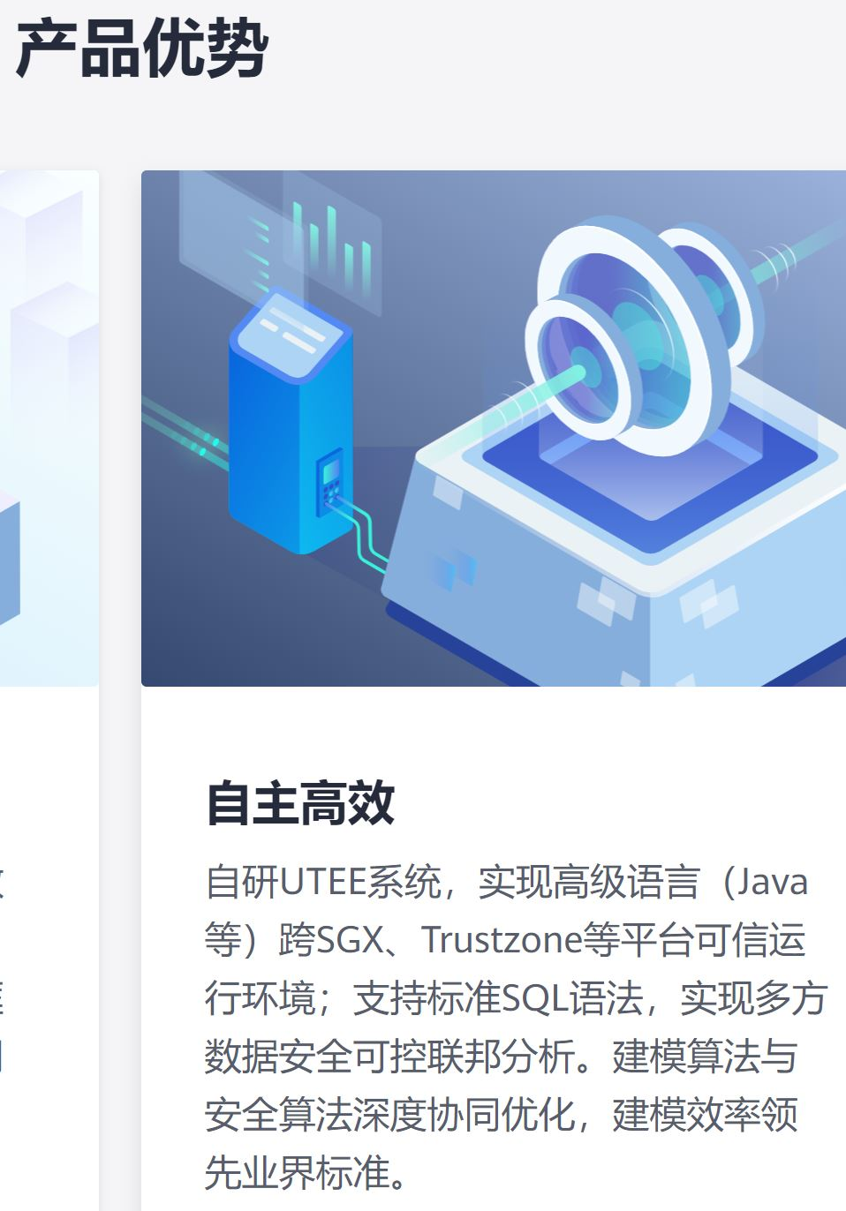
(e) Project Dissemination: Industry Release & Impact
Impact case: a preliminary prototype of UTEE, Dr. Cui’s secure big-data system, has commercially become the core system of Huawei Cloud’s TICS (Trusted & Intelligent Cloud Services)
UTEE (interchangeable, in ppt) == TICS
Huawei claims that UTEE is world-leading (i.e., leading the current global industries’ standards and levels in the big-data security area), which matches a RAE 4-star
UTEE won ITF grant (PI, HK $3.3M)
Dr. Cui won nine grants (PI), totally HK $16.5M, in his 7-year HKU career
Filed 13 patents in past 3 years
Publish 14 international best-tiered (CCF A) journals and conferences, all papers are good candidates of RAE 4-stars
www.huaweicloud.com/product/tics.html

Slide 15
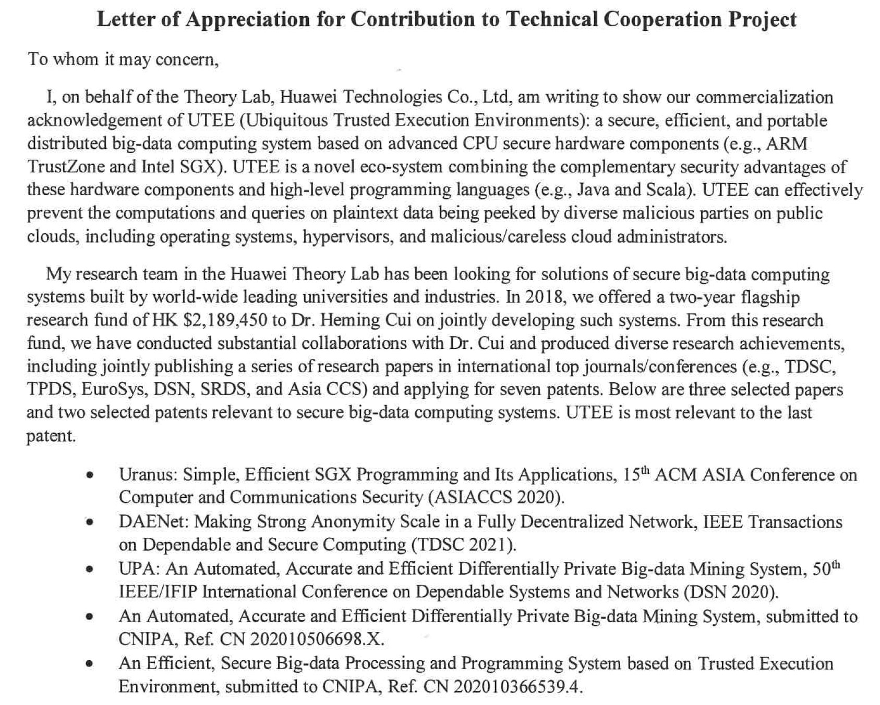
(e) Project Dissemination: Impact Case Letter (Part 1/2)

Slide 16
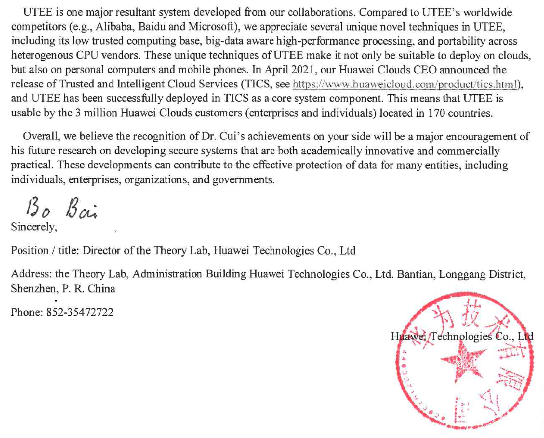
(e) Project Dessemination: Impact Case Letter (Part 2/2)

Slide 17
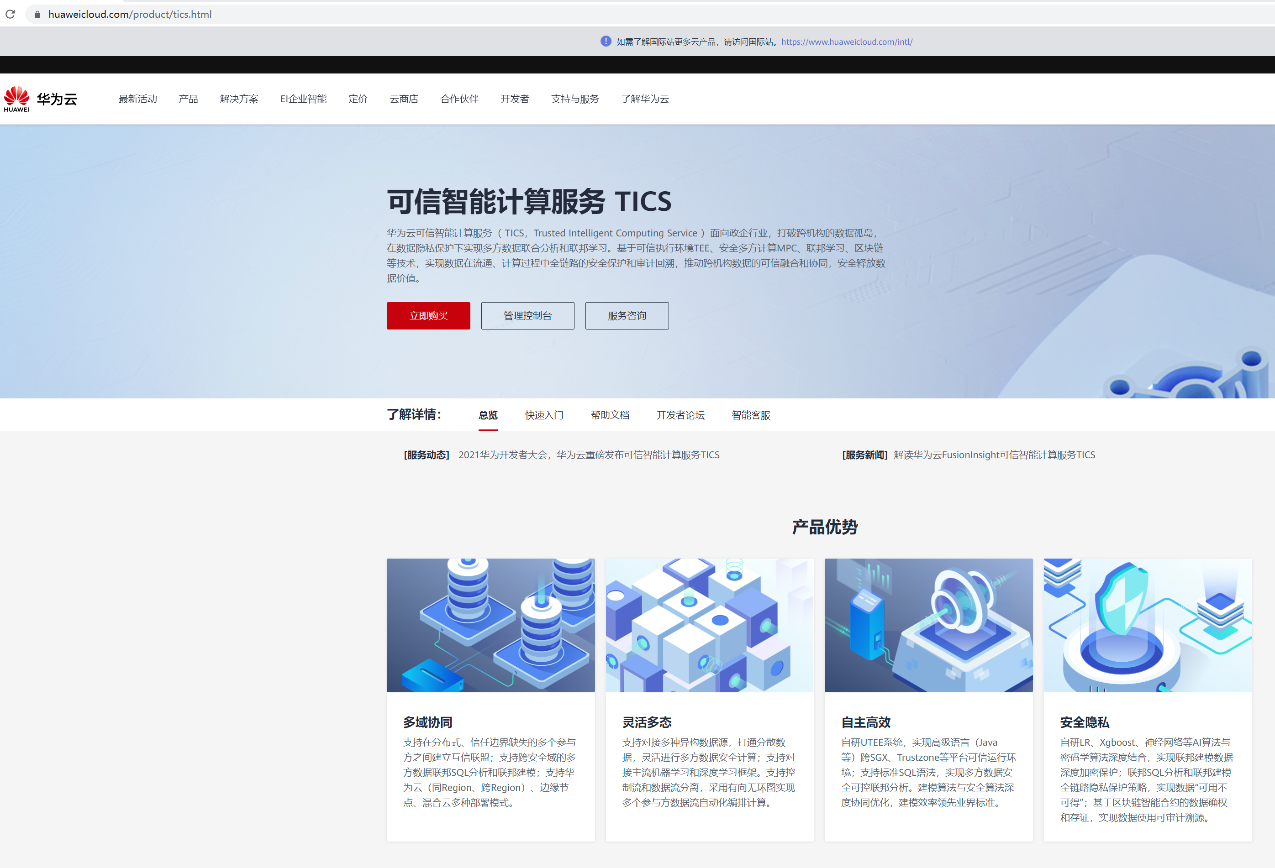
(f) Snapshot of the TICS Website

Slide 18
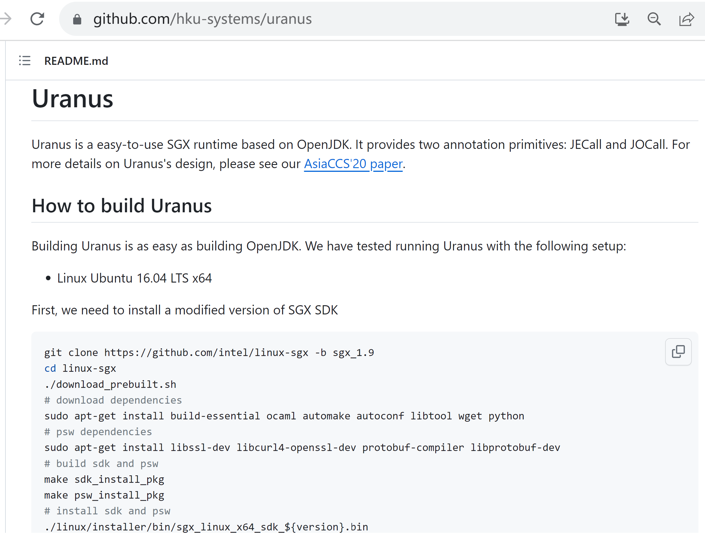
Secure Computing with Protection of Client Cloud against Cloud Provider

Slide 19
Demo Video
Security goal to be demonstrated: the client’s code submitted to the cloud and running in the security hardware (on the cloud) must not be altered by the cloud provider

Slide 20
(f) Equipment
Our study was conducted on ten computers with SGX-equipped
Intel(R) Xeon(R) CPU E3-1280 v6 with 4 cores, 64GB RAM and 2TB
SSD. All computers form a cluster with 40Gbps network. For the
setup of clients in ZooKeeper-Uranus, we ran the clients in host
machines outside the cluster, as clients are trusted and run outside
the cloud in our threat model. ping latency between clients and
servers is 800us. Uranus’s enclave heap size is 80MB to avoid SGX
paging. This heap size setting is common in practice [77].
We compared Spark-Uranus and ZooKeeper-Uranus with two
security systems (i.e., Opaque [77] and SecureKeeper [28]) and two
native and insecure applications (i.e., Spark [76] and ZooKeeper [13]).
We ran Spark-Uranus with all applications using Uranus’s JIT
compiler (§4.2) by default. We used ten machines for each query,
and each machine runs one enclave with four threads by default.
For Spark-Uranus, we included all 8 queries evaluated in Opaque.

Slide 21
(b) Detailed Research Progress: Future Plans
（01/06/2023 -- 30/11/2023，进行中）
3. 基於大數據語義的計算機內存運行空間之高效率重用協議，全球首次支持在可信執行環境內運行典型大數據規模的數據集。
（01/12/2023 -- 31/05/2024，即将开始）
4. 與本項目跨境合作方協調完成UTEE的整體系統的集成、安全特性論證、性能測試，並合作尋找商用示範案例。

Slide 22
Expectation in Future Plans (the Final Report Submitted to ITF in 2024)
No new industrial release links
This was expected to be done in 2024, but we are ahead of the progress, already released now
https://www.huaweicloud.com/product/tics.html
Implementing the “(b) Future Plans” in ITF
More publications
More contract research projects from Huawei

Slide 23
Thanks and Questions! ☺

