Slide 1
HACK4HACKATHON
Explainable Multimodal
Mental-Health Screening
https://h4hhackathon-kpyns25nu2fg7i2xc3ernc.streamlit.app/
Face + voice + 18 behavioural/physiological signals → 4-class stress triage + 3 severity scores, with per-modality confidence, disagreement detection, and a clinician-readable report card.
A screening tool that flags people for professional assessment — not a diagnosis. Made by: Hemish Jain (RA2411003010147, Anukool Kashyap (RA2411003010166)

Slide 2
THE PROBLEM
Distress is measurable — but rarely measured
Today: psychiatric assessment leans on infrequent, self-reported questionnaires and interviews.
But: distress also shows in face, voice, sleep, social engagement, and physiology — continuously observable.
Our task (3 objectives): (1) classify stress into 4 levels, (2) estimate Depression/Anxiety/Stress scores, (3) explain and quantify each modality's contribution.
Framing: a screening / decision-support tool — flags people for a professional. Not a diagnosis.

Slide 3
WHY MULTIMODAL
Each channel alone is ambiguous
Flat voice could be a cold — or blunted affect.
A frown could be concentration — or distress.
The signal is agreement. When face, voice and physiology point the same way, confidence is high; when they disagree, that itself is information.
So we fuse the three — and, uniquely, we measure when they contradict.

Slide 4
THE CORE CHALLENGE
Three datasets. Zero shared people.
Faces (FER2013), voices (RAVDESS) and the 18-feature CSV describe different people. Yet the model needs one person with all three. Something had to be constructed.

Slide 5
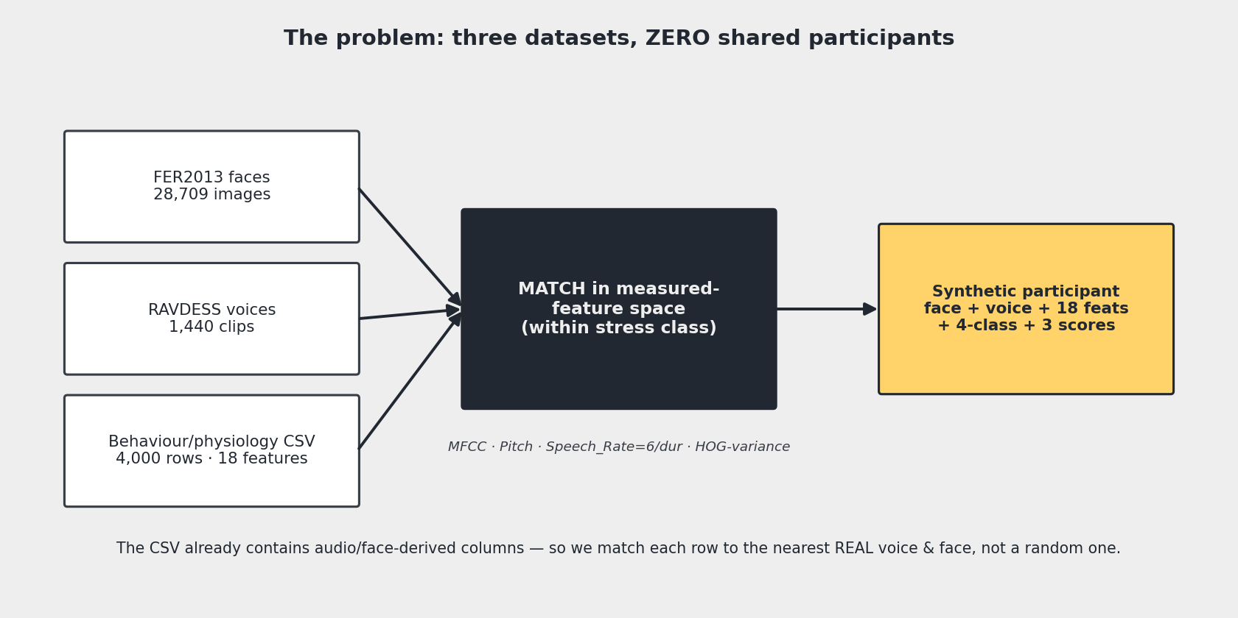
OUR DIFFERENTIATOR
Feature-matched alignment — joining a photo, a voice and 18 numbers
We DON'T staple a random face+voice to a CSV row — we match on measured features within the stress class.

Slide 6
WHY IT'S PRINCIPLED
The CSV told us what each participant should look & sound like
The CSV already contains audio-derived columns (MFCC_Mean, Pitch_Mean, Speech_Rate) and a face-derived one (Facial_Emotion_Variance).
So we compute the SAME quantities from the raw wavs/images and match each CSV row to its nearest real voice & face.
Speech_Rate = 6 / clip-duration — exactly. Every RAVDESS sentence is 6 words (read off the spec, not guessed).
We built BOTH a random-paired and a matched-paired dataset, and trained the identical model on each — to prove matching helps.

Slide 7
WHAT THE DATA TOLD US
Three honest findings (we report them, not hide them)
Tabular is near-noise: the 18 features barely correlate with the targets — LightGBM alone gets 37% (below guessing 'Healthy').
Severe is rare: ~3% of rows, only 19 in the test set → low Severe recall is a stated limitation, not a bug.
A contradiction in the committee's own labels: 'angry' & 'disgust' map to OPPOSITE stress levels in the audio vs image tables — we flag every affected pair so it can't corrupt the analysis.

Slide 8
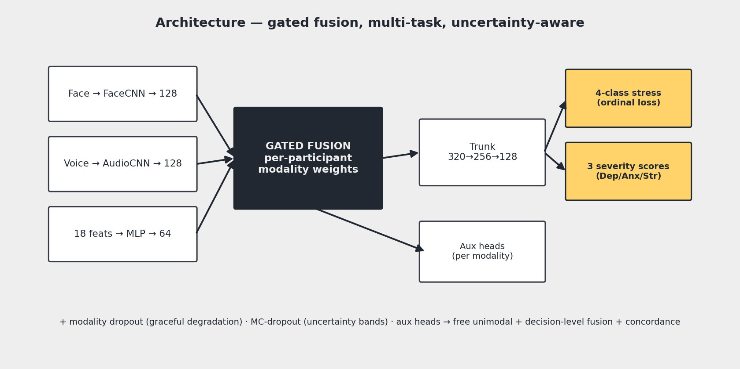
ARCHITECTURE
Three encoders → gated fusion → multi-task, uncertainty-aware

Slide 9
KEY TECHNIQUES
Small additions, large payoff
Ordinal-aware loss: predicting Healthy for a Severe case hurts more than predicting Moderate (the classes are an ordered scale).
Per-participant gated fusion: 'for this person the model leaned 41% on voice' — an explainability output, not just a mechanism.
Auxiliary heads: free single-modality results + the ingredients for decision-level fusion and concordance.
Modality dropout: the demo still works if a judge uploads only a photo.
MC-dropout: 'Depression 21 ± 4', not a fake-precise 21.3 — shows what the model doesn't know.

Slide 10
DID WE EVEN NEED THE PAIRING?
Decision-level fusion — an honest baseline with NO pairing
Capability | Decision-level (no pairing) | Joint gated fusion
4-class classification | ✓ (acc 0.652) | ✓ (acc 0.670)
Depression/Anxiety/Stress regression | ✗ collapses to tabular | ✓
Per-participant modality weights | ✗ global only | ✓
Cross-modal representation learning | ✗ | ✓
Tuned weights: face 0.45 / voice 0.50 / tab 0.05 — the near-zero tab weight confirms tabular is noise. Objectives 2 & 3 REQUIRE the joint model → that's why the alignment engine exists.

Slide 11
RESULTS
The headline: matched pairing beats random — same model
Model | Pairing | Acc | Macro F1 | ROC-AUC | QWK | Str MAE
Tabular only (LightGBM) | n/a | 0.370 | 0.260 | 0.493 | 0.050 | 10.11
Gated fusion | random | 0.553 | 0.474 | 0.775 | 0.437 | 9.28
Gated fusion | matched | 0.655 | 0.571 | 0.849 | 0.564 | 9.06
Final (+ordinal +mod-dropout) | matched | 0.670 | 0.575 | 0.864 | 0.562 | 8.95
Random → matched = +10 accuracy points / +0.13 QWK under an IDENTICAL model → isolates the alignment engine's contribution.

Slide 12
STANDOUT FEATURE
Modality disagreement → route to a human
We measure concordance: do face, voice and tabular agree? (masked affect: people hide distress in the face more than the voice.)
It's a REAL reliability signal: on the clean test subset, accuracy is 0.64 when modalities agree — but only 0.23 when they strongly disagree.
So we route: high concordance → report; medium → caveat; low → FLAG FOR HUMAN REVIEW instead of a confident label.
Calibration: reliability diagram + ECE = 0.198 reported — we show how trustworthy the confidences are.

Slide 13
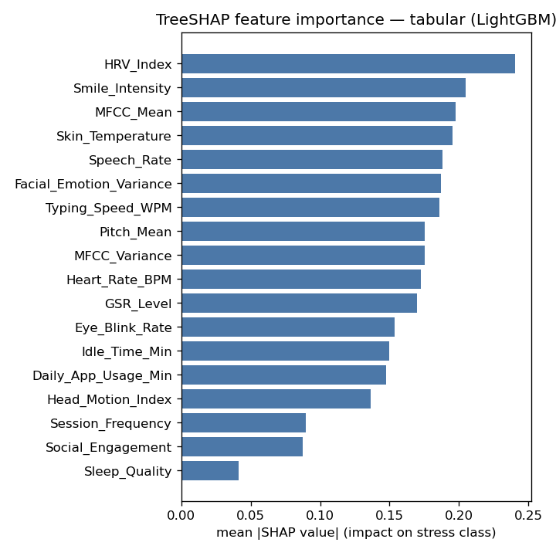
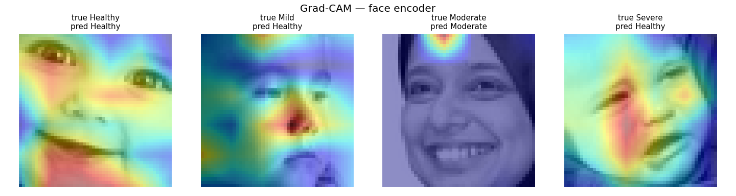
EXPLAINABILITY
Where the model looked + what drives it
SHAP: HRV is the top tabular driver (matches stress physiology). Grad-CAM: the model attends to eyes / nose / mouth.

Slide 14
THE PROTOTYPE
Not just a predictor — a trust layer
Shows the actual inputs it joined: each one-click demo displays the real FACE image and a playable AUDIO clip that were paired — our alignment idea, made visible.
Per-participant gate weights, MC-dropout uncertainty bands, live Grad-CAM on your own face & voice.
Counterfactuals: 'what would change this' — the actionable movers.
Graceful degradation + webcam/mic capture + conflict-aware honesty messaging.
'About the model' panel: ablation table, calibration, concordance evidence — rigour on demand.

Slide 15
LIVE DEMO
Let's screen four participants
Clear Healthy · Severe · a deliberately low-concordance case (caught and routed to review) · a label-conflict case (honesty behaviour).

Slide 16
LIMITATIONS
We name them before you do
Synthetic pairing — constructed participants, not a real cohort; conclusions rest on RELATIVE comparisons.
Acted emotions (RAVDESS/FER) → live webcam/mic is out-of-distribution.
Skewed CSV — Severe ≈ 3% (19 test participants); we quote effective sample size.
Only 1 of 4 face-video columns recoverable from static stills (no blink/head-motion).
Mapping conflict in the committee labels; ECE 0.198 = mild overconfidence. Not clinically validated.

Slide 17
NEXT STEPS & TAKEAWAY
Where this goes
Real longitudinal cohort with shared participants → removes the synthetic-pairing caveat.
Temporal modelling → recovers blink rate & head motion; calibration/temperature scaling to cut ECE.
On-device, privacy-preserving inference.
In one line:
Everyone stapled three encoders together — we aligned participants in measured-feature space and proved it helped (+10 pts), found the contradiction in the committee's own labels, treated the classes as the ordered scale they are, reported what the model doesn't know, and shipped something a clinician could read.

