Slide 1
Function
F01
Function
F08
Function
F09
Function
F02
Function
F03
Function
F07
Function
F04
Function
F06
Function
F05
ISA-95 Level 1, 2, 3 – Control Domain
Function
F10
ISA-95 Level 4 – Enterprise Domain

Slide 2
ISA-95 Level 4
ERP
ISA-95
Enterprise Domain
Innovative
MES
Innovative
MES
ISA-95
Control Domain
ISA-95
Level 3
Traditional MES
ISA-95 Level 1,2
SCADA, PLC, Fieldbus Level

Slide 3
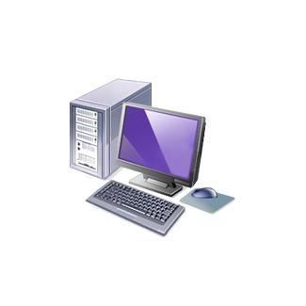
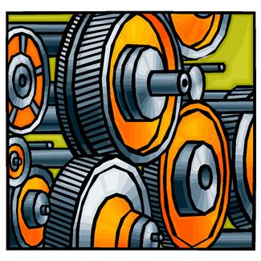
Enterprise Resource Planning System ( ERP )
Manufacturing Execution System ( MES )
SECS/GEM
Host
OPC Server
SECS-II Messaging
HSMS-SS or
SECS-I Protocol
Fieldbus Observation
Protocol of Variables
GEM Interface
PLC
Factory Equipment – Hardware & Software

Slide 4
Enterprise Resource Planning System ( ERP )
Manufacturing Execution System ( MES )
SECS/GEM
Host
OPC Server
Database
SECS-II Messaging
HSMS-SS or
SECS-I Protocol
SQL
Fieldbus Observation
Protocol of Variables
GEM Interface
PLC
Factory Equipment – Hardware & Software

