Slide 1
Parking 4.0
A public user-content driven customer service,
helping car drivers
to find the best parking place and
to be warned in case of need for urgent removal
Developing started on the hackathon "codeFEST8" in Braunschweig, 2015-03-06 – 2015-03-08
Author: Rolf Hemmerling, Team "Parking 4.0"
Slides: http://www.slideshare.net/hemmerling/
License: Creative Commons - Attribution-ShareAlike 4.0 Generic ( http://www.creativecommons.org/licenses/by-sa/4.0/ )
Code: http://github.com/hemmerling/
Date: 2015-03-08

Slide 2
1 Motivation for "Parking 4.0"
What is the major function of a car?
  In average, a privat car is parking for 23/24 hours [1]
If so, what's a primary need for any car driver?
  To find and to have...
    A public user-content driven customer service,
    helping car drivers
    to find the best parking place and
    to be warned in case of need for urgent removal
The service name is based on "Industry 4.0", the German synonym for Internet-Of-Things

Slide 3
2 Unique Selling Propositon (USP) of my Approach
The use of the agile development process "Behavour Driven Development" ( BDD ),
  Suitable for "Lean Startup"
  Successor and extension of "Test Driven Development" ( TDD ), aka "First write the test, then the code"
  Based on the principle of "Executable Specifications"
Its not the list of current features of the service, but the ability to change it quickly according to changing market needs and business models, and to start with a minimum of service features and of costs for the service providers

Slide 4
Feature: Car driver wants to park
As a car-driver driving a car
I want find a parking-place
So that I can park
@WantToPark
Scenario: The driver want to park the car
Given I am driving the car
When I want to park
Then I am offered free parking-places
@SelectParkingplace
Scenario: The driver selects a parking-place
Given I am driving the car
When I found free parking-places
Then I select a parking-place
@Parking
Scenario: The driver parks the car
Given I am driving the car
When I selected a parking-place
Then I park the car
3 .feature File

Slide 5
4 BDD Process 1/2
.feature File BDD source File
code
Native language Executable test code

Slide 6
4 BDD Process 2/2
.feature BDD Application
Source Code Source Code
Native Executable Executable
language test code application code
executable complies
specification

Slide 7
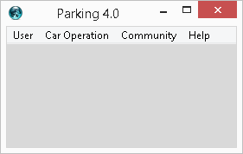
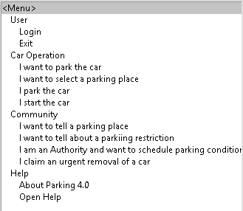
5 GUI Rapid Prototype

Slide 8
6 Result
Technically:
  4 feature files ( login, start, park,community ), 3 of them implemented
  GUI prototype
Development skills:
  Exercising agile and lean startup processes
... fork me on GitHub http://github.com/hemmerling/

Slide 9
7 Resources
ZUKUNFT Mobilität: Die größte Ineffizienz des privaten Pkw-Besitzes: Das Parken", 2013-02-24 ( http://www.zukunft-mobilitaet.net/13615/strassenverkehr/parkraum-abloesebetrag-parkgebuehr-23-stunden/ )

Slide 11
Draft:Use Cases 1/4
Given
  Modern cars are equipped with electronic car services which interact with online services
When
  The car user tells the car that he/she wants to park the car.
Then
  The car services tells and suggests the driver the next parking places
And
  The car service tells the online service the selected parking place as "successfully taken" and "taken until the car is removed".

Slide 12
Draft:Use Cases 2/4
Given
  Many people permanently connected to online services, e.g. by mobile phones
  The car driver adds a sticker to the glass window to his/her car, that the car shares the service
When
  There is an need for urgent removal of the car, e.g. given by a local governmental authority ( "water hightide announced in a harbour" ), or by private users ( "gateway blocked" )
Then
  The car user is informed by a push service, personally

Slide 13
Draft:Use Cases 3/4
Given
  There is a geolocation-based online community
When
  A community member knows / learns about parking places or parking restrictions
Then
  The community member may provide this information to the community, manually
When
  A community member is parking his/her car
Then
  The community member may provide this information to the community, automatically

Slide 14
Draft:Use Cases 4/4
Given ( Repetition )
  There is a geolocation-based online community
When
  A local governmental authority wants to publish informations about parking places and parking restrictions
Then
  The governmental authority may provide this information to the community ( automatically or manually )

