Slide 1
Digital Forensics (20CP411T)
UNIT 1 – Lecture 3
Computer Crimes

Slide 2
Learning Outcomes
After this lecture, students will be able to:
Define a computer crime.
Differentiate between categories of computer crimes.
Explain how computers are used in criminal activities.
Identify common types of computer crimes.
Understand the impact of computer crimes on individuals, organizations, and society.

Slide 3
Computer Crime??????
"Can every cybercrime be considered a computer crime? What about stealing money through a fake phone call without using a computer?"
"By the end of today's lecture, you'll be able to answer this correctly."

Slide 4
What is a Computer Crime?
A computer crime (also called a cybercrime) is any unlawful act in which a computer, digital device, or computer network is used either as the target of the crime or as the tool to commit the crime.
A computer may be attacked (target) or used to commit a crime (tool).

Slide 5
Two Ways a Computer is Involved
COMPUTER CRIME
Computer is the Target
Computer is the Tool
Attack the System
Hacking, Malware, Ransomware
Use the System
Fraud, Phishing, Identity Theft

Slide 6
Two Ways a Computer is Involved
Computer as the Target | Computer as the Tool
The attacker aims to damage, steal, or disrupt a computer system. | The attacker uses a computer to commit another crime.
Example: Hacking a university server. | Example: Sending phishing emails to steal banking credentials.
Goal: Attack the system. | Goal: Commit another offence using the system.

Slide 7
Major Types of Computer Crimes
Computer crimes take many forms.
Some aim to steal money, others target personal information, while some disrupt services or damage computer systems.
Understanding these categories helps investigators recognize the nature and impact of different cyber incidents.

Slide 8
Types of Computer Crimes
Category | Description | Example
💰 Financial Crimes | Crimes committed to obtain financial gain through digital means. | Online banking fraud, credit card fraud
🔓 Unauthorized Access (Hacking) | Accessing a computer or network without permission. | Breaking into a university server
🦠 Malware Attacks | Using malicious software to damage or disrupt systems. | Ransomware, viruses, worms
👤 Identity Theft | Misusing another person's personal information. | Fake social media profile, stolen credentials

Slide 9
Types of Computer Crimes
📧 Email & Internet Crimes | Crimes carried out using email or web services. | Phishing, email spoofing, spam
👥 Crimes Against Individuals | Targeting people through digital platforms. | Cyberbullying, cyberstalking, online harassment
🏢 Crimes Against Organizations | Attacks on businesses or institutions. | Data breaches, insider attacks
🌐 Crimes Against Society & Government | Crimes affecting public services or national interests. | Attacks on public infrastructure, government portals

Slide 10
Financial Computer Crimes
Financial computer crimes involve the use of computers, mobile devices, or the Internet to steal money, financial information, or valuable digital assets. These crimes affect individuals, businesses, banks, and governments, causing significant economic losses every year.
Unlike traditional bank robberies, modern financial crimes are often committed remotely, allowing criminals to target victims across different cities or even countries.

Slide 11
Common Types of Financial Computer Crimes
Crime | Description | Example
💳 Credit/Debit Card Fraud | Unauthorized use of payment card information. | Card details stolen and used for online purchases.
📱 UPI & Online Banking Fraud | Fraud involving digital payment platforms. | Fake payment requests or unauthorized fund transfers.
🎣 Phishing Attacks | Fake emails, SMS, or websites designed to steal banking credentials. | Victim enters login details on a fake banking website.
🛒 Online Shopping Fraud | Fake e-commerce websites or sellers deceive customers. | Customer pays but never receives the product.
💰 Cryptocurrency Fraud | Fraud involving fake crypto investments or exchanges. | Fake investment scheme promising unrealistic returns.

Slide 12
Crimes Against Individuals
Computer crimes are not limited to stealing money. Many cybercriminals target individuals by stealing their identity, invading their privacy, harassing them online, or manipulating personal information.
These crimes can cause emotional distress, financial loss, reputational damage, and privacy violations.
Unlike financial crimes, the primary victim here is an individual rather than an organization.

Slide 13
Common Crimes Against Individuals
Crime | Description | Example
👤 Identity Theft | Using another person's personal information without permission. | Creating a fake social media account using someone else's name and photos.
📱 Cyberstalking | Repeatedly monitoring or threatening someone through digital platforms. | Sending unwanted messages and tracking a person's online activities.
💬 Cyberbullying | Using electronic communication to harass, insult, or intimidate others. | Posting offensive comments or spreading rumors on social media.
📷 Privacy Violation | Accessing or sharing someone's private information without consent. | Leaking personal photos or confidential documents online.
📧 Email Account Hacking | Gaining unauthorized access to another person's email account. | Changing passwords and impersonating the account owner.

Slide 14
Crimes Against Organizations
Organizations rely heavily on digital technologies to manage their daily operations. Customer databases, financial records, intellectual property, employee information, and business communications are all stored electronically.
Cybercriminals often target organizations because they possess valuable data, financial resources, and critical services.
These attacks can lead to financial losses, operational disruption, legal consequences, and reputational damage.
Organizations are attractive targets because compromising one organization can affect thousands or even millions of customers.

Slide 15
Common Crimes Against Organizations
Crime | Description | Real-Life Example
🗄 Data Breach | Unauthorized access to confidential organizational data. | Customer database stolen from an e-commerce company.
👨‍💼 Insider Threat | Employees misuse authorized access for personal gain or revenge. | Employee copies confidential client information before resigning.
🔐 Ransomware Attack | Criminals encrypt company files and demand payment for recovery. | Hospital systems become inaccessible after a ransomware attack.
💻 Intellectual Property Theft | Theft of proprietary software, research, or product designs. | Software source code copied to a competitor.
🌐 Denial-of-Service (DoS/DDoS) Attack | Flooding a server with excessive requests to make services unavailable. | Online shopping website becomes unavailable during a festival sale.

Slide 16
Crimes Against Society and Government
Some computer crimes have consequences that extend far beyond a single person or organization. They disrupt essential public services, affect millions of citizens, and may even threaten national security.
These crimes target systems that society depends on every day, such as electricity, transportation, healthcare, banking, communication, and government services.
When public digital infrastructure is attacked, the impact is experienced by society as a whole.

Slide 17
Common Crimes Against Society & Government
Crime |  | Description | Example
🏛 Attack on Government Systems |  | Unauthorized access to government websites or databases. | Defacing a government website or accessing citizen records.
⚡ Critical Infrastructure Attack |  | Cyberattack targeting essential public services. | Attack on a power grid or water treatment system.
🚆 Transportation System Attack |  | Disruption of transportation services through cyber means. | Railway reservation or airport system outage.
🌐 Distributed Denial-of-Service (DDoS) |  | Large-scale attack making public services unavailable. | Government portal inaccessible during tax filing season.
📢 Misinformation & Fake News Campaigns |  | Using digital platforms to spread false information and create public panic. | Fake emergency messages circulated on social media.

Slide 18
Case Study 1: WannaCry Ransomware Attack (2017)
What Happened?
The WannaCry ransomware spread rapidly across the world.
It encrypted files on infected computers and demanded a ransom payment.
The attack affected organizations in more than 150 countries.
Major Impact
Hospitals canceled medical appointments.
Businesses suspended operations.
Government organizations experienced service disruptions.
Thousands of computers became inaccessible.

Slide 19
Case Study 1:WannaCryRansomwareAttack (2017)
Lesson Learned
Regular software updates and security patches are critical.
Backups help organizations recover more quickly.
Digital Forensics helps investigators understand how the malware spread and assess its impact.

Slide 20
Case Study 2: Bangladesh Bank SWIFT Heist (2016)
What Happened?
Cybercriminals gained unauthorized access to the bank's systems and attempted to transfer nearly $1 billion through the SWIFT international payment network.
Although most transactions were blocked, approximately $81 million was successfully transferred.
Major Impact
Significant financial loss.
International banking investigation.
Increased focus on cybersecurity within the banking sector.

Slide 21
Case Study 2: Bangladesh Bank SWIFT Heist (2016)
Lesson Learned
Financial institutions require strong security controls.
Continuous monitoring and investigation are essential.
Digital Forensics helps reconstruct the sequence of events and identify weaknesses.

Slide 22
Case Study 3: Colonial Pipeline Attack (2021)
What Happened?
A ransomware attack disrupted the operations of a major fuel pipeline inthe United States.
Major Impact
Temporary fuel shortages.
Panic buying at fuel stations.
Economic disruption across several states.
Lesson Learned
Cyberattacks can affect critical infrastructure.
Organizations must prepare incident response and recovery plans.
Digital Forensics supports investigation and future risk reduction.

Slide 23
Emerging Trends in Computer Crimes
Introduction
As technology advances, criminals also adopt new techniques. Modern computer crimes are becoming more sophisticated, automated, and difficult to detect. Understanding these trends helps investigators, organizations, and individuals prepare for future cyber threats.
Cybercriminals continuously adapt to new technologies, making cybersecurity and digital forensics increasingly important.

Slide 24
Current Trends in Computer Crimes
Trend | Description | Example
🤖 AI-Enabled Scams | Criminals use Artificial Intelligence to create convincing scams. | AI-generated voice calls pretending to be family members or bank officials.
🎭 Deepfake Technology | AI-generated fake images, audio, or videos used to deceive people. | Fake video of a public figure making false statements.
📱 Mobile & UPI Frauds | Attacks targeting smartphones and digital payment applications. | Fake QR codes and fraudulent payment requests.
🌐 IoT Device Attacks | Smart devices connected to the Internet become attack targets. | Compromised smart cameras or home automation devices.
☁️ Cloud Service Attacks | Criminals target cloud storage and online services. | Unauthorized access to cloud-hosted business data.
🧠 Social Engineering | Manipulating people instead of exploiting technology. | Fake tech support calls asking users to reveal passwords or OTPs.

Slide 25
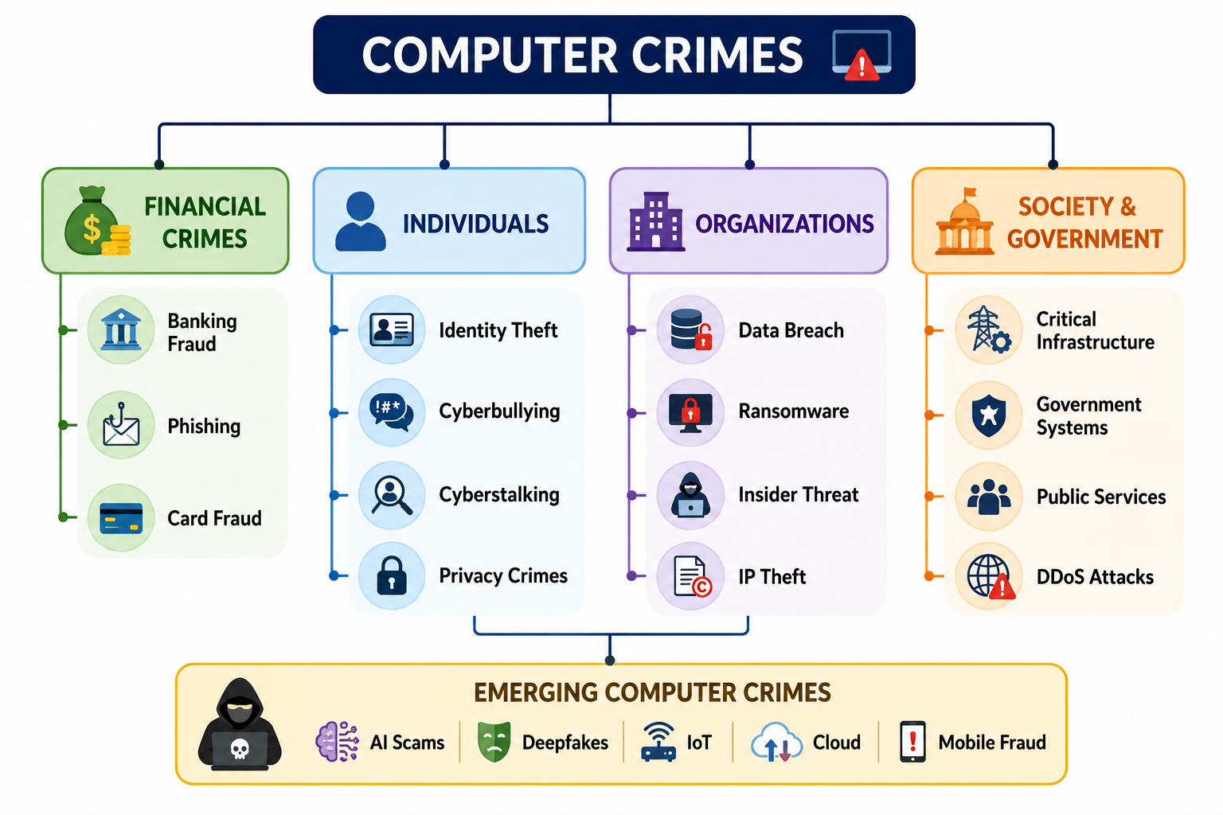
Summary and Review
"Every computer crime leaves behind digital traces. The challenge is not only to detect the crime but also to collect and preserve those traces in a way that they become reliable evidence in a court of law. That is the essence of Digital Forensics.

