Slide 1
Digital Forensics (20CP411T)
UNIT 1 – Lecture 5
Digital Evidence

Slide 2
Learning Outcomes
At the end of this lecture students should be able to:
Define Digital Evidence.
Differentiate physical evidence and digital evidence.
Identify different types of digital evidence.
Explain the characteristics of digital evidence.
Understand why digital evidence is important in courts.
Recognize the challenges associated with digital evidence.

Slide 3
What is Digital Evidence?
Whenever we use a computer, smartphone, ATM, email, social media, or the Internet, we leave behind digital traces. These traces can be collected and analyzed during an investigation.
If these digital traces help establish what happened, who was involved, when it happened, or how it happened, they become digital evidence.
Digital evidence is any information stored or transmitted in digital form that can be used to establish facts during an investigation or legal proceeding.

Slide 4
Examples of Digital Evidence
Digital Device / Source | Possible Digital Evidence
💻 Computer | Documents, browser history, downloaded files
📱 Mobile Phone | SMS, WhatsApp chats, call logs, photos
📧 Email | Messages, attachments, timestamps
🌐 Internet | Website access logs, IP addresses
📷 CCTV/DVR | Video recordings, timestamps
☁️ Cloud Storage | Shared files, activity logs
💳 ATM/POS System | Transaction records
🚗 GPS Device | Location history

Slide 5
Characteristics of Digital Evidence
Digital evidence differs significantly from traditional physical evidence. While a fingerprint or weapon is tangible, digital evidence exists as binary data (0s and 1s) and requires electronic devices to access, interpret, and analyze it.
Understanding these characteristics helps investigators appreciate both the power and the limitations of digital evidence.

Slide 6
Major Characteristics of Digital Evidence
1. Fragile
Digital evidence can be altered, overwritten, or deleted easily—sometimes simply by turning on a device or opening a file.
Example
Opening a document changes its "Last Accessed" timestamp.
Installing software modifies system files.

Slide 7
2. Easily Duplicated
Unlike physical evidence, digital evidence can be copied exactly.
A copied file is identical to the original if copied correctly.
Example
A PDF copied from a USB drive to another computer contains exactly the same information.
"Can investigators work on a copy instead of the original?

Slide 8
3. Invisible to the Human Eye
Digital evidence cannot be understood without electronic devices and software.
Examples include:
Binary files
Database records
Browser cache
System logs
Unlike a handwritten letter, digital evidence cannot be examined directly without technology.

Slide 9
4. Persistent
Deleting a file does not always remove it immediately.
In many cases, traces remain until the storage space is overwritten.
Example
A deleted photograph may still exist on a storage device until new data replaces it.

Slide 10
5. Large Volume
Modern devices store enormous amounts of information.
Examples:
Thousands of photographs
Years of emails
Millions of log entries
Months of browser history
Investigators often need to identify the relevant evidence from vast amounts of data.

Slide 11
6. Time-Stamped
Many digital activities automatically record the date and time.
Examples include:
Email sent time
Login time
File creation time
Transaction time
GPS location history
These timestamps help investigators reconstruct events chronologically.

Slide 12
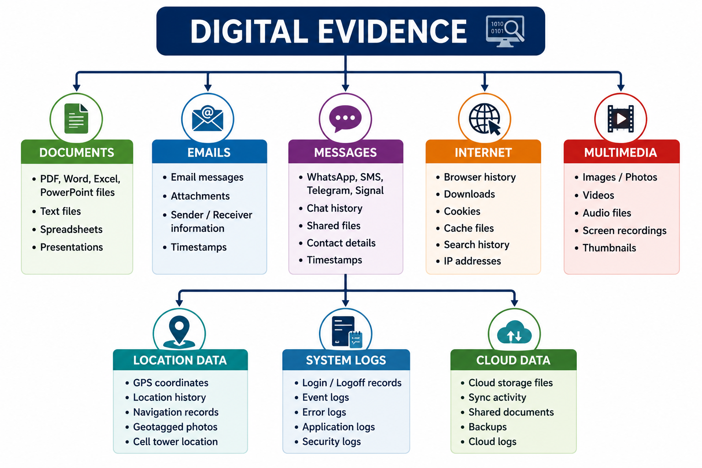
Types of Digital Evidence

Slide 13
Digital Evidence in Courts
Digital evidence plays an increasingly important role in both criminal and civil cases. Courts rely on electronic evidence to reconstruct events, identify suspects, verify claims, and support judicial decisions.
However, not every digital file automatically becomes valid evidence. The court must be satisfied that the evidence is relevant, authentic, reliable, and legally obtained.

Slide 14
Role of Digital Evidence in Court
Digital evidence helps courts to answer important questions such as:
Who committed the crime?
What happened?
When did it happen?
Where did it happen?
How did it happen?

Slide 15
Common Digital Evidence Presented in Court
Evidence | Example | Purpose in Court
📧 Emails | Business communication | Establish communication
💬 Chat Messages | WhatsApp, Telegram | Verify conversations
📱 Call Records | Mobile call logs | Identify contacts
📷 CCTV Footage | Security camera recordings | Identify suspects and events
🌍 GPS Records | Vehicle or phone location | Determine location
💳 Transaction Logs | ATM, UPI, online banking | Prove financial transactions
🌐 Browser History | Websites visited | Show online activity

Slide 16
Requirements for Accepting Digital Evidence
For digital evidence to be useful in court, it should be:
✅ Relevant
It must be directly related to the case.
✅ Authentic
It must be genuine and linked to the correct source.
✅ Reliable
It should accurately represent the original information.
✅ Legally Obtained
It must be collected according to applicable laws and legal procedures.

Slide 17
Challenges of Digital Evidence
Digital evidence has transformed modern investigations, but it also introduces significant challenges.
Unlike physical evidence, digital evidence is dynamic, distributed, and technology-dependent. Investigators must often deal with enormous amounts of data, rapidly changing technologies, and legal constraints.

Slide 18
Major Challenges
Challenge | Explanation | Example
💾 Huge Volume of Data | Modern devices store enormous amounts of information. | A 1 TB hard drive may contain millions of files.
🔐 Encryption | Data may be protected using strong encryption techniques. | Password-protected smartphones and encrypted messaging apps.
☁️ Cloud Storage | Data may be stored on remote servers across different countries. | Files saved on Google Drive or OneDrive instead of the local computer.
🌍 Jurisdiction Issues | Digital evidence may be stored in another country, making legal access more complex. | Email server located outside India.

Slide 19
Major Challenges
🗑 Deleted or Hidden Data | Users may intentionally delete or conceal information. | Deleted chat history or hidden files.
🤖 Rapidly Changing Technology | New devices, applications, and communication platforms appear continuously. | New messaging apps or IoT devices.
⚖️ Privacy and Legal Issues | Investigators must balance evidence collection with individual privacy rights. | Accessing personal data requires proper legal authorization.

Slide 20
Real-Life Example
Cloud-Based Investigation
Suppose a suspect stores important documents in a cloud storage service instead of on their laptop.
Investigators find the laptop, but the files are not present locally.
Questions arise:
Where are the files stored?
Which country hosts the cloud server?
Who owns the account?
How can access be obtained legally?

Slide 21
Computer forensics evidence and courts
Evidence Gathering and Preservation:
Computer forensics experts use specialized techniques to extract data from various digital devices, including computers, mobile phones, and storage media.
They focus on preserving the integrity of the evidence by maintaining a documented chain of custody and ensuring that data is not altered during the investigation.

Slide 22
Computer forensics evidence and courts
Analysis and Interpretation:
The collected data is analyzed to identify relevant information, establish timelines, trace internet activity, and determine the source of cyberattacks.
Investigators may recover deleted files, analyze network traffic, and examine digital documents for signs of tampering or manipulation.

Slide 23
Computer forensics evidence and courts
Admissibility in Court:
For digital evidence to be accepted in court, it must be relevant to the case, authentic, and have integrity.
The field of computer forensics adheres to strict guidelines and practices to ensure that the evidence is reliable and can be used to support or refute claims.

Slide 24
Computer forensics evidence and courts
Applications in Various Cases:
Computer forensics is used in a wide range of legal cases, including criminal investigations (e.g., cybercrime, fraud, theft), civil litigation, and regulatory compliance matters.
It can help establish intent, identify perpetrators, and provide crucial evidence in cases involving digital communication, financial transactions, or intellectual property.

Slide 25
Computer forensics evidence and courts
Evolving Landscape:
The legal framework surrounding digital evidence is constantly evolving to keep pace with technological advancements and changing legal precedents.
Amendments to the Federal Rules of Evidence have streamlined the process of authenticating digital evidence, making it easier to introduce certain types of machine-generated data as evidence.

Slide 26
Types of digital evidence
Emails, text messages, and social media interactions.
Digital documents, spreadsheets, presentations.
Images, videos, and audio recordings.
Computer and internet activity logs (browsing history, file access, system logs).
Location data (GPS).
Financial transactions and blockchain records.

Slide 27
Admissibility of digital evidence in courts
Key legal provisions
In India, the legal framework for digital evidence is primarily governed by the Information Technology Act, 2000 (IT Act) and the Indian Evidence Act, 1872, with the recently introduced Bharatiya Sakshya Sanhita (BSS), 2023 set to replace the latter.

Slide 28
Admissibility of digital evidence in courts
IT Act, 2000: Recognizes electronic records and digital signatures as valid, providing the foundation for their use in legal proceedings.
Indian Evidence Act, 1872 (and BSS, 2023): Section 65B (and Section 63 under BSS) details the conditions for the admissibility of electronic records, emphasizing the need for a certificate verifying authenticity from the person in control of the device or system.

Slide 29
Challenges in digital forensics and evidence handling
Maintaining the chain of custody: Ensuring a documented trail of how evidence was collected, handled, stored, and transferred is crucial to prevent allegations of tampering.

Slide 30
Challenges in digital forensics and evidence handling
Data integrity and authenticity: The ease with which digital data can be altered or deleted necessitates stringent protocols to demonstrate that the evidence is genuine and hasn't been tampered with.

Slide 31
Challenges in digital forensics and evidence handling
Technical complexities: Dealing with encryption, anti-forensics techniques, vast data volumes, cloud storage, and evolving technologies like AI and IoT requires specialized expertise and tools.

Slide 32
Challenges in digital forensics and evidence handling
Legal and procedural complexities: Ensuring compliance with varying jurisdictional laws, obtaining necessary legal authorizations (like search warrants), and effectively presenting technical information to non-technical audiences (judges and juries) can be challenging.

Slide 33
Challenges in digital forensics and evidence handling
Ethical concerns: Balancing the need for evidence with individual privacy rights is a critical ethical consideration in digital forensics.

