Slide 1
Digital Forensics (20CP411T)
UNIT 1 – Lecture 6
Understanding the Computing Investigation

Slide 2
Learning Outcomes
Understand what a computer investigation is.
Explain why investigations are conducted.
Describe the investigation lifecycle.
Identify the role of a forensic investigator.

Slide 3
Role of digital forensic investigator
A specialized professional
    Plays a crucial role in investigating cybercrime and cybersecurity incidents
“Detectives of the digital world“
Uses specialized tools and techniques to
  uncover,
  analyze,
  and preserve digital evidence found on electronic devices
This evidence can then be used in legal proceedings to
  prosecute cybercriminals,
  recover stolen data,
  or determine the cause of security breaches

Slide 4
Computing Investigations
Computing investigations focus on identifying and analyzing digital evidence from computers and related digital devices.
1
These investigations are often part of criminal, civil, or corporate cases.
2
The process must follow strict legal and ethical standards to ensure admissibility in court.
3

Slide 5
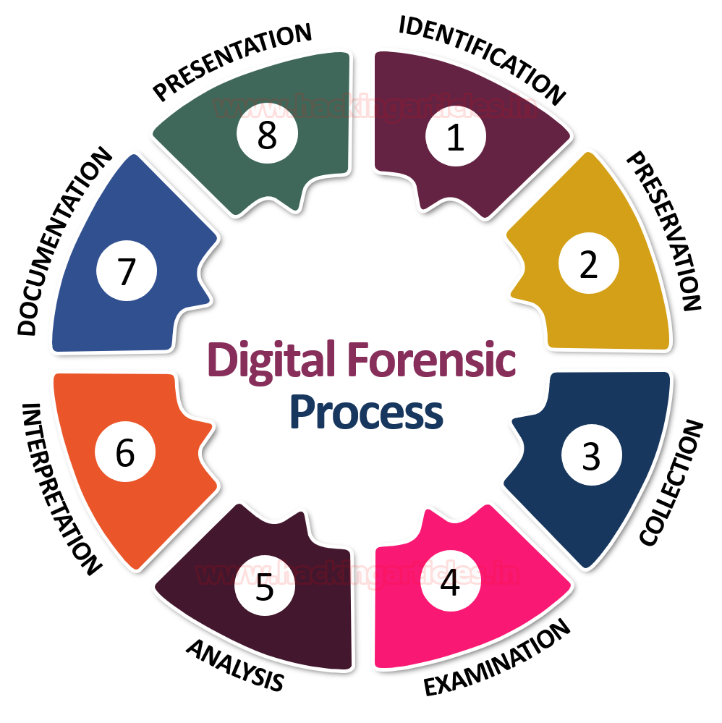
Computing Investigations

Slide 6

Phases of a Computing Investigation
Identification
  Recognizing potential sources of digital evidence.
  Devices may include desktops, laptops, mobile phones, cloud storage, and removable media.

Slide 7

Phases of a Computing Investigation
Preservation
  Ensuring the integrity of digital evidence.
  Use of write blockers and forensic imaging tools to prevent alteration of data.

Slide 8

Phases of a Computing Investigation
Collection
  Extracting data using appropriate tools without compromising original content.
  Documentation of all actions during the process is critical.

Slide 9
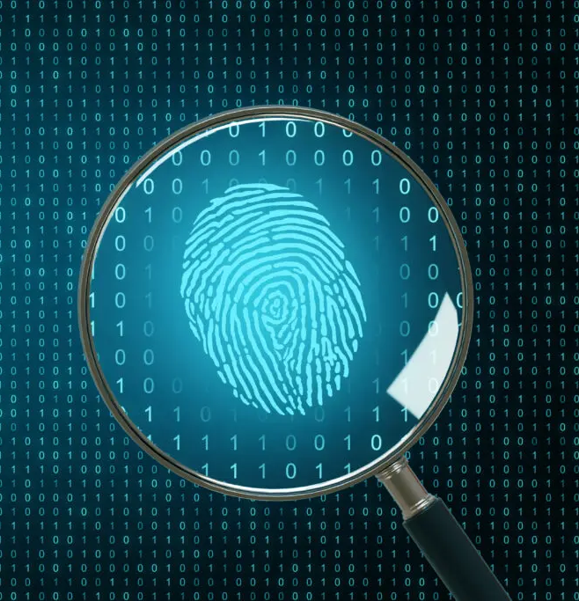
Phases of a Computing Investigation
Examination
  Applying forensic techniques to uncover hidden, deleted, or encrypted information.
  Involves keyword searching, file recovery, log analysis, and metadata extraction.

Slide 10

Phases of a Computing Investigation
Analysis
  Interpreting the data to understand sequences of events or reconstruct user activities.
  Correlating evidence across devices and timelines.

Slide 11

Phases of a Computing Investigation
Presentation
  Compiling findings in a clear, legally acceptable format.
  Includes written reports, exhibits, and possibly expert testimony in court.

Slide 12
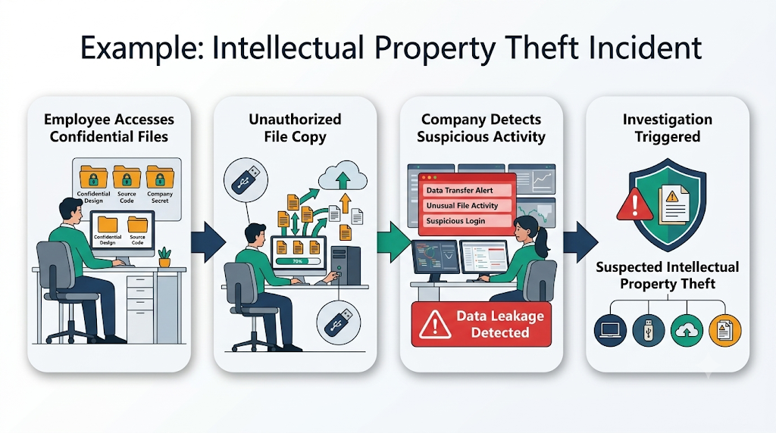
Stages Of Computer Forensics Process …
Imagine a company suspects an employee of intellectual property theft. The computer forensics team would:

Slide 13
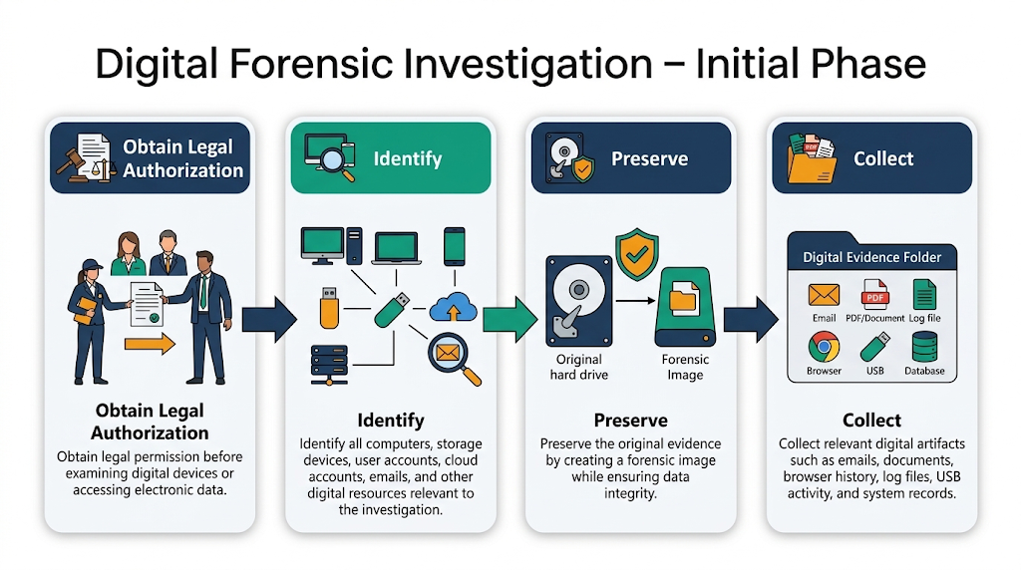
Stages Of Computer Forensics Process …
Obtain Legal Authorization: Ensure they have the necessary legal permissions to investigate the employee's computer.
Identify: Determine which devices and accounts are involved.
Preserve: Take a forensic image of the employee’s computer hard drive and other relevant storage media.
Collect: Extract relevant emails, documents, and log files.

Slide 14
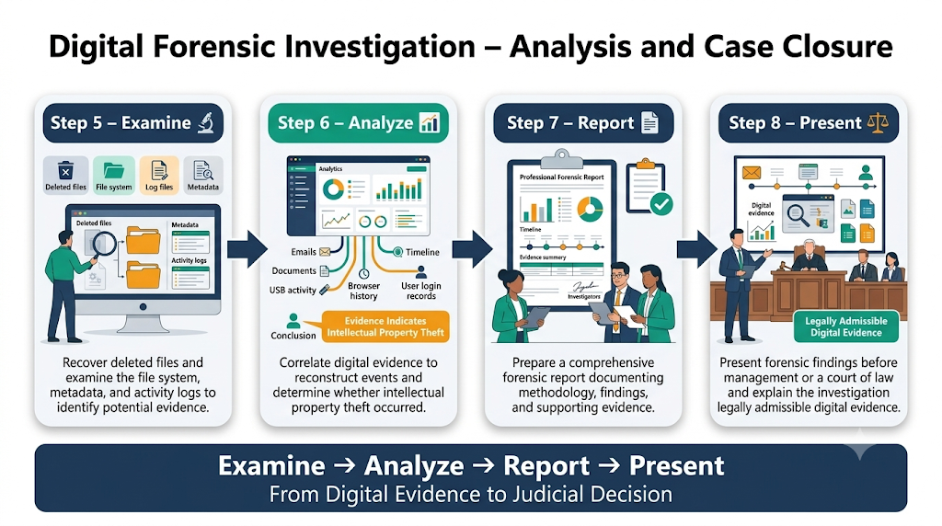
Stages Of Computer Forensics Process …
Examine: Recover deleted files and analyze the computer’s file system and activity logs.
Analyze: Correlate the data to identify evidence of intellectual property theft.
Report: Document the findings and prepare a report for company management and legal teams.
Present: If the case goes to court, present the evidence and explain the forensic process.

Slide 15
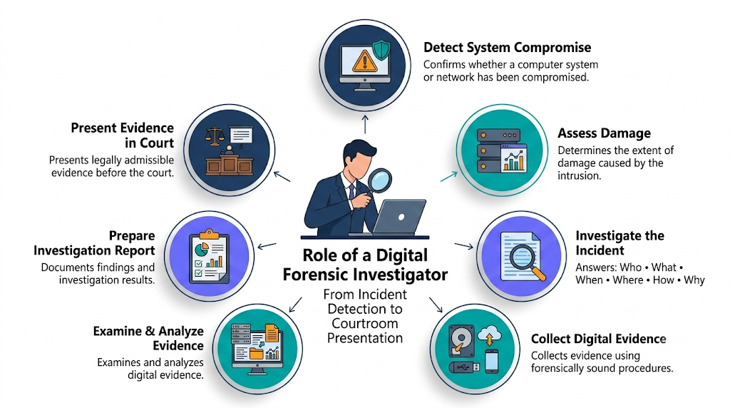
Role of Forensics Investigator
Confirms or dispels whether a resource/network is compromised.
Determine extent of damage due to intrusion.
Answer the questions: Who, What, When, Where, How and Why.
Gathering data in a forensically sound manner.
Handle and analyze evidence.
Prepare the report.
Present admissible evidence in court.

Slide 16
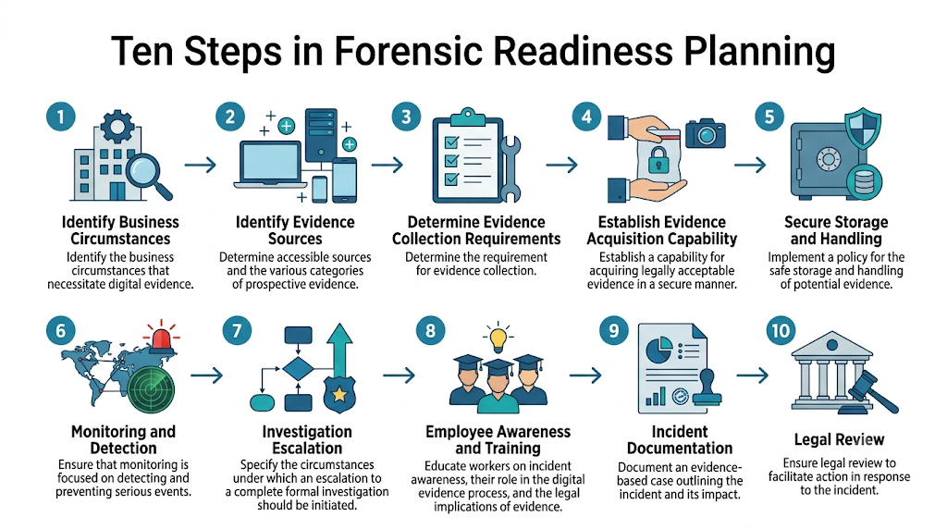
Steps for Forensic Planning…
  Ensure that monitoring is focused on detecting and preventing serious events.
  Specify the circumstances under which an escalation to a complete formal investigation (which may include the use of digital evidence) should be initiated.
  Educate workers on incident awareness so that everyone engaged understands their involvement in the digital evidence process as well as the legal implications of evidence.
  Document a based on evidence case outlining the incident and its impact; and
  Ensure legal review to facilitate action in response to the incident.

