Slide 1
Digital Forensics (20CP411T)
UNIT 1 – Lecture 7
Sources of Digital/Electronic Evidence

Slide 2
Opening Scenario
Imagine a police officer seizes the following items during a cybercrime investigation.
🖥 Laptop
📱 Smartphone
💾 USB Drive
💽 External Hard Disk
💳 Memory Card
🎵 iPod
The investigator asks:
Which device contains useful evidence?
Should every device be examined?
Which device should be examined first?

Slide 3
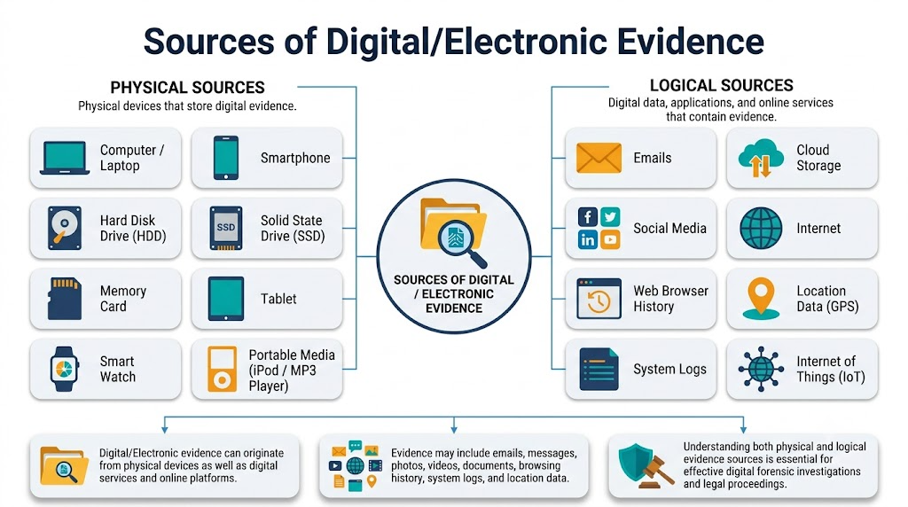
Source of Evidence
Digital evidence is no longer stored only on computers.

Slide 4
Digital Evidence Types
We can differentiate between two main types of digital artifactsaccording to who has created them
Digital Evidence Types
User-Created Data
Machine/Network-Created Data

Slide 5
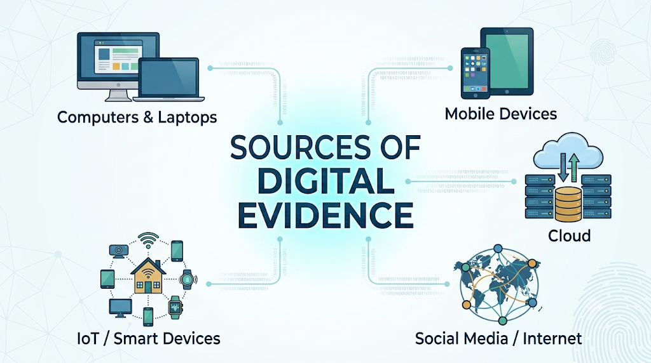
Sources of Digital/Electronic Evidence

Slide 6
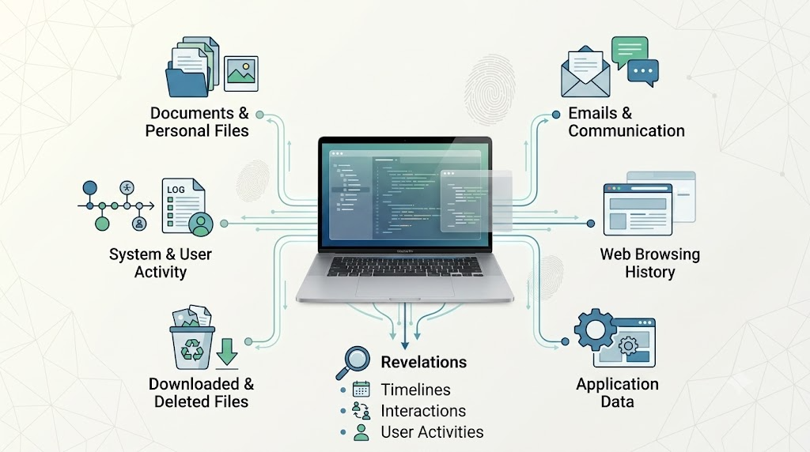
Computers & Laptops

Slide 7
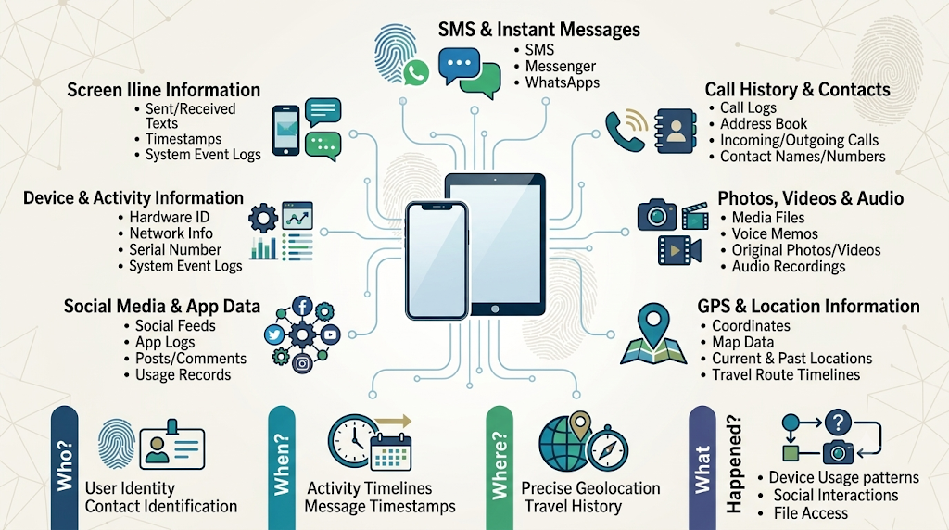
Mobile Device

Slide 8
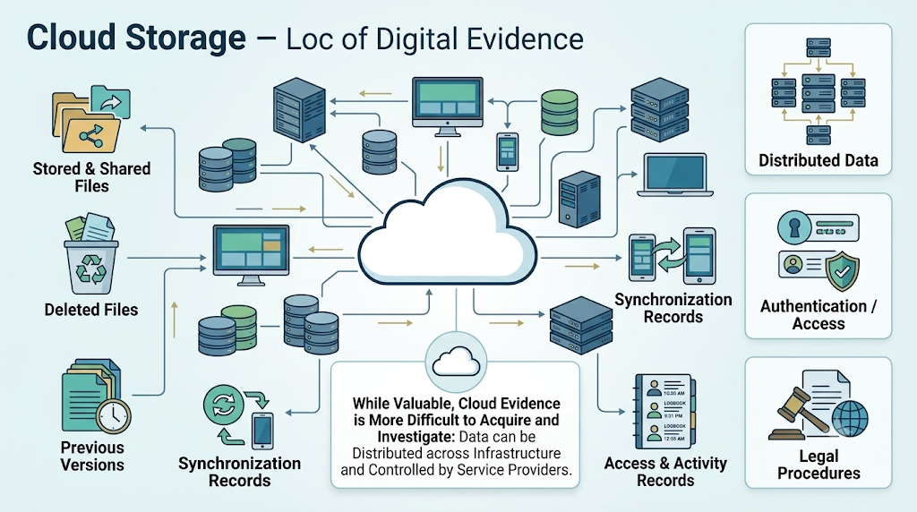
Cloude Storage

Slide 9
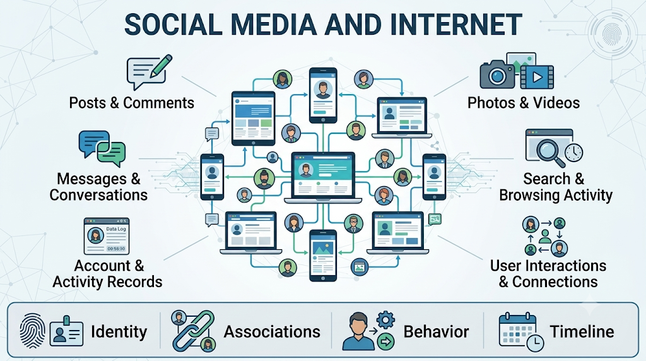
Social Media and Internet

Slide 10
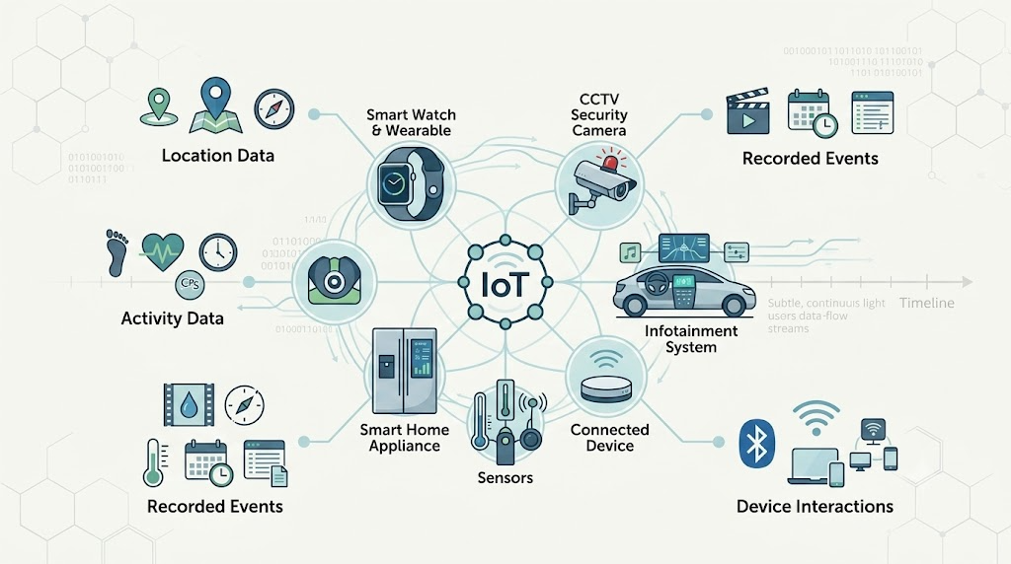
IoT & Smart Devices

Slide 11
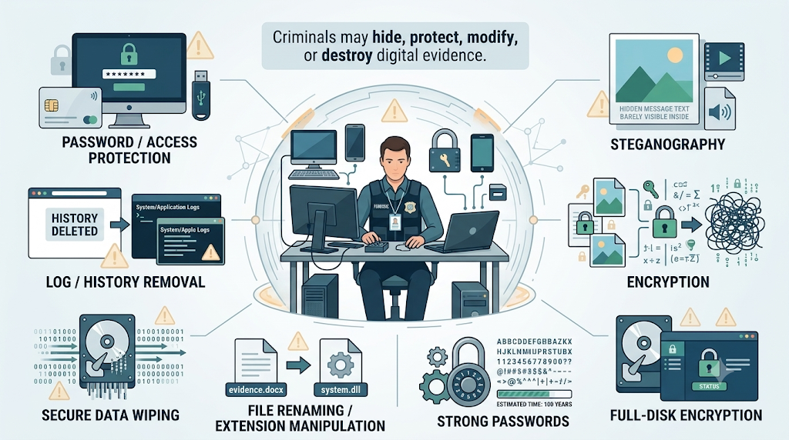
Challenge of Acquiring Digital Evidence-Technical

Slide 12
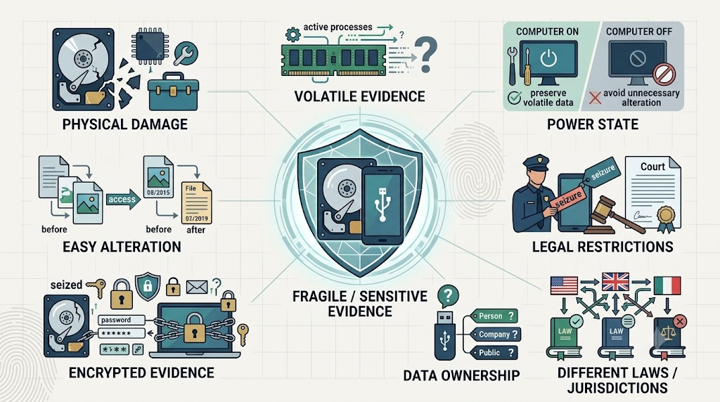
Forensic & Legal Challenges

Slide 13
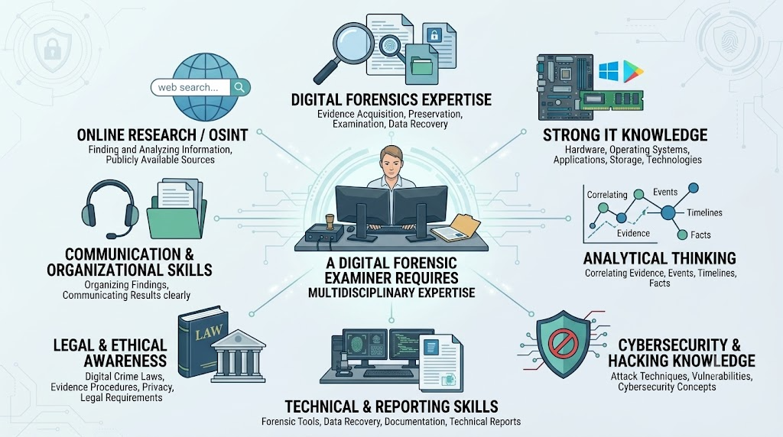
Who Should Collect Digital Evidence?

