Slide 1

StandAlone Cinder

Slide 2
Agenda
Cinder Background
Cinder With OpenStack
Cinder Alone
Cinder with Keystone and Glance
Q&A

Slide 3
BIO: Scott D’Angelo
Senior Software Engineer at IBM
Cinder Core Reviewer
Email: scott.dangelo@ibm.com
Twitter: @scottNdangelo
IRC: scottda

Slide 4
BIO: Ivan Kolodyazhny
Senior Software Engineer at Mirantis
Cinder Core Reviewer
Email: e0ne@e0ne.info
Twitter/IRC: @e0ne

Slide 5
Bio: Walt Boring
Senior Software Engineer at IBM
Cinder Core Reviewer
Email: Walter.A.Boring@ibm.com
IRC: hemna

Slide 6
What is Cinder?
“...virtualizes the management of block storage devices and provides end users with a self service API to request and consume those resources without requiring any knowledge of where their storage is actually deployed or on what type of device.”
Notes:
Scott: Really ,
Cinder is a Software Defined Storage Management System.

Slide 7
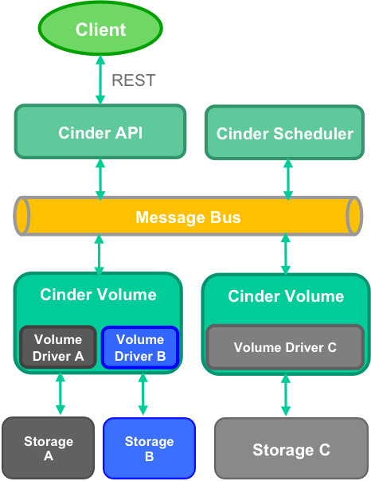
Notes:
Scott: Cinder consists of client code, interacting with an API server Via REST…
A message bus like RabbitMQ is used to cast RPC calls to the Scheduler to determine where a volume will be created…
One or more Volume servers abstract volume creation using Volume drivers that are specific to the storage back end.
And, finally, each volume server has a storage backend where volumes are created,deleted, attached, and detached.
There is more stuff...backups, replication, but we won’t be talking about that here.

Slide 8
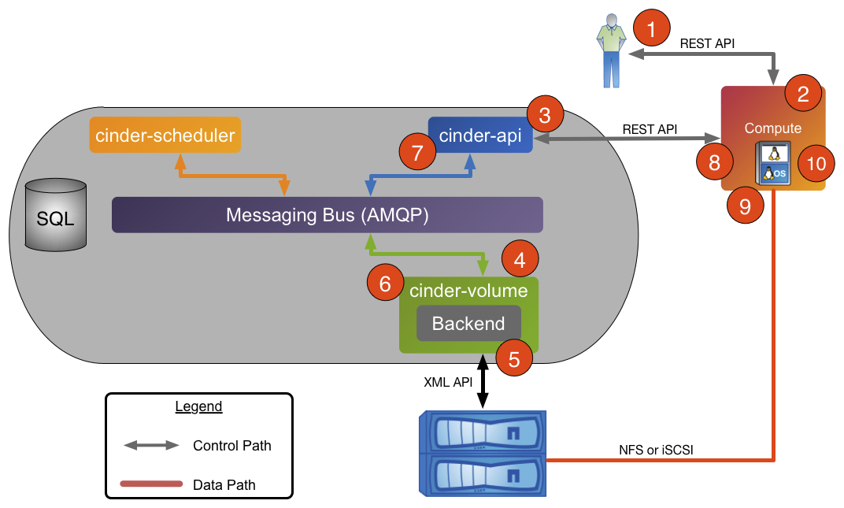
Notes:
Scott: For Normal volume attach using Nova:
Client makes a request to Nova to Attach a volume
Nova starts handling the request, including..
A call to Cinder API
The call goes to cinder Volume server
A request is made to the storage backend for information necessary to attach the volume (i.e. iscsi target)
Cinder Volume packages up the attachment info and...
Passes back to the Cinder API server which …
Sends the Info back to Nova
OS-brick gets this attachment info and uses it to connect the volume from the Storage to the Nova compute host.
Nova finishes up with metadata and DB actions.

Slide 9
Just Use Cinder with OpenStack?
Notes:
Scott: So, why don’t we just use Cinder with all of OpenStack?

Slide 10
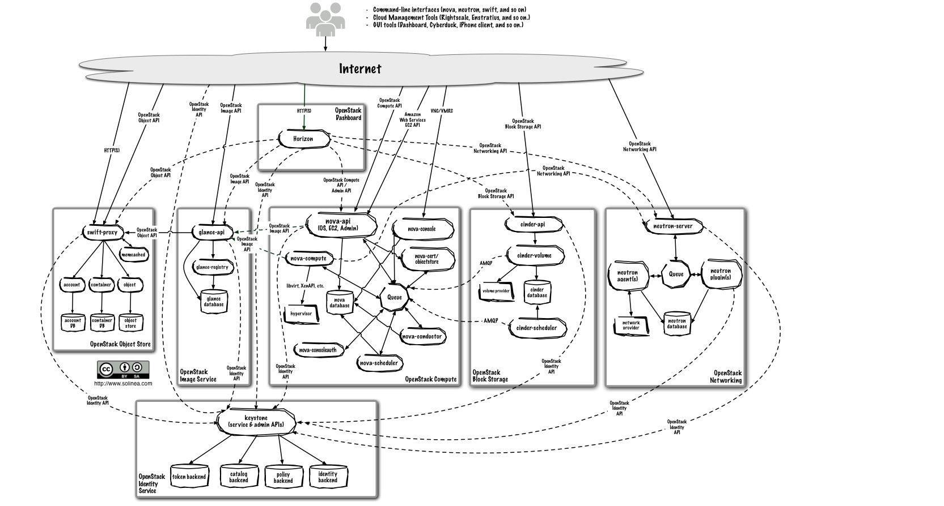
Notes:
Scott: Sure, just deploy all of this...

Slide 11
Use Cases
Or
Why Do We Care?
Notes:
Discuss that it works in a Docker container

Slide 12
Software Defined Storage Manager without the Overhead of OpenStack
Notes:
You may not want virtualized compute using Nova, so Cinder has the created python-brick-cinderclient-ext. (By this I mean Ivan has created the python-brick-cinderclient-ext). Now Cinder can work with Ironic without using Nova.
But what if you don’t want the rest of OpenSTack….

Slide 13
Using Docker containers
Notes:
Refer to secret KeyNote talk

Slide 14
Cinder Will Work with Almost 100 Storage Backends
https://wiki.openstack.org/wiki/CinderSupportMatrix
Notes:
Question: Why does support matrix have 69 drivers, when we have ~100?
Is it because of different flavors?

Slide 15
Backends Drivers
●Block Device Driver (local) ●Blockbridge (iSCSI) ●Coho (NFS) ●CoprHD (FC, iSCSI, scaleio) ●Datera (iSCSI) ●Dell/EMC PS Series (iSCSI) ●Dell/EMC ScaleIO (scaleio) ●Dell/EMC UnityDriver (FC, iSCSI) ●Dell/EMC VMAX (FC, iSCSI) ●Dell/EMC VNX (iSCSI/FC) ●Dell/EMC XtremIO (iSCSI/FC) ●Disco (disco) ●DRBD (DRBD/iSCSI) ●FalconStor (iSCSI/FC) ●Fujitsu ETERNUS (iSCSI/FC) ●GlusterFS (GlusterFS) ●HGST (NFS) ●HPE 3PAR (iSCSI/FC) ●HPE LeftHand (iSCSI) ●HPE MSA (iSCSI/FC) | ●Huawei (iSCSI/FC) ●Huawei FusionStorage DSWare (iSCSI) ●IBM Flashsystem (iSCSI/FC) ●IBM GPFS (GPFS/NFS) ●IBM Storage (iSCSI/FC) ●IBM Storwize SVC (iSCSI/FC) ●Infinidat Infinibox (FC) ●Infortrend (iSCSI/FC) ●Kaminario (iSCSI) ●Lenovo (iSCSI/FC) ●LVM (iSCSI) – Reference* ●NEC M-Series (FC/iSCSI) ●NetApp 7-Mode (iSCSI/FC/NFS) ●NetApp C-Mode (iSCSI/FC/NFS) ●NetApp ONTAP (iSCSI/NFS/FC) ●Nexenta (iSCSI/NFS) ●Nexenta Edge (iSCSI/NBD) ●NFS – Reference ●Nimble Storage (iSCSI/FC) | ●ProphetStor (iSCSI/FC) ●Pure Storage (iSCSI/FC) ●Quobyte (quobyte) ●RBD (Ceph) - Reference ●Reduxio (iSCSI) ●Scality SOFS (scality) ●Sheepdog (sheepdog) ●SolidFire (iSCSI) ●Synology (iSCSI) ●Tegile (iSCSI/FC) ●Tintri (NFS) ●Veritas HyperScale ●Virtuozzo Storage (NFS) ●VMWare (VMDK) ●Windows (SMB) ●X-IO (iSCSI/FC) ●Zadara (iSCSI) ●ZFS (iSCSI/NFS) ●ZTE (iSCSI)
Note: Supported drivers list. Full list may be seen here: https://docs.openstack.org/developer/cinder/drivers.html

Slide 16
Cinder is Open Source, Mature, and under Active Development
Pike Contribution Summary
Commits: 369
LOCs: 76382
Filed Bugs: 235
Resolved Bugs: 140
Notes:
Scott talks through this slide

Slide 17
Demo: Cinder with Devstack
Notes:
[Ivan] ~ 6min: short intro 6 min demo
I think many of us started with Devstack. It’s pretty simple and pretty fast. That’s why I show you a first demo with a Devstack. It’s almost the default configuration except Cinder’s backend. I use Ceph here. I use Nova, Keystone and Glance as well too.
[Run demo]
In this demo you can see that we’re able to attach volume to Nova’s instance first then attach it the local host and read data which were written from the Nova’s instance.

Slide 18
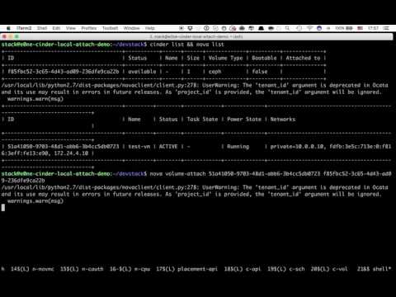
Notes:
[Ivan] ~ 6min: short intro 6 min demo
I think many of us started with Devstack. It’s pretty simple and pretty fast. That’s why I show you a first demo with a Devstack. It’s almost the default configuration except Cinder’s backend. I use Ceph here. I use Nova, Keystone and Glance as well too.
[Run demo]
In this demo you can see that we’re able to attach volume to Nova’s instance first then attach it the local host and read data which were written from the Nova’s instance.

Slide 19
Talk about just Cinder alone
Notes:
[Ivan] 1 min
So we’re able to attach volumes not only to the Nova instances. Good start. What’s the next? You can simple drop not needed services. Neutron, Glance, Nova, Keystone - all of them are not required to run Cinder and use volume it provides. Starting with Pike release, you can use Cinder without keystone as well. Everything you need is just to run Cinder and have installed python-cinderclient package.

Slide 20
How to get Cinder alone installed?
Notes:
[Ivan] 1 min
In a previous demo I used Devstack to install Cinder. You know that it’s not a production-grade installer. For now you’re able to install cinder manually via OS system package installer. Not a bad way but all configuration is your responsibility here. The other way is use some configuration management solutions like Ceph, Puppet, Ansible, etc. Unfortunately, most of them require Keystone to be configured and running. There is one patch to devstack, that allows you to deploy cinder alone. But stop! I said production-grade installer! I’m working on openstack-ansible patches to install Cinder in a standalone mode. I’ll share with you links to my Github forks of it. I hope, it will be merged as a part of Pike release.

Slide 21
Demo: Just Cinder
Notes:
[Ivan] 4 min for the demo
[Run demo]
Here is a short demo of it: only Cinder, MySQL and RabbitMQ services are running. And you’re still able to use your volumes anywhere!

Slide 22
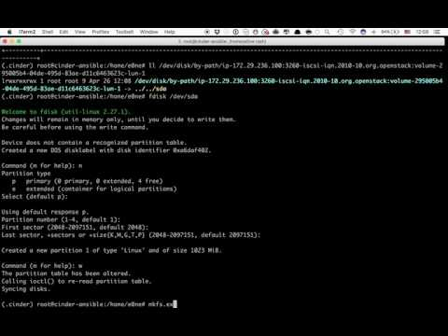
Notes:
[Ivan] 4 min for the demo
[Run demo]
Here is a short demo of it: only Cinder, MySQL and RabbitMQ services are running. And you’re still able to use your volumes anywhere!

Slide 23
Issues and Limitations
Notes:
[Ivan] 1 min
OK, we’re able to deploy Cinder in a standalone mode. Unfortunately, we don’t have a support of all existing Cinder’s features in this mode. What does it mean?

Slide 24
Issues and Limitations
Nested quotas require Keystone
Notes:
Only ceph and iSCSI-based drivers are supported. NFS is in a progress but it’s support has a lot of concerns and security risks. It’s very easy to add a support of any other driver. We just don’t have opportunity to test them. That’s why we disabled them for now. If you want to add local-attach support to your driver driver, just ping us in IRC or after the talk and we describe you how to do it.

Slide 25
Issues and Limitations
Nested quotas require Keystone
Limited drivers support
Notes:
Only ceph and iSCSI-based drivers are supported. NFS is in a progress but it’s support has a lot of concerns and security risks. It’s very easy to add a support of any other driver. We just don’t have opportunity to test them. That’s why we disabled them for now. If you want to add local-attach support to your driver driver, just ping us in IRC or after the talk and we describe you how to do it.

Slide 26
Issues and Limitations
Nested quotas require Keystone
Limited drivers support
Attach works only on Linux-based hosts
Notes:
Also, only Linux-based OS are supported now:(. You can run Cinder on Windows too, but you’re still able to attach volumes to Linux hosts only.

Slide 27
Issues and Limitations
Nested quotas require Keystone
Limited drivers support
Attach works only on Linux-based hosts
Don’t forget about security
Notes:
I can’t miss security part of these things. Using local attach feature by tenants users requires some additional work for operators. Once tenant user is able to attach volume to any host, he will know not only where API endpoint exits, users will know more details about storage network and storage itself. That’s not what Cinder supposed to do..l You have to be very careful with it. We provide you this feature, but you’re responsible for all security stuff.
That’s why you could be interesting in deploying Keystone too. Walt, your turn.

Slide 28
Why add Keystone and Glance?
Keystone provides authentication and has plugins for enterprise auth.
Glance provides cinder the ability to do volume to image operations.
Notes:
Walt starts here.

Slide 29
Demo with Keystone and Glance

Slide 30
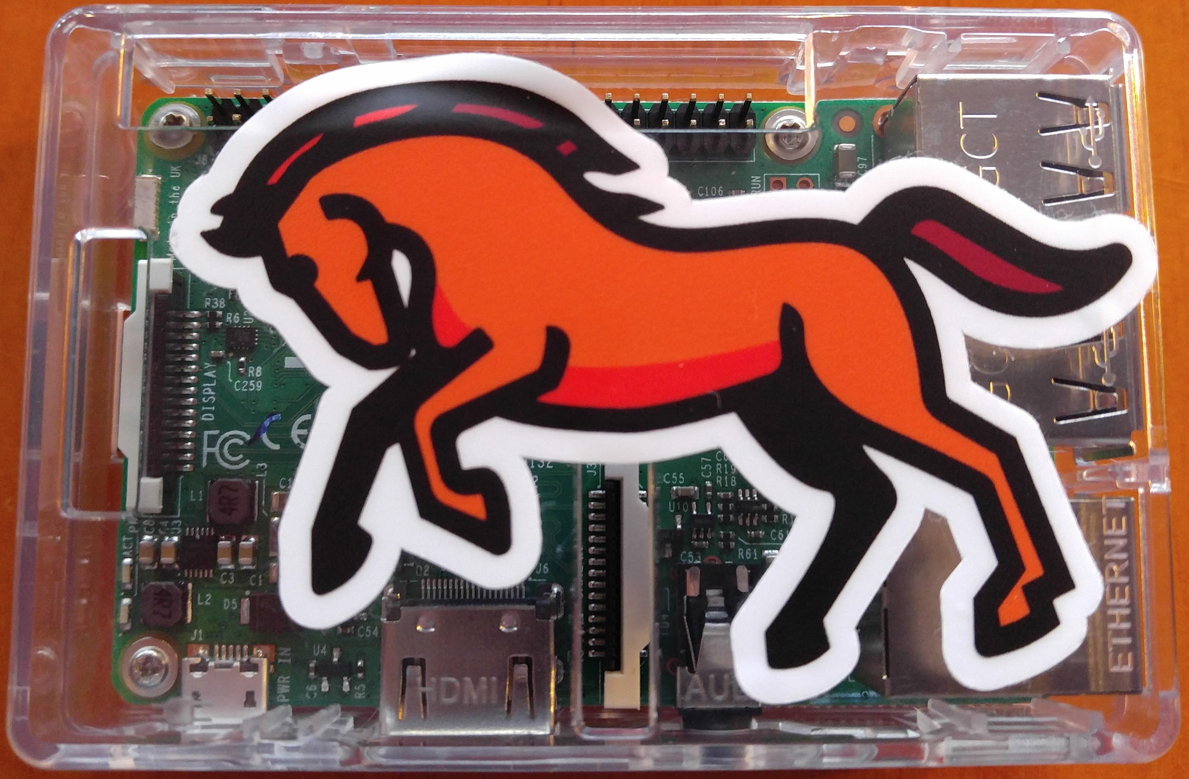

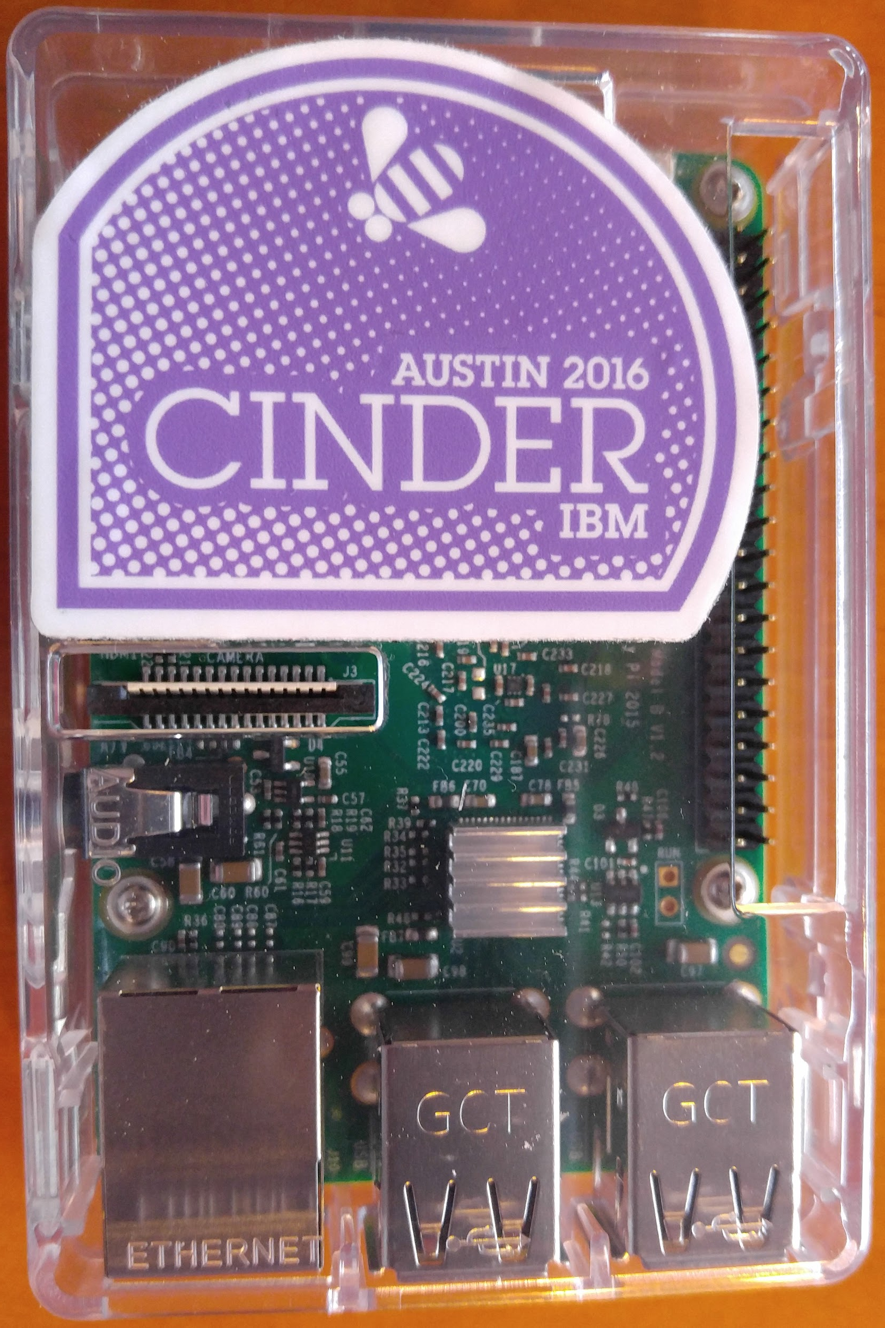


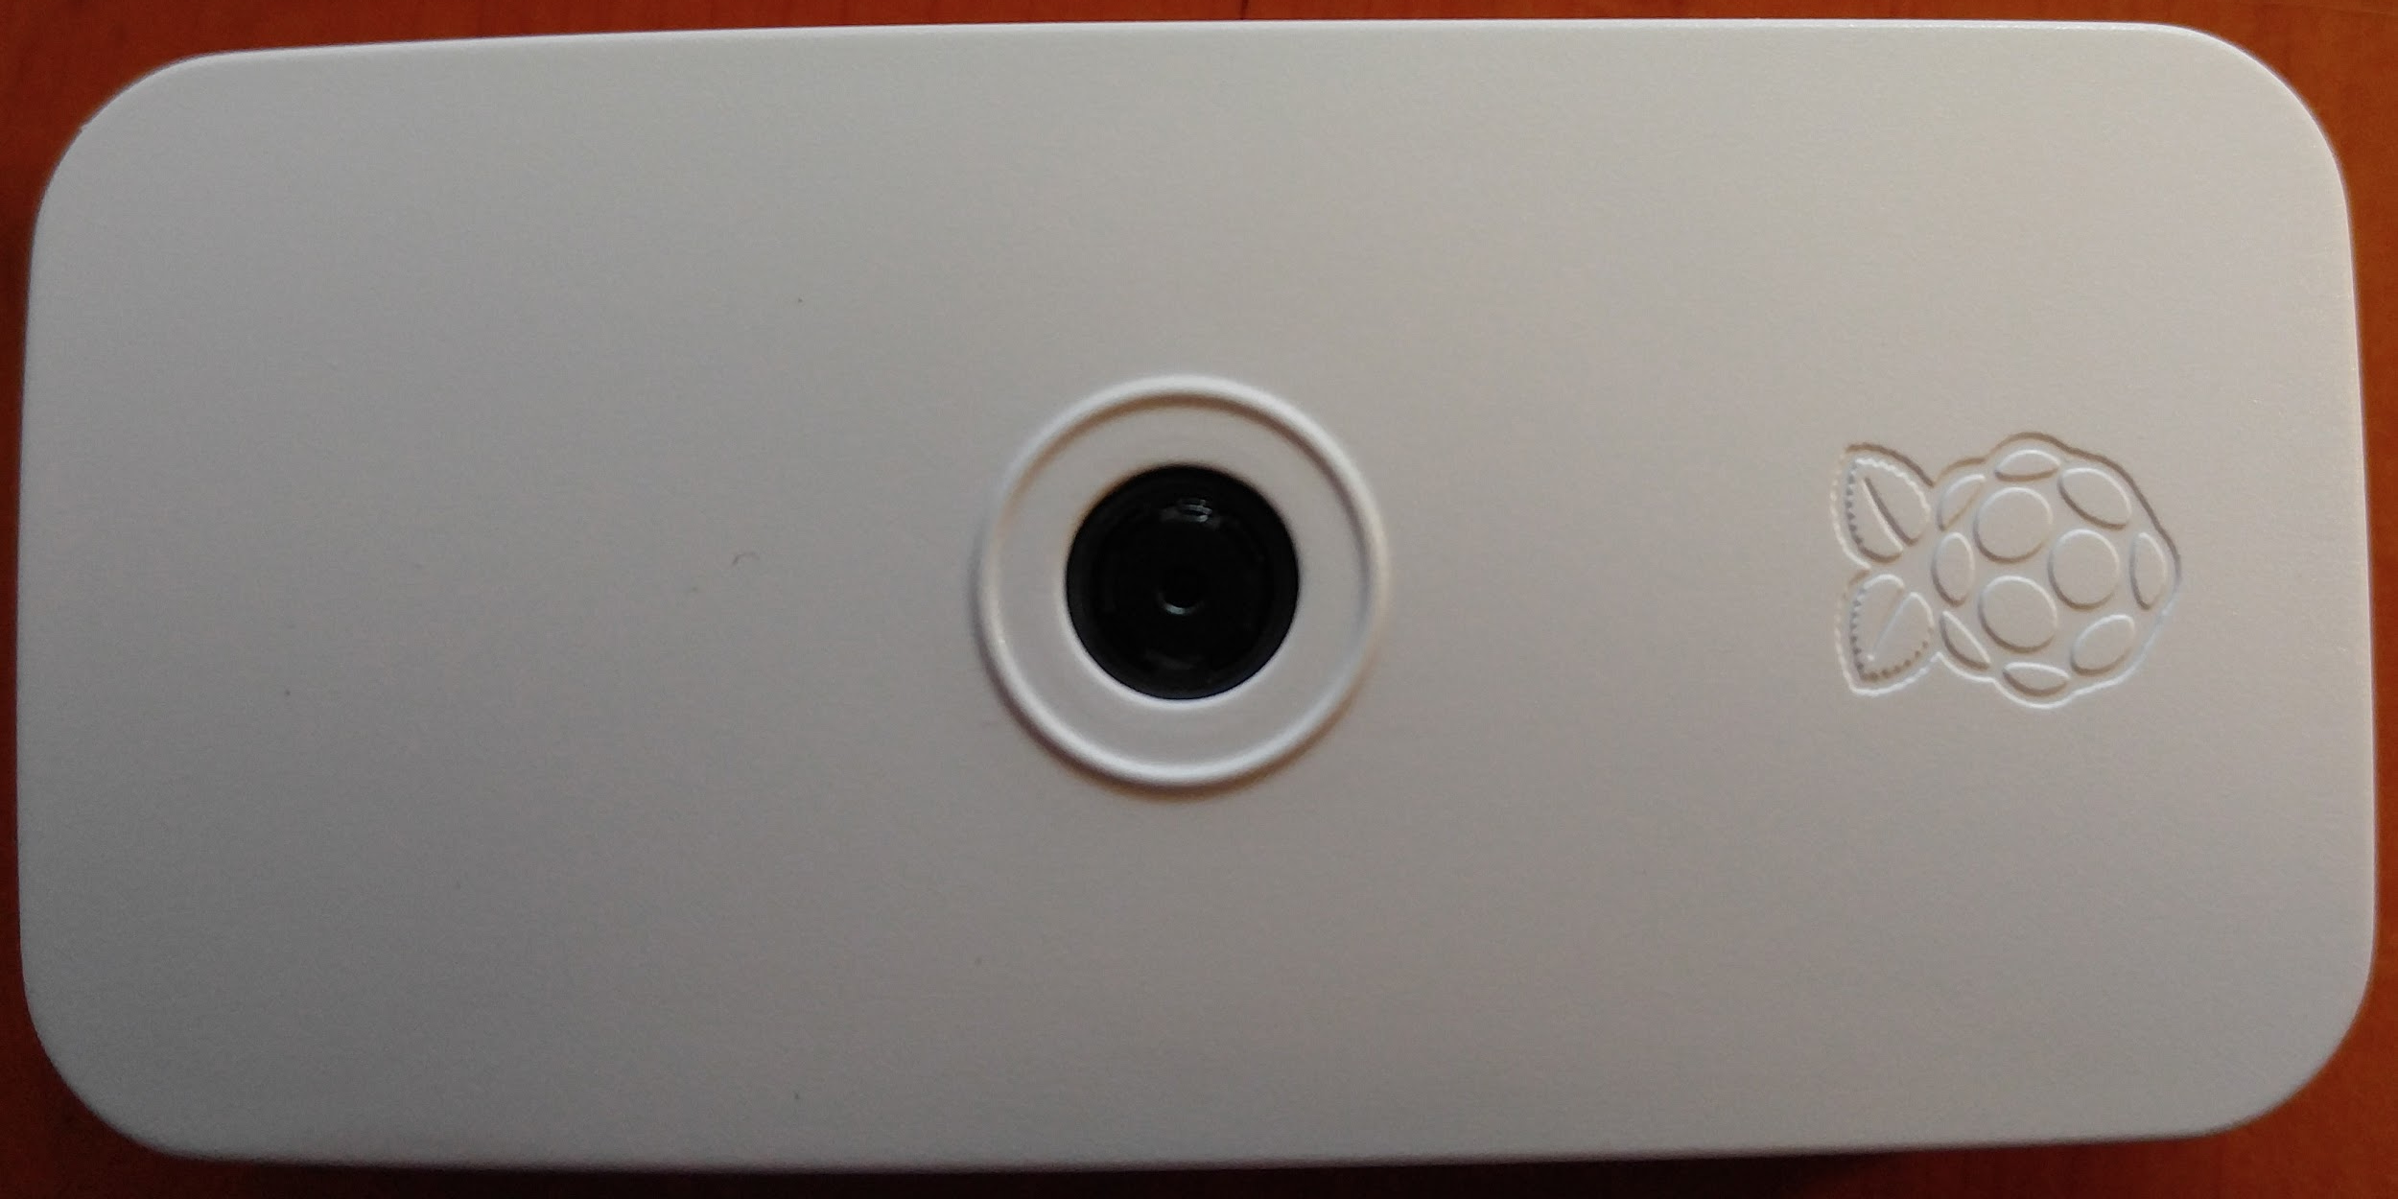
Fun Stuff: Raspberry PI
Raspberry Pi 3
Raspberry Pi 3
Keystone, Glance, Cinder
The Internets!!
LG V10 Cell phone,
WiFI Hotspot
Cinder client, os-brick,
Brick cinderclient extension.
Cinder client, os-brick,
Brick cinderclient extension.
Notes:
The Raspberry pi cinder cloud. This includes keystone, glance and cinder services running on the Raspberry pi 3 (horse), the Raspberry pi 3 running cinderclient, brick cinderclient extension, os-brick. Raspberry Pi Zero W running cinder client, brick cinderclient extension, os-brick.

Slide 31
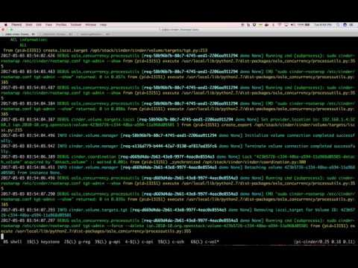
Notes:
The Raspberry pi cinder cloud. This includes keystone, glance and cinder services running on the Raspberry pi 3 (horse), the Raspberry pi 3 running cinderclient, brick cinderclient extension, os-brick. Raspberry Pi Zero W running cinder client, brick cinderclient extension, os-brick.

Slide 32
Acknowledgements
http://www.freeimages.com/search/stand-alone
https://gorka.eguileor.com/standalone-cinder/
https://etherpad.openstack.org/p/cinder-standalone-demo

Slide 33
Questions

