Slide 1
Exploring Cinema Trends: An IMDB Data Study
Findings on Release Counts, Film Length and Genre Success

Slide 2
Coverage: Reviewed films released across the contemporary era, from 2000 through 2025
Output Growth: The number of films released each year has climbed steadily over the past twenty years, pointing to strong industry expansion and richer data coverage.
Genre Mix: Releases are led by a few core categories and pairings, such as stand-alone Dramas and Comedies, which account for the vast majority of titles.

Slide 3
The Big Question: Does a film’s length meaningfully affect how audiences rate it, and should our studio tune the running time of upcoming releases to boost viewer scores?
Why It Matters? Production costs rise with every extra minute of footage. If longer films do not score higher, trimming runtimes could save the studio millions.

Slide 4
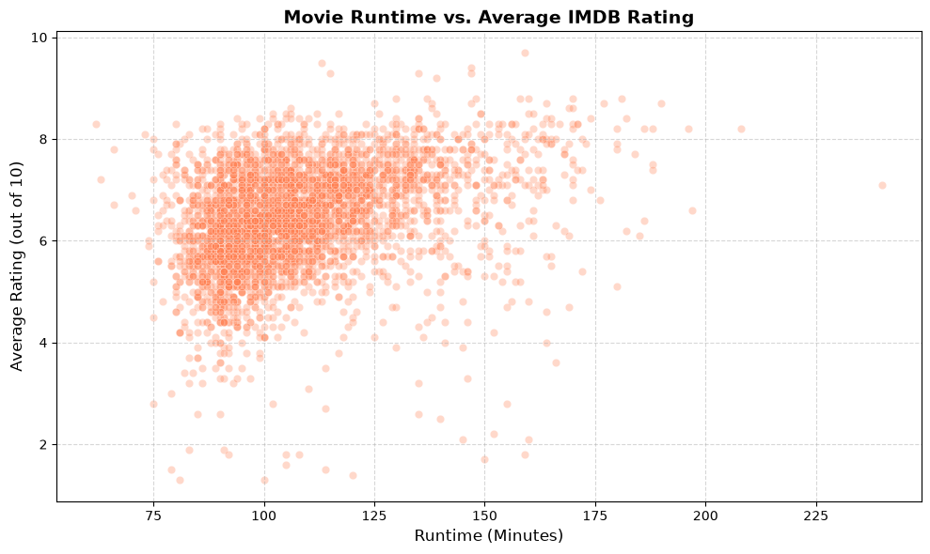

Slide 5
Data Preparation Steps
Missing Values: Records with empty entries in key fields like runtime_minutes and start_year were dropped from the analysis.
Rating Reliability: Raw scores are distorted by sparsely voted titles, such as a film with one lone 10/10 vote.
Outlier Trimming: Very short or very long runtimes add visual clutter and were filtered out to keep standard feature films.

Slide 6
Takeaway – Releasing more titles in a genre does not guarantee better reviews. Dramas and Comedies lead in volume, yet niche genre blends often earn the highest average ratings.

