Slide 1
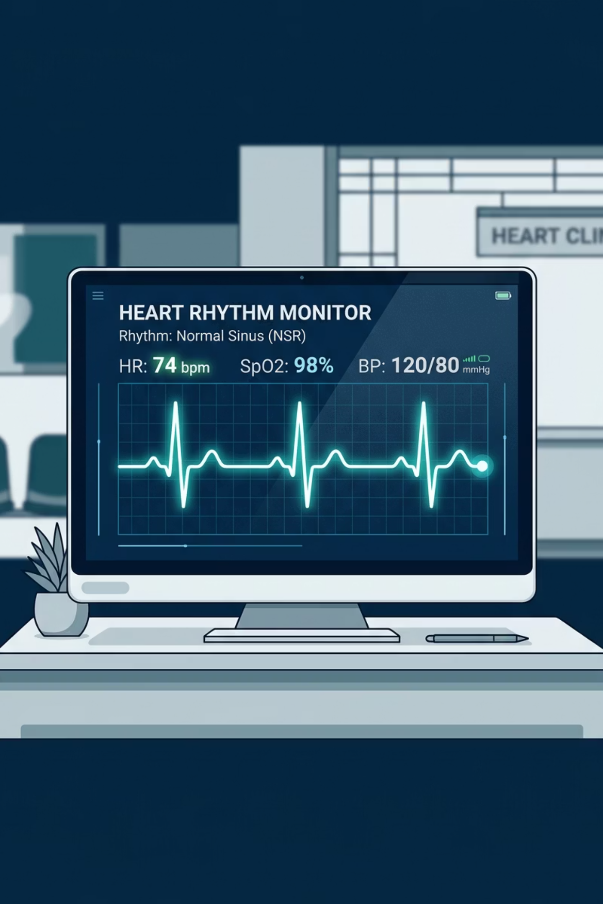
CardioInsight
Explainable AI for ECG Diagnosis
Abdallah Jbr , Ibrahim Melhem
Supervised by Dr. Wafaa Almaaitah · Faculty of Artificial Intelligence, Al-Balqa Applied University

Slide 2

The Scale of the Challenge
17.9M
22.2M
Deaths Per Year
Projected by 2030
CVDs cause ~31–32% of all global fatalities
Rising burden demands scalable, intelligent diagnostic solutions
90%+
DL Accuracy
CNNs and Transformers match or exceed cardiologist-level performance
ECG is the cornerstone cardiac diagnostic — non-invasive and widely accessible. Wearables are generating unprecedented ECG volumes, yet manual interpretation remains slow, expert-dependent, and inconsistent across observers.

Slide 3

The Transparency Gap in Cardiac AI
The Core Problem
Deep learning models achieve 90–95%+ accuracy on ECG classification, yet operate as black boxes. Clinicians receive a diagnosis with no insight into how it was reached.
Over-trust or dismissal
Interpretability drives adoption
Without transparency, clinicians either blindly accept or reject AI recommendations
Research confirms explainability significantly increases clinician acceptance

Slide 4
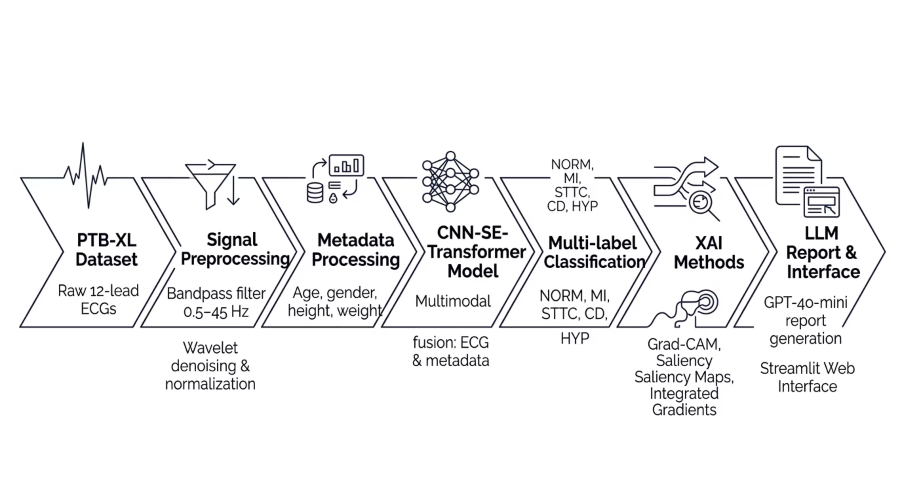

System Architecture
A unified pipeline from raw ECG signal to clinically interpretable output — a two-tier deep learning design, multi-method explainability, and bilingual LLM-generated narratives.
NiceGUI Web Interface

Slide 5
Two-Tier Screening Architecture
A lightweight binary model screens every live window; only flagged signals reach the heavy CNN-SE-Transformer, XAI, and report engine.
Normal
Keep monitoring; heavy model is skipped
TIER 1 · SCREENING
Live ECG Stream
10 s windows with 5 s overlap
Lightweight Binary Model
Fast Normal vs. Non-normal screening on the signal alone
TIER 2 · DEEP ANALYSIS
CNN-SE-Transformer
Multi-label: NORM, MI, STTC, CD, HYP, fused with metadata
Explainable Output
Grad-CAM, Saliency, Integrated Gradients + AI report (EN / AR)
Abnormal windows are escalated automatically, so heavy inference and XAI run only when the binary screen flags risk.

Slide 6
Three Operational Modes
One NiceGUI interface serves single-record analysis, long-recording batches, and simulated real-time cardiac monitoring.
01
Manual Upload
One 10-second ECG signal with patient metadata
Multi-label output: NORM, MI, STTC, CD, HYP
XAI: Grad-CAM, Saliency, Integrated Gradients
AI clinical report in English or Arabic
02
Batch Mode
Long-duration recordings or many short ones
Split into 10 s chunks; record status = highest chunk probability
Automated batch classification table
Reports generated on demand only
03
Live Monitoring
Simulated real-time cardiac monitoring
Binary model screens every window
Abnormal window stops the stream and escalates to the CNN-SE-Transformer
Full XAI and clinical report for the flagged window

Slide 7

Where the Field Stands Today
Recent advances demonstrate strong classification performance, but a critical gap persists: no existing system combines high-accuracy ECG classification, multi-method XAI, and LLM-generated clinical narratives in a single integrated pipeline.
Study
Contribution
Limitation
Hannun et al. (2019)
CNN matches cardiologist accuracy
Black box — no transparency
Key Gap: No prior work unifies CNN-SE-Transformer classification + multi-method XAI + fine-tuned LLM clinical reports.
Ansari et al. (2023)
DL review, consistent accuracy gains
Explainability unresolved
Denysyuk et al. (2023)
DL outperforms traditional methods
Generalization, interpretability gaps
Goettling et al. (2024)
Improved interpretability (xECGArch)
Clinical narrative lacking
Zhang et al. (2025)
LLMs support clinical reasoning
Not ECG-specific

Slide 8

Project Objectives
Primary: Develop CardioInsight — an explainable AI system classifying five cardiac conditions from ECG signals with clinically meaningful explanations.
Two-Tier Deep Learning Models
Binary screen + CNN-SE-Transformer; ≥90% ROC-AUC, F1 ≥ 0.75
Multi-Method XAI
Grad-CAM, Saliency Maps, and Integrated Gradients
Bilingual Fine-Tuned LLM Reports
GPT-4o-mini writes clinician-ready reports in English and Arabic
Multi-Mode Clinician Interface
NiceGUI app with Manual, Batch, and Live Monitoring modes

Slide 9
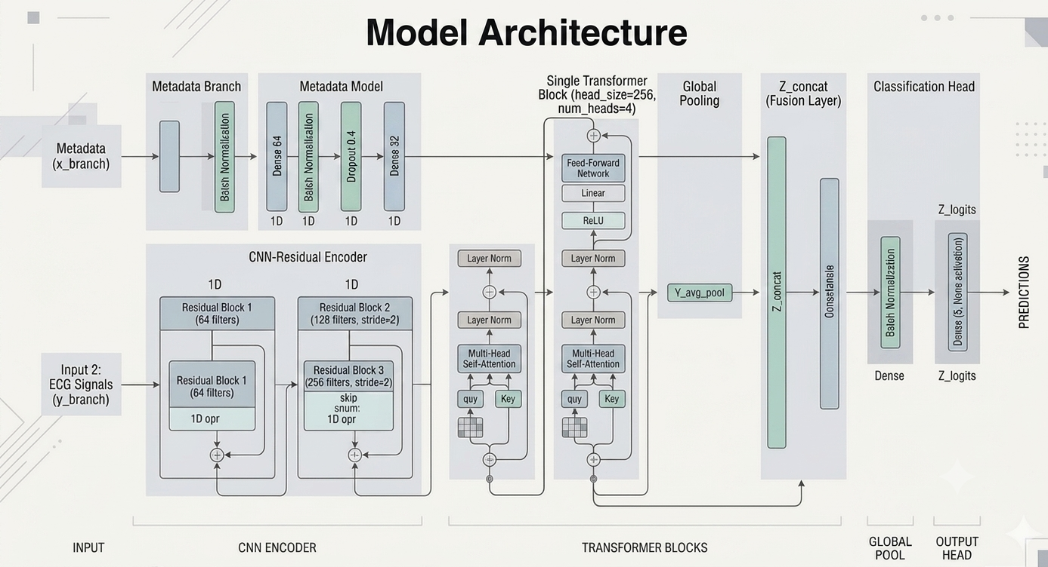
Machine Learning Implementation
Dataset & Preprocessing
PTB-XL: 21,837 clinical 12-lead ECGs from 18,885 patients. Bandpass filter (0.5–45 Hz), Daubechies wavelet denoising, global normalization. Stratified 70/15/15 split.
Architecture
CNN residual blocks + Squeeze-and-Excitation attention + Transformer encoder. Multimodal fusion of ECG signal and patient metadata (age, gender, height, weight). Focal loss and label smoothing address class imbalance.
XAI Methods
Grad-CAM — per-lead heatmaps
Saliency Maps — temporal inflection points
Integrated Gradients — per-feature attribution

Slide 10
LLM & Web Interface
GPT-4o-mini Fine-Tuning
NiceGUI Web Interface
JSONL dataset
80/20 train/validation split (seed 42).
Three epochs, batch size 8.
Learning rate multiplier 0.05.
Left panel: Mode selector (Manual · Batch · Live), patient metadata, XAI method, report language, ECG upload
Right panel: ECG visualization, predictions, XAI figures, bilingual LLM report, metadata charts
Interaction: Asynchronous processing keeps the interface responsive during live streaming
Reports in English and Arabic cover:
condition overview
ECG interpretation
symptoms
clinical significance
follow-up

Slide 11
Project Contributions
01
02
First Integrated Pipeline
Multimodal Architecture
CNN-SE-Transformer + multi-method XAI + bilingual fine-tuned LLM for ECG diagnosis
Fuses ECG signals with patient demographic metadata for richer context
03
04
Multi-Layered Explainability
Bilingual Clinical Narratives
Grad-CAM, Saliency Maps, and Integrated Gradients applied simultaneously
Turns predictions into structured clinical reports in English and Arabic
05
06
Two-Tier Real-Time Screening
Multi-Mode Clinical Interface
A lightweight binary model screens live ECG and escalates only abnormal signals to the deep model
Manual, Batch, and Live modes in one NiceGUI app, also a resource for trainees

Slide 12
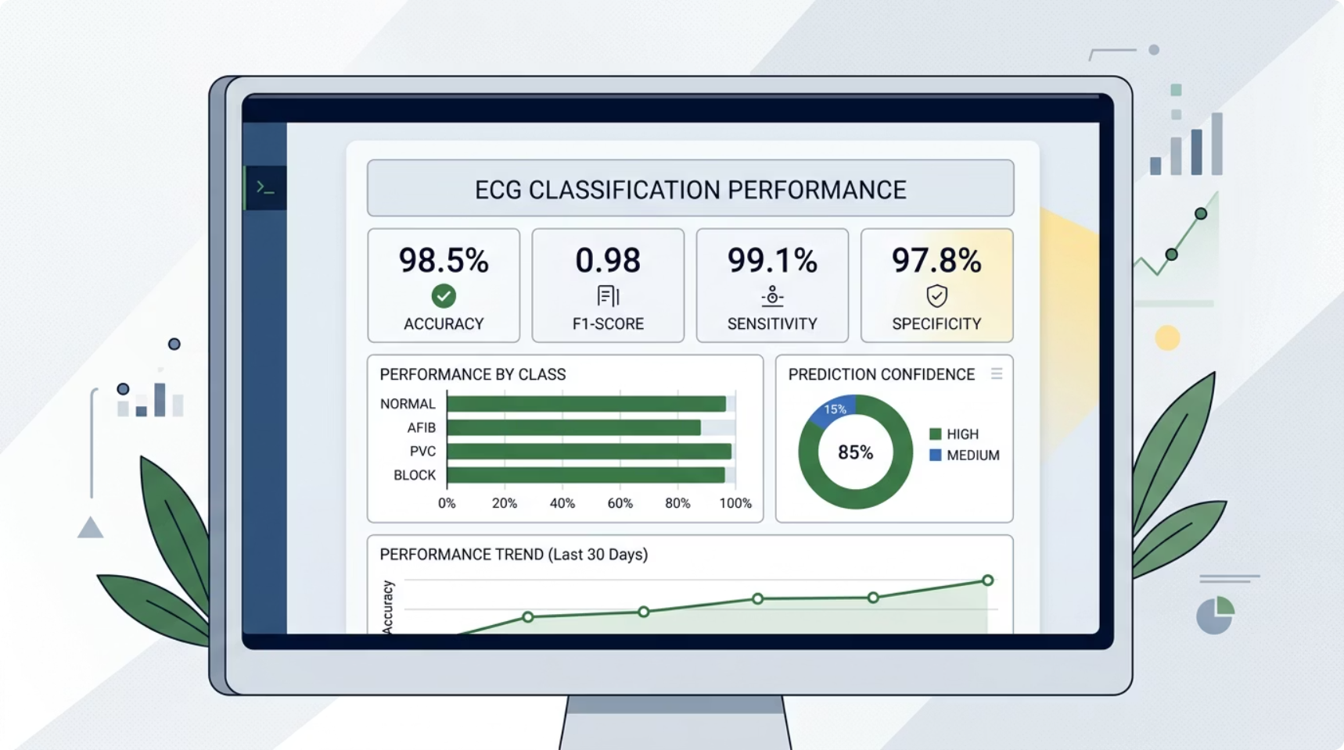

Results & Evaluation
Key Findings
Predictive Accuracy
High accuracy across all five diagnostic classes. MI and STTC were the strongest, with subtle patterns well-detected.
Clinical Report Quality
All sections consistently generated — overview, ECG interpretation, symptoms, significance, and follow-up.
Medical Terminology
Standardized, consistent cardiology terms used across all generated reports.
Interface Usability
Clear layout, intuitive navigation, and real-time response confirmed.
Key bugs resolved: wavelet selection, class imbalance (focal loss), prompt engineering for complete reports, and responsive layout.

