Slide 1
Metabarcoding – data processing steps explained
Most graphs were taken from the APSCALE-GUI manual (https://github.com/TillMacher/apscale_gui)

Slide 2
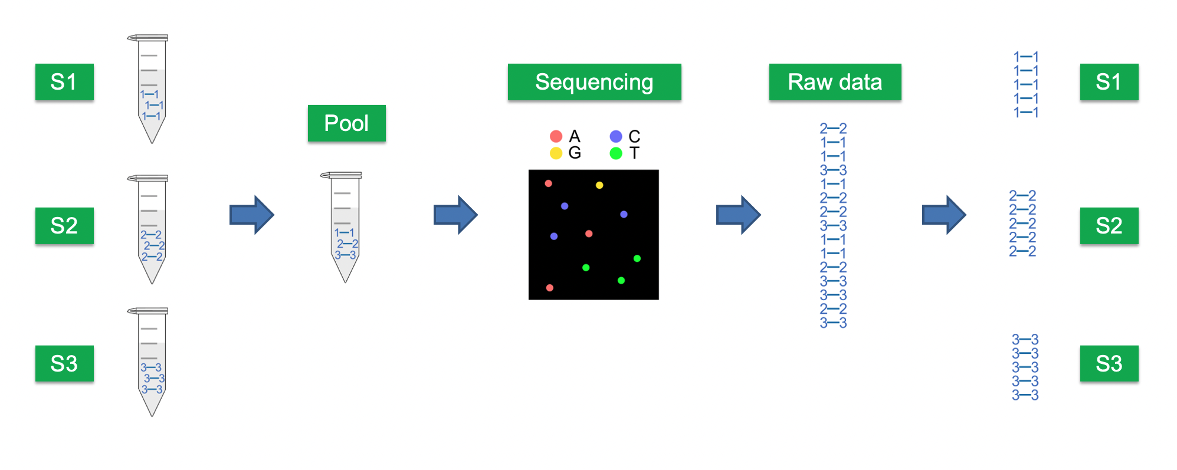
From samples to sequencing data
Samples with indices (1, 2, 3 in this example)
Each sample is called a LIBRARY
Raw data contains reads from all samples, which are distinguishable by their indices
Samples/libraries are mixed = POOLED
Individual samples are distinguishable by their indices
The resulting POOL can also be called LIBRARY POOL or sometimes just LIBRARY (which can be confusing, since indexed samples are also called library)
Raw data is split up sample-wise into separate files, based on the indices = DEMULTIPLEXING

Slide 3
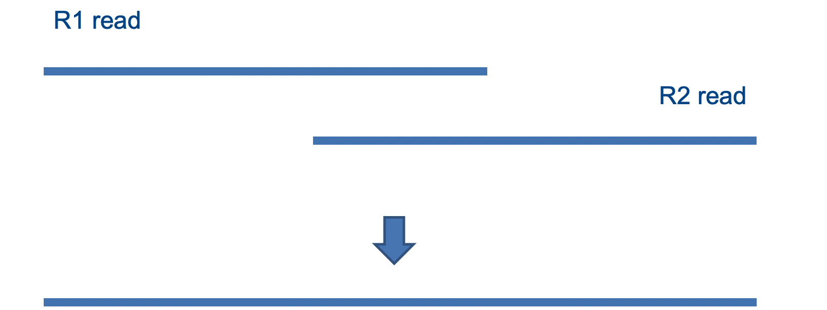
1. Paired-end merging
Raw data is delivered in two files, forward/R1 and reverse/R2, since sequences are read from the forward and reverse side separately. Forward and reverse reads from the same sequence (=read pairs) are merged based on overlapping bases:
Note: when designing a project, make sure that your reads overlap, i.e., choose an appropriate sequencing length for your amplicon length! For example, if your amplicon is 500 bp long but you sequence 2x150bp (150bp forward and reverse each), your reads won’t overlap, and all reads will be lost in this step!

Slide 4
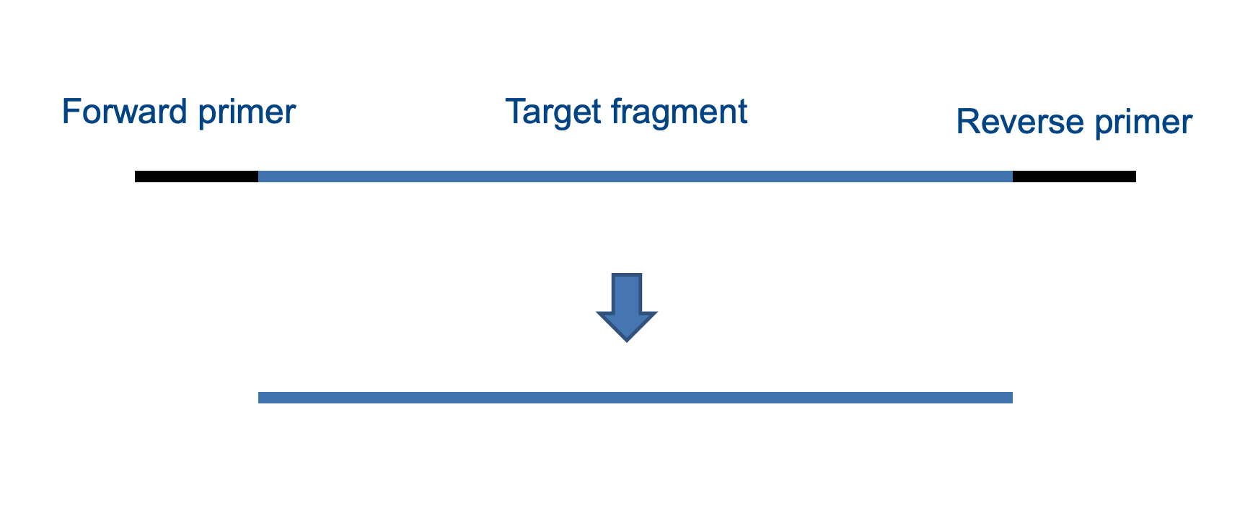
2. Primer trimming
Removing (=trimming) metabarcoding primers from the start and end of merged reads (some people also do the primer trimming first and then merge forward and reverse reads)

Slide 5
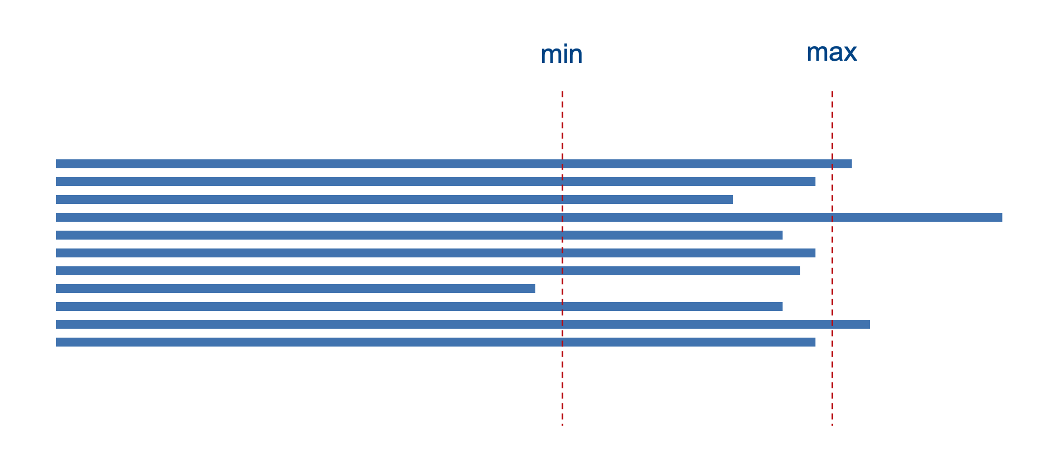
3.1 Quality filtering: based on read length
Discarding reads that don’t fall within the target amplicon size range, for example target size +- 10 bp (some people use different ranges), since too long or too short reads likely don’t stem from the target organisms/group
- 10 bp
Target size
+ 10 bp

Slide 6
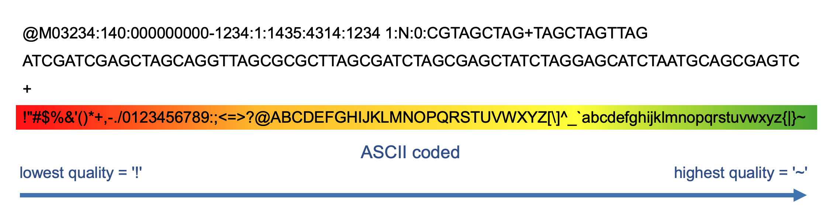
3.2 Quality filtering: based on quality scores
Reads are saved in .fastq files, containing 4 lines per read
These lines refer to the read name, read sequence, a “+” spacer, and base qualities, like so:
We don’t want low-quality bases, since they’re unreliable (=sequencing errors), so we can cut reads at low quality bases and only retain the reliable portion of a read (=better safe than sorry)

Slide 7
Next step: either clustering into OTUs, OR denoising into ESVs, OR even a combination of both

Slide 8
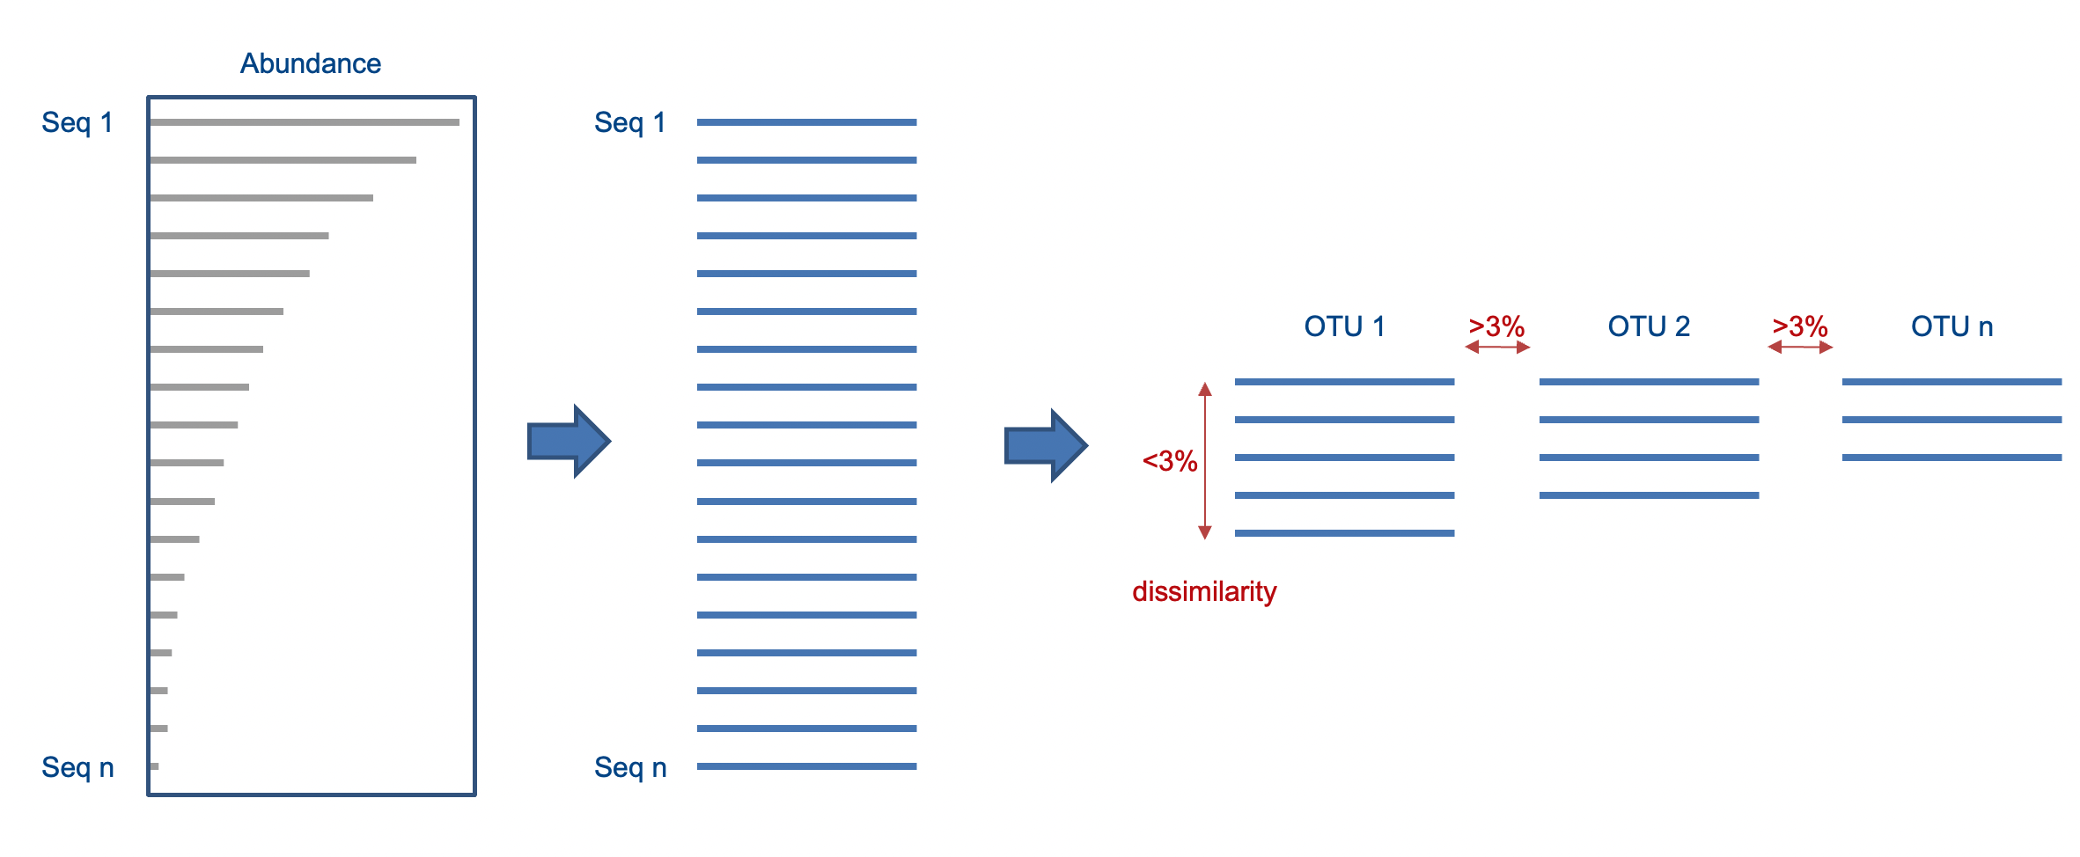
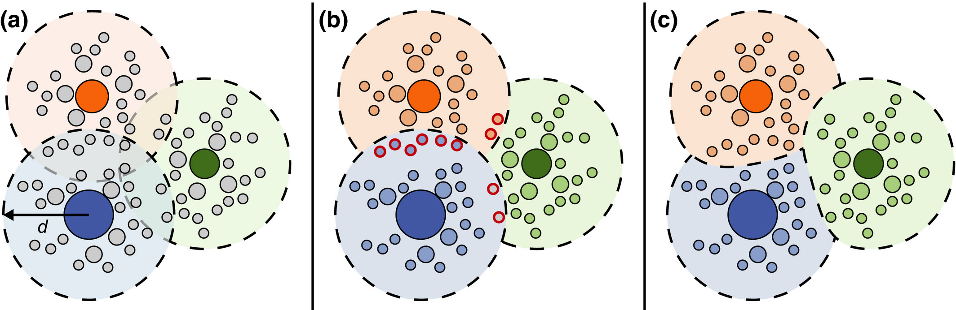
4. Option 1. OTU clustering: Greedy algorithm (for example vsearch)
Reads are clustered into Operational Taxonomic Units (OTUs) based on a similarity threshold (common threshold: 97%, but others used, too).
Problem: some reads can fall
between clusters:
2D representation:
3%

Slide 9
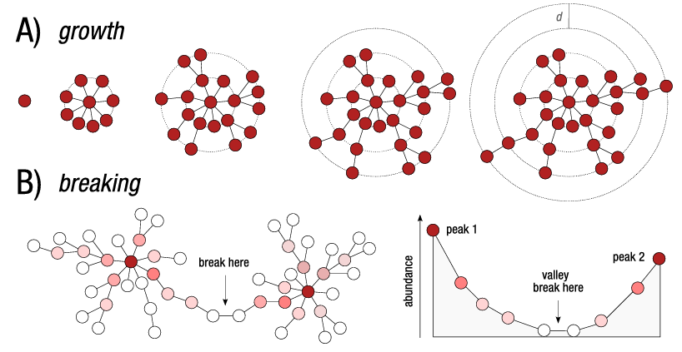
4. Option 1. OTU clustering: Alternative algorithm: Swarm
Swarm is another clustering algorithm. It has 2 phases:
growth phase: sequence differences between aligned pairs of amplicons are computed to delineate OTUs
breaking phase: Swarm uses amplicon abundance information and OTUs’ internal structures to refine the clustering results
Advantage: not based on a static
similarity threshold
But in praxis: results can be better, but ALSO WORSE than with greedy algorithms (for example with vsearch) (see this paper)
Description at the top and figure taken from swarm v2 paper

Slide 10
4. Option 1. OTU clustering: other algorithms
There’s many more algorithms:
CD-HIT
DMSC
USEARCH
CROP
DNAClust
…
Results of algorithms depend on dataset and chosen parameters. Therefore, focus less on algorithm choice and instead stick to algorithms that you know well and that are fast
Additional option: you can also first denoise your reads (see next slide), which “cleans” them further, and THEN cluster them into OTUs (pros: your clusters are more error-free; cons: you lose resolution and again introduce the challenges of OTU clustering)

Slide 11
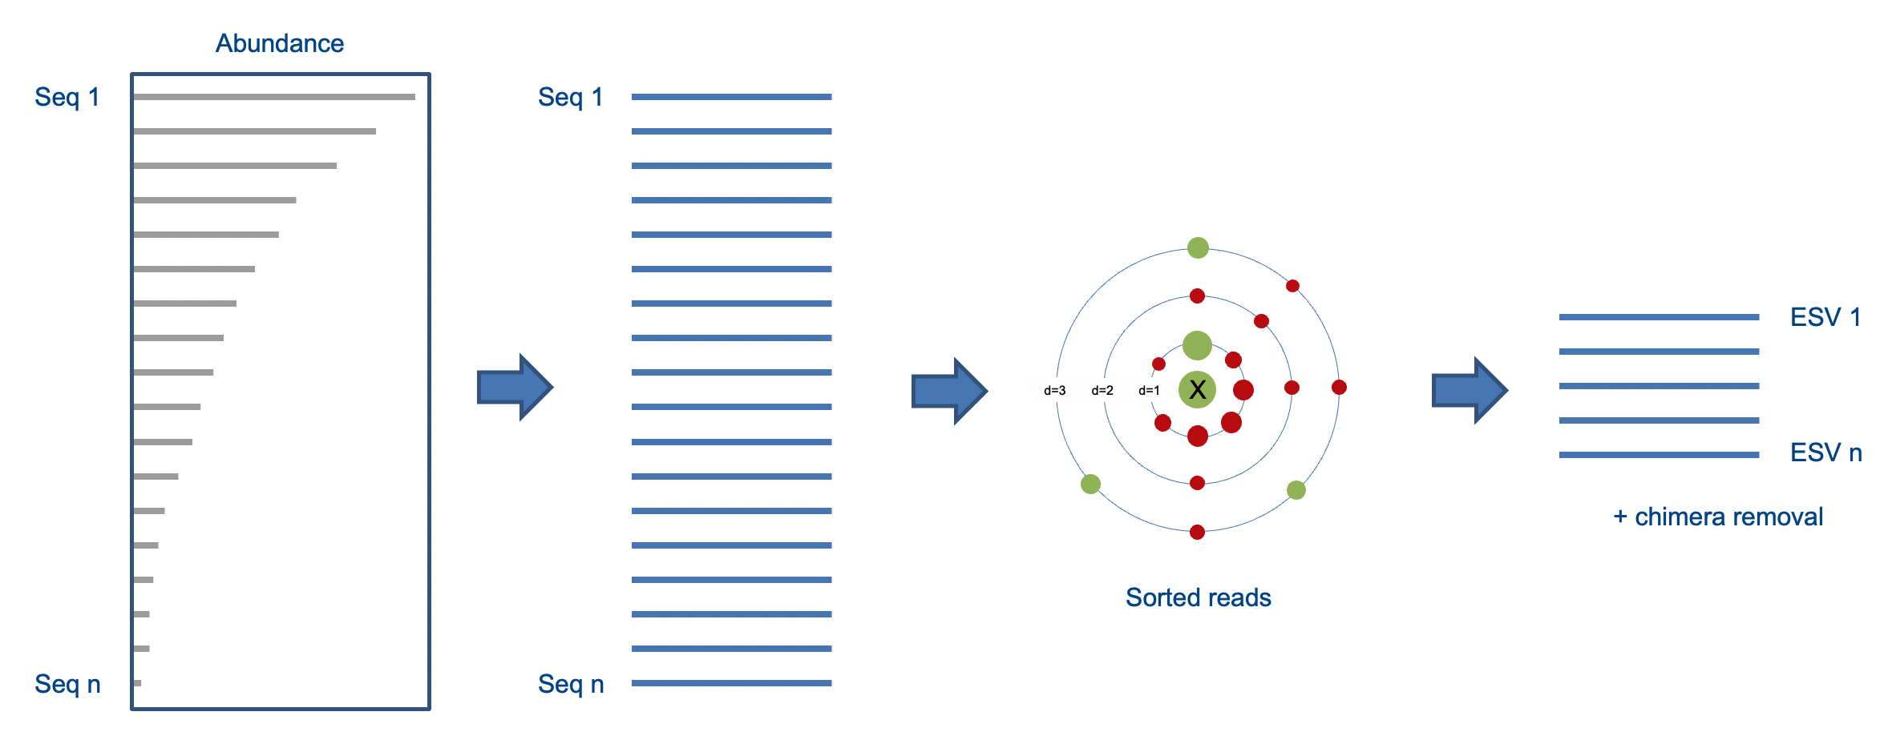
4. Option 2. Denoising (ESV generation)
Reads are denoised into Exact Sequence Variants (ESVs)
“Neighbour” reads with small numbers of differences and small abundance compared to the center read of a cluster (=X in figure) are predicted to be erroneous versions of X and removed. Denoising is an error removal step!

Slide 12
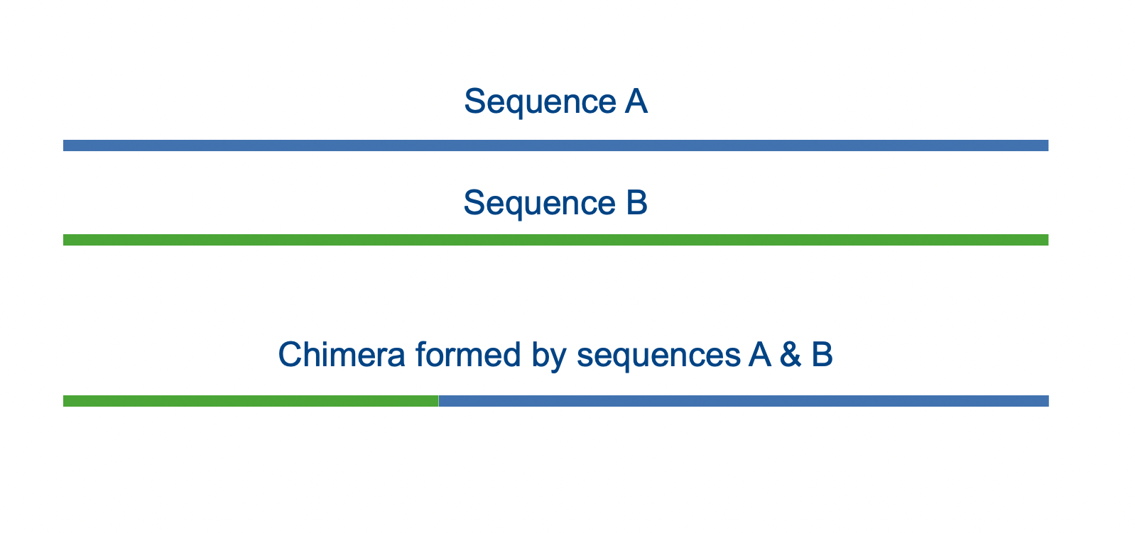
5. Chimera removal
Chimeras are artificial products derived from two biological sequences. They can occur through incomplete extension during PCR. Chimeras can be identified and removed.

Slide 13
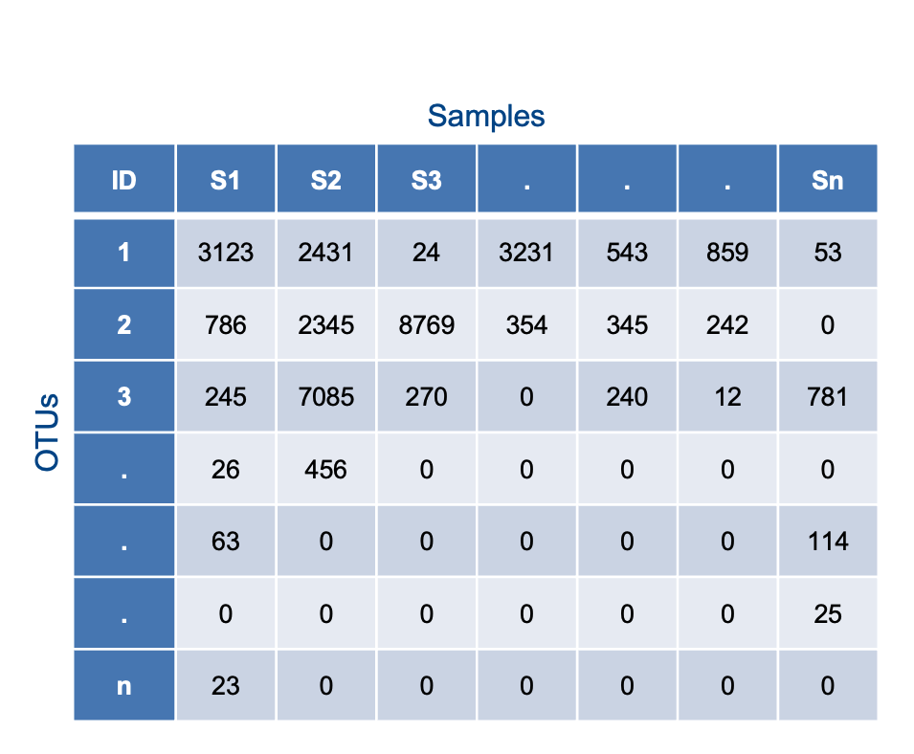
Result: ESV or OTU table

