Slide 1
Cryptography
Part 2: Modern Cryptosystems
Jerzy Wojdyło
September 21, 2001

Slide 2
Overview
Classical Cryptography
  Simple Cryptosystems
  Cryptanalysis of Simple Cryptosystems
Shannon’s Theory of Secrecy
Modern Encryption Systems
  DES, AES.
  RSA.
Signature Scheme(s)

Slide 3
Cryptosystem
A cryptosystem is a five-tuple (P,C,K,E,D), where the following are satisfied:
P is a finite set of possible plaintexts.
C is a finite set of possible ciphertexts.
K, the key space, is a finite set of possible keys
∀K∈K, ∃E_{K}∈E (encryption rule), ∃D_{K}∈D (decryption rule).
Each E_{K}: P→C and D_{K}: C→P are functions such that ∀x∈P, D_{K}(E_{K}(x)) = x.

Slide 4
Notation
Alphabet {0, 1} (bits)
Plaintext and ciphertext ∈ {0, 1}*
New operation: XOR (EXOR, ⊕)
0 ⊕ 0 = 0, 1 ⊕ 1 = 0,
0 ⊕ 1 = 1, 1 ⊕ 0 = 1,
bitwise addition modulo 2.

Slide 5
Data Encryption Standard (DES)
1973, NBS solicits proposals for cryptosystems for “unclassified” documents.
1974, NBS repeats request.
IBM responds with modification of LUCIFER.
NBS asks NSA to evaluate.
IBM holds patent for DES.
1975, details of the algorithm published, public discussion begins.
1976 Adapted as a standard for all unclassified government communications.

Slide 6
Data Encryption Standard (DES)
Originally designed to be efficient in hardware
(4 bit was the norm in 1974).
A LOT of money has been invested in hardware.
First publicly available algorithm certified by NSA as secure.
Certificate to be renewed every 5 years.

Slide 7
Data Encryption Standard (DES)
1983, no problem.
1987, passed, but
  NSA says that DES soon will be vulnerable to brute-force attack. This is the last time.
  Business lobbies to keep it, since so the had much invested.
1993, still passed (no alternatives).
1997, call for proposals: AES.

Slide 8
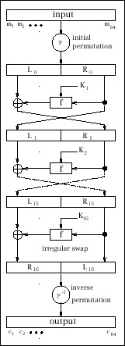
Data Encryption Standard (DES)
The algorithm
Uses blocks of size 64 bits.
Key of length 56 (well, 64,
but 8 bits are just check bits)
Initial permutation IP.
16 rounds.
Final permutation IP⁻¹
(IP and IP⁻¹ have minor
cryptographic value).

Slide 9
Data Encryption Standard (DES)
Key schedule K₁, K₂,…, K₁₆
Discard the parity-check bits of K.
Compute PC-1(K) = C₀D₀,
where PC-1 is a fixed permutation,
C₀, D₀ left and right halves, 28-bit each.
For i = 1, 2, …, 16:
C_{i} := LS_{i}(C_{i-1}), D_{i} := LS_{i}(D_{i-1}),
where LS_{i} left cyclic shift of one
(i= 1, 2, 9, 16) or two positions (else),
K_{i} := PC-2(C_{i}D_{i}),
PC-2 fixed permutation selecting 48 bits.

Slide 10
Data Encryption Standard (DES)
PC-1(K) = C₀D₀
      57 49 41 33 25 17 9
      1 58 50 42 34 26 18
      2 59 51 43 35 27
      19 11 3 60 52 44 36
      63 55 47 39 31 23 15
      7 62 54 46 38 30 22
      6 61 53 45 37 29
      21 13 5 28 20 12 4

Slide 11
Data Encryption Standard (DES)
K_{i} := PC-2(C_{i} D_{i})
      14 17 11 24 1 5
      3 28 15 6 21 10
      23 19 12 4 26 8
      16 7 27 20 13 2
      41 52 31 37 47 55
      30 40 51 45 33 48
      44 49 39 56 34 53
      46 42 50 36 29 32

Slide 12
Data Encryption Standard (DES)
x₀ = IP(m) = L₀R₀.
16 Rounds, i = 1, 2, …, 16:
L_{i} := R_{i-1},
R_{i} := L_{i-1} ⊕ f (R_{i-1} , K_{i}),
where
f (R_{i-1} , K_{i}) = P(S(E(R_{i-1}) ⊕ K_{i})),
with operations E (expansion),
S (S-box lookup), and P some
(permutation).
c = IP⁻¹(L₁₆R₁₆).

Slide 13
Data Encryption Standard (DES)
x₀ = IP(m) = L₀R₀
Initial Permutation
    58 50 42 34 26 18 10 2
    60 52 44 36 28 20 12 4
    62 54 46 38 30 22 14 6
    64 56 48 40 32 24 16 8
    57 49 41 33 25 17 9 1
    59 51 43 35 27 19 11 3
    61 53 45 37 29 21 13 5
    63 55 47 39 31 23 15 7

Slide 14
Data Encryption Standard (DES)
f (R_{i-1} , K_{i}) = P(S(E(R_{i-1}) ⊕ K_{i}))
Expansion:
    32 1 2 3 4 5
    4 5 6 7 8 9
    8 9 10 11 12 13
    12 13 14 15 16 17
    16 17 18 19 20 21
    20 21 22 23 24 25
    24 25 26 27 28 29
    28 29 30 31 32 1

Slide 15
Data Encryption Standard (DES)
f (R_{i-1} , K_{i}) = P(S(E(R_{i-1}) ⊕ K_{i}))
S-box lookup
There are 8 S-boxes: S₁,…, S₈
For example S₅:
2 12 4 1 7 10 11 6 8 5 3 15 13 0 14 9
14 11 2 12 4 7 13 1 5 0 15 10 3 9 8 6
4 2 1 11 10 13 7 8 15 9 12 5 6 3 0 14
11 8 12 7 1 14 2 13 6 15 0 9 10 4 5 3
4×16 array of 4-bit binary numbers.

Slide 16
Data Encryption Standard (DES)
f (R_{i-1} , K_{i}) = P(S(E(R_{i-1}) ⊕ K_{i}))
E(R_{i-1}) ⊕ K_{i} = B₁B₂…B₇B_{8.}
For j = 1, 2,…, 8, let
B_{j} = b₁ b₂ b₃ b₄ b₅b₆.
In S-box S_{j}:
b₁ b₆ binary coordinate of a row r,
b₂ b₃ b₄ b₅ bin. coord. of a column c.
Replace B_{j} with S_{j}(r, c).

Slide 17
Data Encryption Standard (DES)
f (R_{i-1} , K_{i}) = P(S(E(R_{i-1}) ⊕ K_{i}))
P fixed permutation
    16 7 20 21 29 12 28 17
    1 15 23 26 5 18 31 10
    2 8 24 14 32 27 3 9
    19 13 30 6 22 11 4 25
Result: bitstring of length 32.

Slide 18
Data Encryption Standard (DES)
c = IP⁻¹(L₁₆R₁₆)
    14 17 11 24 1 5
    3 28 15 6 21 10
    23 19 12 4 26 8
    16 7 27 20 13 2
    41 52 31 37 47 55
    30 40 51 45 33 48
    44 49 39 56 34 53
    46 42 50 36 29 32

Slide 19
Data Encryption Standard (DES)
DES is efficient
1992, DEC fabricated a 50K transistor chip that could encrypt at the rate 1Gbit/sec using a clock rate of 250 MHz. Cost $300.
The Avalanche Effect
Small change in either the plaintext or the key produces a significant change in the ciphertext.

Slide 20
Data Encryption Standard (DES)
Strength of DES: the S-boxes
DES permutations don’t form a group, they generate a group of size at least 10²⁴⁹⁹.
Double encryption using 2 different keys is not stronger (surprise) than a single encryption (meet-in-the-middle attack)
Triple-DES (3-DES) is stronger and very popular recently.

Slide 21
Data Encryption Standard (DES)
The DES controversy
Why 56 is the key length? LUCIFER had 128.
The key space 2⁵⁶ is too small.
Why 16 rounds?
Why were the criteria for the S-boxes classified?
Did NSA put “trapdoors” into the S-boxes?
No evidence of “trapdoors” so far.

Slide 22
Data Encryption Standard (DES)
Attacks on DES
1977, Diffie & Hellman suggested a VLSI chip that could test 10⁶ keys/sec. A machine with 10⁶ chips could test the entire key space in 10 hours. Cost: $20,000,000.
1990, differential cryptanalysis, Eli Biham, Adi Shamir (Israel).
1993, linear cryptanalysis, Mitsuru Masui (Japan).

Slide 23
Data Encryption Standard (DES)
Attacks on DES
The Electronic Frontier Foundation (EFF).
July 17, 1998, the EFF DES Cracker broke the DES-encrypted message in 56 hours. 1,536 chips, testing 88×10⁹ keys/sec. Cost < $250,000.
January 19, 1999, Distributed.Net, a worldwide coalition of computer enthusiasts, worked with EFF's DES Cracker and a worldwide network of nearly 100,000 PCs on the Internet, broke the DES-encrypted message in 22 hours and 15 minutes.

Slide 24
Advanced Encryption Standard
AES = Advanced Encryption Standard
1997, NIST solicited proposals for AES
June 15, 1998, of the 21 submitted, 15 meet the NIST’s criteria:
Rijndael (Belgium), Serpent (UK, Israel, Norway),
FROG (Costa Rica), LOKI97(Australia),
Magenta (Germany), CAST-256, DEAL (Canada),
DFC (France), CRYPTON (Korea),
Hasty Pudding Cipher (HPC), RC6, MARS, SAFER+, Twofish (USA) E2 (Japan),

Slide 25
Advanced Encryption Standard
August 9, 1999, NIST announced 5 finalists:
Rijndael (Belgium),
RC6, MARS, Twofish (USA),
Serpent (UK, Israel, Norway).
October 2, 2000, The US Commerce Department announced: Rijndael = AES.

Slide 26
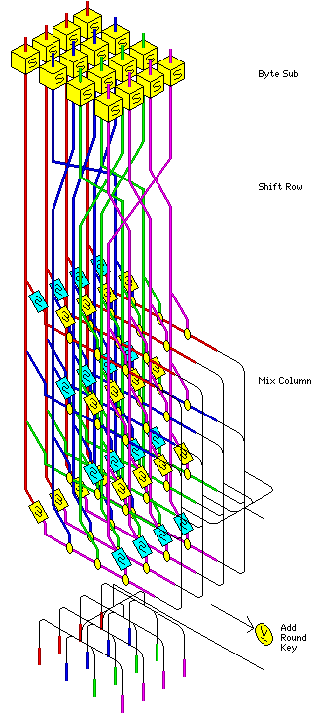
Rijndael
Block size 128 bits,
supports also 192 and 256 bits.
Key sizes: 128, 192, 256 bits.
Number of rounds
10 (block and key 128),
12 (block or key 192),
14 (block or key 256).
Not a Feistel Network.
Uses GF(2⁸), ⊕, new S-boxes,
permutations.

Slide 27
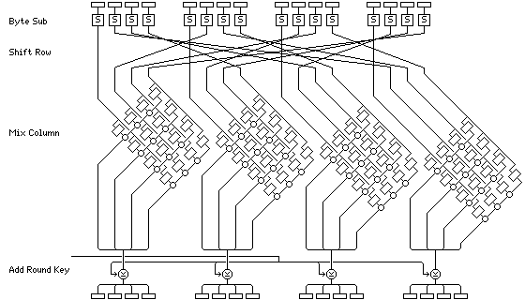
Rijndael

Slide 28
Key Distribution Problem
Both DES and AES are private, symmetric key cryptosystems.
Encryption and decryption keys are the same.
Both keys must be kept secret from Oscar
Alice and Bob must exchange keys over a secure channel.
What if they cannot?

Slide 29
Diffie-Hellman Key Exchange
p - LARGE prime (public).
α - primitive element of Z_{p} (public).
Alice: selects a (secret),
computes αª(mod p) and sends it to Bob.
Bob: selects b (secret),
computes α^{b}(mod p) and sends it to Alice.
Alice computes K = (α^{b})ª(mod p).
Bob computes K = (αª)^{b}(mod p).

Slide 30
Diffie-Hellman Key Exchange
D-H security is based on
discrete log problem:
Let p be a prime number, α∈Z_{p} primitive element, and β∈Z_{p}. Find the unique x∈Z, 0 ≤ x ≤ p-2, such that
α ^{x} ≡ β (mod p).
Difficult, especially if p has at least 150 digits and p-1 has at least one “large” prime factor (“strong” prime).
No known polynomial-time algorithm.

Slide 31
Fermat And Euler
Fermat’s Little Theorem
Let p be prime, a∈Z⁺, a not a multiple of p. Then a ^{p-1} ≡ 1 (mod p).
Euler’s “phi” function
∀n∈Z⁺, φ(n) = |{z∈Z⁺: gcd(z, n) = 1}|,
φ(1) = 1.
Euler’s Theorem
∀a, n∈Z⁺, gcd(a, n)=1 ⇒ a ^{φ(n)} ≡1 (mod n).

Slide 32
RSA (public key encryption)
Ron Rivest, Adi Shamir, Leonard Adleman, “A Method for Obtaining Digital Signatures and Public Key Cryptosystems”, Communications of the ACM, Vol. 21,
no. 2, February 1978, 120-126.
REVOLUTION!
www.rsa.com

Slide 33
RSA (public key encryption)
Alice wants Bob to send her a message. She:
selects two (large) primes p, q, TOP SECRET,
computes n = pq and φ(n) = (p-1)(q-1),
φ(n) also TOP SECRET,
selects an integer e, 1 < e < φ(n), such that
gcd(e, φ(n)) = 1,
computes d, such that de ≡ 1 (mod φ(n)),
d also TOP SECRET,
gives public key (e, n), keeps private key (d, n).

Slide 34
RSA (public key encryption)
RSA in action
Bob wants to send plaintext P, 0 < P < n.
Encryption: E_{(e, n)}(P) = C = P^{e} (mod n).
Bob sends ciphertext C.
Alice receives C.
Decryption: D_{(d, n)}(C) = C^{d} (mod n) = P (ha!)

Slide 35
RSA (public key encryption)
Does it work?
Yes!
D_{(d, n)}(C) = D_{(d, n)}(P ^{e}) = P ^{ed} =
= P ^{kφ(n)} ⁺¹ = de ≡ 1 (mod φ(n))
= (P ^{φ(n)})^{k} P ≡
≡ P (mod n). Euler’s Theorem

Slide 36
RSA (public key encryption)
Is it secure?
Yes, if p and q are large primes (over 150 decimal digits each).
Factoring is a HARD problem, no known polynomial time algorithm.
http://www.rsa.com/rsalabs/challenges/factoring/_x000b_numbers.html
RSA is much slower than DES or AES.

Slide 37
RSA (public key encryption)
Alice’s Signature
Alice encrypts her signature S using her private key:
E_{(d, n)}(S) = T = S^{d} (mod n)
and sends T to Bob.
Bob decrypts T using Alice’s public key to authenticate her message:
D_{(d, n)}(T) = T^{d} (mod n) = S.

Slide 38
The End
Cryptography,
Part 2: Modern Cryptosystems
Cryptography
Part 3: Quantum Cryptography
Stay Tuned…
(but don’t hold your breath)

