Slide 1
Search Engines:
Technology, Society, and Business
Prof. Marti Hearst
Aug 27, 2007

Slide 2
Today
Discussion
Course Goals and Logistics
Invited Speakers and Instructors
How the Internet / Web Works
How Search Engines Work

Slide 3
A Seminar Course
Undergraduates
Low-key; learn something new!
Both undergrads and graduate students.
Very wide-ranging backgrounds
Mass Commun. | 20
Undeclared | 12
Double Major | 9
Interdisc. Studies | 3
Anth/Soc/Legal | 3
Math/Chem/Op.Rs. | 3
Environ. Economics | 2
Business | 2
Rhetoric | 1
Grad students
iSchool | 16
CS/EECS | 2
Business | 1

Slide 4
Course Goals
Gain an interdisciplinary understanding of search engines and related technologies.
  How they work
  How they affect communication
  How they affect business
  How they are changing our understanding of information and knowledge.
Make the techy parts understandable for everyone.

Slide 5
Class Format
Lectures by up-to-date experts
A few short homework assignments, turned in online
A paper or project on a topic of your choice
    Topics will need to be approved by TAs/Prof

Slide 6
Class Attendance
You must attend class.
  We want a good audience for our fantastic speakers.
  Counting today, there are 14 lectures.
  You can miss only one class (not counting today). Each class missed beyond that will be a reduction of one letter grade.
  During each class, the TAs will mark your name off a list; you must show your student ID.

Slide 7

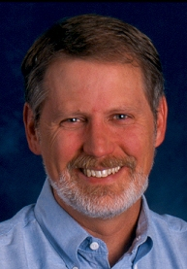
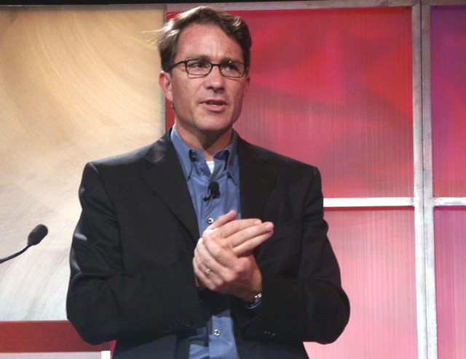
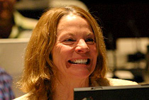
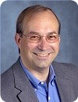

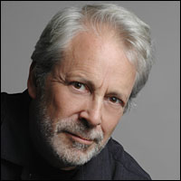


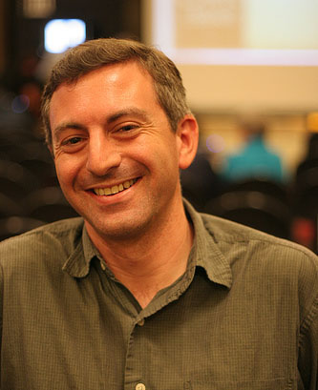
Lecturers

Slide 8
Instructor Background
Prof. Marti Hearst
Associate Professor in the School of Information
  Affiliate position in the CS department
  PhD in Computer Science from UC Berkeley
Research areas:
  Search, especially user interfaces for search
  Computational linguistics
  Information Visualization
Industry Experience
  Researcher at Xerox PARC for many years
  Worked at HP, IBM
  Was a member of the Scientific Advisory Board for Altavista and Yahoo! Search
  Consulting at a search startup now.

Slide 9
TAs
Eun Kyoung Choe
  iSchool masters student
Ani Sen
  iSchool Masters Student
Office hours TBD

Slide 10
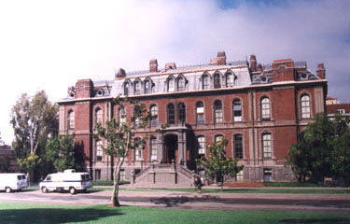

What is the iSchool?
School of Information
  Used to be called SIMS
Newest school on campus; started in 1997
We have a PhD program and a professional masters degree
  Like MBAs and Journalism school
Faculty have diverse backgrounds
  Computer science, economics, law, political science, sociology, and others.

Slide 11
iSchool Mission
We are developing scholars, entrepreneurs, and public leaders who can transform information into knowledge and understanding.
Notes:
We are committed to enhancing information access and quality. Our goal is to design and develop systems and policies that meet the needs and protect the rights of different information users--including individuals and groups, organizations and communities, and society as a whole a program that will advance, through teaching and research, the organization, management and use of information and information technology, and enhance our understanding of the impact of information on individuals, institutions, and society society. This mission has both a technical component, concerned with the design and use of information systems and services, and a social sciences component, concerned with understanding how people seek, obtain, evaluate, use, and categorize information. The proposed program will use the approaches of several social sciences and professional and technical disciplines to address a core set of information-related issues.
The primary educational mission of the program will be to prepare professionals for corporations, government agencies, and the academic world who can develop improved approaches to handling information, to design and manage information functions, and to merge them with other aspects of the organization.

Slide 12
SCHOLARSHIP
Information economics and policy
Information design and architecture
Computer Science
Law and Policy
iSchool
Human-computer interaction
Information assurance
Sociology of information
Social Sciences
Management Science
PROFESSIONAL SKILLS
Notes:
Information Design and Architecture ORGANIZATION AND CLASSIFICATION OF INFORMATION FOR NAVIGATION, SEARCH, RETRIEVAL, CONTENT ANALYSIS. DATABASE DESIGN, DOCUMENT ENGINEERING, NETWORK SYSTEM DESIGN TO ADDRESS BUSINESS PROCESSES, ONLINE COMMUNITIES, DIGITAL LIBRARIES, WEBSITES: NAVIGATION, SEARCH, RETRIEVAL, ANALYSIS
Information Economics and Policy
Effective management of information and information systems requires an understanding of the economics of information, of information systems, and of information infrastructures as well as some grounding in information law and policy which form the regulatory framework within which information is managed. Design of information systems should be undertaken in an economically sound manner and in conformity with legal rules and policy goals (e.g., consistent with intellectual property, privacy, and telecommunications law and policy).
Human-Computer Interaction DESIGN AND DEVELOPMENT OF SYSTMES THAT ARE USEABLE, ENJOYABLE, USEFUL. INTERDISCIPLINARY: DRAWA ON BEHAVIORAL AND SOCIAL SCIENCES FOR STUDY OF HUMAN USE OF INFORMATION SYSTEMS; DESIGN –ORIENTED, GRAPHIC DESIGN, VISUALIZATIONA ND PRESENTATIO OF INFORMATION USING QUALITATTIVEA ND QUANTIATIVE METHODS. COMPUTER MEDIATED COLLABORATIVE WORK.
Sociology of Information
Information technology has the potential to dramatically broaden access to information and to support novel forms of collaboration and communication; however it is deployed in social and institutional environments that can either impede or support such outcomes. Successful information systems explicitly integrate technical (software/hardware) and organization design. This requires understanding of how technology, social structure, and organization jointly shape the dynamics of information exchange and learning at various scales: within an organization, between individuals and organizations located in the same region, as well as those separated by great distances.
Information Assurance HOW INFORMATION GATHERED, PROTECTED, EVALUATED: QUALITY & CREDIBILITY, AUTHORITY OF SOURCES, METHODS OF ASSESSING, PROTECTING INFORMATION FROM ALTERATION OR LOSS OR UNAUTHORIZED USES, STRUCTURES TO INSURE ACCURACY, AVAILABILITY, COMPLETENESS

Slide 13
iSchool Courses (Sample)
Information in Society
Database Design
Information Visualization and Presentation
Open Source Software: Economic, Legal & Social Implications
Web Services
The Quality of Information

Slide 14
Master’s student placements
Representative employers:
Google, eBay, Yahoo!, Microsoft, Oracle, HP
UC, Kaiser, US Government, CA Digital Library
Entrepreneurial
Notes:
Of students in full-time career positions 76% private sector and 24% public sector
Public sector positions included academic, government and non-profit jobs.
Employers include ebay, Google, Microsoft, Yahoo!, Lawrence Berkeley National Lab, Oracle, Razorfish, Samsung, HP, University of California, Innovative Interfaces, California Digital Library, Kaiser and the US Coast Guard. Although different titles mean different things within different organizations there are a few that tend to come up repeatedly:
Product/Project Manager
User Interface Designer
Human Factors Engineer
Content Engineer
Web Engineer
Application Engineer
Information Engineer

Slide 15
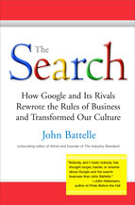
The Next Two Weeks
Get the textbook, “The Search” by John Battelle
  Read Chapters 1-2 of “The Search”
Read this article in the NYTimes:
  Google Keeps Tweaking Its Search Engine, by SAUL HANSELL, June 3, 2007
  http://www.nytimes.com/2007/06/03/business/yourmoney/03google.html?ei=5070&en=5656dc62628eac96&ex=1188273600&pagewanted=all
No lecture next week (campus holiday)
Monday, Sept 10: Jan Pedersen on how search engines work

Slide 16
How Search Engines Work

Slide 17

How Do Search Engines Work?
Say a user named Oski using his computer at home (or in, say, Seoul) wants to find information about i141?
What happens when he:
  Brings up a search engine home page?
  Types his query?
First we have to understand how the network works!
Then we can understand search engines.

Slide 18
Internet vs. WWW
Internet and Web are not synonymous
Internet is a global communication network connecting millions of computers.
World Wide Web (WWW) is one component of the Internet, along with e-mail, chat, etc.
Now we’ll talk about both.

Slide 19
How Does the WWW Work?
Let’s say Oski received email with the address for the i141 web page, or saw it on a flyer.
He goes to a networked computer, and launches a web browser.
He then types the address, known as a URL, into the address bar of the browser.
What happens next?
(URL stands for Uniform Resource Locator)

Slide 20

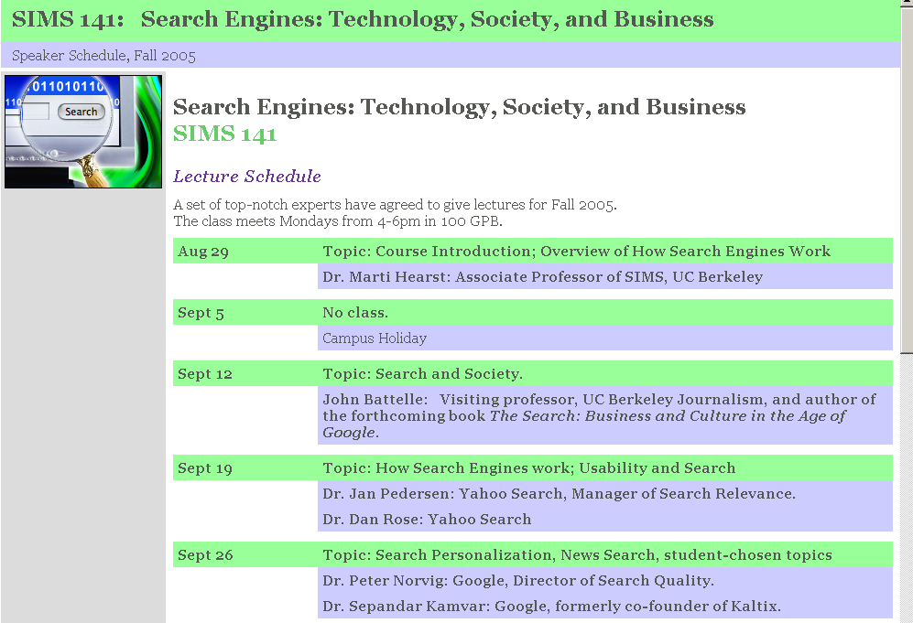

How Does the WWW Work?
Say Prof. Hearst has written some web pages for her class on her PC.
She copied the pages to a directory on a computer on her local network at the ischool. The computer’s name is herald.
This computer is connected to the Internet and runs a program called Apache. This allows herald to act as a web server.
Web server

Slide 21

How Does the WWW Work?
How does the computer at Oski’s desk figure out where the i141 web pages are?
In order for him to use the WWW, Oski’s computer must be connected to another machine acting as a web server (via his ISP).
This machine is in turn connected to other computers, some of which are routers.
iSchool
Network
Routers figure out how to move information from one part of the network to another.
There are many different possible routes.

Slide 22
How Does the WWW Work?
How do Oski’s server and the routers know how to find the right server?
First, the url has to be translated into a number known as an IP address.
Oski’s server connects to a Domain Names Server (DNS) that knows how to do the translation.
DNS server

Slide 23
Domain Name Syntax
Domain names are read right to left, from general to more specific locations
For example, www.xyz.com can be interpreted as follows:
    com — commercial site top-level domain
    xyz — registered company domain name
    www — host name (it is a convention to name web server hosts “www” which stands for “world wide web”)

Slide 24
Typical Domain Name
www.xyz.com
Server (host) name
Registered company domain name
Domain category
(top-level domain)
Domain names are part of URLs, used in web pages.

Slide 25
Top-Level Domains
com, biz, cc — commercial or company sites
edu — educational institutions, typically universities
org — organizations; originally meant for clubs, associations and nonprofit groups
mil — U.S. military
gov — U.S. civilian government
net — network sites, including ISPs
int — international organizations (rarely used)
Many other top level domains are available

Slide 26
Converting Domain Names
Domain names are for humans to read.
The Internet actually uses numbers called IP addresses to describe network addresses.
The Domain Name System (DNS) – resolves IP addresses into easily recognizable names
For example:
  12.42.192.73 = www.xyz.com
A domain name and its IP address refer to the same Web server.

Slide 27
Internet Addresses
The internet is a network on which each computer must have a unique address.
The Internet uses IP addresses; for example, herald’s IP address is 128.32.226.90
Internet Protocol version 4 (IPv4) – supports 32-bit dotted quad IP address format
  Four sets of numbers, each set ranging from 0 to 255
  UC Berkeley’s LAN addresses range from 128.32.0.0 to 128.32.255.255
  Other addresses in the iSchool LAN include 128.32.226.49
Using this setup, there are approximately 4 billion possible unique IP addresses
Router software knows how to use the IP addresses to find the target computer.

Slide 28
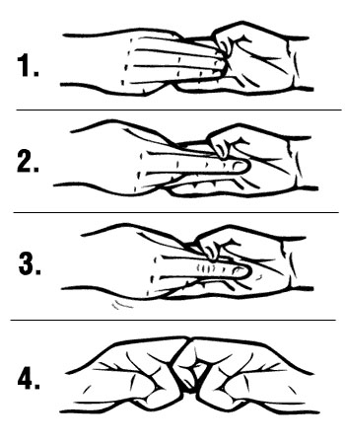
How the Internet Works
Network Protocols:
  Protocol – an agreed-upon format for transmitting data between two devices
    Like a secret handshake
  The Internet protocol is TCP/IP
  The WWW protocol is HTTP
Network Packets:
  Typically a message is broken up into smaller pieces and re-assembled at the receiving end.
  These pieces of information, surrounded by address information are called packets.

Slide 29
IP Packet Format (v4)
Bit 0
Field length in bits
Bit 31
Version
(4)
Hdr Len
(4)
TOS (8)
Total Length in bytes (16)
Identification (16 bits)
Flags (3)
Fragment Offset (13)
Header
Time to Live (8)
Protocol (8)
Header Checksum (16)
Source IP Address (32)
Destination IP Address (32)
Options (if any)
Data (variable length)
Data
Notes:
Max packet size = 2^16 bytes or 64kBytes

Slide 30
How Does the WWW Work?
What happens now that the request for information from Oski’s browser has been received by the web server herald at www.ischool.berkeley.edu?
The web server processes the url to figure out which page on the server is requested.
It then sends all the information from that page back to the requesting address.
iSchool
Network

Slide 31
Reading a URL
http://courses.ischool.berkeley.edu/i141/f07/index.html
http:// = HyperText Transfer Protocol
courses = service name (often is www)
.ischool = host name
.berkeley = primary domain name
.edu/ = top level domain
i141/ = directory name
f07/ = directory names
index.html = file name of web page

Slide 32
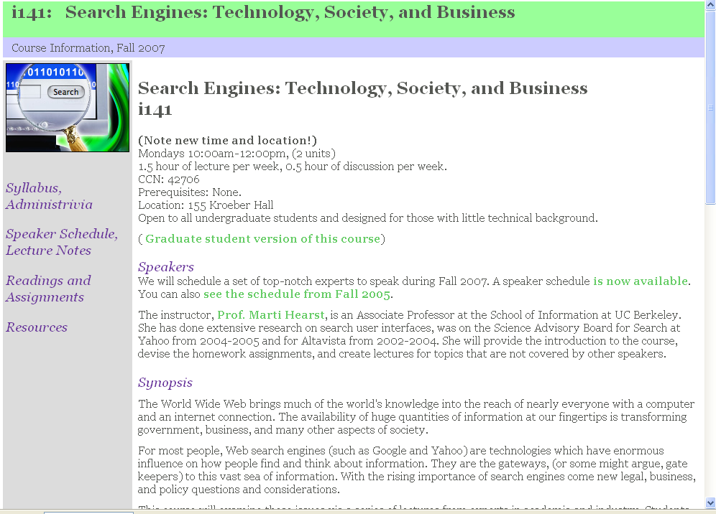
Web Pages and HTML
So what do we see at http://courses.ischool.berkeley.edu/is141/f07/index.html ?

Slide 33
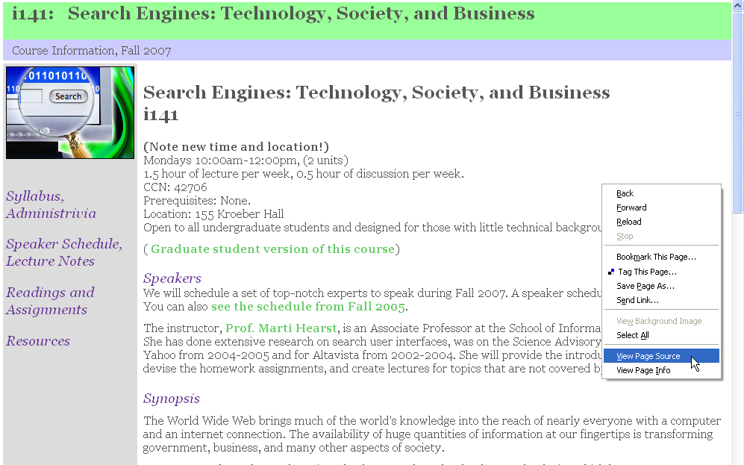
Web Pages and HTML
So what do we see at http://courses.ischool.berkeley.edu/is141/f07/index.html ?
Right-click to see the “source” or HTML code for the web page

Slide 34
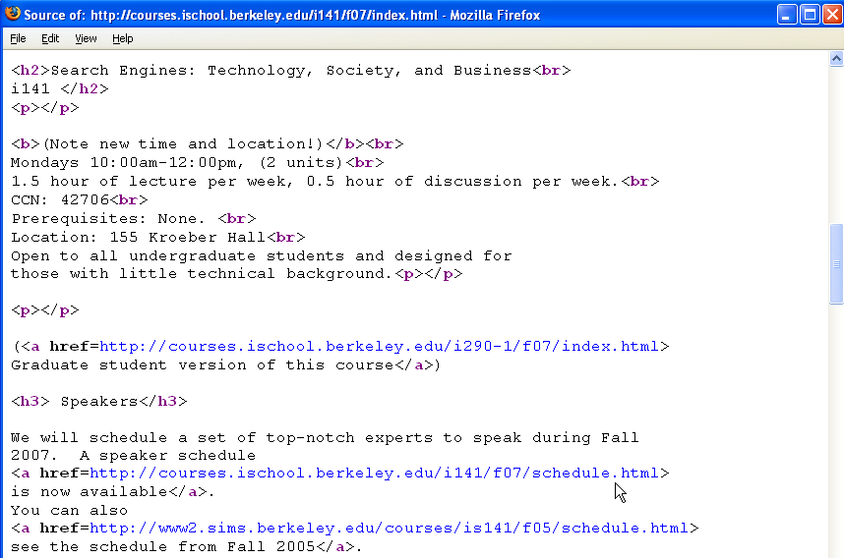
Web Pages and HTML
What does HTML look like?

Slide 35
HTML
HyperText Markup Language
  Uses <tags> which mark up the text and tell the browser how to display the content.
  A backslash tag means the end of the command but is sometimes optional
Examples
  This is <b> boldface text </b>.
  <p> indicates a paragraph break
  <h1> This is a large heading </h1>
  <h3> This is a smaller heading </h3>

Slide 36
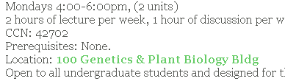
HTML Hyperlinks
Hyperlink is the most important:
  <a href=http://www.berkeley.edu/map/maps/BC23.html> 100 Genetics & Plant Biology Bldg </a>
  The green part is called anchor text
    It’s the text you see on the link
  The pink part is the url that the link will take you to if you click on it. The http:// at the front indicates the http (Web) protocol.
  The <a href= …> … </a> is the command that indicates the enclosed information is a hyperlink, and the that text between the tags is the anchor text.
A hyperlink can be clicked on by a person OR followed by a computer program.

Slide 37
HTTP
HTTP is the protocol used by the WWW
When a user clicks on a hyperlink in their web browser, this sends an HTTP command to the Web server named in the URL
This command usually is to “GET” the contents of the web page and return them to the user’s browser.
It is a very simple protocol
  It relies on the TCP/IP functionality

Slide 38
HTTP Request: Example
This information is received by the web server at
www.ischool.berkeley.edu :
Request line
GET i141/s07/index.html HTTP/1.1<CRLF>
Request header
Host: courses.ischool.berkeley.edu <CRLF>
Blank line
<CRLF>
Because HTTP is built on TCP/IP, the web server
knows which IP address to send the contents of
the web page back to.

Slide 39
How Does the WWW Work?
When Oski typed in the url for the i141 home page, this was turned into an HTTP request and routed to the web server in Berkeley.
The web server then decomposed the url and figured out which web page in its directories was being asked for.
The server then sends the HTML contents of the page back to Oski’s IP address.
iSchool
Network
Oski’s browser receives these HTML contents and renders the page in graphical form.
If he clicks on the hyperlink to the GPB map, a similar sequence of events will happen.

Slide 40
How the WWW/Internet Work
More information is available online.
There are many good glossaries:
  http://www.alpinetech.net/glossary.html
  http://www.lib.berkeley.edu/TeachingLib/Guides/Internet/Glossary.html
There are good essays too:
  http://en.wikipedia.org/wiki/Internet_Protocol
  http://computer.howstuffworks.com/web-server.htm

Slide 41
How Search Engines Work
There are MANY issues
I’m only giving the basics today
More will come out in future lectures

Slide 42
How Search Engines Work
Three main parts:
Gather the contents of all web pages (using a program called a crawler or spider)
Organize the contents of the pages in a way that allows efficient retrieval (indexing)
Take in a query, determine which pages match, and show the results (ranking and display of results)

Slide 43
Standard Web Search Engine Architecture
Check for duplicates,
store the
documents
crawl the
web
DocIds
Crawler
machines
Create an
inverted
index
Inverted
index
Search
engine
servers

Slide 44
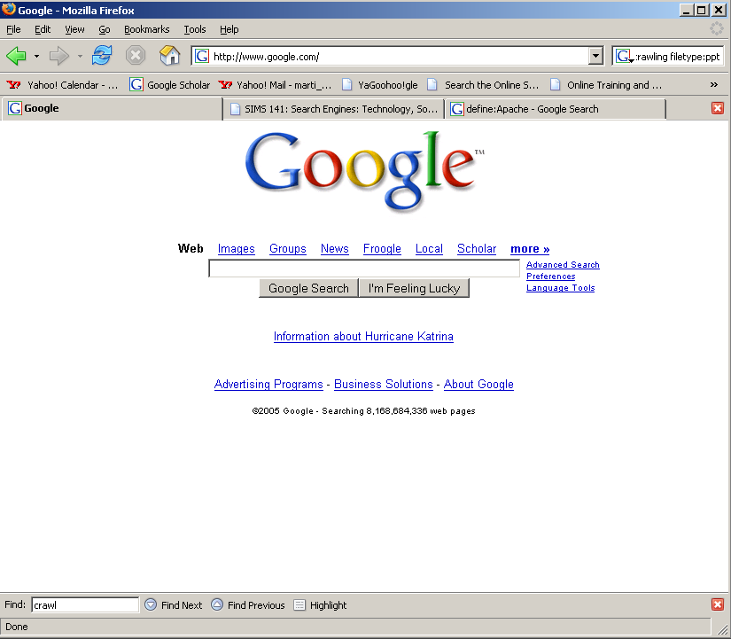
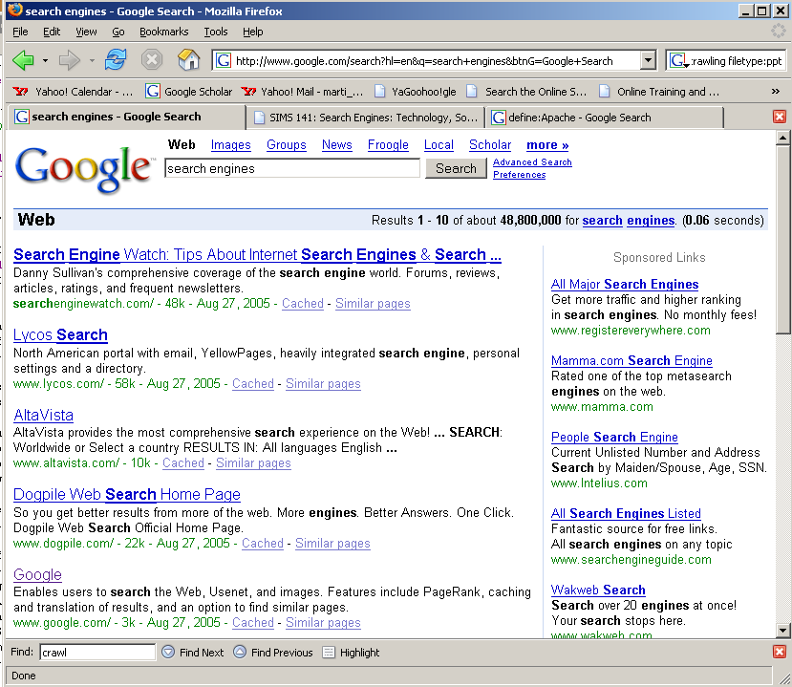
Standard Web Search Engine Architecture
Check for duplicates,
store the
documents
crawl the
web
DocIds
Crawler
machines
user
query
Create an
inverted
index
Inverted
index
Search
engine
servers
Show results
To user

Slide 45
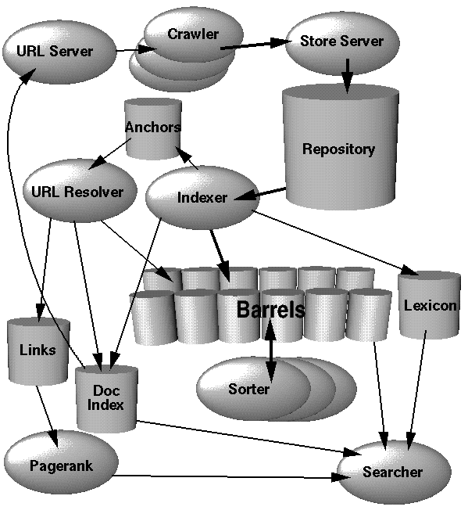
More detailed architecture, from “Anatomy of a Large-Scale Hypertext Web Search Engine”, Brin & Page, 1998. http://dbpubs.stanford.edu:8090/pub/1998-8

Slide 46
Spiders or crawlers
How to find web pages to visit and copy?
  Can start with a list of domain names, visit the home pages there.
  Look at the hyperlink on the home page, and follow those links to more pages.
    Use HTTP commands to GET the pages
  Keep a list of urls visited, and those still to be visited.
  Each time the program loads in a new HTML page, add the links in that page to the list to be crawled.

Slide 47
Spider behaviour varies
Parts of a web page that are indexed
How deeply a site is indexed
Types of files indexed
How frequently the site is spidered

Slide 48
Four Laws of Crawling
A Crawler must show identification
A Crawler must obey the robots exclusion standard
  http://www.robotstxt.org/wc/norobots.html
A Crawler must not hog resources
A Crawler must report errors

Slide 49
Lots of tricky aspects
Servers are often down or slow
Hyperlinks can get the crawler into cycles
Some websites have junk in the web pages
Now many pages have dynamic content
  The “hidden” web
  E.g., schedule.berkeley.edu
    You don’t see the course schedules until you run a query.
The web is HUGE

Slide 50
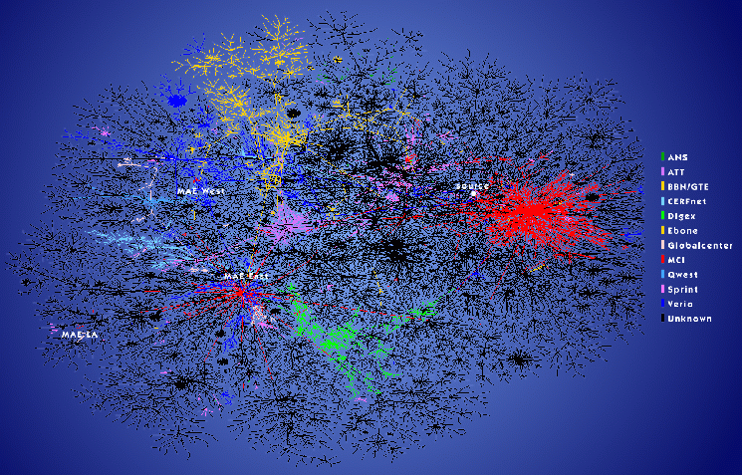
The Internet Is Enormous
Image from http://www.nature.com/nature/webmatters/tomog/tomfigs/fig1.html

Slide 51
“Freshness”
Need to keep checking pages
  Pages change (25%,7% large changes)
    At different frequencies
    Who is the fastest changing?
    Pages are removed
  Many search engines cache the pages (store a copy on their own servers)

Slide 52
What really gets crawled?
A small fraction of the Web that search engines know about; no search engine is exhaustive
Not the “live” Web, but the search engine’s index
Not the “Deep Web”
Mostly HTML pages but other file types too: PDF, Word, PPT, etc.

Slide 53
ii. Index (the database)
Record information about each page
List of words
  In the title?
  How far down in the page?
  Was the word in boldface?
URLs of pages pointing to this one
Anchor text on pages pointing to this one

Slide 54
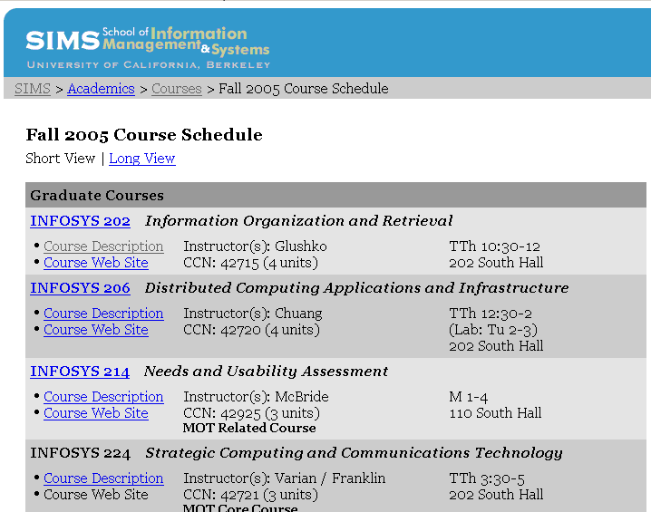
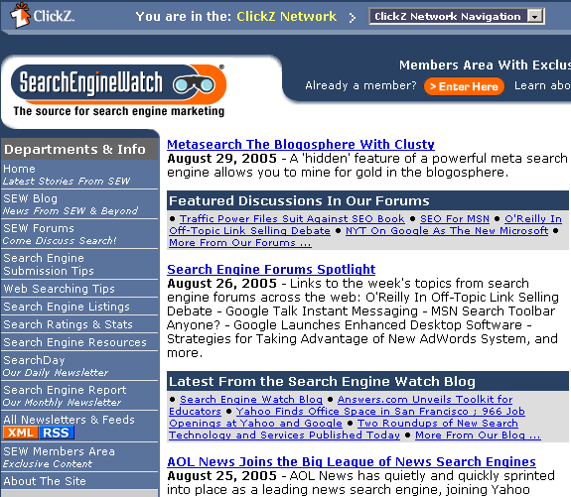
The importance of anchor text
<a href=http://courses.ischool…>
A terrific course on search
engines </a>
<a href=http://courses.ischool…>
i141 </a>
The anchor text summarizes
what the website is about.

Slide 55
Inverted Index
How to store the words for fast lookup
Basic steps:
  Make a “dictionary” of all the words in all of the web pages
  For each word, list all the documents it occurs in.
  Often omit very common words
    “stop words”
  Sometimes stem the words
    (also called morphological analysis)
    cats -> cat
    running -> run

Slide 56
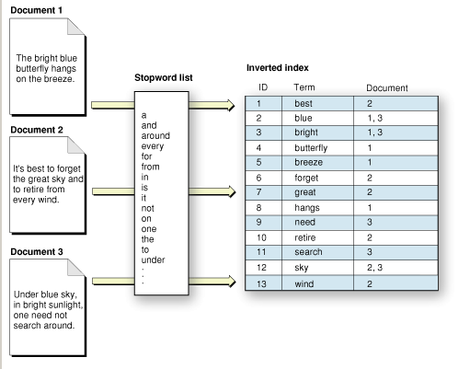
Inverted Index Example
Image from http://developer.apple.com
/documentation/UserExperience/Conceptual/SearchKitConcepts/searchKit_basics/chapter_2_section_2.html

Slide 57
Inverted Index
In reality, this index is HUGE
Need to store the contents across many machines
Need to do optimization tricks to make lookup fast.

Slide 58
Query Serving Architecture
“travel”
Load Balancer
Index divided into segments each served by a node
Each row of nodes replicated for query load
Query integrator distributes query and merges results
Front end creates a HTML page with the query results
“travel”
…
…
FE₁
FE₂
FE₈
“travel”
…
…
QI₁
QI₂
QI₈
“travel”
“travel”
…
Node_{1,1}
Node_{1,2}
Node_{1,3}
Node_{1,N}
…
Node_{2,1}
Node_{2,2}
Node_{2,3}
Node_{2,N}
…
Node_{3,1}
Node_{3,2}
Node_{3,3}
Node_{3,N}
…
Node_{4,1}
Node_{4,2}
Node_{4,3}
Node_{4,N}

Slide 59
iii. Results ranking
Search engine receives a query, then
Looks up the words in the index, retrieves many documents, then
Rank orders the pages and extracts “snippets” or summaries containing query words.
  Most web search engines assume the user wants all of the words (Boolean AND, not OR).
These are complex and highly guarded algorithms unique to each search engine.

Slide 60
Some ranking criteria
For a given candidate result page, use:
  Number of matching query words in the page
  Proximity of matching words to one another
  Location of terms within the page
  Location of terms within tags e.g. <title>, <h1>, link text, body text
  Anchor text on pages pointing to this one
  Frequency of terms on the page and in general
  Link analysis of which pages point to this one
  (Sometimes) Click-through analysis: how often the page is clicked on
  How “fresh” is the page
Complex formulae combine these together.

Slide 61
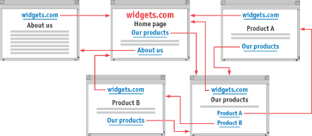
Measuring Importance of Linking
PageRank Algorithm
  Idea: important pages are pointed to by other important pages
  Method:
    Each link from one page to another is counted as a “vote” for the destination page
    But the importance of the starting page also influences the importance of the destination page.
    And those pages scores, in turn, depend on those linking to them.
Image and explanation from http://www.economist.com/science/tq/displayStory.cfm?story_id=3172188

Slide 62
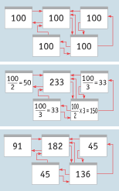
Measuring Importance of Linking
Example: each page starts with 100 points.
Each page’s score is recalculated by adding up the score from each incoming link.
  This is the score of the linking page divided by the number of outgoing links it has.
  E.g, the page in green has 2 outgoing links and so its “points” are shared evenly by the 2 pages it links to.
Keep repeating the score updates until no more changes.
Image and explanation from http://www.economist.com/science/tq/displayStory.cfm?story_id=3172188

Slide 63
Manipulating Ranking
Motives
  Commercial, political, religious
  Promotion funded by advertising budget
Operators
  Search Engine Optimizers
  Web masters
  Hosting services
Forum
  Web master world ( www.webmasterworld.com )

Slide 64
A few spam technologies
Cloaking
  Serve fake content to search engine robot
  DNS cloaking: Switch IP address. Impersonate
Doorway pages
  Pages optimized for a single keyword that re-direct to the real target page
Keyword Spam
  Misleading meta-keywords, excessive repetition of a term, fake “anchor text”
  Hidden text with colors, CSS tricks, etc.
Link spamming
  Mutual admiration societies, hidden links, awards
  Domain flooding: numerous domains that point or re-direct to a target page
Robots
  Fake click stream
  Fake query stream
  Millions of submissions via Add-Url
Cloaking
SPAM
Y
Is this a Search
Engine spider?
N
Real
Doc
Meta-Keywords =
“… London hotels, hotel, holiday inn, hilton,
discount, booking, reservation, sex, mp3,
britney spears, viagra, …”
Notes:
Small biotech firm ; query example from last time ; infoseek exapmle

Slide 65
Paid ranking
Pay-for-inclusion
Deeper and more frequent indexing
Sites are not distinguished in results display
Paid placement
Keyword bidding for targeted ads

Slide 66
Know your search engine
What is the default boolean operator? Are other operators supported?
Does it index other file types like PDF?
Is it case sensitive?
Phrase searching?
Proximity searching?
Truncation?
Advanced search features?

Slide 67
Keyword search tips
There are many books and websites that give searching tips; here are a few common ones:
  Use unusual terms and proper names
  Put most important terms first
  Use phrases when possible
  Make use of slang, industry jargon, local vernacular, acronyms
  Be aware of country spellings and common misspellings
  Frame your search like an answer or question
For more, see http://www.googleguide.com/

Slide 68
Search Engine Information
www.searchengineland.com
www.searchenginewatch.com
www.searchenginejournal.com
www.searchengineshowdown.com
http://battellemedia.com

Slide 69
Class Attendance
You must attend class.
  We want a good audience for our fantastic speakers.
  Counting today, there are 14 lectures.
  You can miss only one class. Each class missed beyond that will be a reduction of one letter grade.
  During each class, the TAs will mark your name off a list; you must show your student ID.

Slide 70
The Next Two Weeks
Read Chapter 1-2 of “The Search”
Read this article in the NYTimes:
  Google Keeps Tweaking Its Search Engine, by SAUL HANSELL, June 3, 2007
  http://www.nytimes.com/2007/06/03/business/yourmoney/03google.html?ei=5070&en=5656dc62628eac96&ex=1188273600&pagewanted=all
No lecture next week (campus holiday) but we will have discussion sections next week:
Monday, Sept 10: Jan Pedersen

