Slide 1
DT023G Project
WiFi Telemetry ETL Pipeline
A refined extension of the DT212G Mininet-WiFi and Airflow project
Hem Raj & Mohit Kumar
REQUESTS
8000
4 stations × 2000
SUCCESS RATE
100%
0 failed requests
MEAN LATENCY
12.32 ms
final refined run
ROAMING
1 event
detected in final run
DT023G | 1

Slide 2
From DT212G Prototype to DT023G Extension
The new project focuses on scale, reliability, visualization, and workflow quality.
DT212G BASELINE
2 APs / 2 stations
1000 requests per station
DT023G REFINED
4 APs / 4 stations
2000 requests per station
→
The aim was not only to repeat the previous project, but to make it more realistic and easier to analyze.
Larger wireless topology and heavier workload
More complete telemetry outputs with latency, RSSI, AP association, and roaming evidence
Improved reporting and Airflow-based workflow evidence
DT023G | 2

Slide 3
Previous Project Baseline: DT212G
The original project proved the ETL pipeline with a smaller WiFi scenario.
TOPOLOGY
2 APs + 2 stations
one backend server
WORKLOAD
1000 / station
about 2000 requests
SUCCESS RATE
99.55%
final Airflow run
MEAN LATENCY
7.60 ms
smaller setup
Airflow DAG: run_experiment → transform → report
Artifacts: raw_requests.csv, wifi_link.csv, analytics.csv, report.txt
Roaming detected for sta1 and sta2
Interpretation DT212G was a successful proof of concept: small topology, low latency, and clear roaming evidence. It created a good base for extension.
DT023G | 3

Slide 4
Final DT023G Refined Result
The final run improved reliability and scale while keeping latency acceptable.
TOTAL REQUESTS
8000
4 × 2000
SUCCESS RATE
100.0%
8000 / 8000
MEAN LATENCY
12.32 ms
stable under load
P95 LATENCY
18.87 ms
tail latency
ROAMING
1 event
detected
FAILURES
0
no dropped requests
APS
4
larger topology
STATIONS
4
more clients
Key message: the refined DT023G project is a more complete telemetry engineering workflow, with stronger reliability and richer visual evidence than the original project.
DT023G | 4

Slide 5
Direct Comparison: DT212G vs DT023G
Latency is higher in DT023G because the network is larger, but scale and reliability improved.
Metric | DT212G Previous | DT023G Refined | Meaning
Access points | 2 | 4 | larger wireless scenario
Stations | 2 | 4 | more clients
Requests / station | 1000 | 2000 | heavier workload
Total requests | ~2000 | 8000 | 4× larger dataset
Success rate | 99.55% | 100.0% | stronger reliability
Mean latency | 7.60 ms | 12.32 ms | acceptable under larger load
P95 latency | 8.48 ms | 18.87 ms | higher due to roaming + scale
Roaming | both stations | 1 event | roaming logic included
DT023G | 5

Slide 6
What Was Improved Inside DT023G
The first DT023G attempt was tuned until reliability and latency became much better.
Success rate increased from 82.12% to 100.0%
Failed requests dropped from 1430 to 0
Mean latency improved from 17.39 ms to 12.32 ms
P95 latency improved from 27.28 ms to 18.87 ms
DT023G | 6

Slide 7
Final Architecture and Workflow
Experiment data is converted into analytics, graphs, and a readable KPI report.
STEP 1
Mininet-WiFi Experiment
4 APs + 4 stations
STEP 2
Raw Logs
HTTP + WiFi telemetry
STEP 3
Transform
pandas analytics
STEP 4
Visualize
Latency / RSSI / AP
STEP 5
Report
KPI summary
→
→
→
→
Airflow connects the processing stages so the pipeline is easier to rerun, validate, and explain during demonstration.
DT023G | 7

Slide 8
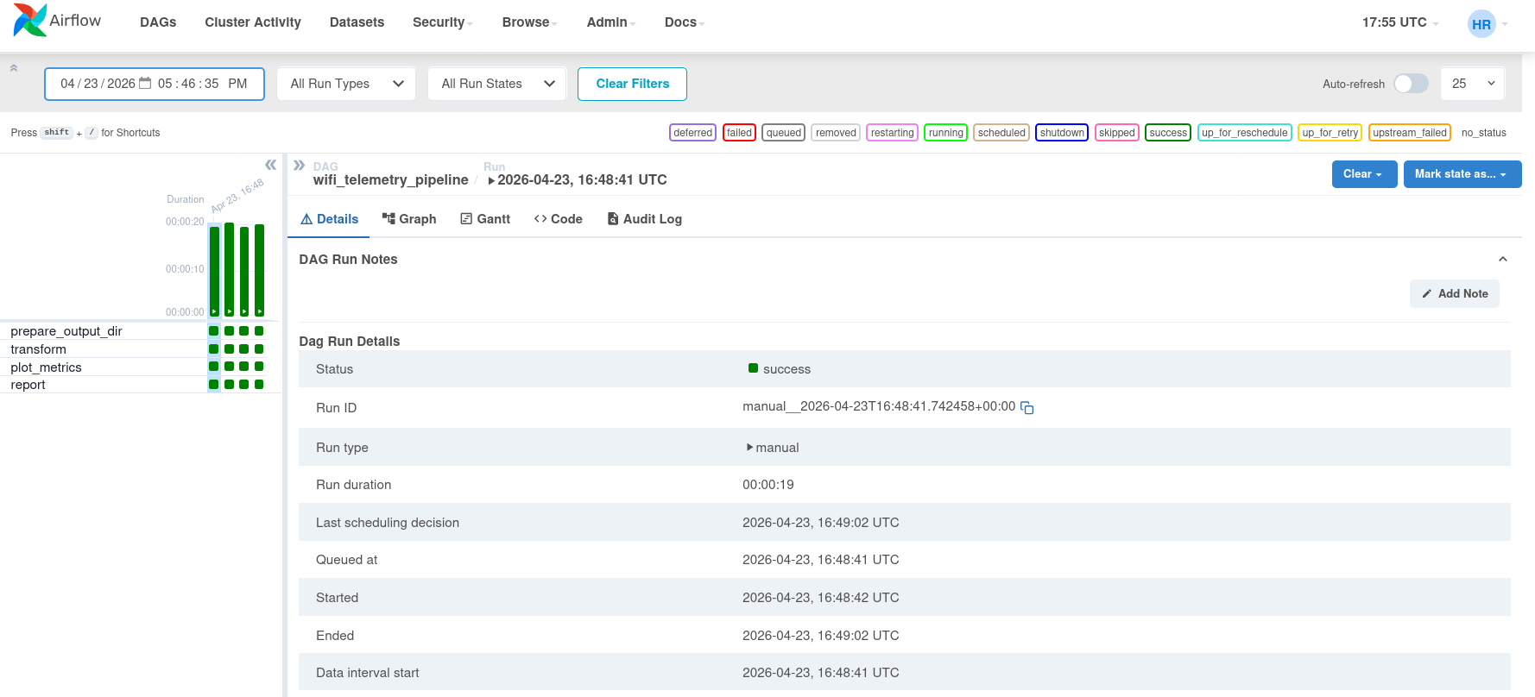
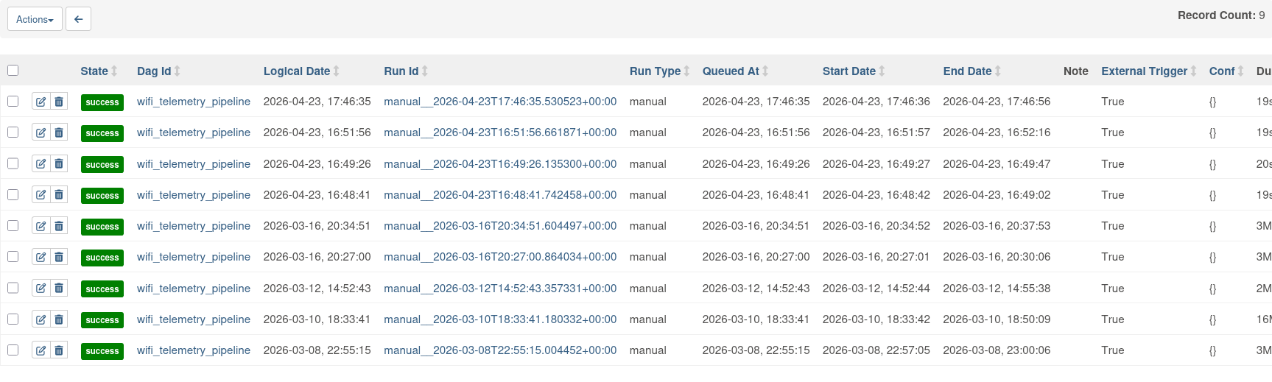
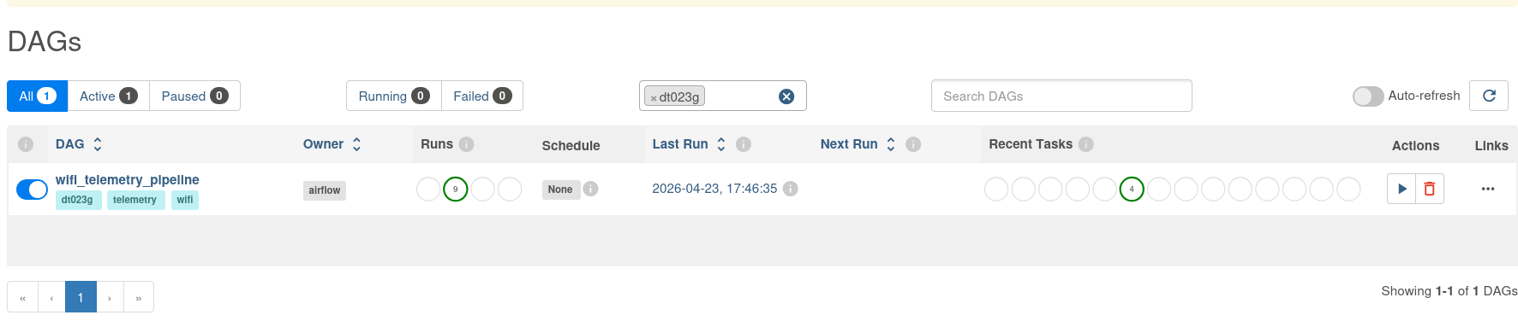
Airflow Execution Evidence
The DAG was used to run transformation, graph generation, and reporting in a clear sequence.
Airflow provides workflow evidence: DAG visibility, task execution, and run history.
DT023G | 8

Slide 9
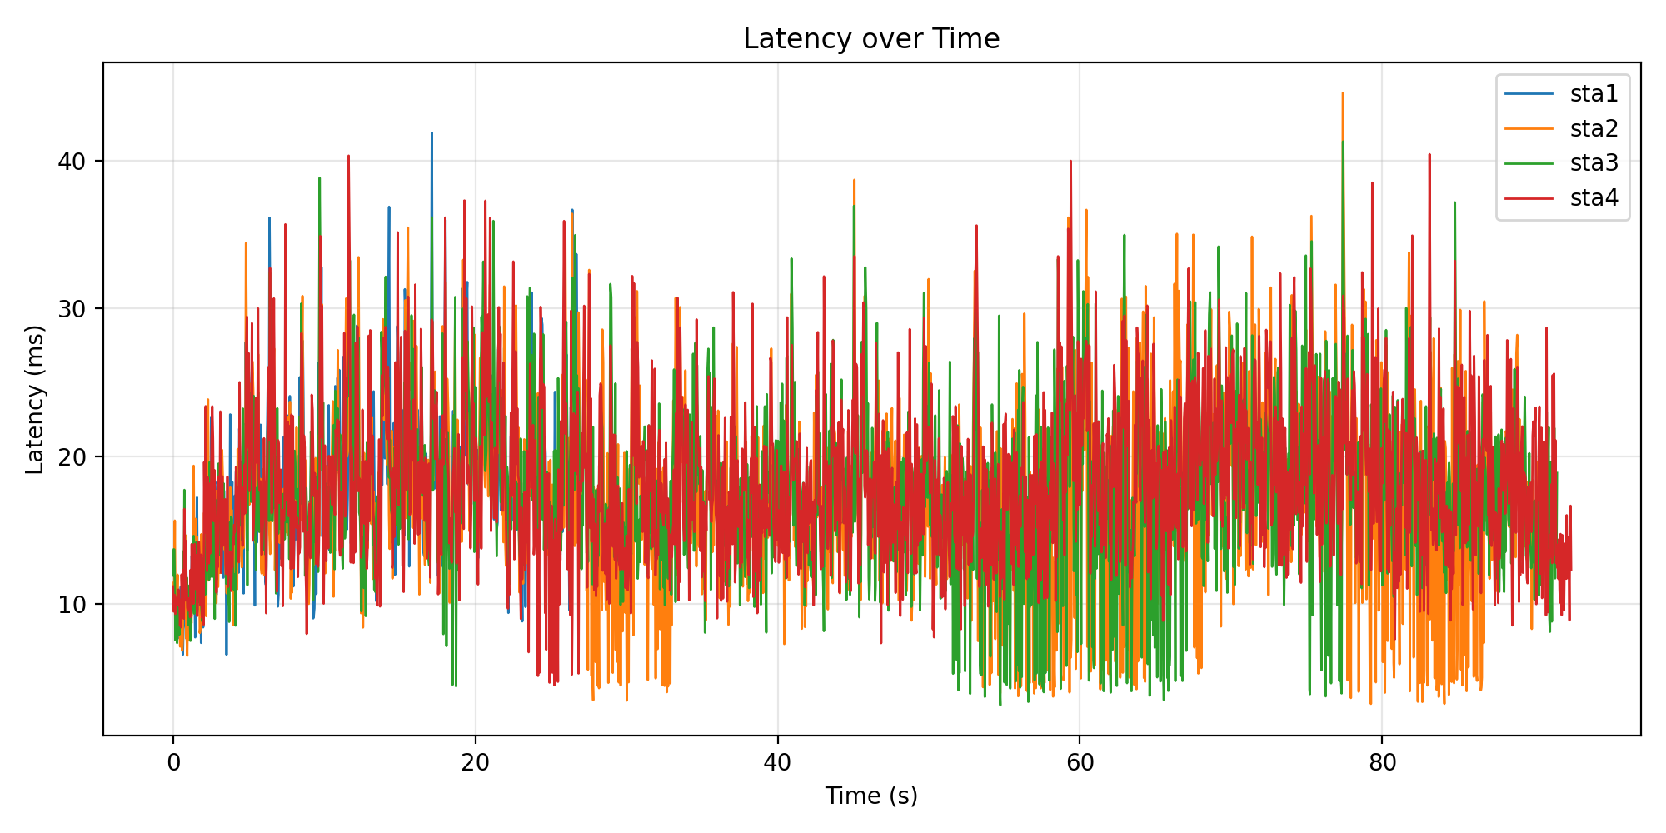
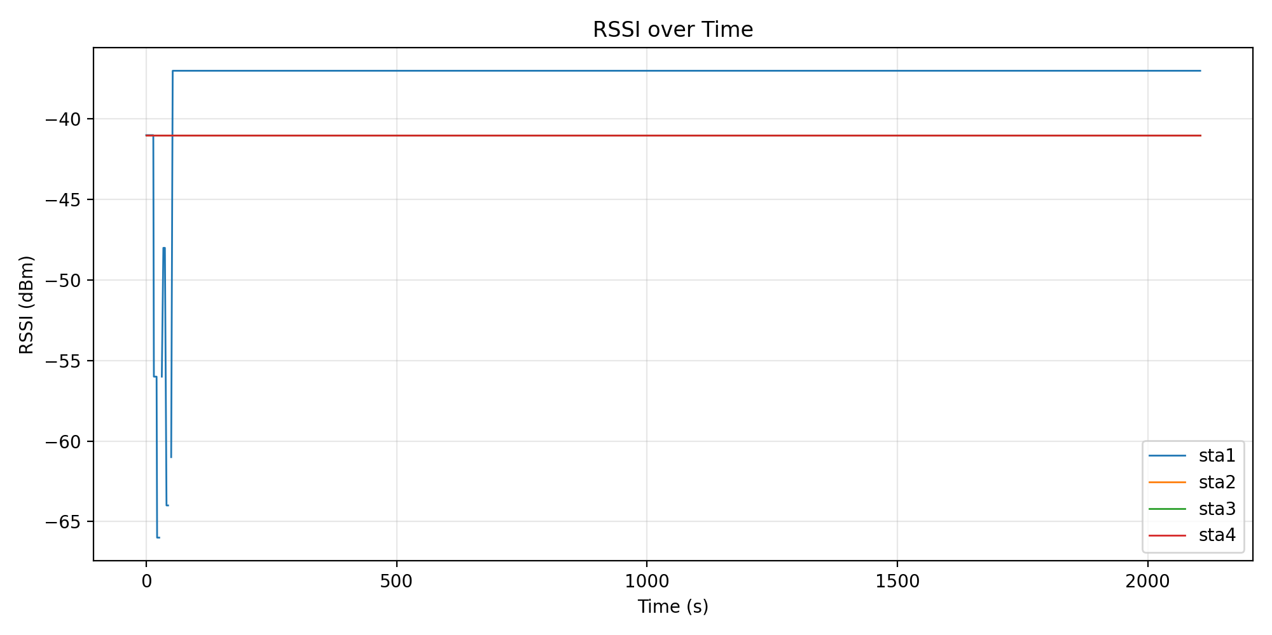
Graph Evidence: Latency and RSSI
The project now gives visual insight, not only text-based KPI values.
Latency graph shows request behavior over time for all stations.
RSSI graph shows link quality and movement impact during the experiment.
DT023G | 9

Slide 10
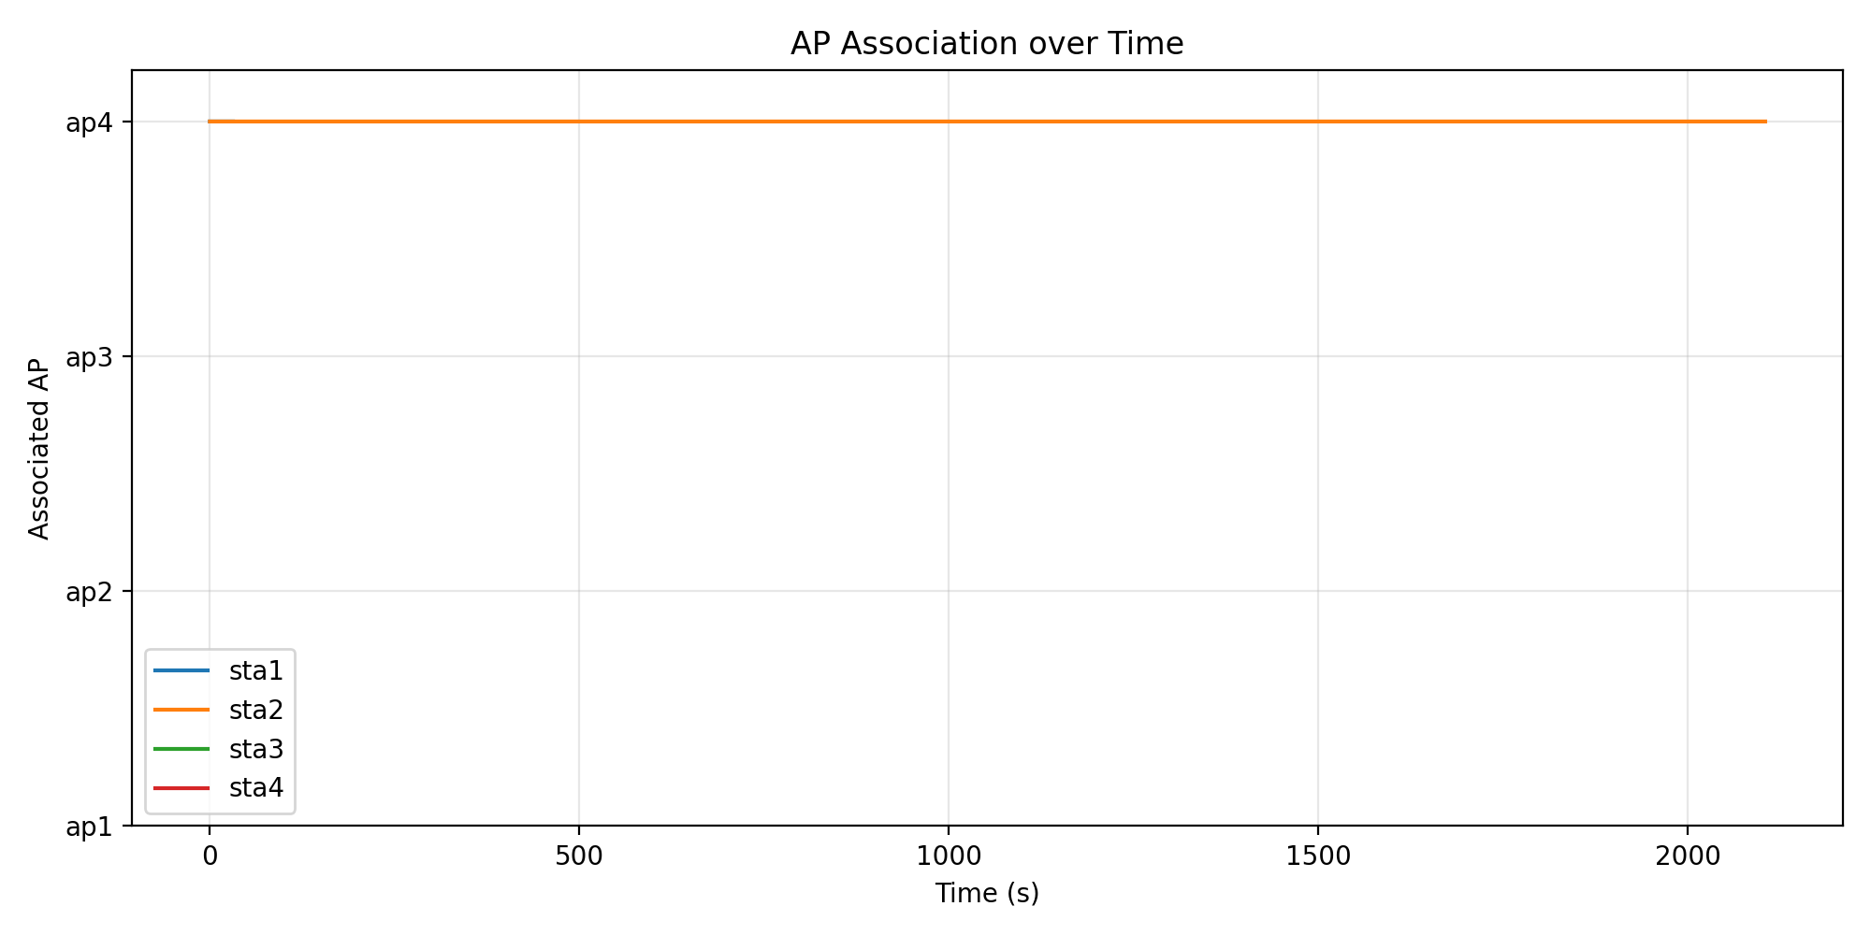
Roaming and AP Association
AP association over time helps prove whether roaming was detected.
Why this graph matters
It shows which AP each station is connected to over time.
AP changes are used as roaming evidence.
The final DT023G run detected one roaming event.
DT023G | 10

Slide 11
Engineering Fixes That Made the Final Run Stable
The final version is the result of debugging and tuning, not just running the old setup again.
Expanded AP coverage and lowered propagation loss to reduce disconnections.
Used traffic pauses during station movement to protect success rate.
Added one retry for failed HTTP requests.
Created root wrapper scripts for controlled Mininet execution.
Used Airflow for repeatable transformation, graphing, and reporting.
MAIN OUTCOME
100% success
final refined run
RELIABILITY
0 failures
8000 requests completed
EVIDENCE
graphs + Airflow
clearer demo proof
DT023G | 11

Slide 12
Final Conclusion
DT023G turns the DT212G prototype into a stronger, larger, and more explainable telemetry pipeline.
The refined DT023G project is a clear extension, not just a repeat.
Larger experiment: 4 APs, 4 stations, and 8000 requests
Stronger reliability: 100% success rate and zero failed requests
Better evidence: latency, RSSI, AP association graphs, and Airflow execution proof
Honest performance view: latency is higher than DT212G because the new setup is larger, but the workflow is much stronger
Presented by Hem Raj & Mohit Kumar
DT023G | 12

