Slide 1
PRT563 Advanced Data Management
Introduction
Darwin Group 7
Student Name | Student ID
Ayush Bhusal | S400314
Hemraj Budhathoki | S399267
Sujan Gautam | S400602
Sangam GC | S400607
Assessment 2 presentation
Notes:
Introduce the project as a database system for an Australian aged-care and disability-support provider. The presentation explains the business problem, conceptual models, relational mapping, normalization, SQLite implementation, and the required SQL queries.

Slide 2
PRT563 Advanced Data Management
Aged-Care & Disability-Support
Service Management System
Database design, EER/UML modelling, 3NF mapping, SQLite implementation and SQL query demonstration
Darwin Group 7
Charles Darwin University
Assessment 2 presentation
Notes:
Introduce the project as a database system for an Australian aged-care and disability-support provider. The presentation explains the business problem, conceptual models, relational mapping, normalization, SQLite implementation, and the required SQL queries.

Slide 3
OVERVIEW
Business problem and scope
Problem
Core workflow
Design goal
A support provider needs one reliable system to manage clients, care plans, service agreements, worker bookings, delivered services, progress notes, incidents, invoices and payments.
Client → Service Agreement / Care Plan → Service Booking → Service Delivery → Progress Notes / Incidents → Invoice → Payment
Create a normalized database that reduces duplicated data, enforces referential integrity, and supports clear reporting through SQL queries.
System boundary
The model focuses on operational service management rather than payroll, rostering awards, clinical diagnosis, or external government claim processing.
Key data flow
CLIENT → AGREEMENT → BOOKING → DELIVERY → INVOICE LINE → PAYMENT
PRT563 Advanced Data Management · Darwin Group 7 · 2
Notes:
Explain that the project scope was deliberately kept around the service lifecycle. The model captures how clients receive support, how workers are assigned, how service delivery is documented, and how invoicing/payment is handled.

Slide 4
TEAM
Team contributions
MEMBER
PRIMARY CONTRIBUTION
Ayush Bhusal
Requirements gathering, business problem and project scope
Hemraj Budhathoki
Conceptual modelling — EER and UML class diagrams
Sangam GC
EER-to-relational mapping and SQLite implementation
Sujan Gautam
SQL query design, testing, limitations and conclusion
COORDINATION
The team coordinated through WhatsApp for task allocation, design feedback, database testing and progress tracking.
PRT563 Advanced Data Management · Darwin Group 7 · 3
Notes:
Keep this slide short. Explain how the group worked together and that WhatsApp was used as the main coordination channel. Before final submission, add one or two screenshots that demonstrate communication and progress updates.

Slide 5
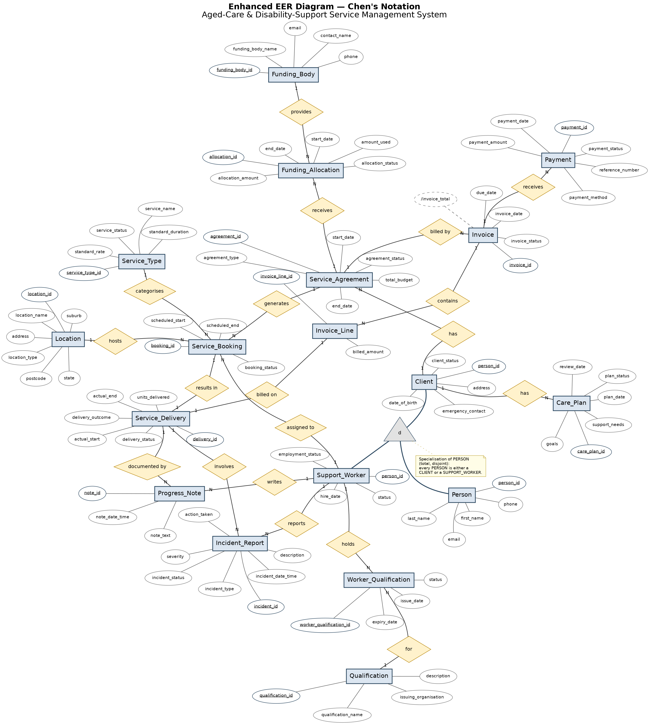
MODEL DESIGN
Conceptual model: Enhanced EER diagram
EER model in Chen's notation: entity rectangles, attribute ovals, relationship diamonds, cardinalities and PERSON specialisation.
Notes:
Use this slide to explain the conceptual model. Highlight PERSON as a supertype with CLIENT and SUPPORT_WORKER as subtypes. Mention service agreements, bookings, deliveries, notes, incidents, invoices and payments. Also mention that invoice total is derived from invoice line amounts.

Slide 6
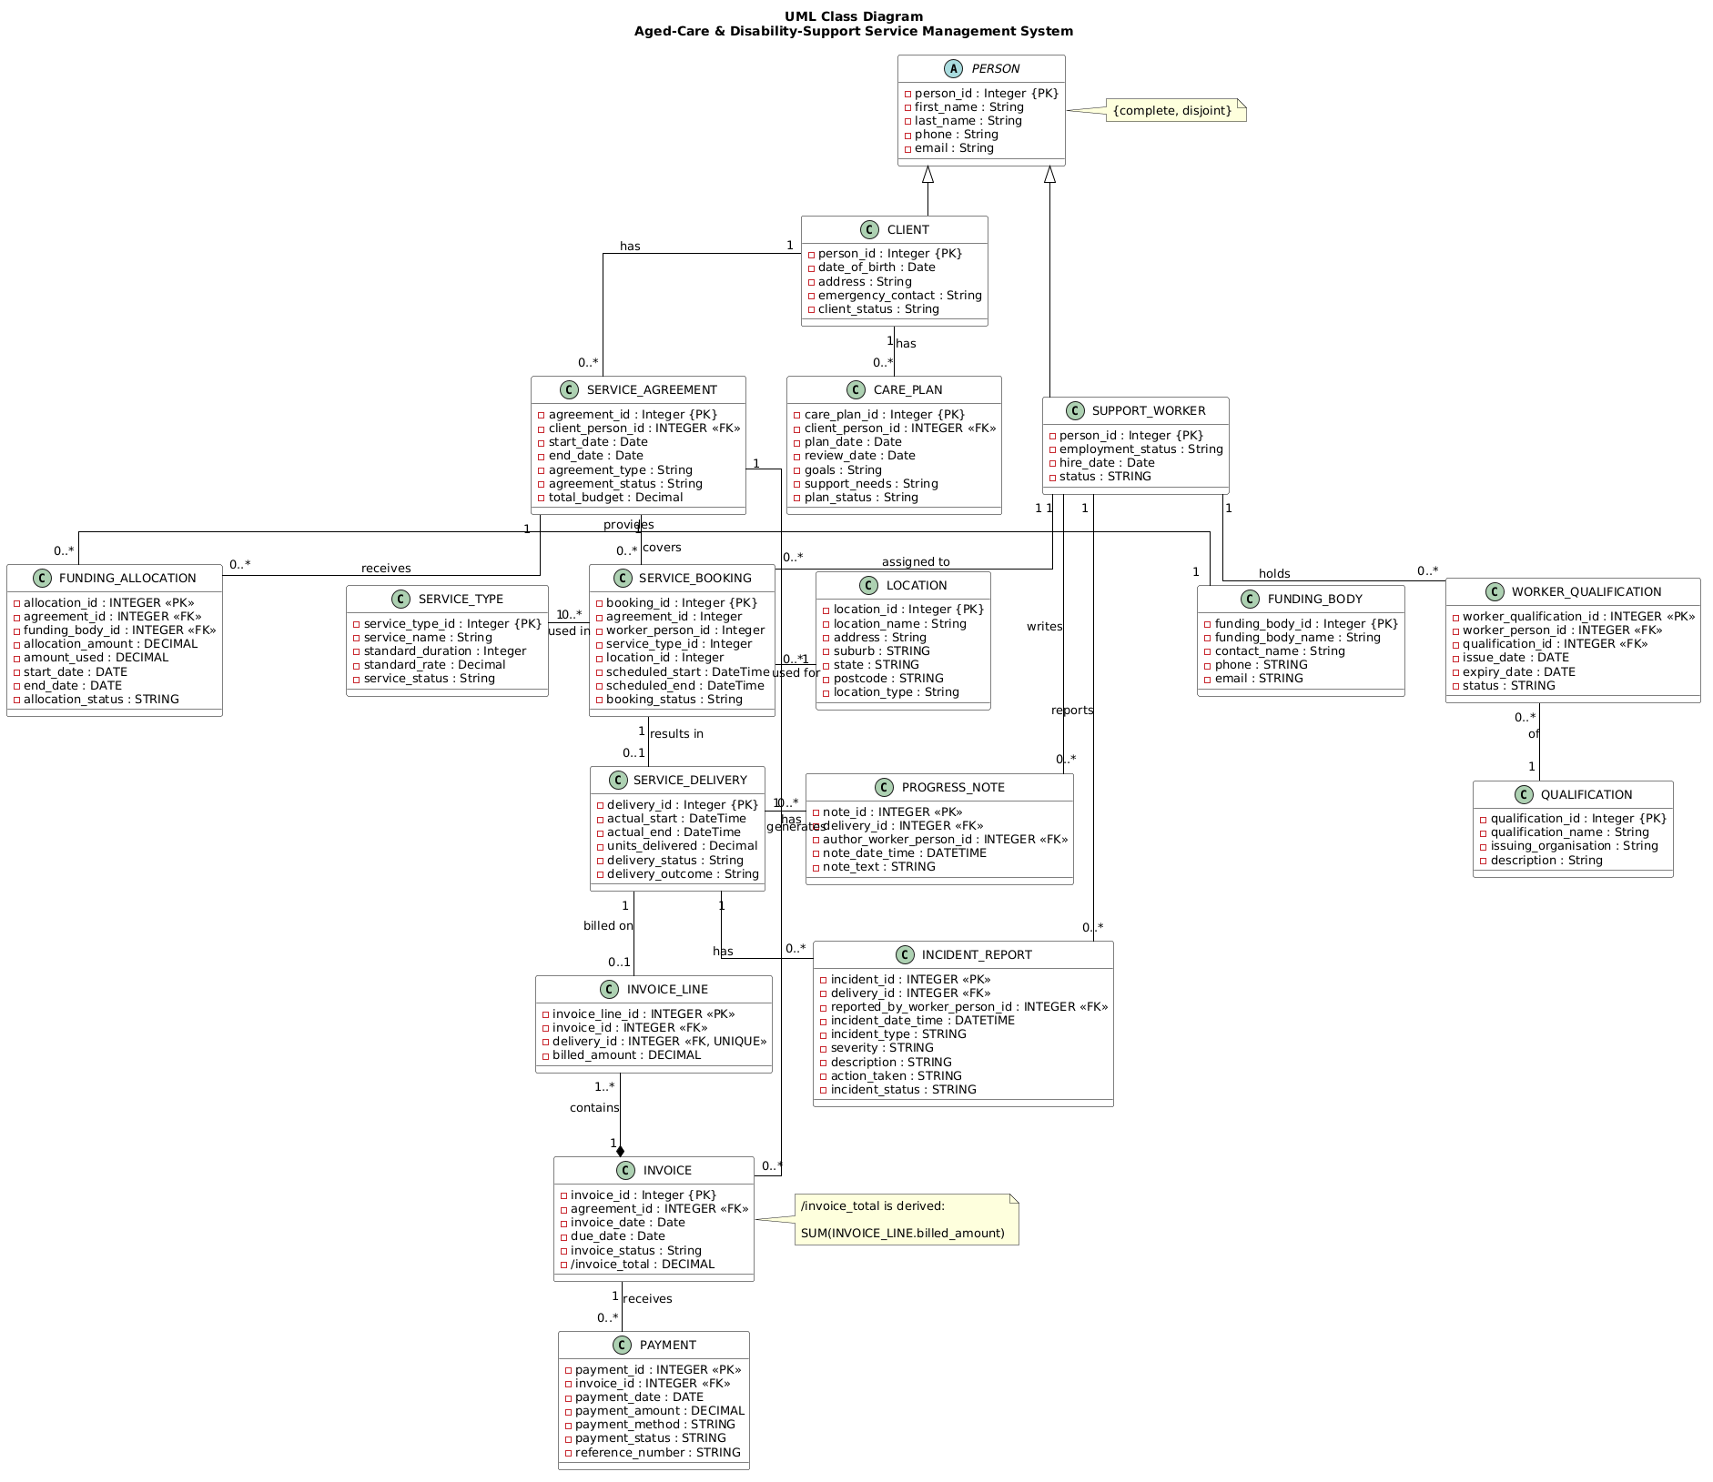
LOGICAL STRUCTURE
UML class diagram
The UML diagram translates the same system into class boxes, attributes, multiplicities, generalisation and a derived /invoice_total attribute.
Notes:
Explain that the UML model mirrors the EER model in class notation. Focus on the generalisation from PERSON to CLIENT and SUPPORT_WORKER, the multiplicities around bookings, and the invoice to invoice line relationship.

Slide 7
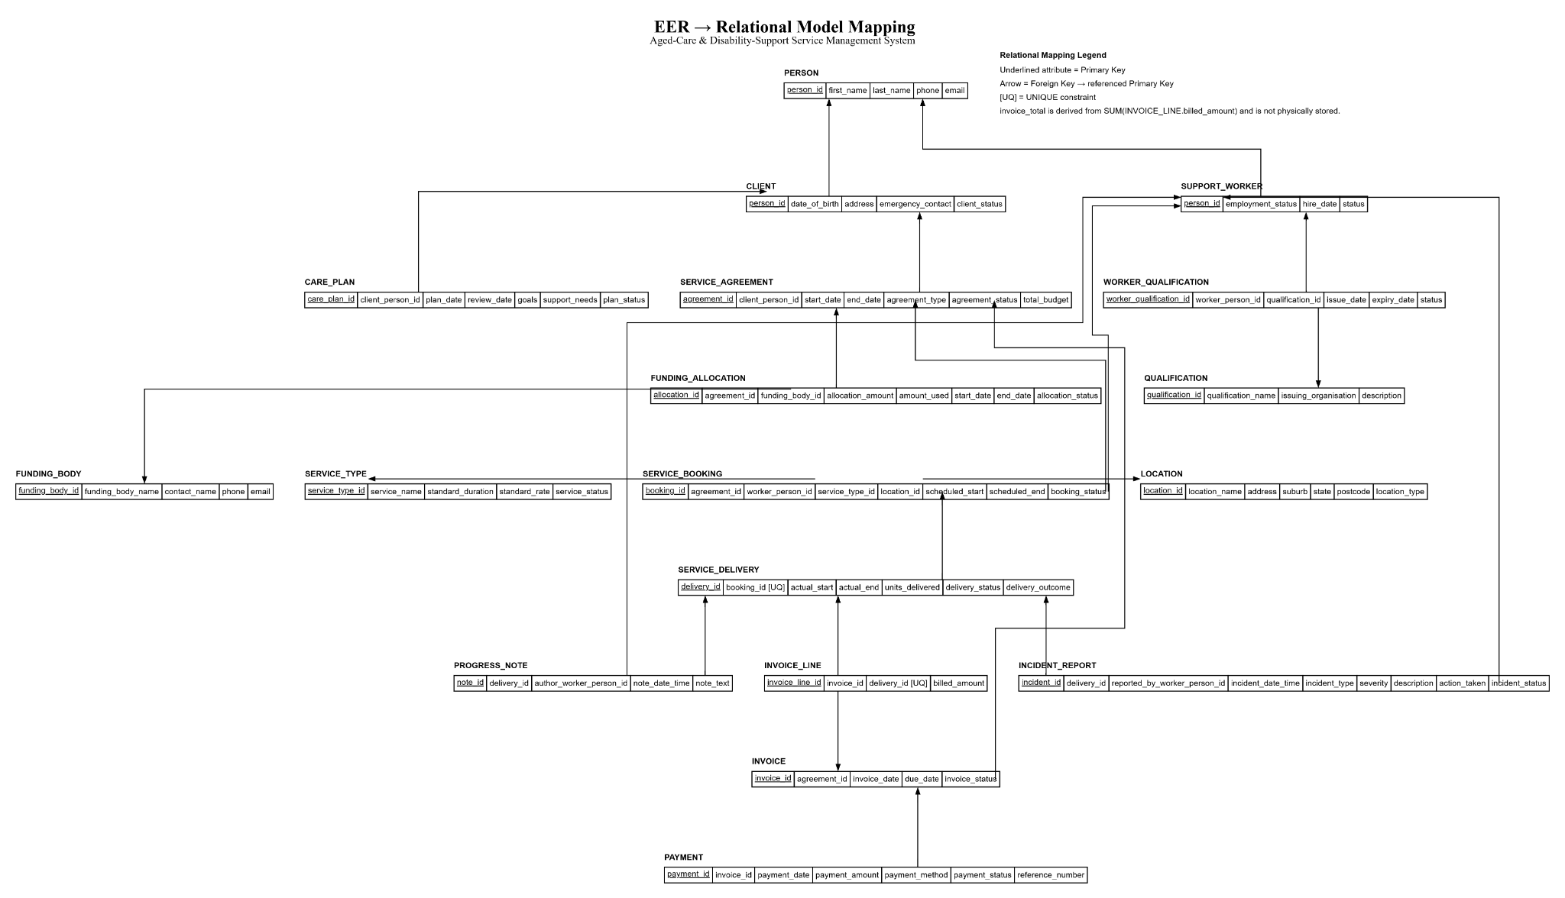
LOGICAL MODEL
EER to relational mapping
Underlined attributes are primary keys; arrows indicate foreign-key references; [UQ] shows uniqueness constraints.
PRT563 Advanced Data Management · Darwin Group 7 · 6
Notes:
Explain how the conceptual design was mapped to relations. Primary keys identify each table, foreign keys implement relationships, and unique constraints enforce maximum-one constraints for delivery and invoice-line relationships.

Slide 8
DATA QUALITY
Normalisation to Third Normal Form
1NF
2NF
3NF
Each table has a primary key. Attributes hold single values within scope. Repeating groups are separated into child relations such as PAYMENT and PROGRESS_NOTE.
Non-key attributes depend on the whole key. Most tables use a single-column primary key; association details in WORKER_QUALIFICATION describe that worker–qualification link.
Data about workers, service types, locations and funding bodies is stored once in the correct relation, not repeated in bookings, invoices or incidents.
Examples used in our model
• WORKER_QUALIFICATION resolves the worker–qualification many-to-many relationship
• FUNDING_BODY details stay in FUNDING_BODY and are referenced by FUNDING_ALLOCATION
• Invoice total is calculated from INVOICE_LINE instead of stored in INVOICE
• INCIDENT_REPORT does not duplicate client details; the client can be reached through delivery → booking → agreement
Outcome: fewer update, insertion and deletion anomalies while preserving referential integrity.
PRT563 Advanced Data Management · Darwin Group 7 · 7
Notes:
This should be presented as a short explanation rather than a report. State that the design satisfies 1NF, 2NF and 3NF, then give examples such as worker qualifications, funding body details and the derived invoice total.

Slide 9
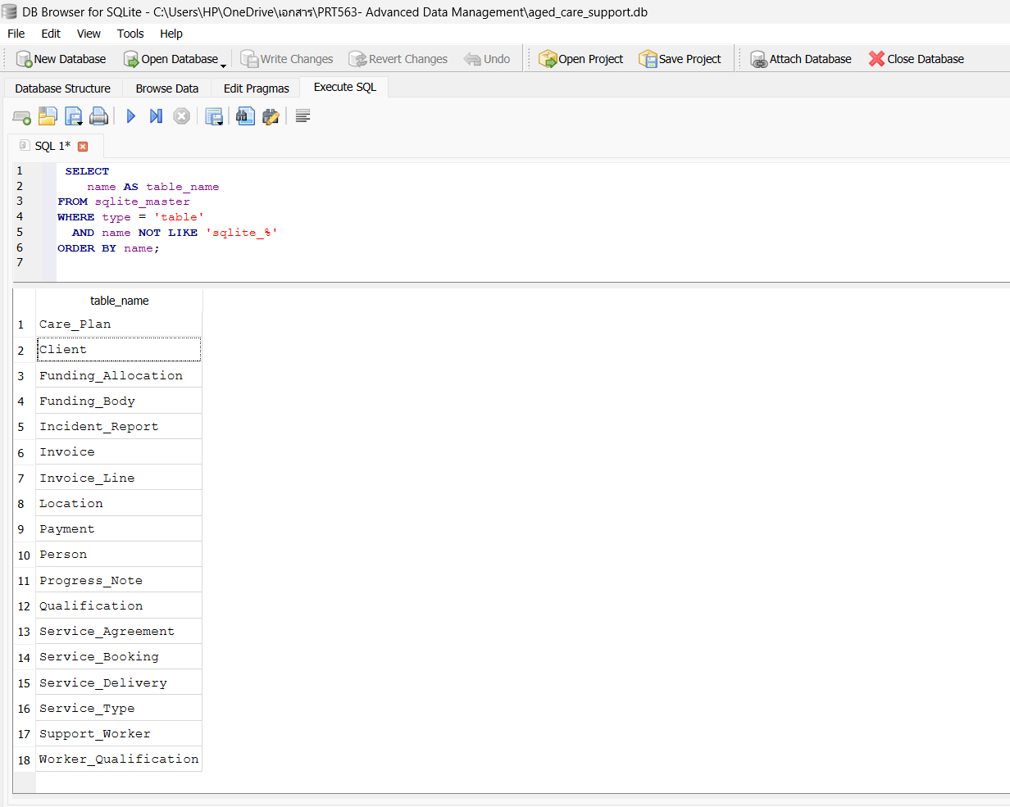
DATABASE BUILD
SQLite implementation
Implementation evidence
• 18 tables created in SQLite
• Realistic sample data inserted
• Primary keys and foreign keys implemented
• NOT NULL, CHECK and UNIQUE constraints used
• ON UPDATE CASCADE used as an advanced constraint
• DROP TABLE IF EXISTS and UPDATE demonstrated in the SQL script
Verified row counts
• Person: 14
• Client: 8
• Support_Worker: 6
• Service_Booking: 16
• Service_Delivery: 12
• Payment: 7
PRT563 Advanced Data Management · Darwin Group 7 · 8
Notes:
Explain that the final database was implemented in SQLite, not just MySQL. The screenshot confirms the 18 tables. Mention that sample data was inserted and row counts were verified.

Slide 10
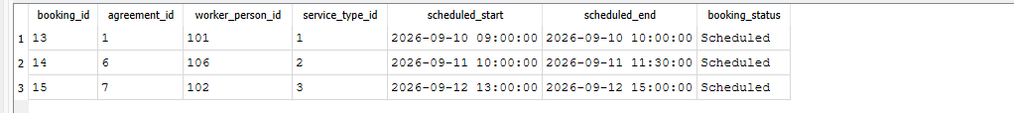
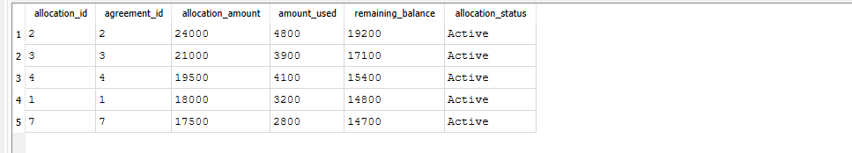
SQL QUERIES
Query use cases: simple SQL queries
Query 1 — Simple query
Query 2 — Simple query
Scenario
List scheduled service bookings in September 2026 for selected workers 101, 102 and 106.
Scenario
Find active funding allocations above $17,000 where less than $5,000 has been used.
SELECT booking_id, agreement_id, worker_person_id, service_type_id, scheduled_start, scheduled_end, booking_status FROM Service_Booking WHERE booking_status = 'Scheduled' AND scheduled_start BETWEEN '2026-09-09' AND '2026-09-30' AND worker_person_id IN (101,102,106);
SELECT allocation_id, agreement_id, allocation_amount, amount_used, allocation_amount - amount_used AS remaining_balance, allocation_status FROM Funding_Allocation WHERE allocation_status = 'Active' AND allocation_amount > 17000 AND amount_used < 5000;
Query result
3 scheduled bookings returned.
Query result
5 active allocations returned with remaining balances.
Practical purpose
Supports daily scheduling and workforce planning.
Practical purpose
Helps coordinators monitor funding and remaining budget.
PRT563 Advanced Data Management · Darwin Group 7 · 9
Notes:
For Query 1, explain that it finds scheduled bookings during September for selected workers. For Query 2, explain that it filters active funding allocations and calculates remaining balances.

Slide 11
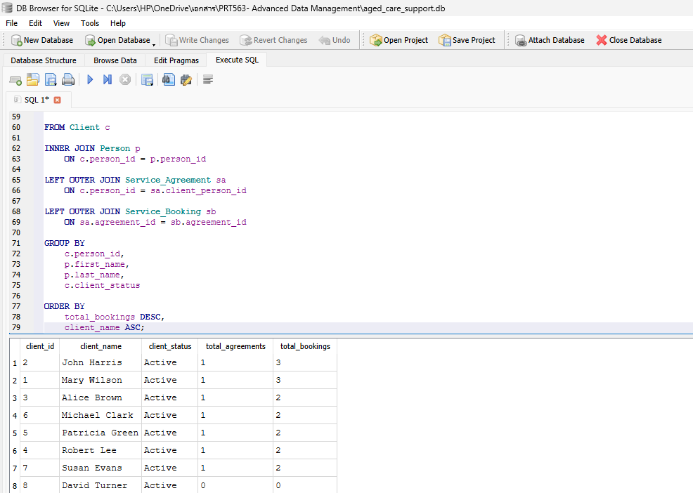
SQL QUERIES
Query 3: moderately complex JOIN query
Scenario
Count each client’s service agreements and bookings, including clients with no agreement or booking records.
FROM Client c JOIN Person p ON c.person_id = p.person_id LEFT OUTER JOIN Service_Agreement sa ON c.person_id = sa.client_person_id LEFT OUTER JOIN Service_Booking sb ON sa.agreement_id = sb.agreement_id GROUP BY c.person_id;
Query result
All 8 clients remain visible. David Turner appears with 0 agreements and 0 bookings, showing why LEFT OUTER JOIN is appropriate.
Practical purpose
Identifies clients with low or no service engagement so coordinators can follow up.
Evidence: David Turner is included with 0 / 0 because the query uses LEFT OUTER JOIN.
PRT563 Advanced Data Management · Darwin Group 7 · 10
Notes:
Explain the purpose of the LEFT OUTER JOIN. The important result is David Turner, who has no service agreement and no bookings but still appears in the output. This directly demonstrates why an outer join is appropriate.

Slide 12
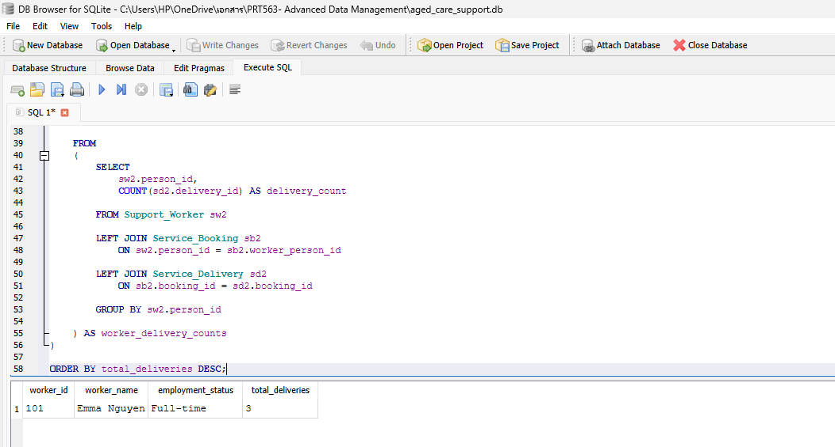
SQL QUERIES
Query 4: complex subquery + aggregate
Scenario
Find support workers whose service-delivery count is above the average across all workers.
SELECT worker_id, worker_name, employment_status, COUNT(delivery_id) AS total_deliveries FROM Support_Worker LEFT JOIN Service_Booking LEFT JOIN Service_Delivery GROUP BY worker_id HAVING COUNT(delivery_id) > ( SELECT AVG(delivery_count) FROM (...));
Query result
Emma Nguyen is returned with 3 deliveries, indicating above-average service-delivery workload.
Practical purpose
Supports workload monitoring and helps managers balance future worker assignments.
PRT563 Advanced Data Management · Darwin Group 7 · 11
Notes:
Explain that Query 4 is the complex query because it compares each worker's delivery count with an average calculated in a subquery. Then quickly connect this to integrity features such as UNIQUE constraints and the derived invoice total.

Slide 13
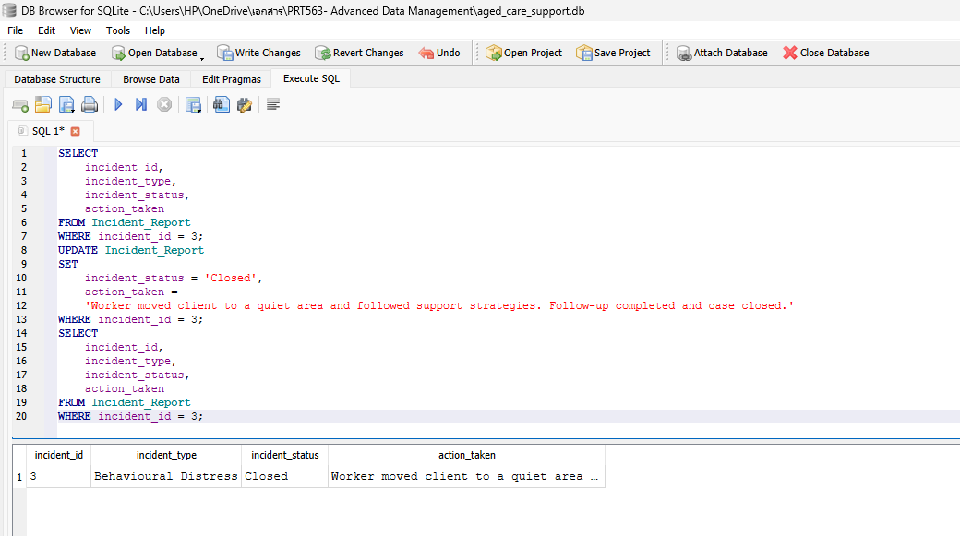
FINAL CHECKS
Update demonstration, limitations and conclusion
UPDATE example
Incident 3 was updated to Closed and the action taken was recorded. This demonstrates realistic operational data maintenance.
Implementation limitation
The conceptual model shows total and disjoint PERSON specialisation. Basic PK/FK constraints represent the subtype relationship, but full enforcement would require triggers or application logic.
Conclusion
The system delivers a consistent conceptual, logical and physical design with normalized relations, realistic sample data and tested SQL queries.
PRT563 Advanced Data Management · Darwin Group 7 · 12
Notes:
Close with the update demonstration and the main limitation. The limitation is useful because the rubric values the ability to articulate modelling limitations. End by stating that the database design, implementation and required queries have been completed.

