Slide 1

S226 HIT140 FOUNDATIONS OF DATA SCIENCE
Group Assignment – 2
Group members (Group number – 49)
01
Hemraj Budhathoki
Shooting
02
Sujan Gautam
Yellow Cards
03
Ayush Bhusal
Save %
04
Sangam GC
Team Possession

Slide 2
INTRODUCTION
FIFA World Cup 2026 — Statistical Analysis
Our team analyses four focal points using a common statistical workflow.
Focal Point (Sub – topic)
01
Attacking
Shooting
02
Discipline
Yellow Cards
03
GoalKeeping
Save %
04
Possession
Team Possession

Slide 3
OBJECTIVE 1 • ATTACKING ANALYSIS
Do Forwards Shoot More
Than Midfielders?
FIFA World Cup 2026 — Shots per 90 minutes | Two-sample t-test
Presented by Hemraj • HIT140 Foundations of Data Science • Charles Darwin University
Notes:
Hello, I'm Hemraj, student ID [SHOW ID]. My part covers the attacking analysis. Our question: during the 2026 World Cup, do forwards take more shots than midfielders? I tested this using shots-per-90-minutes and a two-sample t-test.

Slide 4
Our Methodology
Every task in our project follows the same six-step data-science workflow.
1
Analytic Question
2
Data Wrangling
3
Preparation & Sampling
Define a clear, testable research question
Load & clean the raw FBref data
Filter, group, and take a random sample
4
Descriptive Statistics
5
Confidence Interval
6
Hypothesis Test
Mean, median, standard deviation
Estimate the true population average (95%)
Two-sample t-test → is the difference real?
Notes:
Every one of our four tasks follows this same six-step pipeline: we state a question, clean the data, prepare and sample it, describe it with statistics, estimate the population with a confidence interval, and finally run a hypothesis test to check if the difference is real. This keeps all four tasks consistent.

Slide 5
Research Question & Hypotheses
Do forwards and midfielders differ significantly in their average number of shots per 90 minutes during the FIFA World Cup 2026?
H₀ (Null)
H₁ (Alternative)
No difference — forwards and midfielders take the same average shots per 90.
There IS a difference between the two groups.
Significance level: α = 0.05 — if the p-value is below 0.05, we reject H₀.
Notes:
My research question: do forwards and midfielders differ in shots per 90 minutes? The null hypothesis says there's no difference; the alternative says there is. I set the significance level at 0.05 — if my p-value comes out below that, I reject the null.

Slide 6
Data Wrangling & Cleaning
Dataset: FBref Player Shooting Stats 2026 — 1,039 players, 19 columns
df = pd.read_csv(
"shooting_stats.csv",
skiprows=1)
df = df.drop(columns=
["-9999","Matches","Rk"])
for col in ["90s","Sh","Sh/90"]:
df[col] = pd.to_numeric(
df[col], errors="coerce")
df["Squad"] = df["Squad"].str
.replace(r"^[a-z]{2}\s+", "")
skiprows=1
FBref puts a junk category row on top — we skip it so the real headers load.
drop(columns=...)
Remove leftover export columns we don't need.
pd.to_numeric
Force columns to be numbers, not text, so we can do maths.
str.replace(...)
Strip country-code prefixes: "us USA" → "USA".
Notes:
My data is the FBref shooting file — 1039 players. In cleaning: skiprows=1 skips the junk header row; drop removes unneeded columns; to_numeric makes sure the stats are real numbers; and the replace strips the country codes off team names. I chose the variable Sh/90 because it has zero missing values, unlike shot-accuracy columns which are blank for players who took no shots.

Slide 7
Preparation & Sampling
played = df[df["90s"] >= 1]
forwards = played[
played["Pos"]=="FW"]
midfielders = played[
played["Pos"]=="MF"]
fw = forwards.sample(
n=80, random_state=42)
mf = midfielders.sample(
n=80, random_state=42)
90s >= 1
Keep only players with at least one full match — stops tiny playing time from distorting per-90 stats.
Pos == "FW" / "MF"
Split into the two groups we're comparing.
sample(n=80)
Take a random, balanced sample of 80 from each group.
Population available: 99 forwards & 254 midfielders → sampled 80 each for a fair comparison.
random_state=42
Locks the randomness so the sample is reproducible every run.
Notes:
I kept only players with at least one full match, then split into forwards and midfielders. There were 99 forwards and 254 midfielders available, so I took a random balanced sample of 80 from each. random_state=42 makes it reproducible — anyone re-running my code gets the exact same 80 players.

Slide 8
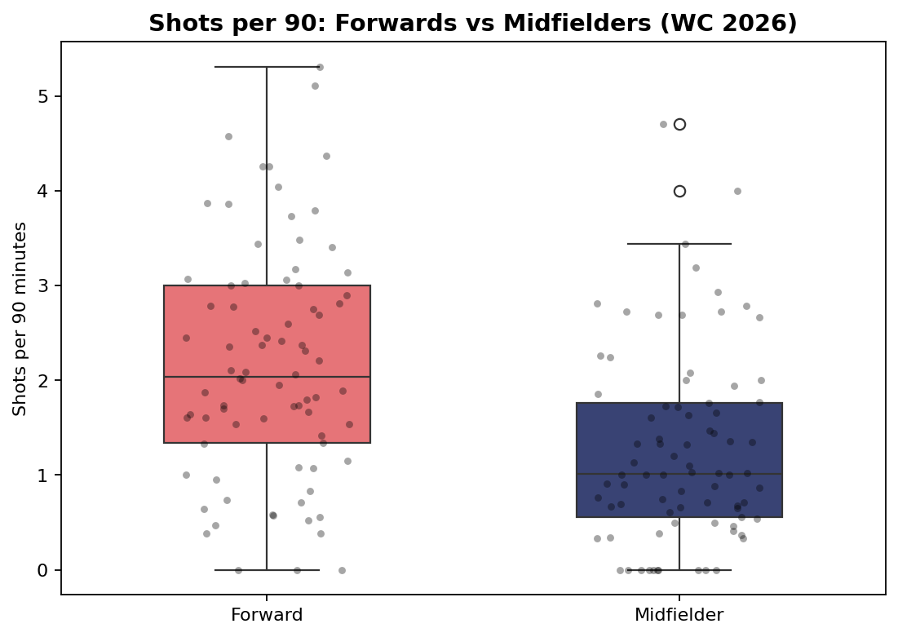
Results — Descriptive Statistics & Visualisation
FORWARDS
MIDFIELDERS
2.17
1.26
mean shots / 90
mean shots / 90
FW median
MF median
2.04
1.01
std = 1.23
std = 1.01
Forwards average almost double the shots of midfielders.
Notes:
The descriptive stats show forwards averaged 2.17 shots per 90 versus 1.26 for midfielders — almost double. The boxplot makes it visual: the coral forward box sits clearly higher than the navy midfielder box, and the two barely overlap. Each dot is one player.

Slide 9
Confidence Intervals & the t-Test
95% Confidence Intervals
Welch Two-Sample t-Test
Forwards: [1.89 , 2.44]
t = 5.07
Midfielders: [1.04 , 1.49]
p-value < 0.001
The two ranges do NOT overlap → strong sign the groups genuinely differ.
p is far below 0.05 → REJECT H₀
equal_var=False makes this Welch's test — it doesn't assume the two groups have equal variance (the safer choice).
Notes:
The 95% confidence intervals don't overlap — forwards' lowest plausible value, 1.89, is still above midfielders' highest, 1.49. The Welch t-test gives t = 5.07 and a p-value below 0.001, far under 0.05, so I reject the null hypothesis. I used Welch's test because the two groups have slightly different variances.

Slide 10
Effect Size — Is the Difference Meaningful?
A significant result is paired with a measure of how large the difference actually is.
How to read Cohen's d
COHEN'S d
0.80
0.2
0.5
0.8
Small
Medium
Large
LARGE EFFECT
Our d = 0.80 lands right at the 'large' threshold — forwards shoot substantially more than midfielders, not just detectably more.
The gap is not only real — it is substantial in size.
Notes:
Beyond significance, I measured the effect size with Cohen's d, which came out at 0.80 — a large effect. So the difference between forwards and midfielders isn't just statistically detectable, it's substantial in magnitude. On the standard scale, 0.2 is small, 0.5 medium, and 0.8 large — we're right at that large threshold.

Slide 11
Assumption Check & Limitation
An honest analysis checks its assumptions and states its limits.
Normality check (Shapiro–Wilk)
LIMITATION
Forwards: p = 0.24 → normal ✓
Shots per 90 measures shot volume, not shot quality or goals. A midfielder taking fewer but better chances isn't captured. The midfielder group also departs slightly from normality, so the test is interpreted with mild caution.
Midfielders: p = 0.0001 → departs slightly
Welch's t-test is robust with n = 80 per group (Central Limit Theorem), so the result still holds.
Association, not causation — position relates to shot volume; it doesn't prove position causes it.
Notes:
I also checked my assumptions honestly. The Shapiro-Wilk test shows forwards are normally distributed, while midfielders depart slightly — but with 80 per group, the Central Limit Theorem means Welch's test is still robust. My main limitation: shots per 90 measures shot volume, not quality or goals, so a midfielder taking fewer but better chances isn't captured. And this shows an association between position and shot volume, not causation.

Slide 12
Conclusion
During the FIFA World Cup 2026, forwards took significantly more shots per 90 minutes than midfielders (p < 0.001).
1
2
3
Statistically proven
Matches football sense
Clean method
Every step agreed: stats, non-overlapping CIs, and t-test all point the same way.
Forwards play closest to goal and are the main shot-takers.
Reproducible sample, correct variable (Sh/90), Welch's t-test.
Notes:
In conclusion: forwards took significantly more shots per 90 than midfielders, with p below 0.001. Every step agreed — descriptive stats, non-overlapping confidence intervals, and the t-test. The result also matches football intuition. Thank you.

Slide 13
Goalkeeping Performance & Tournament Progression
FIFA World Cup 2026 • Statistical Analysis
Research question
Do goalkeepers from teams that progressed to the knockout stage differ significantly in average Save% from goalkeepers whose teams were eliminated in the group stage?

Slide 14
01 • OVERVIEW
HIT140 • FIFA World Cup 2026 • Task 4
What are we testing?
Research design, variables and statistical objective.
RESEARCH QUESTION
VARIABLES
Do goalkeepers from knockout-stage teams have a significantly different average Save% from goalkeepers whose teams were eliminated in the group stage?
• Outcome: goalkeeper save percentage (Save%)
• Grouping variable: tournament progression
• Groups: Knockout vs Group Eliminated
• Significance level: α = 0.05
• Two-sided alternative hypothesis
POPULATION
SAMPLE
GROUPS
Statistical test
59
30
2
Welch independent two-sample t-test
eligible goalkeepers
random sample
15 knockout • 15 eliminated
Selected for two independent groups; Welch's test does not require equal population variances.

Slide 15
02 • METHOD
HIT140 • FIFA World Cup 2026 • Task 4
From raw data to analysis
A reproducible workflow using Goalkeeping Statistics and Match Results.
01
02
03
04
05
LOAD
→
CLEAN
→
CLASSIFY
→
SAMPLE
→
ANALYSE
Goalkeeping Stats + Match Results
Remove undefined Save% standardise team names
Knockout rounds → Knockout remaining → Eliminated
Equal-allocation stratified 15 + 15 goalkeepers
Describe • 95% CI Welch t-test • effect size
DATA QUALITY / WRANGLING
• 62 raw goalkeeper records were loaded.
• 3 records with undefined Save% were excluded because SoTA = 0, leaving 59 eligible goalkeepers.
• Team names were standardised across both datasets; all 48 teams matched.
• Match results identified 32 knockout-stage teams.
• Eligible population: 40 Knockout and 19 Group Eliminated goalkeepers.

Slide 16
03 • SAMPLING
Population, sample and preparation
Equal-allocation stratified random sampling ensured both progression groups were represented equally.
POPULATION
SAMPLE
COVERAGE
MISSING SAVE%
59 goalkeepers
30 goalkeepers
15 + 15
3
equal allocation by stratum
excluded before sampling
40 knockout • 19 eliminated
15 knockout • 15 eliminated
WHY STRATIFIED SAMPLING?
ANALYTICAL SAMPLE
The research question directly compares two progression groups. Sampling separately within each group guarantees representation and gives equal group sizes for the comparison.
• Knockout: 15 randomly selected from 40 eligible goalkeepers
• Group Eliminated: 15 randomly selected from 19 eligible goalkeepers
• Total analytical sample: n = 30
• Fixed seed = 42 for reproducibility
• Same sample used for descriptive and inferential analysis

Slide 17
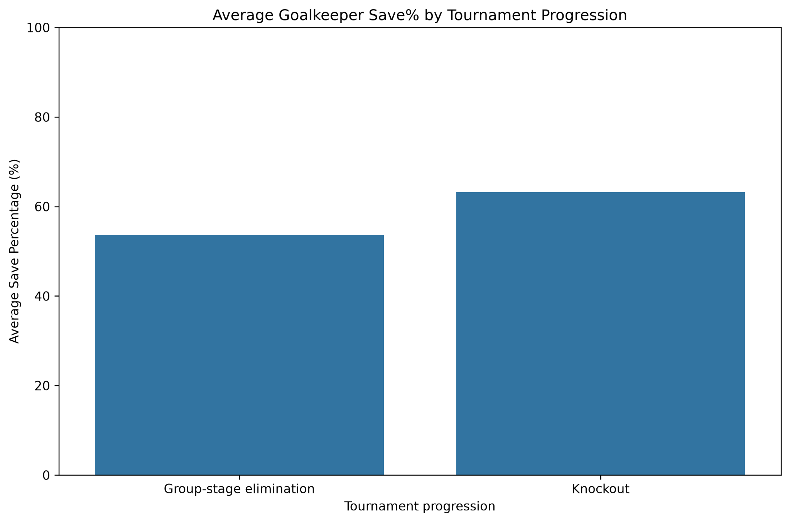
04 • RESULTS
What does the sample show?
Knockout-stage goalkeepers recorded a higher mean and median Save%, with greater variability.
DESCRIPTIVE SUMMARY
Group
n
Mean
Median
SD
Group Eliminated
15
53.64%
54.50%
17.91
Knockout
15
63.19%
69.20%
20.44
OBSERVED DIFFERENCE
+9.55 percentage points
Knockout goalkeepers also had a higher median (69.20% vs 54.50%). The knockout sample showed greater variability (SD 20.44 vs 17.91).
Descriptively, the knockout group performed better, but statistical inference is required before drawing a population-level conclusion.

Slide 18
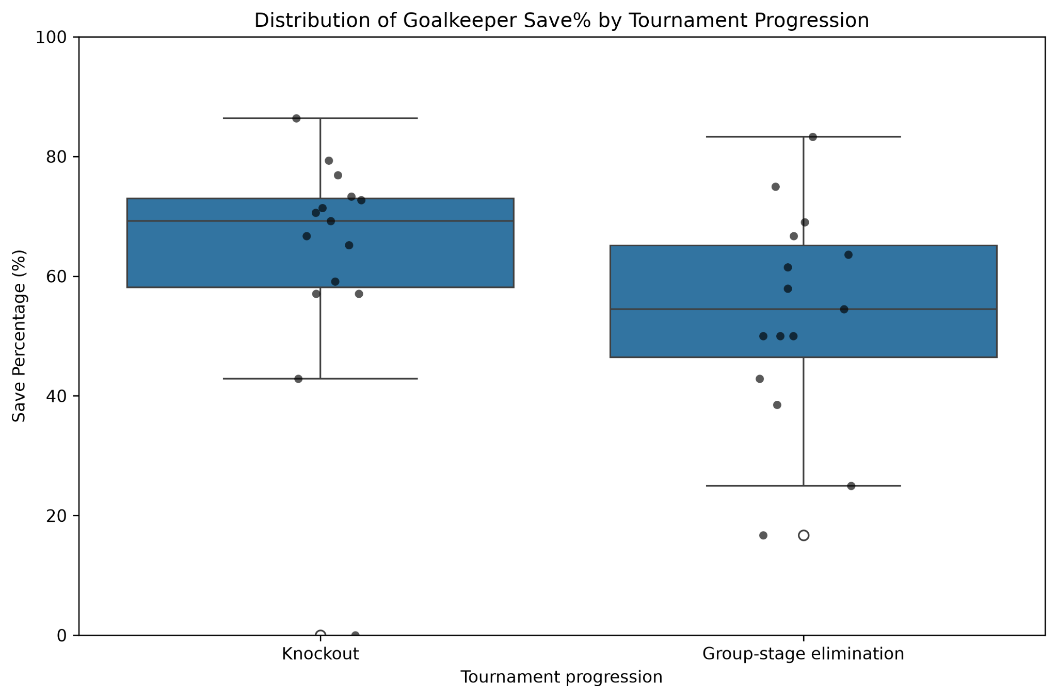
05 • DISTRIBUTION
HIT140 • FIFA World Cup 2026 • Task 4
Distribution and assumption checks
The box plot shows substantial overlap and an extreme 0% observation in the knockout sample.
NORMALITY / DISTRIBUTION CHECK
Knockout: W = 0.7691, p = 0.0015 • Group Eliminated: W = 0.9730, p = 0.8998
The knockout sample departs from normality, largely reflecting the extreme 0% observation. It was retained as a valid sampled observation, so the Welch t-test is interpreted cautiously.

Slide 19
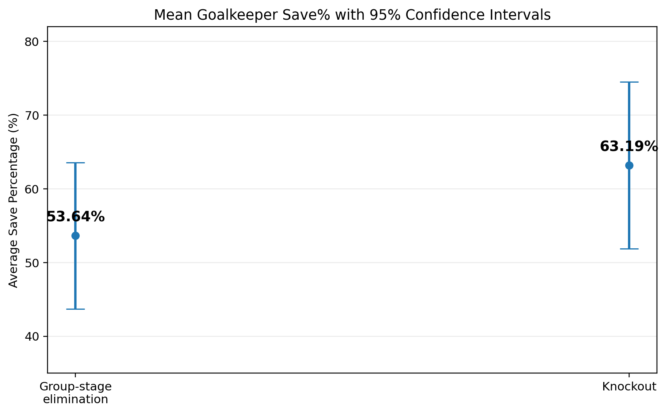
06 • CONFIDENCE INTERVALS
HIT140 • FIFA World Cup 2026 • Task 4
How precise are the group means?
95% confidence intervals quantify uncertainty around average goalkeeper Save%.
GROUP ELIMINATED
KNOCKOUT
53.64%
63.19%
95% CI: 43.72%–63.56%
95% CI: 51.87%–74.51%
INTERPRETATION
Both intervals are fairly wide because each group contains only 15 goalkeepers. The intervals overlap, so significance should be determined by the formal two-sample test rather than CI overlap alone.
Next: test H₀: μKnockout = μEliminated against H₁: μKnockout ≠ μEliminated.

Slide 20
07 • INFERENCE
HIT140 • FIFA World Cup 2026 • Task 4
Is the difference statistically significant?
Welch independent two-sample t-test; two-sided alternative; α = 0.05.
H₀: μKnockout = μEliminated — No statistically significant difference in mean goalkeeper Save%.
H₁: μKnockout ≠ μEliminated — A statistically significant difference exists in mean goalkeeper Save%.
TEST STATISTIC
DEGREES OF FREEDOM
P-VALUE
DECISION
1.3614
27.53
0.1844
Fail to reject H₀
t-value
Welch–Satterthwaite df
above α = 0.05
not statistically significant
Because p = 0.1844 > 0.05, the sample does not provide sufficient evidence to conclude that mean goalkeeper Save% differs between the two progression groups.
Decision: p = 0.1844 > α = 0.05 → FAIL TO REJECT H₀
Conclusion: insufficient evidence to conclude that the two population mean Save% values differ.

Slide 21
09 • TAKEAWAY
HIT140 • FIFA World Cup 2026 • Task 4
Conclusion and limitation
A higher sample mean for knockout goalkeepers, interpreted cautiously because the difference was not statistically significant.
CONCLUSION
LIMITATION
Goalkeepers from knockout-stage teams had a higher average Save% in the selected sample, but the evidence was insufficient to conclude that the population means differ.
Save% is influenced by shots faced, shot quality and team defence. The sample is small (15 per group), multiple goalkeepers may come from the same team, and the knockout sample contains an extreme 0% observation.
63.19% vs 53.64% • difference = 9.55 percentage points Welch t-test: t(27.53) = 1.3614, p = 0.1844 Cohen's d = 0.497 — moderate sample-level effect
Therefore, this analysis supports a comparison/association between Save% and progression, not a causal claim.
STRONGER FOLLOW-UP
A stronger follow-up could analyse one primary goalkeeper per team and control for shots faced or shot quality, using a larger sample where possible.

Slide 22
HIT140 • GROUP PROJECT PRESENTATION
Player Discipline
Do defenders and midfielders differ significantly in their average number of yellow cards?
FOCAL VARIABLE
GROUPS
CrdY — number of yellow cards
Defenders (DF) • Midfielders (MF)
HIT140 • FIFA World Cup 2026 |

Slide 23
01 • METHOD
From raw data to analysis
A reproducible workflow using the player standard-statistics dataset.
01
02
03
04
05
RAW
FILTER
SAMPLE
DESCRIBE
INFER
1,039 players
DF + MF only
150 + 150
Mean, SD, median
95% CI + t-test
REQUIRED SKILLS
Question formulation • Wrangling • Preparation & sampling • Descriptive statistics • Confidence interval • t-test
HIT140 • FIFA World Cup 2026 |

Slide 24
02 • DATA
Preparation and quality checks
Only unambiguous positional classifications were retained.
ORIGINAL
ELIGIBLE
SAMPLE
MISSING CRDY
1,039
650
300
0
player records
344 MF + 306 DF
150 per group
complete outcome data
QUALITY CHECK
✓
Combined codes (e.g., DFMF / MFDF) excluded to avoid subjective classification.
✓
CrdY stored as integer values; observed range in sample: 0–3.
✓
No negative yellow-card values.
✓
No duplicate player records.
✓
Sampling was reproducible with random_state = 42.
HIT140 • FIFA World Cup 2026 |

Slide 25
03 • RESULTS
What does the sample show?
The group means are almost identical, and both distributions are concentrated at zero.
DESCRIPTIVE SUMMARY
DEFENDER
0.3467
95% CI 0.2532–0.4401
MIDFIELDER
0.3400
95% CI 0.2469–0.4331
Mean difference
0.0067 yellow cards
HIT140 • FIFA World Cup 2026 |

Slide 26
04 • INFERENCE
Is the difference statistically significant?
Welch independent two-sample t-test; two-sided alternative; α = 0.05.
TEST STATISTIC
P-VALUE
DECISION
0.09985
0.92053
Fail to reject H₀
t-value
far above α = 0.05
no significant difference
H₀
μDF = μMF
No difference in population mean yellow-card count.
H₁
μDF ≠ μMF
A difference exists between the two population means.
HIT140 • FIFA World Cup 2026 |

Slide 27
05 • TAKEAWAY
Conclusion and limitation
A statistically clear result, with an important distributional caveat.
CONCLUSION
LIMITATION
There is insufficient statistical evidence to conclude that defenders and midfielders differ significantly in average yellow-card counts.
Yellow cards are discrete count data with a strong concentration at zero. Therefore, normality is not perfectly satisfied.
The required Welch t-test was retained, and this distributional limitation is acknowledged when interpreting the result.
p = 0.92053 > 0.05
HIT140 • FIFA World Cup 2026

Slide 28
Task 4
Team Possession & Tournament Progression
FIFA World Cup 2026 • Statistical Analysis
Research question
Do teams that progressed to the knockout stage have a significantly different average possession percentage from teams eliminated in the group stage?
Poss • Knockout vs Group Eliminated • Welch two-sample t-test

Slide 29
01 • OVERVIEW
HIT140 • FIFA World Cup 2026 • Task 4
What are we testing?
Research design, variables and statistical objective.
RESEARCH QUESTION
VARIABLES
Do knockout-stage teams have a significantly different average possession percentage from teams eliminated in the group stage?
• Outcome: average possession percentage (Poss)
• Grouping variable: tournament progression
• Groups: Knockout vs Group Eliminated
• Significance level: α = 0.05
• Two-sided alternative hypothesis
POPULATION
SAMPLE
GROUPS
Statistical test
48
36
2
Welch independent two-sample t-test
World Cup teams
75% of population
24 knockout • 12 eliminated
Selected because group sizes and variability differ, and Welch's test does not require equal population variances.

Slide 30
02 • METHOD
HIT140 • FIFA World Cup 2026 • Task 4
From raw data to analysis
A reproducible workflow using Squad Possession and Match Results.
01
02
03
04
05
LOAD
→
CLEAN
→
CLASSIFY
→
SAMPLE
→
ANALYSE
Squad Possession + Match Results
Remove invalid rows standardise team names
Round of 32 → Knockout remaining → Eliminated
Proportional stratified 24 + 12 teams
Describe • 95% CI Welch t-test • effect size
DATA QUALITY / WRANGLING
• Match data reduced to 104 valid matches after removing non-match rows.
• 72 group-stage matches contained all 48 unique teams.
• Round-of-32 participants identified 32 knockout teams; 16 teams were classified as group-stage eliminated.
• Team names were standardised across both datasets before matching.
• Final team classification matched all 48 possession records with no unmatched teams.

Slide 31
03 • SAMPLING
HIT140 • FIFA World Cup 2026 • Task 4
Population, sample and preparation
Proportional stratified random sampling preserved the tournament group structure.
POPULATION
SAMPLE
COVERAGE
MISSING POSS
SEED
48 teams
36 teams
75%
0
42
32 knockout • 16 eliminated
24 knockout • 12 eliminated
of each progression stratum
complete analytical sample
reproducible sampling
WHY STRATIFIED SAMPLING?
ANALYTICAL SAMPLE
The research question directly compares two progression groups. Sampling within each group ensures both are represented while preserving the original 2:1 population ratio.
• Knockout: 24 of 32 teams
• Group Eliminated: 12 of 16 teams
• No duplicate team records
• No missing possession values
• Sample used consistently for descriptive and inferential analysis

Slide 32
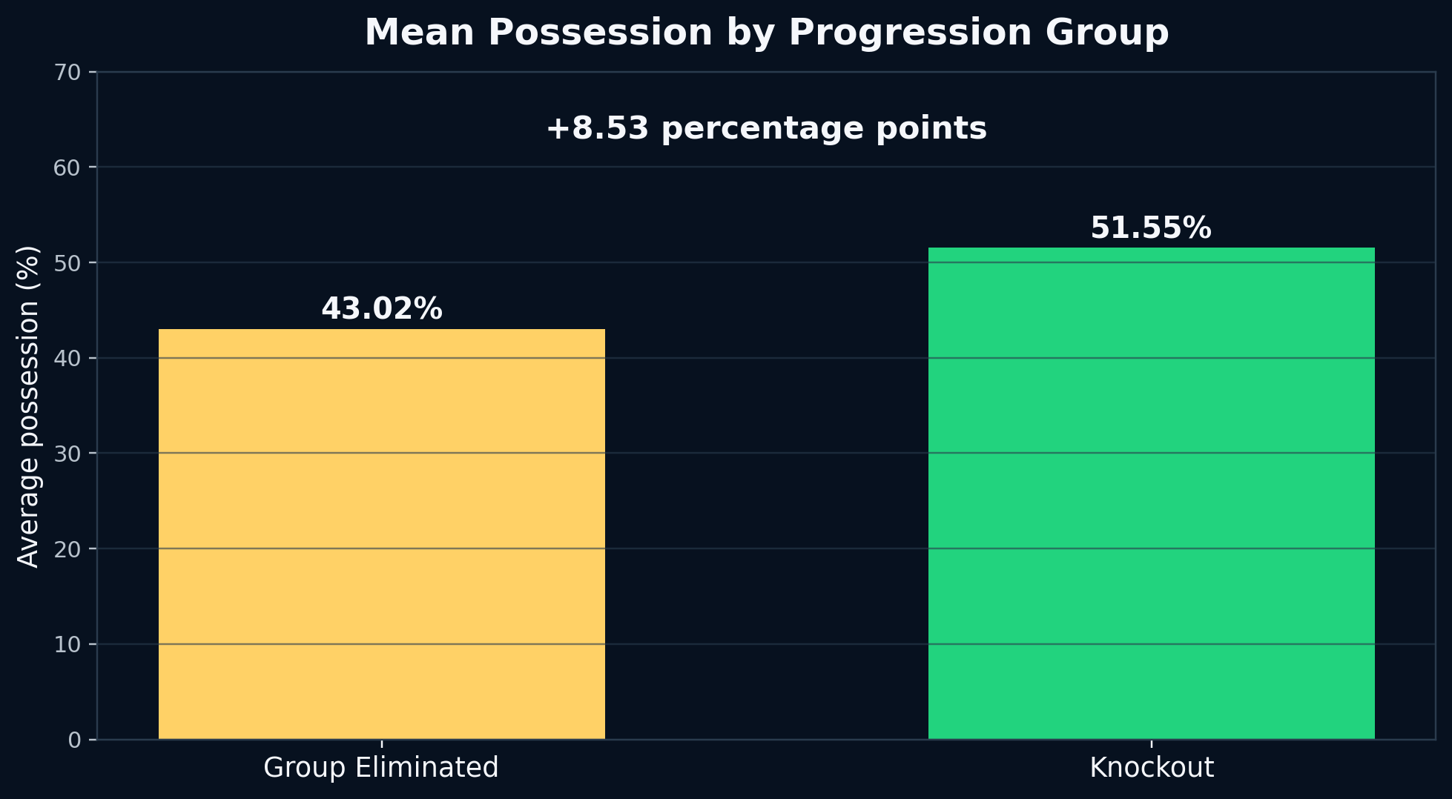
04 • RESULTS
HIT140 • FIFA World Cup 2026 • Task 4
What does the sample show?
Knockout teams recorded higher central possession and slightly lower variability.
DESCRIPTIVE SUMMARY
Group
n
Mean
Median
SD
Group Eliminated
12
43.02%
42.70%
10.10
Knockout
24
51.55%
53.65%
7.95
OBSERVED DIFFERENCE
+8.53 percentage points
Knockout teams also had a higher median (53.65% vs 42.70%). Eliminated teams showed greater variability (SD 10.10 vs 7.95).
Descriptive evidence suggests a difference, but statistical inference is required before drawing a conclusion.

Slide 33
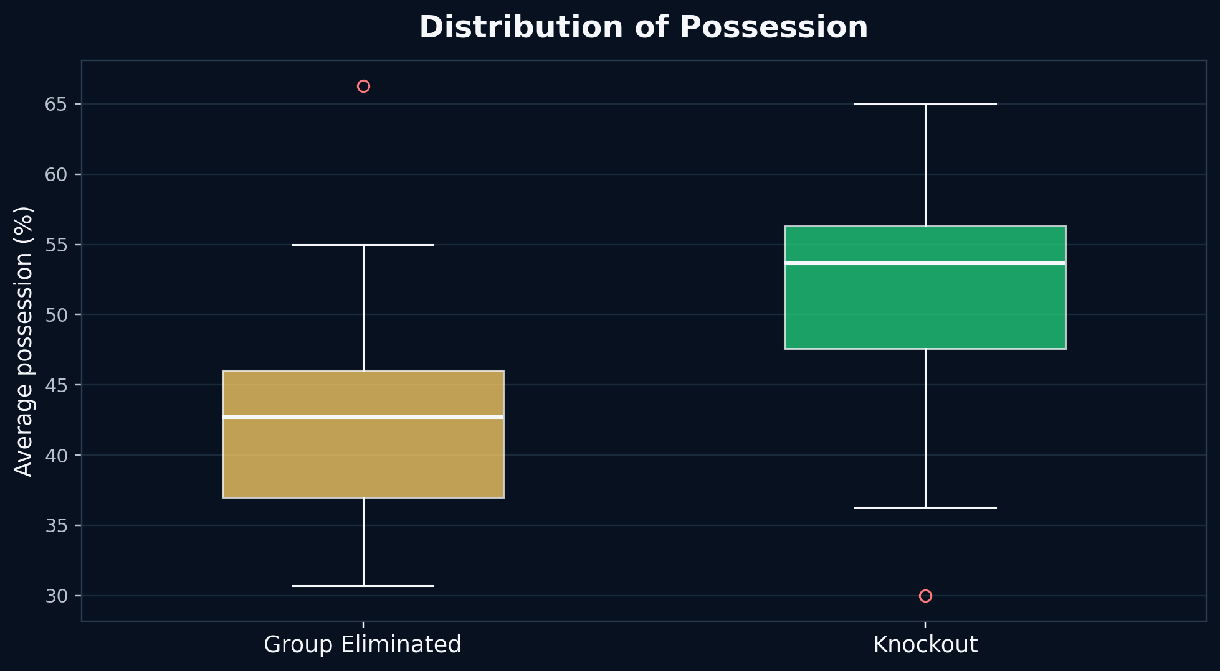
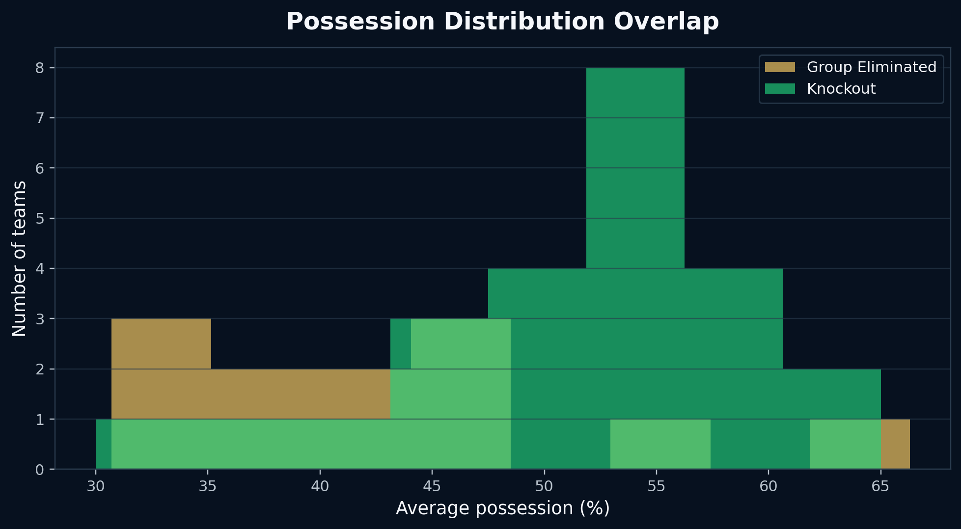
05 • DISTRIBUTION
HIT140 • FIFA World Cup 2026 • Task 4
Distribution and assumption checks
Visual inspection and Shapiro–Wilk tests support proceeding with the t-test.
NORMALITY CHECK
Knockout: W = 0.9398, p = 0.1615 • Group Eliminated: W = 0.9156, p = 0.2516
Both p-values exceed 0.05, so there is insufficient evidence to reject normality. Potential outliers were retained because they represent valid team observations.

Slide 34
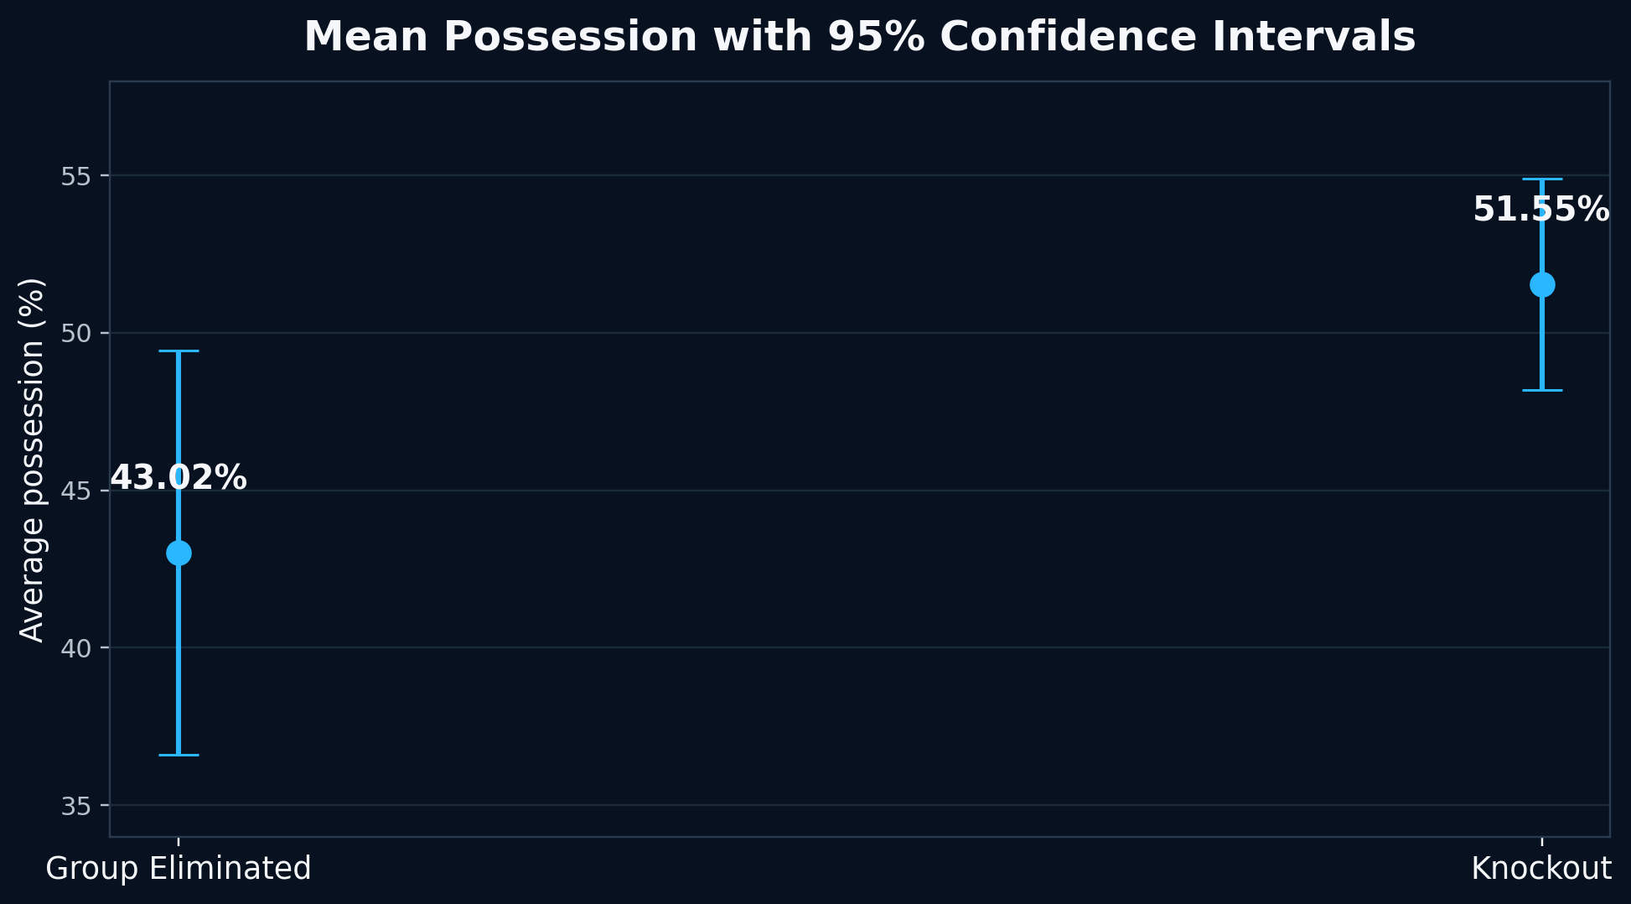
06 • CONFIDENCE INTERVALS
HIT140 • FIFA World Cup 2026 • Task 4
How precise are the group means?
95% confidence intervals quantify uncertainty around average possession.
GROUP ELIMINATED
KNOCKOUT
43.02%
51.55%
95% CI: 36.61%–49.44%
95% CI: 48.20%–54.90%
INTERPRETATION
The eliminated-group interval is wider because the sample is smaller and more variable. The individual confidence intervals overlap slightly, so significance should be determined by the formal two-sample test rather than CI overlap alone.
Next: test H₀: μKnockout = μEliminated against H₁: μKnockout ≠ μEliminated.

Slide 35
07 • INFERENCE
HIT140 • FIFA World Cup 2026 • Task 4
Is the difference statistically significant?
Welch independent two-sample t-test; two-sided alternative; α = 0.05.
TEST STATISTIC
DEGREES OF FREEDOM
P-VALUE
DECISION
2.5553
18.03
0.0199
Reject H₀
t-value
Welch–Satterthwaite df
below α = 0.05
statistically significant
H₀
μKnockout = μEliminated
H₁
μKnockout ≠ μEliminated
No difference in population mean possession.
A difference exists between the two population means.
Because p = 0.0199 < 0.05, the observed difference is unlikely to be explained by sampling variation alone under the null hypothesis.

Slide 36
08 • EFFECT SIZE
HIT140 • FIFA World Cup 2026 • Task 4
Is the difference practically meaningful?
Statistical significance is paired with a measure of magnitude.
COHEN'S d
0.980
0.2
0.5
0.8
Large effect
Small
Medium
Large
Observed d = 0.980
Using conventional interpretation guidelines, d ≈ 0.98 indicates a substantial difference between the two progression groups in the analysed sample.
The result is therefore not only statistically significant; the sample-level difference is also substantial in magnitude.

Slide 37
09 • TAKEAWAY
HIT140 • FIFA World Cup 2026 • Task 4
Conclusion and limitation
A significant result, interpreted carefully within the available data.
CONCLUSION
LIMITATION
Teams progressing to the knockout stage had significantly higher average possession than teams eliminated in the group stage in the analysed sample.
The available Poss variable is tournament-level. Teams progressing further may have possession calculated across more matches than teams eliminated in the group stage.
51.55% vs 43.02% • difference = 8.53 percentage points Welch t-test: t(18.03) = 2.5553, p = 0.0199 Cohen's d = 0.980 — large effect
Therefore, this analysis supports an association between possession and progression, not a causal claim.
STRONGER FOLLOW-UP
Recalculate possession using only each team's three group-stage matches so every team is measured over the same tournament phase.

Slide 38
Thank You

