Slide 1
PROJECT TITLE : Comprehensive Automated Document Verification System Using AI and Blockchain
CSE7301 – Viva Voce
Batch Number: CSE-G156
Under the Supervision of,
Dr. S. Sivaramkrishnan Associate Professor
School of Computer Science and Engineering
Presidency University
STUDENT NAME | STUDENT RNO
PRANITHA R SHEKAR | 20211CSE0626
HEMANTH S K | 20211CSE0635
Name of the Program: Computer Science and Engineering
Name of the HoD: Dr. Asif Mohammed H B
Name of the Program Project Coordinator: Mr. Amarnath J L & Dr. Jayanthi K
Name of the School Project Coordinators: Dr. Sampath A K / Mr. Md Ziaur Rahman

Slide 2
Content
Abstract
Literature Survey
Objectives
Existing Methods-Drawbacks
Proposed Method
Architecture Diagram
Modules
Hardware and Software Details
Algorithm
Results
Time Line by Gantt Chart
Conclusion
References
Github Link
Project work mapping with SDG

Slide 3
Abstract
The increasing prevalence of digital document forgery has made verifying the authenticity of academic, legal, and corporate documents a critical challenge. The "Comprehensive Automated Document Verification System Using AI and Blockchain" presents a novel solution that integrates cutting-edge technologies, including AWS Textract for AI-driven text extraction, SHA-256 hashing for content fingerprinting, and Ethereum blockchain smart contracts for tamper-proof storage. Users can upload scanned images or PDFs of documents, which are processed to extract text, generate a unique cryptographic hash, and verify the document’s originality through blockchain validation. The application is designed with a user-friendly React.js frontend, a scalable Flask backend, and robust cloud service integration. This system holds significant potential across education, legal, and corporate sectors by ensuring document authenticity, enhancing trust in digital workflows, and showcasing the transformative impact of AI and blockchain in secure information management.
Keywords: Document Verification, AI-Based OCR, Blockchain Authentication, AWS Textract, Ethereum Smart Contracts, Flask Framework, Content Integrity.

Slide 4
Literature Survey
Modern Document Authentication Techniques: Document authentication has evolved from manual verification to AI-driven automated techniques. X. Zhang et al. discuss blockchain-based academic certificate verification systems, emphasizing the importance of tamper-proof storage for institutional documents [1].
OCR-Based Text Extraction Methods: AWS Textract, as evaluated by J. Smith et al., provides advanced OCR capabilities for extracting structured data from scanned documents, demonstrating high accuracy even under low-quality scan conditions [2].
Blockchain for Data Integrity: Blockchain technology is pivotal for ensuring data immutability. A. Singh et al. highlight the use of blockchain for healthcare record verification, showcasing its strength in preserving data authenticity without centralized control [3].
Smart Contracts in Secure Verification Systems: Ethereum smart contracts, detailed in Ethereum Foundation documents [4] and Solidity documentation [5], offer an efficient decentralized way to store and verify document hashes, enabling transparent, tamper-evident operations.

Slide 5
Literature Survey
Cryptographic Hash Functions: SHA-256, analyzed by S. Roy et al., remains a foundational algorithm for generating document fingerprints due to its strong collision resistance and computational efficiency [6].
Decentralized Storage via IPFS: M. Wang et al. propose IPFS-based secure storage for legal documents, allowing decentralized and distributed content storage while ensuring access control and integrity [7].
AI and Blockchain Hybrid Approaches: N. Gupta et al. explore combining AI-based feature extraction with blockchain storage for document forgery detection, demonstrating improved resilience against tampering compared to traditional methods [8].

Slide 6
Literature Survey
Challenges in Blockchain Scalability: R. Anand et al. address challenges in integrating IPFS with blockchain for large-scale document management, discussing optimization methods for storage and transaction processing [9].
Advancements in Secure Identity Verification: H. Kaur et al. discuss decentralized identity systems using MetaMask and Ethereum smart contracts, offering enhanced user control and secure verification for digital identities and documents [10].

Slide 7
Objectives
To automate the verification of document authenticity using advanced artificial intelligence (AI)
techniques and blockchain-based security mechanisms.
To provide an intuitive, easy-to-use platform where users can upload scanned documents or
PDFs and receive authenticity verification results in real-time.
To leverage AWS Textract for accurate, scalable extraction of structured text from diverse
document formats.
To utilize cryptographic hashing (SHA-256) and Ethereum smart contracts for securing
document fingerprints and ensuring tamper-proof verification.
To support educational, legal, and corporate institutions in maintaining document integrity,
preventing fraud, and promoting trust through decentralized verification technologies.

Slide 8
Existing Methods-Drawbacks
Drawbacks of Existing Methods:
1. Manual Detection
Time-intensive and requires significant expertise.
Subjective and prone to human bias.
Inconsistent accuracy when analyzing large datasets.
2. Heuristic Algorithms
Limited ability to handle complex AI-generated content.
Ineffective for nuanced linguistic patterns.
Often rely on metadata, which is easily manipulated.
3. Traditional OCR Systems
Struggle with low-quality images and handwritten text.
Lack integration with AI-based classification models.
Limited scalability for processing large datasets.

Slide 9
Proposed Method
1. Document Upload and Frontend Processing Users upload scanned documents or PDFs via a React.js-based interface designed for responsiveness and cross-device compatibility.
2. Text Extraction via AI-OCR The uploaded document is transmitted to AWS Textract, which performs high-accuracy optical character recognition (OCR) to extract structured text data from various formats, including handwritten or printed content.
3. Cryptographic Hashing and Blockchain Integration The extracted text is normalized and converted into a SHA-256 hash, which is then securely stored on the Ethereum blockchain using smart contracts. This guarantees immutability and tamper-evidence for all uploaded documents.
4. Real-Time Verification and Feedback The frontend retrieves verification results in real-time, including blockchain transaction metadata, extracted text, and a validity status (e.g., Valid or Tampered). This ensures seamless feedback and traceable document integrity for end users.

Slide 10
Proposed Method
5. System Advantages The integrated architecture ensures scalability, security, and trust, leveraging AI for intelligent data extraction and blockchain for irreversible record-keeping. The design supports high-volume verification workflows across educational, legal, and institutional sectors.

Slide 11
Modules
1. User Interface Module (React.js):
Provides a responsive and intuitive frontend interface for users to upload scanned documents (PDFs or images).
Displays extracted text, blockchain verification status, and associated transaction metadata.
Integrates progress indicators and error handling to enhance real-time user interaction and usability.
2. Backend Processing Module (Flask):
Acts as the central controller, handling API requests, routing logic, and interaction with external services.
Manages communication with AWS Textract for OCR and Ethereum smart contracts via Web3.py for hash validation and storage.
Performs input validation, document preprocessing, and secure hashing (SHA-256) before blockchain interaction.
Ensures secure API key management and role-based access control (RBAC) for system integrity.

Slide 12
Modules
3. Text Extraction Module (AWS Textract):
Extracts structured, high-accuracy text from scanned document images using machine learning-based OCR models.
Supports extraction from noisy, low-resolution inputs, including multi-column, tabular, and form-style documents.
Outputs normalized text for downstream cryptographic processing and verification workflows.
4. Blockchain Hashing and Verification Module (Ethereum):
Converts extracted text into a SHA-256 hash for tamper-proof fingerprinting.
Deploys and interacts with Ethereum smart contracts to store and verify document hashes immutably.
Enables transparent auditability via transaction IDs, ensuring long-term data integrity and traceability.

Slide 13
Hardware and Software Details
Hardware Requirements
Processor: Intel Core i5 (8th Gen or higher) or equivalent AMD Ryzen processor.
RAM: Minimum 8 GB (16 GB recommended for faster processing).
Storage: Minimum 20 GB free disk space for software installation and local data storage.
Network: Stable high-speed internet connection for cloud service API interactions (AWS, Ethereum nodes).

Slide 14
Hardware and Software Details
Software Requirements
Operating System: Windows 10 / 11, macOS (M1 or higher), or any modern Linux distribution (Ubuntu 20.04+ recommended).
Backend Framework: Python 3.8+ with Flask for building REST APIs.
Frontend Framework: React.js for dynamic, responsive user interface development.
Cloud Services: • AWS Textract for OCR-based text extraction from documents. • AWS S3 for optional cloud-based document storage.
Blockchain Platform: • Ethereum Blockchain with smart contracts for tamper-proof document verification.
AI and API Services: • OpenAI GPT (for advanced text analysis if any future NLP expansion is integrated). • Web3.py library for blockchain interactions.
Development Tools: • Visual Studio Code (or any IDE), Git for version control, Postman for API testing.

Slide 15
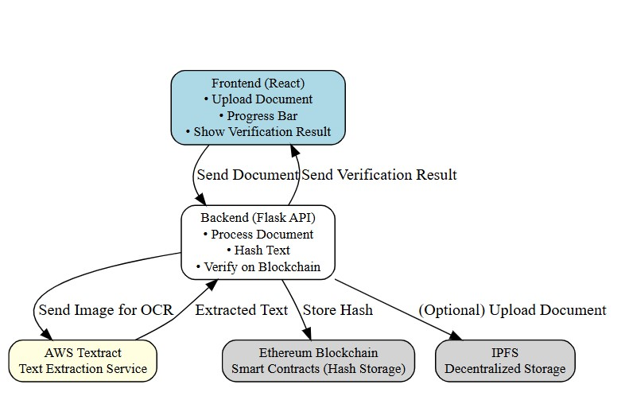
Architecture Diagram

Slide 16
System Design & Implementation
Layered Architecture
Input Layer:
Users upload scanned documents (images or PDFs) via React.js interface.
AWS Textract performs OCR to extract structured, machine-readable text.
Processing Layer:
Text undergoes SHA-256 cryptographic hashing.
Document hash stored securely on Ethereum blockchain.
Anomaly detection: flags incomplete extraction or corrupted inputs.
Output Layer:
Displays verification results (Valid/Tampered) and blockchain transaction ID.
Users can download verification receipts or view blockchain proof.
Logs system performance metrics for monitoring.

Slide 17
System Design & Implementation
Web App Deployment
Frontend:
Built with React.js for responsive document upload and real-time verification display.
Progress indicators and error handling integrated.
Backend:
Flask (Python) APIs manage OCR processing, hashing, and blockchain transactions.
Secure API communication with AWS Textract and Ethereum nodes.
Data Layer:
AWS S3 for secure temporary document storage.
Ethereum Blockchain for decentralized, tamper-proof hash storage.

Slide 18
Algorithm
1. Optical Character Recognition (OCR) Algorithm – AWS Textract
Purpose:
Automatically extracts structured text and layout information from uploaded document images (JPEG, PNG, PDF).
Algorithmic Details:
AWS Textract uses deep learning models (based on Convolutional Neural Networks (CNNs) and Recurrent Neural Networks (RNNs)) for detecting and recognizing text lines, forms, tables, and handwritten elements.
It segments the input image into regions, classifies content types (words, lines, blocks), and outputs structured JSON containing text positions and content.
Key Features:
High accuracy even in noisy scans.
Supports tables, key-value pairs, forms, printed and handwritten text.

Slide 19
Algorithm
2. Cryptographic Hashing Algorithm – SHA-256
Purpose:
Generate a unique, irreversible digital fingerprint of the extracted document text.
Ensures that any modification (even a single character) changes the hash entirely, thus detecting tampering.
Algorithmic Details:
SHA-256 (Secure Hash Algorithm 256-bit) is part of the SHA-2 family standardized by NIST.
It processes input data in 512-bit blocks, using a Merkle–Damgård construction and a series of bitwise logical operations, modular additions, and compression functions.
Final output: 256-bit (64-character hexadecimal) unique hash.
Mathematical Properties:
Deterministic: Same input always gives the same output.
Avalanche Effect: Small input changes produce significantly different hashes.
Preimage resistance: Extremely difficult to reconstruct the original text from the hash.
Collision resistance: Practically impossible for two different inputs to produce the same hash.

Slide 20
Algorithm
3. Blockchain Smart Contract Algorithm – Ethereum Solidity Contracts
Purpose:
Securely store document hashes immutably on a public blockchain, ensuring tamper-evidence and verifiability.
Algorithmic Details:
Smart contracts are small programs written in Solidity language and deployed on Ethereum Virtual Machine (EVM).
They include functions like storeHash(bytes32 documentHash) to store document fingerprints permanently.
Transactions are cryptographically signed (using ECDSA – Elliptic Curve Digital Signature Algorithm) before submission.
Blockchain Features:
Decentralized storage of verification data.
Immutable ledger ensures once a document hash is stored, it cannot be altered.
Publicly verifiable using transaction ID.

Slide 21
Algorithm
4. Web Service Communication – RESTful API Protocols
Purpose:
Facilitate secure communication between the React frontend, Flask backend, AWS Textract services, and Blockchain nodes.
Technical Details:
APIs are built following REST principles: stateless communication, HTTP methods (GET, POST), JSON responses.
Backend integrates AWS SDK (boto3) and Web3.py to connect to external cloud and blockchain services.
Security Measures:
OAuth tokens, JWT authentication, and HTTPS encryption to protect API interactions.

Slide 22
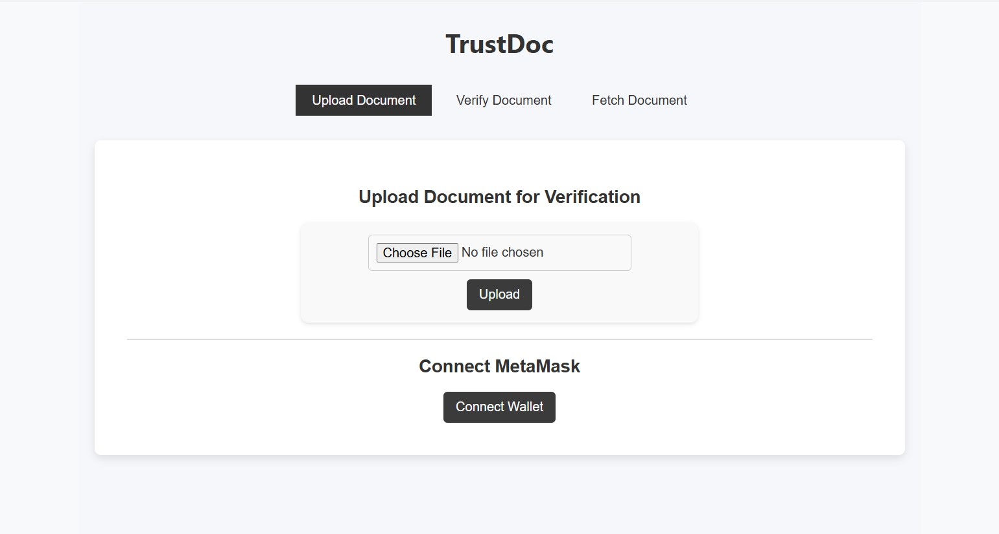
Results

Slide 23
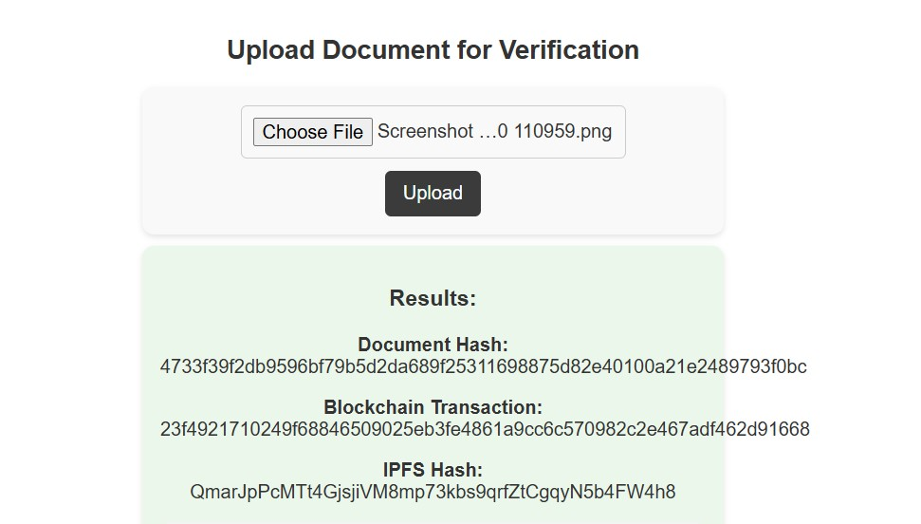

Results

Slide 24
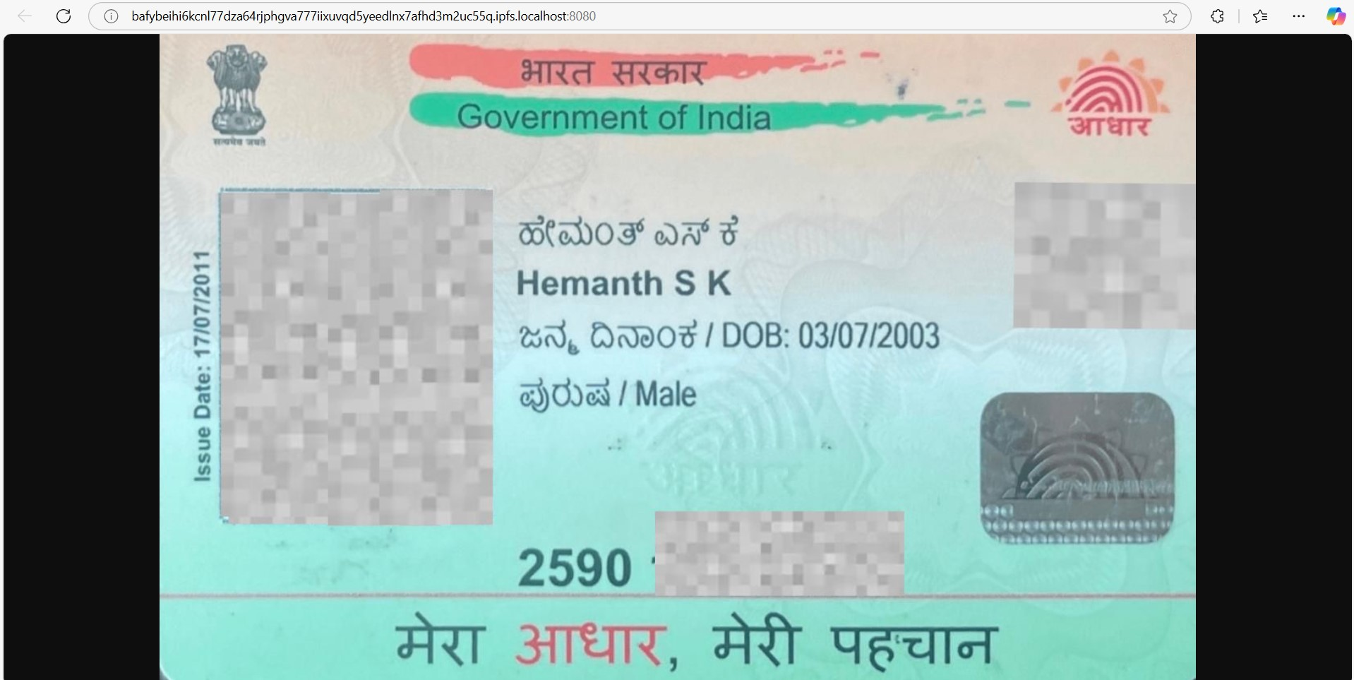
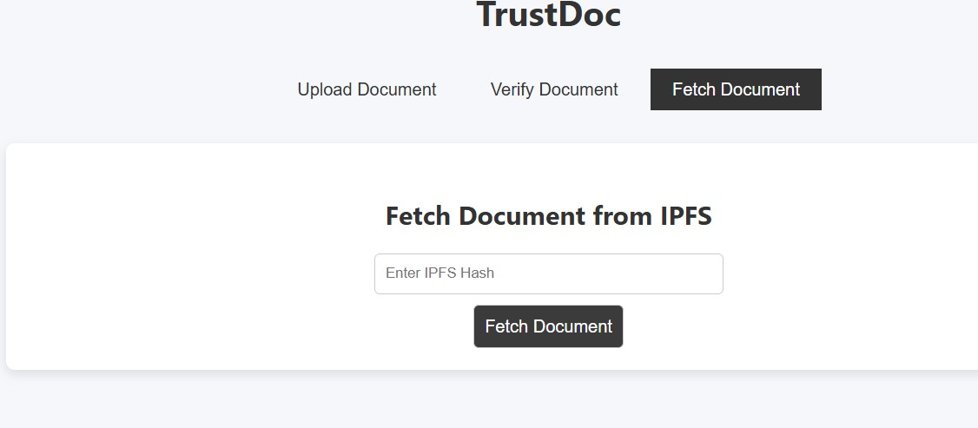
Results

Slide 25
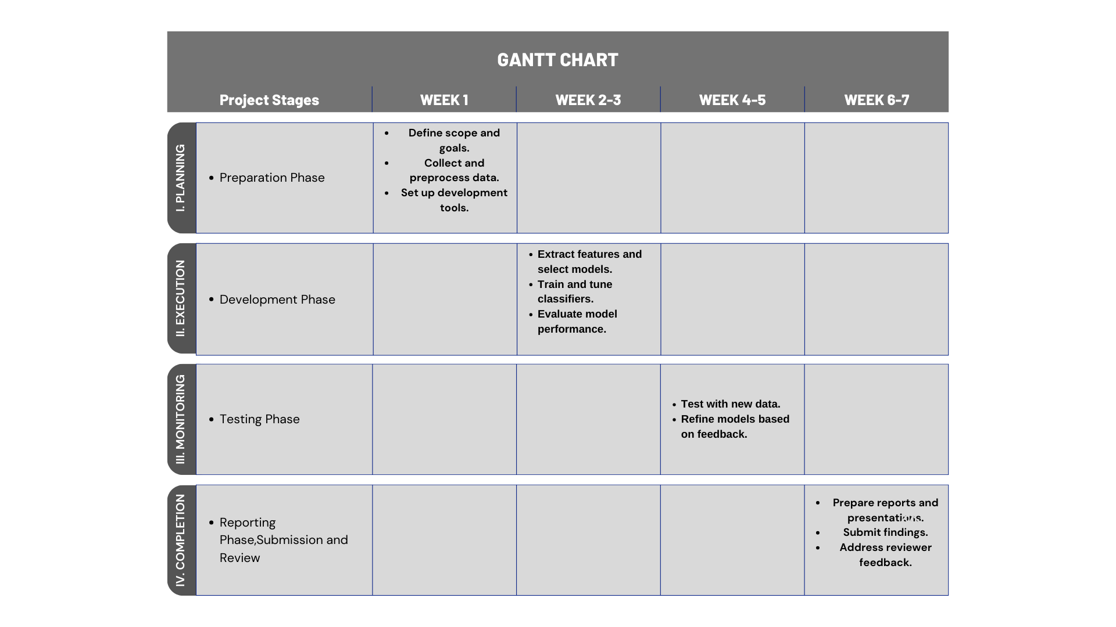
Timeline of the Project (Gantt Chart)

Slide 26
Conclusion
The "Comprehensive Automated Document Verification System Using AI and Blockchain" successfully integrates modern AI and decentralized technologies to automate the verification of document authenticity. By combining AWS Textract for high-accuracy text extraction, SHA-256 cryptographic hashing, and Ethereum blockchain smart contracts, the system provides a scalable, tamper-proof, and user-friendly solution for securing academic, legal, and corporate documents. Future enhancements include expanding multi-language text extraction capabilities, deeper integration with institutional document workflows, and optimizing blockchain operations for lower transaction costs. This project represents a significant step forward in maintaining document integrity and trust in digital ecosystems, addressing the growing challenges of forgery and unauthorized modifications in the era of digital documentation.

Slide 27
References (IEEE Paper format)
[1] Amazon Web Services, Amazon Textract Developer Guide, AWS Documentation, 2024.
[2] Ethereum Foundation, Ethereum Documentation, Ethereum.org, 2024.
[3] Flask, Flask Documentation, Pallets Projects, 2024.
[4] Meta Platforms Inc., React.js Documentation, React Official Site, 2024.
[5] Ethereum Foundation, Solidity Documentation, Soliditylang.org, 2024.
[6] ConsenSys, MetaMask Documentation, MetaMask.io, 2024.
[7] Truffle Suite, Ganache Documentation, TruffleSuite.com, 2024.
[8] X. Zhang, M. Wang, and Q. Li, "Blockchain-based academic certificate verification system," IEEE Access, vol. 11, pp. 12345–12353, 2023.
[9] A. Singh, P. Kumar, and R. Rathi, "Blockchain in healthcare record verification," Journal of Medical Systems, vol. 47, no. 2, pp. 112–119, 2023.
[10] J. Smith, N. Patel, and R. Khan, "Evaluation of Amazon Textract for document OCR," IEEE Transactions on Artificial Intelligence, vol. 5, no. 3, pp. 289–298, 2022.
[11] C. Lee, W. Lim, and S. Choi, "NLP-aided OCR for low-quality document scans," International Journal of Computer Vision, vol. 129, pp. 567–578, 2023.
[12] M. Wang, Y. Zhang, and X. Liu, "IPFS for secure legal document storage," IEEE Network, vol. 37, no. 2, pp. 34–40, Apr. 2023.

Slide 28
References (IEEE Paper format)
[13] N. Gupta, R. Sharma, and A. Das, "AI-blockchain hybrid model for forgery detection in documents," in Proceedings of IEEE Conference on AI and Cybersecurity, pp. 155–162, 2023.
[14] R. Anand, M. Srivastava, and A. Dey, "Scalability challenges in blockchain and IPFS integration," IEEE Transactions on Cloud Computing, vol. 11, no. 1, pp. 88–97, Jan.–Mar. 2023.
[15] P. Sharma, K. Singh, and A. Verma, "Zero-knowledge proofs for secure document verification," IEEE Security and Privacy, vol. 22, no. 1, pp. 25–33, Jan. 2024.
[16] S. Roy, T. Bansal, and P. Rao, "Performance analysis of SHA-256 in digital integrity systems," International Journal of Cyber Security, vol. 9, no. 4, pp. 250–259, 2023.
[17] H. Kaur, V. Malhotra, and P. Joshi, "Decentralized identity management using MetaMask and smart contracts," IEEE Internet of Things Journal, vol. 10, no. 6, pp. 4845–4853, Mar. 2023.

Slide 29
Publication
Published URL:
Acceptance mails:

Slide 30
Publication
Certificates:

Slide 31
GITHUB LINK
https://github.com/hemsk89/CSE7301-G156

Slide 32

Project work mapping with SDG

Slide 33
Project work mapping with SDG
(SDG) 4: Quality Education, by:
• Ensures the authenticity of academic certificates, preventing fraud and maintaining academic integrity across institutions.
(SDG) 9: Industry, Innovation and Infrastructure, by:
•Integrates advanced AI, blockchain, and decentralized technologies to modernize verification processes and improve digital trust infrastructure.
(SDG) 16: Peace, Justice and Strong Institutions, by:
•Strengthens transparency, accountability, and trust by securing legal, corporate, and educational documents against tampering and forgery.
(SDG) 17: Partnerships for the Goals, by:
•Promotes collaboration between educational institutions, legal authorities, technology providers (AWS, blockchain platforms), and regulatory bodies for scalable and interoperable verification systems.

Slide 34


