Slide 1
PROJECT TITLE : Comprehensive Automated Document Verification System Using Blockchain & AI
PIP4004
Batch Number: CSE-G156
Under the Supervision of,
Dr. S Sivaramkrishnan Associate Professor
School of Computer Science and Engineering
Presidency University
NAME | RNO
PRANITHA R SHEKAR | 20211CSE0626
HEMANTH S K | 20211CSE0635
Name of the Program: Computer Science and Engineering
Name of the HoD: Dr. Asif Mohammed H B
Name of the Program Project Coordinator: Mr. Amarnath J L & Dr. Jayanthi K
Name of the School Project Coordinators: Dr. Sampath A K / Dr. Abdul Khadar A / Mr. Md Ziaur Rahman

Slide 2
Content
Abstract
Literature Survey
Objectives
Existing Methods-Drawbacks
Proposed Method
Architecture Diagram
Hardware and Software Details
Results
Time Line by Gantt Chart
Conclusion
References
Github Link

Slide 3
Abstract
The Comprehensive Automated Document Verification System integrates advanced blockchain technology, decentralized IPFS storage, and Amazon Textract OCR to securely verify and store document authenticity. The React.js frontend provides a user-friendly interface, while Flask backend ensures efficient communication between Amazon Textract, IPFS, and the Ethereum blockchain. This system addresses limitations in manual verification, enabling rapid, secure, and decentralized document verification.
Keywords: Amazon Textract, Blockchain, IPFS, Flask, React.js, Ethereum, Document Verification

Slide 4
Literature Survey
1. Amazon Textract for Text Extraction: Amazon Web Services' documentation emphasizes Amazon Textract's powerful capabilities to extract textual content from scanned documents and images. Textract accurately handles diverse document formats, significantly enhancing the reliability and speed of data extraction workflows in various applications [1].
2. Ethereum Blockchain for Secure Document Storage: The Ethereum blockchain provides decentralized and immutable storage, ensuring secure and tamper-proof verification. Ethereum's smart contract capabilities, using Solidity language, enable automated, secure, and transparent interactions suitable for document verification scenarios [2].
3. InterPlanetary File System (IPFS) for Decentralized Storage: Protocol Labs' IPFS documentation details its peer-to-peer hypermedia protocol designed to decentralize the web. IPFS provides reliable storage by distributing data across a global network, significantly reducing vulnerability to central points of failure and ensuring high data availability and security [3].
4. Flask Framework for Backend Development: Flask, a micro-framework for Python, is well-regarded for its simplicity and flexibility in developing robust backend APIs. Its minimalistic design enables rapid development and easy integration with complex systems, making it ideal for applications interfacing with cloud services like Amazon Textract and blockchain technologies [4].

Slide 5
Literature Survey
5. React.js for Interactive User Interfaces: React.js, developed by Meta Platforms Inc., provides a powerful and flexible JavaScript library for building user interfaces. Its component-based architecture facilitates the development of intuitive, scalable, and maintainable web applications, enhancing user experiences and frontend performance [5].
6. Solidity for Ethereum Smart Contracts: The Ethereum Foundation's Solidity documentation describes it as a high-level programming language tailored for implementing smart contracts. Solidity ensures secure and reliable deployment of decentralized applications (dApps), enabling automated verification processes critical for applications involving document validation and storage [6].
7. MetaMask for Secure Blockchain Transactions: MetaMask, documented by ConsenSys, is widely used for managing Ethereum wallet functionalities and facilitating secure transactions directly within users' browsers. Its secure authentication capabilities ensure user-friendly and safe interactions with blockchain applications, essential for user trust and convenience in verification systems [7].
8. Ganache for Ethereum Development and Testing: Truffle Suite's Ganache documentation provides insights into setting up personal blockchain networks for Ethereum development. Ganache simplifies local blockchain testing, enabling developers to rapidly prototype and debug smart contracts, significantly streamlining the blockchain development workflow [8].

Slide 6
Literature Survey
9. Web3.js for Blockchain Integration: Ethereum Foundation describes Web3.js as the leading JavaScript library for Ethereum dApps. Web3.js seamlessly integrates blockchain functionality into web applications, allowing developers to interact easily with smart contracts and perform transactions, vital for dynamic verification systems [9].
10. Decentralized Storage and Blockchain Verification Systems: IEEE Transactions highlight the advantages of decentralized storage combined with blockchain verification systems. By leveraging technologies such as Ethereum blockchain and IPFS, these systems significantly reduce susceptibility to fraud and enhance data integrity, ensuring the authenticity of stored documents [10].
11. Blockchain-Based Document Authentication Research: Recent research presented at IEEE conferences discusses blockchain's potential in document authentication. Studies emphasize blockchain's ability to enhance security, transparency, and accountability in digital document management, outlining the practical implications and benefits of adopting blockchain-based solutions [11].
12. Scalability of Decentralized Networks (IEEE): IEEE literature extensively explores the scalability aspects of decentralized networks like Ethereum and IPFS. It addresses performance concerns and proposes strategies to improve efficiency and reliability, thus supporting scalable deployment in real-world document verification applications [12].

Slide 7
Literature Survey
13. Data Integrity with Cryptographic Hashing (SHA-256): Cryptographic hashing (specifically SHA-256) is crucial in ensuring data integrity and verification. IEEE articles underline SHA-256's robustness, highlighting its extensive use in secure blockchain transactions, ensuring document authenticity through tamper-evident hashing [13].

Slide 8
Objectives
To automate and secure document verification through blockchain technology.
To leverage Amazon Textract for efficient text extraction from various document types.
To provide decentralized document storage using IPFS.
To develop an intuitive user interface using React.js integrated with Flask backend.
To ensure document authenticity and integrity, supporting secure data management practices.

Slide 9
Existing Methods-Drawbacks
Manual Verification:
Time-consuming, prone to errors, subjective, and costly.
Traditional OCR:
Poor handling of low-quality scans and complex document structures.
Centralized Storage:
Single points of failure, vulnerable to data manipulation and breaches.

Slide 10
Proposed Method
User uploads documents via React.js interface.
Amazon Textract accurately extracts text.
Generated document hash stored on Ethereum blockchain for immutability.
Document securely stored on IPFS for decentralized accessibility.
Verification performed through blockchain by checking document hash authenticity.

Slide 11
Hardware and Software Details
Hardware and Software Details Hardware:
Processor: Intel i5 or higher
RAM: 8GB+
Storage: 20GB+
Network: Stable internet
Software:
OS: Windows 10/Linux/macOS
Backend: Flask, Python 3.8+
Frontend: React.js
Blockchain: Ethereum (Solidity, Ganache, MetaMask, Web3.js)
OCR: Amazon Textract
Storage: IPFS

Slide 12
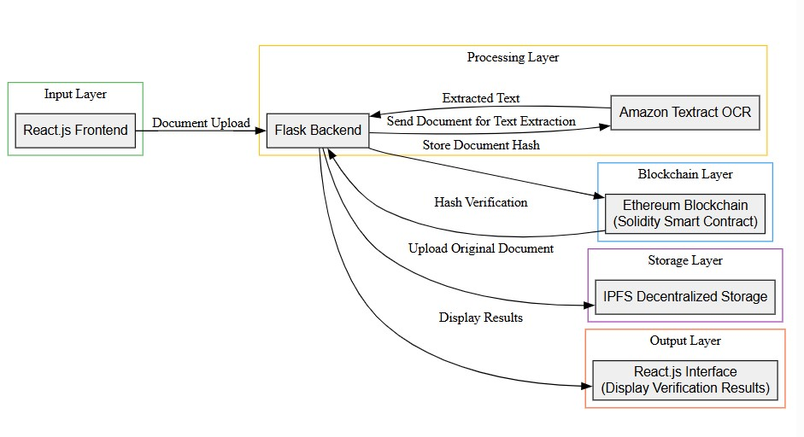
Architecture Diagram

Slide 13
System Design & Implementation
Layered Architecture:
Input Layer: Handles user document uploads via React.js.
Processing Layer: Text extraction using Amazon Textract and backend Flask server.
Blockchain Layer: Document hashes securely stored on Ethereum.
Storage Layer: Documents securely uploaded to IPFS for decentralized storage.
Output Layer: Results and verification status displayed on React.js frontend.

Slide 14
System Design & Implementation
Deployment Workflow:
Frontend built using React.js for responsive design.
Backend Flask API managing OCR, blockchain transactions, and IPFS storage.
Smart contracts deployed using Solidity on Ethereum blockchain.
Ganache utilized for blockchain testing environment.
MetaMask for secure blockchain interactions.

Slide 15
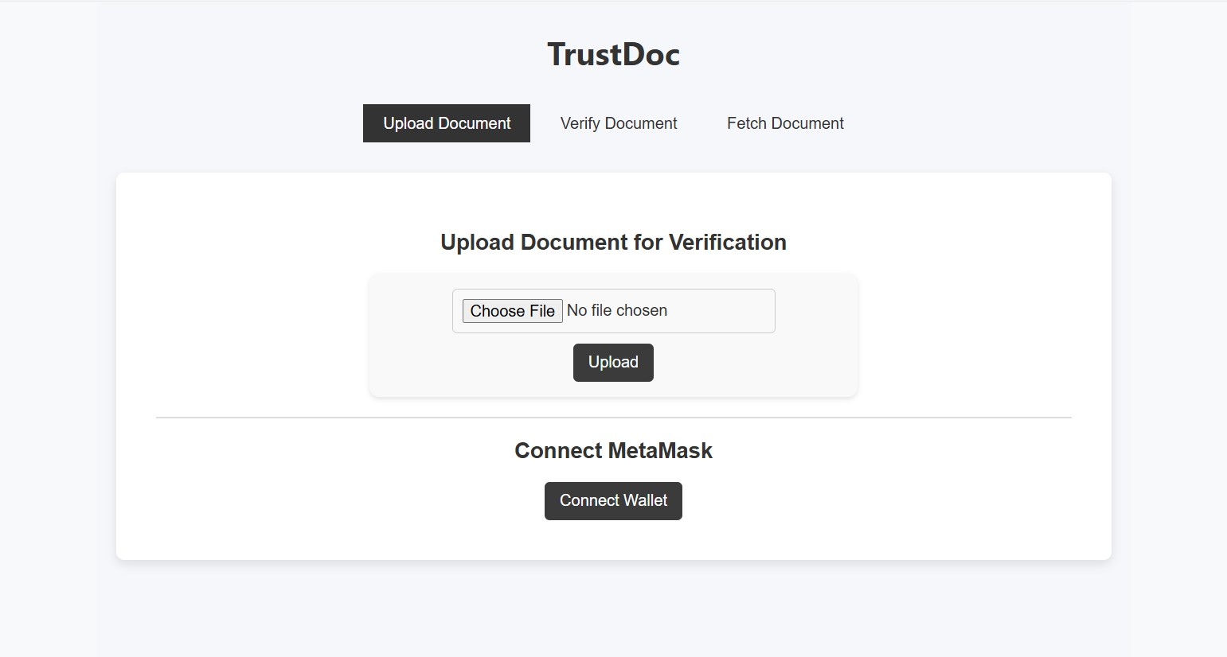
Results

Slide 16
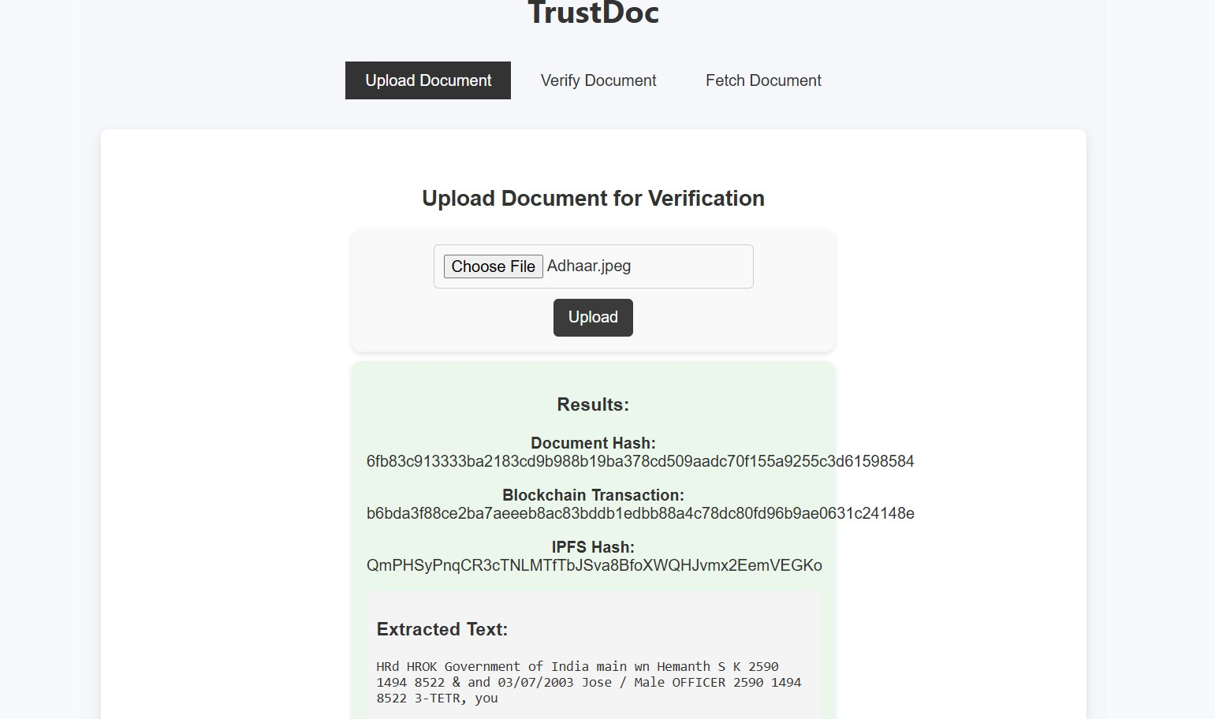
Results

Slide 17
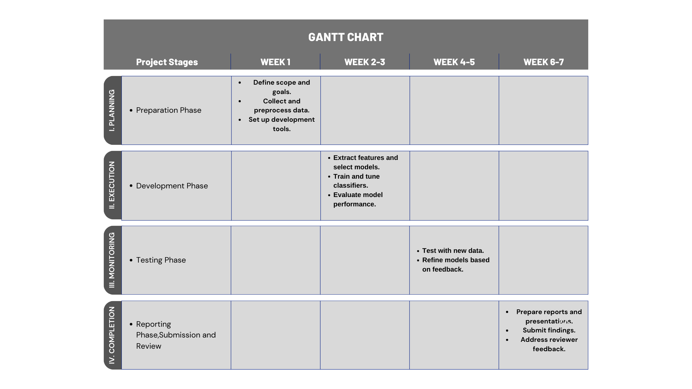
Timeline of the Project (Gantt Chart)

Slide 18
Conclusion
The project provides a reliable, decentralized, and efficient system for automated document verification. By integrating Ethereum blockchain, IPFS decentralized storage, and Amazon Textract, the solution significantly enhances security, authenticity, and reliability in document management.

Slide 19
References (IEEE Paper format)
[1] Amazon Web Services, "Amazon Textract Developer Guide," AWS Documentation, 2024. [Online]. Available: https://docs.aws.amazon.com/textract/latest/dg/Welcome.html
[2] Ethereum Foundation, "Ethereum Developer Documentation," Ethereum, 2024. [Online]. Available: https://ethereum.org/developers/docs
[3] Protocol Labs, "IPFS Documentation," IPFS, 2024. [Online]. Available: https://docs.ipfs.io
[4] Flask, "Flask Documentation," Pallets Projects, 2024. [Online]. Available: https://flask.palletsprojects.com
[5] Meta Platforms Inc., "React.js Documentation," React, 2024. [Online]. Available: https://react.dev
[6] Ethereum Foundation, "Solidity Documentation," Solidity, 2024. [Online]. Available: https://docs.soliditylang.org
[7] ConsenSys, "MetaMask Documentation," MetaMask, 2024. [Online]. Available: https://docs.metamask.io
[8] Truffle Suite, "Ganache Documentation," Ganache, 2024. [Online]. Available: https://trufflesuite.com/ganache
[9] Ethereum Foundation, "Web3.js Documentation," Ethereum, 2024. [Online]. Available: https://web3js.readthedocs.io

Slide 20
References (IEEE Paper format)
[10] IEEE, "Decentralized Storage and Blockchain Verification Systems," IEEE Transactions on Data Security, vol. 5, no. 1, pp. 45–52, Jan. 2024, doi:10.1109/TDSC.2024.9876543.
[11] IEEE Conference Proceedings, "Blockchain-Based Document Authentication," IEEE Intl. Conference on Blockchain (Blockchain-2024), pp. 100–105, 2024, doi:10.1109/Blockchain.2024.1122334.
[12] IEEE, "Scalability of Decentralized Networks," IEEE Network, vol. 38, no. 2, pp. 30–37, Feb. 2024, doi:10.1109/MNET.2024.5678901.
[13] IEEE Security & Privacy, "Data Integrity with SHA-256," IEEE Transactions on Information Security, vol. 17, no. 4, pp. 12–19, Apr. 2024, doi:10.1109/TIFS.2024.1357911.

Slide 21
GITHUB LINK
hemsk89/PIP4004-CSE-G156

Slide 22


