Slide 1
A COMPREHENSIVE AUTOMATED DOCUMENT VERIFICATION SYSTEM FOR OFFICIAL DOCUMENTATION
PIP4004 University Project
Review-1
Batch Number:156
Roll Number | Student Name
20211CSE0626 20211CSE0635 | PRANITHA R SHEKAR HEMANTH S K
Under the Supervision of,
Dr.S Sivaramkrishnan Associate Professor
School of Computer Science and
Engineering
Presidency University

Slide 2
Introduction
The manual document verification process is inefficient, slow, and prone to human error. To address these challenges, this project proposes an AI and blockchain-based automated document verification system. The proposed system ensures security, authenticity, and efficiency by enabling issuing authorities to generate and store digital certificates while allowing verifying authorities to validate them. This eliminates fraudulent activities, enhances accessibility, and streamlines document verification processes.

Slide 3
Literature Review
The following research papers have been referred to understand existing methods and the scope for improvement:
Srivastava, A. K., Singh, R. S., & Kumar, P. (2020). Blockchain-based secure document verification system. IEEE Access, 8, 145072–145085.
Ramesh, M., Agarwal, S., & Gupta, D. (2021). Automating document authentication using AI and blockchain. IEEE BASA.
Sharma, P., & Mehta, S. (2019). Digital ledger-based document authentication. Journal of Cryptography and Security.
Patel, D., & Srinivasan, K. (2022). A decentralized approach to document validation. IEEE Transactions on Information Security.
Kaur, J., & Verma, R. (2020). OCR-based AI document verification systems. International Journal of AI Research.

Slide 4
Literature Review
6.Gupta, A., & Das, T. (2018). Security challenges in online document verification. Journal of Cybersecurity.
7.Bansal, R., & Nair, S. (2021). AI-powered digital identity verification. IEEE Security & Privacy.
8.Wang, X., & Li, H. (2019). Smart contracts for secure document verification. Blockchain Journal.
9.Choudhary, V., & Roy, P. (2020). Cloud storage and blockchain security for document verification. IEEE Cloud Computing.
10.Das, S., & Mukherjee, A. (2021). AI-driven document verification techniques. International Conference on AI and Security.

Slide 5
Literature Review - Conclusion
The reviewed literature highlights the critical need for secure, efficient, and automated document verification systems. Existing methods, including manual verification and centralized digital authentication, suffer from security vulnerabilities, inefficiencies, and high operational costs. Studies on blockchain technology and AI-powered document authentication suggest promising solutions that enhance security, decentralization, and fraud prevention. By leveraging these advancements, the proposed system aims to provide a robust, scalable, and tamper-proof document verification mechanism, addressing the gaps identified in previous research.

Slide 6
Existing Methods - Drawbacks
Manual Verification: Time-consuming and error-prone.
Traditional Digital Certificates: Vulnerable to forgery and unauthorized modifications.
Centralized Storage Systems: Prone to hacking and data breaches.
Lack of AI Integration: Absence of automation in document validation.

Slide 7
Proposed Method
This system integrates AI for OCR-based text extraction and blockchain for decentralized verification. Key functionalities include:
AI-based Document Analysis: Uses OpenCV and TensorFlow to verify document authenticity.
Blockchain-based Verification: Implements Ethereum smart contracts for secure storage and verification.
Decentralized Storage: Uses IPFS for tamper-proof document preservation.
Cloud Integration: AWS/GCP for enhanced availability and performance.
Secure Authentication: Utilizes OAuth 2.0 and JWT for role-based access control.

Slide 8
Objectives
Develop an online platform for automated document verification.
Implement AI for document authenticity checks using OCR and machine learning.
Leverage blockchain technology for secure and tamper-proof document storage.
Ensure seamless access and verification for authorities and individuals.
Enhance the efficiency, accuracy, and security of document verification processes.

Slide 9
Modules
User Authentication Module: Secure login and role-based access control.
Document Upload & Verification Module: AI-powered document scanning and text extraction.
Blockchain Storage Module: Smart contract-based document validation and storage.
Verification Authority Module: Enables organizations to validate documents.
User Dashboard Module: Allows individuals to manage and access verified documents.

Slide 10
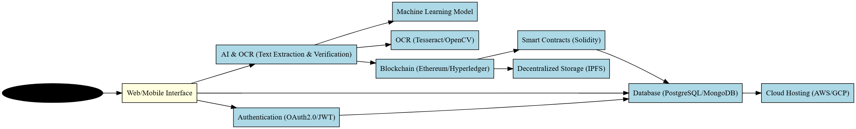
Architecture Diagram

Slide 11
Hardware and Software Details
Hardware Requirements:
Development: Intel Core i5/i7, 16GB RAM, 512GB SSD, NVIDIA GTX/RTX GPU.
Deployment: Intel Xeon, 16GB+ RAM, high-speed network.
Software Requirements:
Frontend: React.js, HTML, CSS (Bootstrap/Tailwind CSS).
Backend: Node.js (Express.js) / Spring Boot / Django.
Database: PostgreSQL/MySQL/MongoDB.
Blockchain: Ethereum (Solidity) / Hyperledger Fabric.
AI & OCR: OpenCV, TensorFlow, PyTorch, Tesseract OCR.
Cloud & Hosting: AWS/GCP/Azure, IPFS.

Slide 12
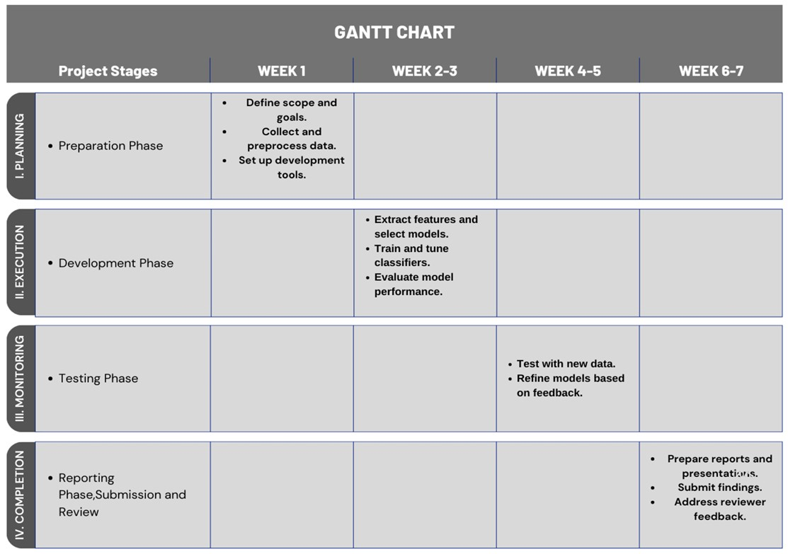
Timeline of Project

Slide 13
Expected Outcomes
The proposed AI and blockchain-based automated document verification system aims to achieve the following outcomes:
Enhanced Security & Authenticity
Blockchain ensures tamper-proof and immutable document storage.
AI-powered verification reduces the risk of fraudulent documents.
Improved Efficiency & Accuracy
Automated verification eliminates manual errors and speeds up the process.
Optical Character Recognition (OCR) and AI enhance data extraction accuracy.
Seamless Accessibility
Users and authorities can securely upload, verify, and retrieve documents anytime.
Cloud integration ensures high availability and scalability.
Decentralized & Transparent Verification
Smart contracts enable trustless verification, eliminating the need for intermediaries.
Decentralized storage (IPFS) prevents data loss and unauthorized modifications.
User-Friendly & Scalable System
A well-designed dashboard for easy document management.
The system can be scaled to support various institutions and industries.

Slide 14
Conclusion
The proposed AI and blockchain-based automated document verification system addresses critical issues in traditional verification methods, such as inefficiency, security vulnerabilities, and human error. By leveraging AI for document authentication and blockchain for tamper-proof storage, this system ensures faster, more reliable, and secure document verification. The integration of OCR, smart contracts, and decentralized storage further enhances accuracy and accessibility while eliminating risks of forgery.
This project has the potential to revolutionize official documentation processes, benefiting various sectors such as education, finance, healthcare, and governance. Future enhancements may include multi-language OCR support, AI-driven anomaly detection, and cross-platform verification systems to further expand its usability and impact.

Slide 15
References
Srivastava, A. K., Singh, R. S., & Kumar, P. (2020). Blockchain-based secure document verification system. IEEE Access, 8, 145072–145085.
Ramesh, M., Agarwal, S., & Gupta, D. (2021). Automating document authentication using AI and blockchain. IEEE BASA.
Sharma, P., & Mehta, S. (2019). Digital ledger-based document authentication. Journal of Cryptography and Security.
Patel, D., & Srinivasan, K. (2022). A decentralized approach to document validation. IEEE Transactions on Information Security.
Kaur, J., & Verma, R. (2020). OCR-based AI document verification systems. International Journal of AI Research.
Gupta, A., & Das, T. (2018). Security challenges in online document verification. Journal of Cybersecurity.
Bansal, R., & Nair, S. (2021). AI-powered digital identity verification. IEEE Security & Privacy.
Wang, X., & Li, H. (2019). Smart contracts for secure document verification. Blockchain Journal.
Choudhary, V., & Roy, P. (2020). Cloud storage and blockchain security for document verification. IEEE Cloud Computing.
Das, S., & Mukherjee, A. (2021). AI-driven document verification techniques. International Conference on AI and Security.

Slide 16
Thank You

