Slide 1
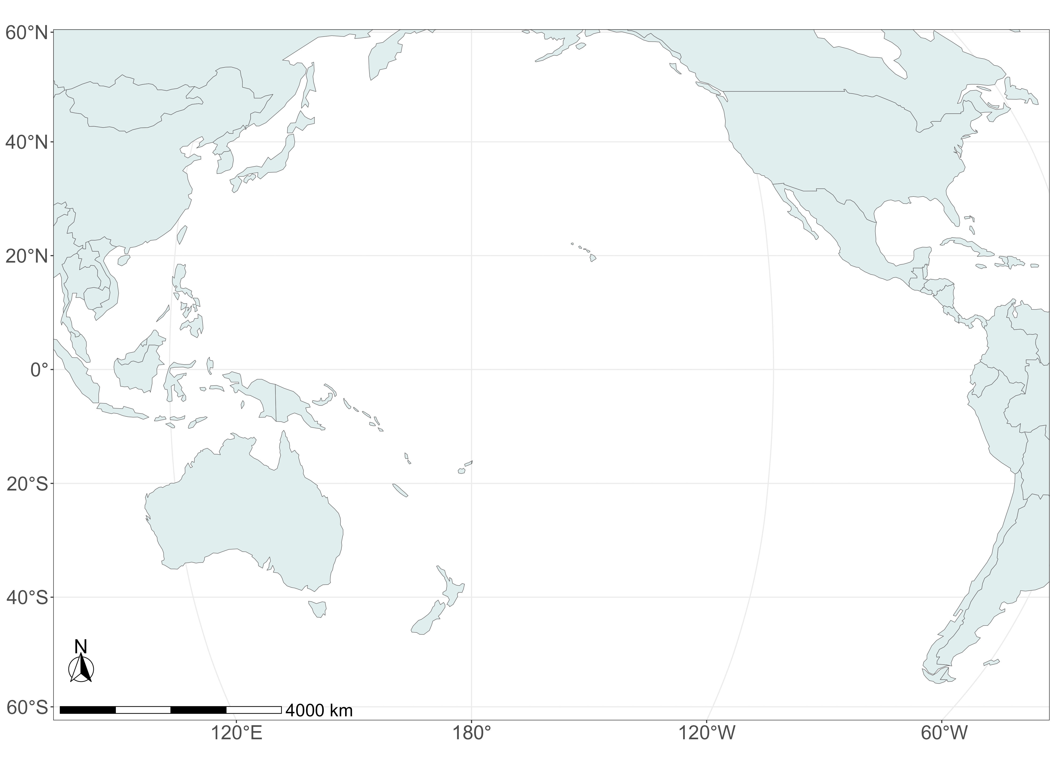
1840s
Status:
Ancestral, Migratory
Non-native, Non-Migratory
Non-native, Migratory
1870s
Sampling
Location
1930s

