Slide 1
KuberSelfHeal
Diagnosing and self-healing cross-node pod connectivity failures on a Raspberry Pi Kubernetes cluster
Hem Tilva
Vansh Barfiwala
Pratham Choksi
Shivangi Thaker
Jils Shah
24110374
24110380
24110275
24110371
24110148
Notes:
KuberSelfHeal: an agent that finds out why a pod on one Kubernetes node cannot reach its database on another node, and repairs it when that is safe. Built and evaluated on three Raspberry Pi 5 boards.

Slide 2
One symptom, many possible causes
The backend on node A cannot reach its database on node B.
Every request crosses several layers. A mistake in any one of them looks the same to the user.
Kubernetes restarts crashed pods. It does not fix a configuration that is valid but wrong.
1
DB_HOST
name the backend uses
2
DNS
CoreDNS resolves it
3
Service
db-service
4
Selector
which pods it picks
5
Ready endpoints
pods that pass readiness
6
targetPort
where traffic is sent
7
VXLAN tunnel
route, firewall, MTU, loss, delay
Notes:
When the backend cannot reach the database, the user sees one symptom. The cause can sit in any layer: DNS, the Service, its selector, endpoints, the target port, or the overlay network between the nodes. Kubernetes restarts crashed pods, but it keeps a wrong configuration in place, faithfully.

Slide 3
What we built: diagnose, fix, verify
1
2
3
4
Diagnose
Fix, only if safe
Verify
Undo or escalate
walk the connection path; label the cause with evidence
high confidence and one exact action
the app must answer HTTP 200 again
a fix that did not help is rolled back
Anything else is labelled other and handed to a human, never “fixed”.
A label must hold both ways: the agent reports a fault if and only if it is the cause.
?
Notes:
The agent diagnoses, applies one fix only when the fix is safe and unambiguous, verifies that the app really answers HTTP 200 again, and undoes the change or escalates otherwise. Anything outside the faults it covers is labelled 'other' and handed to a human instead of being guessed at.

Slide 4
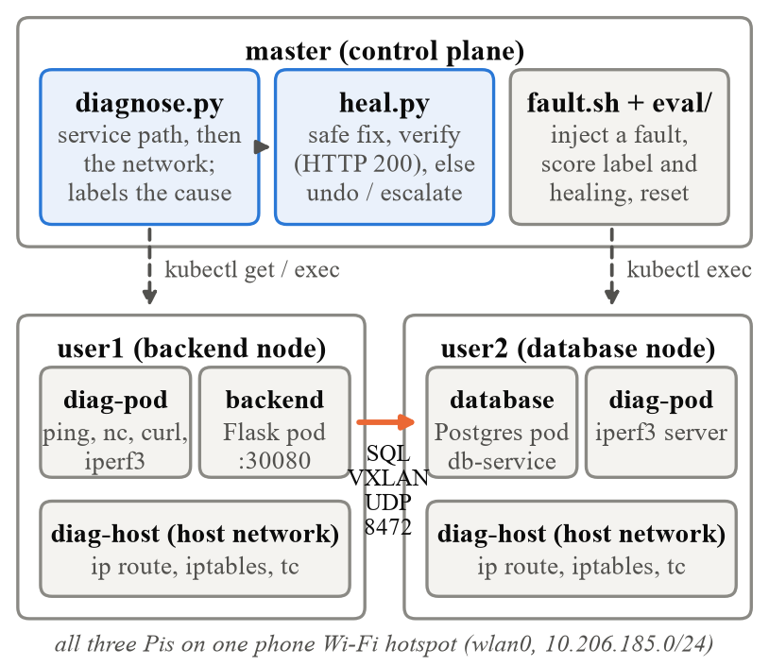
Testbed: three Raspberry Pi 5 on a hotspot
Hardware
3× Raspberry Pi 5, 8 GB RAM
Software
Debian 13 (arm64), k3s v1.36, Flannel VXLAN
Network
phone Wi-Fi hotspot (wlan0) only
App
Flask backend on user1 → PostgreSQL 15 on user2
Toolbox
diag-pod (pod network) and diag-host (node network) on every Pi
Notes:
Three Raspberry Pi 5 boards with 8 GB each, on a phone Wi-Fi hotspot. The control plane runs the agent. The backend runs on user1 and Postgres on user2, so every request crosses the VXLAN tunnel. Toolbox pods on each node run the active tests and read routes, firewall and traffic control.

Slide 5
First, record what healthy looks like
12.7 ms
0 %
1450 B
13.2 Mbit/s
pod → pod RTT across nodes
(node → node: 10.2 ms)
packet loss, pod → pod and node → node
path MTU in the tunnel
(Wi-Fi: 1500 B, VXLAN header 50 B)
pod → pod throughput
(node → node: 14.9 Mbit/s)
All 60 requests through the app succeeded during the baseline (p50 95 ms, p99 162 ms). Wi-Fi signal: −45 to −49 dBm.
Notes:
Before injecting anything we recorded the healthy network. Pod-to-pod across nodes: 12.7 ms, 0% loss, 13.2 Mbit/s, and a path MTU of 1450 bytes, 50 bytes less than the Wi-Fi's 1500 because of the VXLAN header. Network faults are judged against these numbers.

Slide 6
Ten faults in two groups; everything else is “other”
Group 1: Kubernetes service path
Group 2: cross-node network
1
CoreDNS down
6
VXLAN blocked by a firewall rule (UDP 8472)
2
wrong Service name (DB_HOST)
7
route to the other node's pods missing
3
selector does not match the DB pods
8
MTU black hole (big packets vanish)
4
no Ready endpoints (scaled to 0, failing readiness)
9
packet loss on the tunnel
5
wrong targetPort
10
high latency on the tunnel
other: a NetworkPolicy blocking the DB, the Wi-Fi itself down, a database error, or a diagnosis that cannot finish (API unreachable)
Notes:
The agent covers ten faults in two groups. Group one is the Kubernetes service path; group two is the network between the nodes. We inject each of them on purpose. Everything else, such as a NetworkPolicy or the Wi-Fi going down, must come out as 'other'.

Slide 7
Diagnosis: follow the path, then compare layers
Group 1: first broken link wins
Group 2: compare layers and the baseline
1
Does CoreDNS have a ready pod?
nodes OK, pods ≥ 90 % loss
tunnel broken → check route, firewall, netem
2
Does the Service in DB_HOST exist?
pod loss or RTT ≫ baseline, nodes clean
3
Does its selector pick the DB pods?
shaping on the tunnel → netem rule?
1450-byte DF ping fails, small ones pass
4
Is any of them Ready?
MTU black hole → measure path MTU, bulk TCP
5
Is the targetPort the one that is open?
tunnel fine, DB pod silent
blocked at the pod → other
Notes:
Group one follows the connection in order and stops at the first broken link, so a later symptom is never blamed for an earlier cause. Group two runs only if group one is clean. It compares the Wi-Fi link, the pod tunnel and the baseline: if the nodes can talk but pods cannot, the tunnel is broken; then it looks for the exact route, firewall rule or traffic-control rule.

Slide 8
Lesson: “refused” does not prove a wrong port
First evaluation run
After requiring positive evidence
21/24
24/24
All 3 NetworkPolicy trials labelled port_mismatch: k3s rejects denied packets, and the client sees the same “connection refused” as a wrong port.
port_mismatch now needs the targetPort to be undeclared or another declared port to be open. Otherwise: other, with the NetworkPolicies listed as evidence.
Notes:
Our first evaluation labelled all three NetworkPolicy trials as a wrong port. k3s rejects packets denied by a policy, so the client sees 'connection refused', exactly like a wrong port. We changed the rule: the agent now needs positive evidence for every label, here that the port is undeclared or another declared port is open. The second run got all 24 right.

Slide 9
Healing safely: six rules
1
2
3
High confidence, exact fix
One change at a time
Healed = HTTP 200
otherwise escalate with the evidence
each one verified before the next
not “kubectl succeeded”
4
5
6
Undo what did not help
Never touch other
Log every step
except removing a faulty rule or route
a NetworkPolicy may be intentional
audit trail in heal_log.jsonl
Notes:
The healer is deliberately conservative. It acts only on a high-confidence label with one exact action, one change at a time, and calls it fixed only when the app answers again. A change that did not help is undone, except removing a faulty rule, which would only bring the fault back. 'other' is never touched, because a NetworkPolicy may be intentional security.

Slide 10
Results on the Pi cluster
24/24
18/18
30/33
0
correct labels, group 1
(incl. no-fault and NetworkPolicy → other)
correct labels, group 2
(incl. no-fault)
injected faults healed;
app answers HTTP 200 again
changes in 9 no-fault and
uncovered-fault runs
The 3 healing misses: the readiness fault, escalated instead of rolled back by the first version. The rule was fixed (roll back only a revision that was never Ready) but not yet re-run on the Pis.
Notes:
On the real cluster, in the final runs, every trial got the right label: 24 of 24 for group one, including the NetworkPolicy as 'other', and 18 of 18 for group two. Healing fixed 30 of 33 injected faults; the three misses were the readiness fault in the first version. In the nine no-fault and NetworkPolicy runs the healer changed nothing.

Slide 11
Time to recover per fault
2–8 s
Kubernetes fixes: from the fix to a working app
≤ 7.3 s
network fixes: one verifying diagnosis
23 s
MTU: verification repeats the MTU search and a bulk transfer
Notes:
Kubernetes-level fixes bring the app back in two to eight seconds after the fix. For network faults most time goes into the diagnosis itself, which measures the network. The 7.3 seconds after a network fix is one verifying diagnosis, so real recovery is at most that. MTU takes longest because verification repeats the MTU search and a bulk transfer.

Slide 12
Limitations and next steps
Limitations
Next steps
!
one application topology, one fault at a time
→
re-run the full evaluation on the current code
!
faults injected by us: clean signatures
→
explain NetworkPolicy denials (which rule) without changing them
!
one small cluster on one Wi-Fi network
→
handle several simultaneous faults
!
latest code changes not yet re-run on the Pis
→
larger clusters and other CNI plugins
Notes:
Limits: one application, one fault at a time, faults we injected ourselves, one small cluster on one Wi-Fi network. The last code changes, including the readiness rollback, still need a run on the Pis. Next: re-run the full evaluation, explain NetworkPolicy denials without changing them, handle several faults at once, and test on larger clusters and other network plugins.

Slide 13
Thank you
Questions?
github.com/hemtilva/KuberSelfHeal
code · report · slides · raw results · AI transcripts
Hem Tilva · Vansh Barfiwala · Pratham Choksi · Shivangi Thaker · Jils Shah
Notes:
Thank you. The code, the report, the raw results and our AI transcripts are in the repository.

