Slide 1

Agentic AI for Early Detection of Lung Cancer in Non-Smokers Through Genomic Profiling and Predictive Modeling
Mentor: Dr. V. Lakshmi Chetana
Team Members:
Goureddy Abhinav Reddy - AV.EN.U4CSE22217
3. Prajwala Yadlapalli - AV.EN.U4CSE22248
2. Pallapothu Hemanya Sai - AV.EN.U4CSE22233
4. Anupalli Varshith Reddy - AV.EN.U4CSE22257

Slide 2

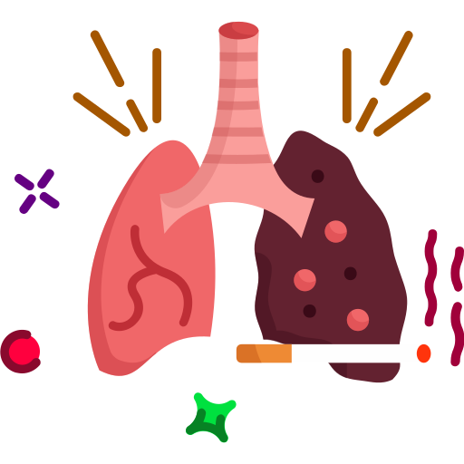


Problem Statement & Motivation
Why Early Detection of Lung Cancer in Non-Smokers Needs a New Approach ?
Current Problem:
Lung cancer in never-smokers is rising
Often diagnosed late due to non-specific symptoms
Existing screening tools don’t target non-smokers
Lack of early, personalized detection methods
Why This Matters
Clinical notes contains unnoticed early clues
Genomic data offers biomarker potential
Manual review is slow → AI agents can scale & reason
Early detection = better survival, less invasive treatment
Our Direction
Agentic AI
Genomic Profiling
Clinical Notes
Explainable Early Detection

Slide 3
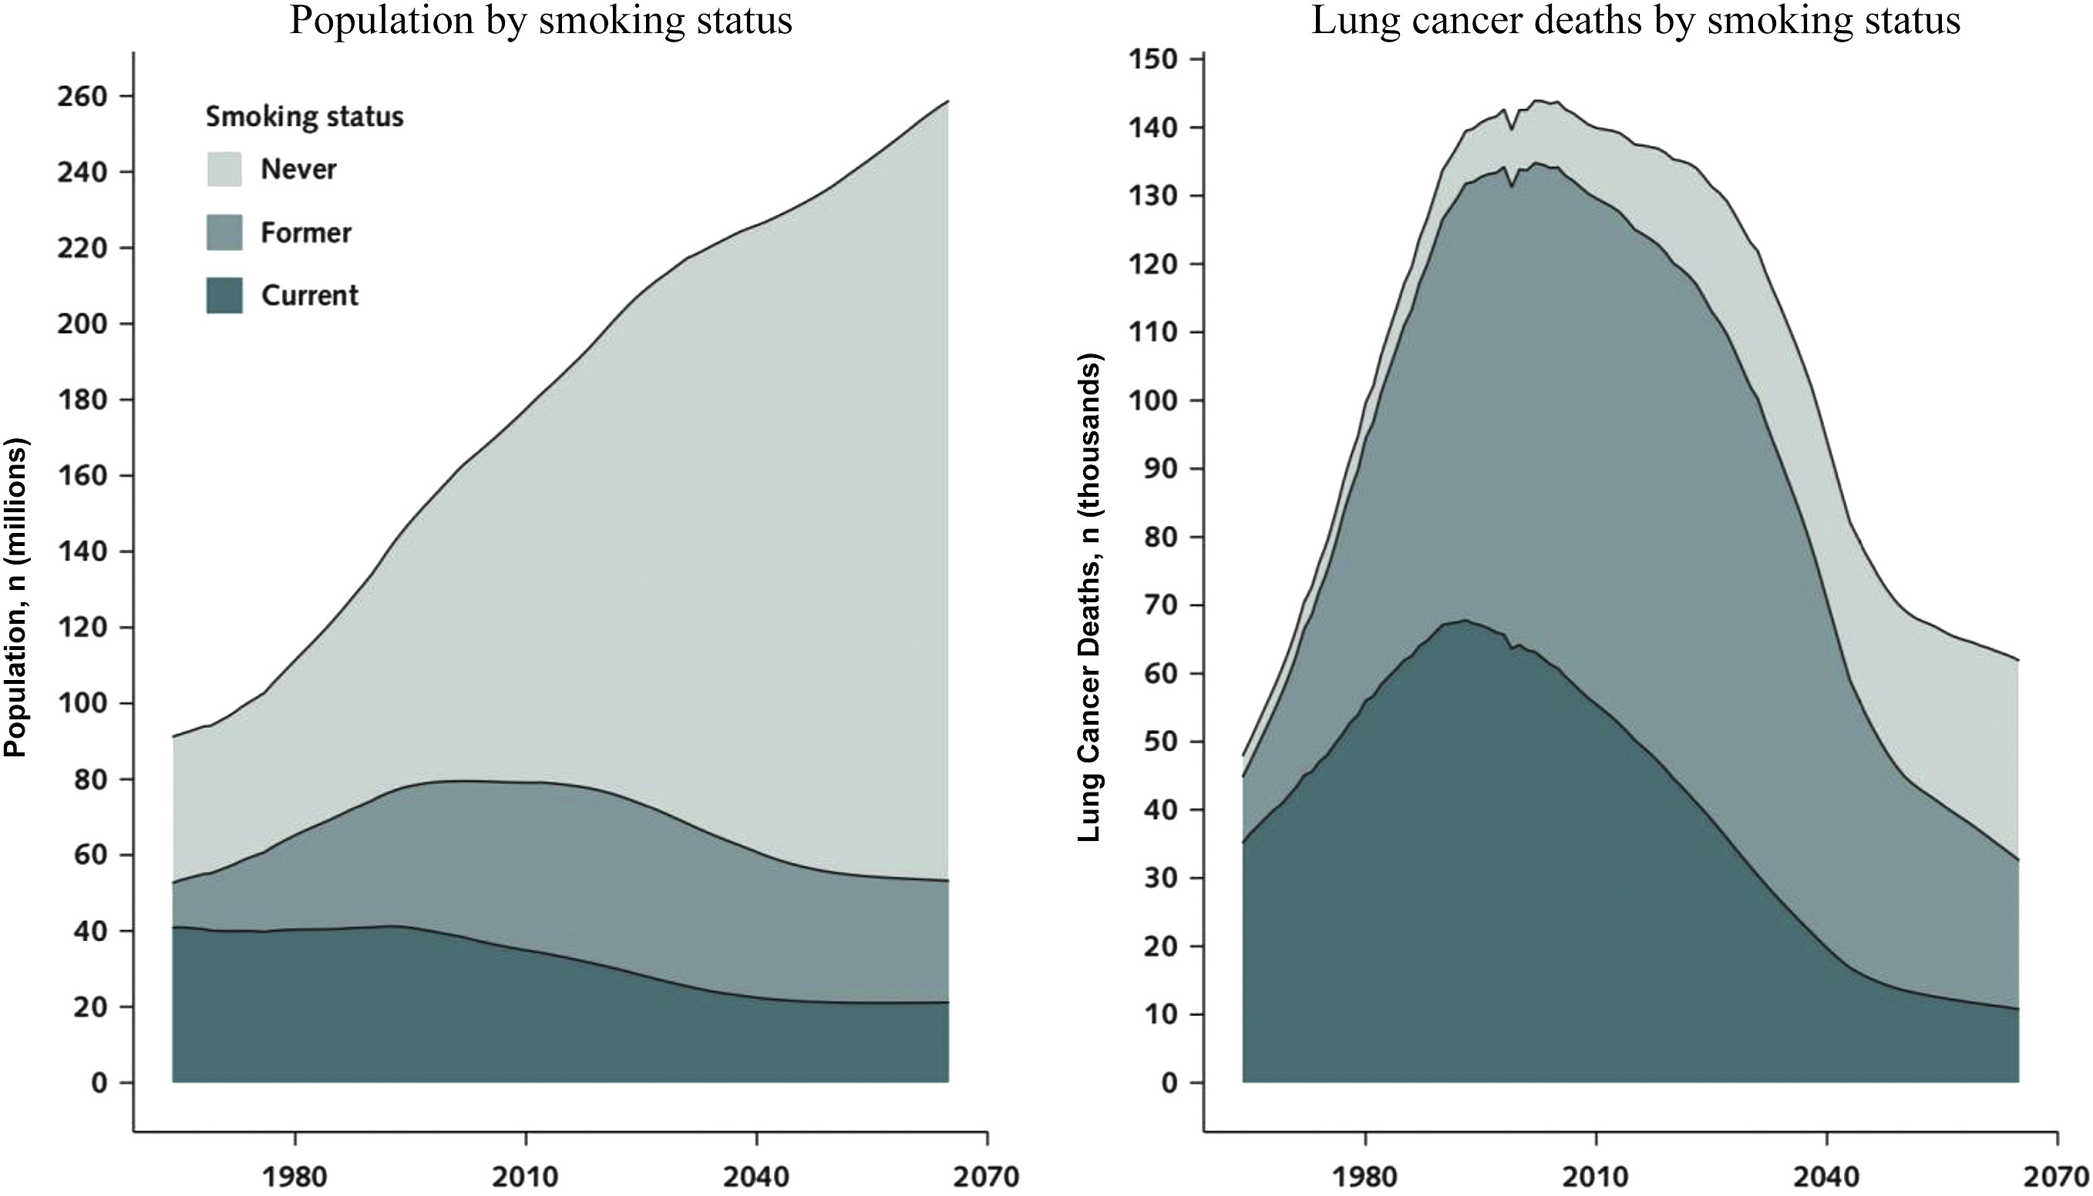
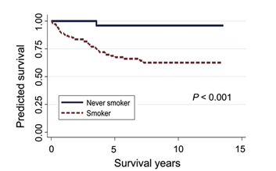
Project Objectives
Enable early detection of lung cancer in never-smokers.
Map clinical symptoms to relevant lung cancer genes.
Build interpretable and explainable AI models.
Integrate clinical notes and genomic data for prediction.
Automate the workflow using agentic AI tools.
Source: Journal of Thoracic Oncology 2022

Slide 4
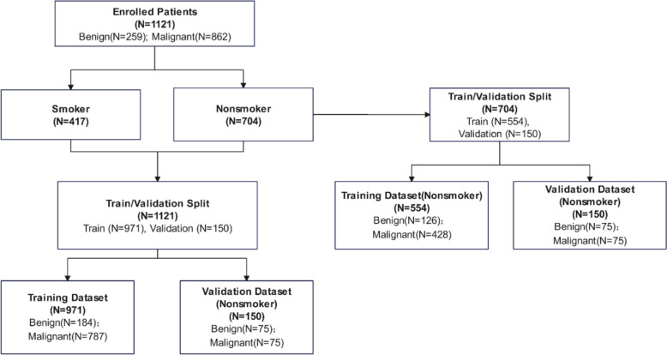
Base Paper
"An early lung cancer diagnosis model for non-smokers incorporating CT imaging analysis and circulating genetically abnormal cells (CACs)"
https://pubmed.ncbi.nlm.nih.gov/39844169/
Built AI models using CT imaging + liquid biopsy + clinical features for non-smokers.
Achieved AUC = 0.99, sensitivity 92%, specificity 97%.
Limitation: Does not use unstructured clinical notes or agentic AI for explainability.
Our Difference
We integrate clinical notes + genomic profiles (not CT/biopsy).
Use agentic AI + knowledge graphs for explainable predictions.
Focus on symptom–gene mapping and patient journey interpretation.

Slide 5
Dataset Description
This dataset was synthesized for early detection of lung cancer using Docker Desktop.
Image created: ollama
Container: llama3
Key Columns:
visit_date – Date and time of hospital/clinic visit.
SMOKING – Smoking history indicator (0 = non-smoker, higher = severity).
YELLOW_FINGERS – Clinical sign often associated with nicotine usage.
ANXIETY – Psychological state measurement.
PEER_PRESSURE – Social influence contributing to lifestyle habits.
CHRONIC DISEASE – Presence of long-term illness or comorbidity.
FATIGUE – Level of tiredness and physical weakness.
ALLERGY – Indication of respiratory or other allergic conditions.
WHEEZING – Sound indicating narrowed or obstructed airways
LUNG_CANCER – Target label (YES/NO diagnosis).

Slide 6
Clinical Notes Example
Patient 1 Note:
“This patient, an 78-year-old female never-smoker, presents with symptoms consistent with advanced lung cancer including yellow fingers, anxiety, fatigue, wheezing, coughing, shortness of breath, chest pain, and swallowing difficulty. Her symptoms have worsened over the past few days. Symptoms: paraneoplastic syndrome (since 10 weeks), night sweats (since 4 years), SVC syndrome (since 5 weeks), chest pain (since 2 years), shoulder pain (since 3 years), peripheral edema (since 11 months), shortness of breath (since 5 months).”
Key Clinical Insights – 78-year-old Female, Never-Smoker:
Yellow fingers + anxiety + fatigue → systemic/psychological impact
Respiratory symptoms → wheezing, cough, dyspnea, chest pain, dysphagia
Paraneoplastic syndrome (10 weeks) → strong cancer association
SVC syndrome (5 weeks) → mediastinal tumor compression
Night sweats (4 years) → chronic systemic symptom, possible malignancy marker
Chest pain (2 years) → local tumor/pleural involvement
Shoulder pain (3 years) → possible Pancoast tumor involvement
Peripheral edema (11 months) → venous/lymphatic obstruction
Shortness of breath (5 months) → progressive respiratory compromise
Confirmed advanced lung cancer ✅
Takeaway: Combination of paraneoplastic features, vascular compression (SVC syndrome, edema), systemic red flags (night sweats, weight loss, fatigue), and chronic pain (chest, shoulder) → points to advanced lung cancer with multi-system involvement, despite patient being a never-smoker.

Slide 7
Model Architecture
Dataset Collection
Agent 1: Symptom & Timeline Extractor
Agent 2:
Gene Matcher
Agent 3:
Causal Inference Reasoning
Risk Scoring
Agent 4:
Personalized Risk Calibration
Agent 2:
Gene Matcher
Agent 1: Symptom & Timeline Extractor
Agent 2: Gene Matcher (Knowledge Graph-Based)
Tools: LangChain + Ollama + Python
Input: Clinical notes from multiple patient visits
Output: Extracted symptoms with timestamp metadata
Builds a Patient Journey Graph showing symptom evolution over time
Uses a Lung Cancer Knowledge Graph (e.g., gene–symptom–disease relationships from DisGeNET, UMLS, etc.)
Maps extracted symptoms to relevant lung cancer-associated genes.
Captures multi-hop biological relationships (e.g., Symptom → Disease → Gene)

Slide 8
Model Architecture
Dataset Collection
Agent 1: Symptom & Timeline Extractor
Agent 2:
Gene Matcher
Agent 3:
Causal Inference Reasoning
Risk Scoring
Agent 4:
Personalized Risk Calibration
Agent 2:
Gene Matcher
Agent 3: Causal Inference Reasoning Agent
Agent 4: Personalized Risk Calibration Agent
Tools: Python + DoWhy / CausalNex + NetworkX
Input:
Mapped symptom–gene associations from Agent 2
Patient demographics (age, gender)
Environmental exposure factors (air pollution, radon, occupation)
Output:
Causal-weighted gene risk factors
Confounder-adjusted causal effect scores
Causal explanation graphs
Tools: Python + Bayesian Modeling + Calibration Techniques (Platt Scaling / Isotonic Regression)
Input:
Raw lung cancer risk score
Causal-weighted outputs from Agent 4
Patient demographic and population-level attributes
Output:
Personalized, calibrated lung cancer risk score
Population-aware screening thresholds
Bias-adjusted risk interpretation

Slide 9
METHODOLOGY
AGENT 3:Causal Inference Reasoning Agent
Purpose:
Introduces causal reasoning to distinguish true lung cancer risk factors from mere correlations.
Structural Causal Model (SCM):
Constructs a Directed Acyclic Graph (DAG) representing causal relationships.
Models interactions between environmental exposure, gene mutations, symptoms, and lung cancer.
Adjusts for confounders such as age and gender.
Causal Effect Estimation:
Estimates causal impact of specific gene mutations on lung cancer risk.
Answers counterfactual queries (e.g., effect of removing a gene mutation).
Uses intervention-based reasoning to ensure unbiased inference.
Techniques Used:
Backdoor adjustment
Propensity score matching
Do-calculus–based intervention analysis
Tools & Frameworks:
DoWhy – causal estimation
CausalNex – causal graph modeling
NetworkX – DAG representation

Slide 10
METHODOLOGY
Explainability:
Provides causal explanations instead of correlation-based reasoning.
Quantifies independent contribution of genes after confounder adjustment.
Enhances clinical interpretability and trust.
Output to Risk Scoring Module:
Causal-weighted gene risk scores
Confidence estimates for each causal factor
Filtered, bias-reduced inputs for final risk computation.
Output to Downstream Agent:
Final Risk = Σ (Causal Effect × Symptom Evidence × Temporal Weight)
Key Advantages:
Aspect | Improvement
Clinical trust | Very high
False positives | Reduced
Scientific rigor | Strong
Publication value | Excellent

Slide 11
METHODOLOGY
AGENT 4: Personalized Risk Calibration Agent
Purpose:
Converts generic lung cancer risk scores into patient-specific and population-aware predictions.
Need for Calibration:
Raw risk scores may not reflect true risk across different demographic groups.
Never-smoker lung cancer risk varies significantly with age, gender, and exposure history.
Calibration Approach:
Incorporates demographic and environmental priors into risk estimation.
Uses Bayesian updating to adjust risk scores based on subgroup prevalence.
Performs subgroup-aware calibration to ensure consistent interpretation across populations.
Techniques Used:
Bayesian risk modeling
Platt scaling and isotonic regression
Population-level prior adjustment

Slide 12
METHODOLOGY
Outputs:
Personalized and calibrated lung cancer risk score
Demographic-adjusted screening relevance
Bias-aware risk interpretation
Fairness & Bias Mitigation:
Evaluates risk calibration across demographic subgroups.
Reduces overestimation and underestimation caused by dataset imbalance.
Ensures equitable decision support for never-smoker populations.
Clinical Impact:
Improves reliability of early screening recommendations.
Enhances trustworthiness of AI-assisted diagnosis.
Supports ethical and responsible deployment in real-world healthcare settings.
Example Output Instead of:
Risk = 0.72 (High)
System reports:
Risk = 0.68 (High for 35–45 year female never-smokers)
This prevents:
Over-screening low-risk groups.
Under-screening vulnerable populations.

Slide 13
Key References
[1] Chen, C.-Y., Kuo-Yen, & Yang, P.-C. (2024). The role of PM2.5 exposure in lung cancer: mechanisms, genetic factors, and clinical implications. EMBO Molecular Medicine. https://www.embopress.org/doi/full/10.1038/s44321-024-00175-2
[2] Chiu, C.-H., & Yang, P.-C. (2024). Challenges of lung cancer control in Asia. The Lancet eClinicalMedicine, 72, Article 102942. https://www.thelancet.com/journals/eclinm/article/PIIS2589-5370(24)00285-2/fulltext
[3] Zheng, H., Zhang, Q., Gong, Y., Liu, Z., & Chen, S. (2024). Identification of prognostic biomarkers for stage III non-small cell lung carcinoma in female nonsmokers using machine learning. In 2024 10th International Conference on Biomedical Engineering and Informatics (BMEI). https://ieeexplore.ieee.org/abstract/document/10762221
[4] Hendriks, L. E. L., Remon, J., Faivre-Finn, C., Garassino, M. C., Heymach, J. V., Kerr, K. M., Tan, D. S. W., Veronesi, G., & Reck, M. (2024). Non-small-cell lung cancer. Nature Reviews Disease Primers, 10, Article 43.

Slide 14
[5] Buana, I., Soeroso, N. N., Tarigan, S. P., & Syahruddin, E. (2022). Risk factors for lung cancer in non-smoking women, North Sumatera, Indonesia. Sumatera Medical Journal, 8(1), 28–34. https://doi.org/10.32734/sumej.v8i1.18763
[6] Győrffy, B. (2024). Transcriptome-level discovery of survival-associated biomarkers and therapy targets in non-small-cell lung cancer. British Journal of Pharmacology, 181(5), 1007–1022.
[7]Lam, S. (2025). Lung cancer screening in never-smokers. Current Opinion in Oncology, 37(1), 54–58. https://journals.lww.com/co-oncology/abstract/2025/01000/lung_cancer_screening_in_never_smokers.13.aspx
[8]Kang, H.-R., Cho, J. Y., Lee, S. H., Lee, Y. J., Park, J. S., Cho, Y.-J., Yoon, H. I., Lee, K. W., Lee, J. H., & Lee, C.-T. (2019). Role of low-dose computerized tomography in lung cancer screening among never-smokers. Journal of Thoracic Oncology, 14(10), 1649–1657.

Slide 15
[9] Kerpel-Fronius, A., Tammemägi, M., Cavic, M., Henschke, C., Jiang, L., Kazerooni, E., Lee, C.-T., Ventura, L., Yang, D., Lam, S., Huber, R. M., et al. (2022). Screening for lung cancer in individuals who never smoked: An International Association for the Study of Lung Cancer Early Detection and Screening Committee report. Journal of Thoracic Oncology, 17(2), 188–205. https://www.sciencedirect.com/science/article/pii/S1556086421023911
[10] Wang, P., Sun, S., Lam, S., & Lockwood, W. W. (2023). New insights into the biology and development of lung cancer in never smokers—Implications for early detection and treatment. Journal of Translational Medicine, 21(1), Article 484.

Slide 16
THANK YOU

