Slide 1

Agentic AI for Early Detection of Lung Cancer in Non-Smokers Through Genomic Profiling and Predictive Modeling
Mentor: Dr. V. Lakshmi Chetana
Team Members:
Goureddy Abhinav Reddy - AV.EN.U4CSE22217
3. Prajwala Yadlapalli - AV.EN.U4CSE22248
2. Pallapothu Hemanya Sai - AV.EN.U4CSE22233
4. Anupalli Varshith Reddy - AV.EN.U4CSE22257

Slide 2




Problem Statement & Motivation
Why Early Detection of Lung Cancer in Non-Smokers Needs a New Approach ?
Current Problem:
Lung cancer in never-smokers is rising
Often diagnosed late due to non-specific symptoms
Existing screening tools don’t target non-smokers
Lack of early, personalized detection methods
Why This Matters
Clinical notes contains unnoticed early clues
Genomic data offers biomarker potential
Manual review is slow → AI agents can scale & reason
Early detection = better survival, less invasive treatment
Our Direction
Agentic AI
Genomic Profiling
Clinical Notes
Explainable Early Detection

Slide 3
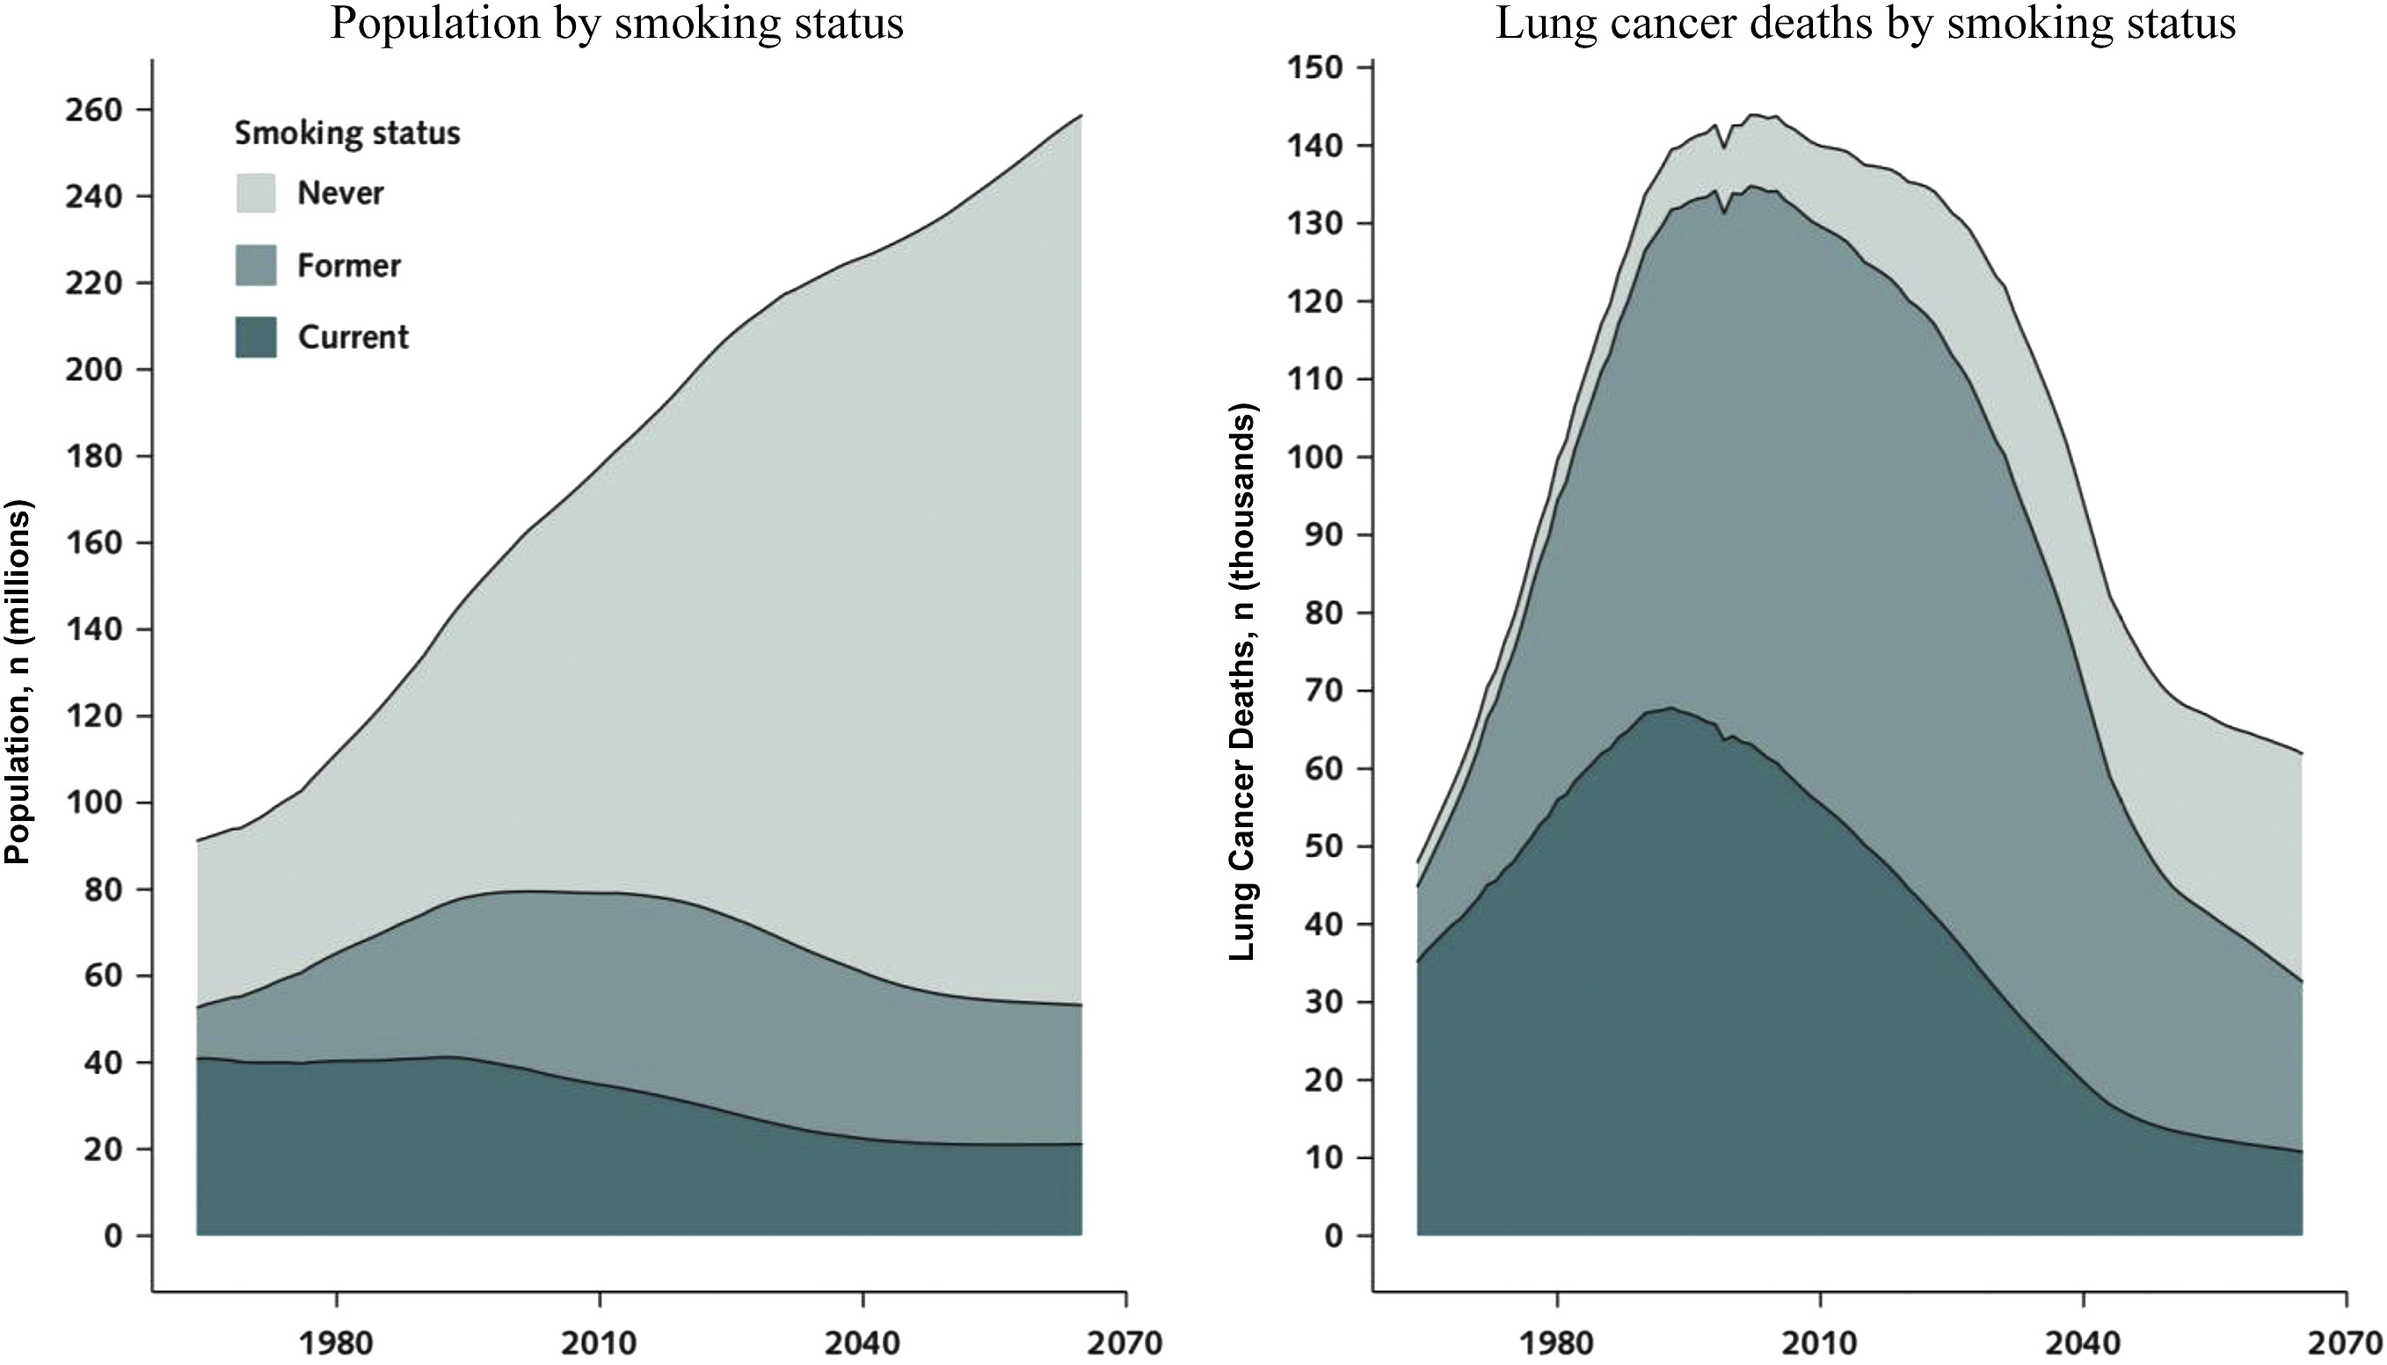
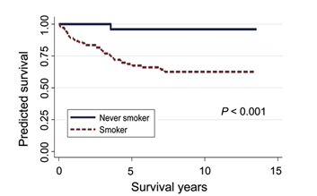
Project Objectives
Enable early detection of lung cancer in never-smokers.
Map clinical symptoms to relevant lung cancer genes.
Build interpretable and explainable AI models.
Integrate clinical notes and genomic data for prediction.
Automate the workflow using agentic AI tools.
Source: Journal of Thoracic Oncology 2022

Slide 4




Clinical Workflow
EHR Data Collection
Risk Score Calculation
Existing medical history, family history, and clinician notes are gathered.
Symptom & Timeline Extraction
Gene Risk Mapping
Builds structured symptom timeline.
Symptoms matched to gene database.

Slide 5
Model Architecture & Evaluation
Dataset Collection
Agent 1: Symptom & Timeline Extractor
Agent 2:
Gene Matcher
Risk Scoring
Agent 1: Symptom & Timeline Extractor
Agent 2: Gene Matcher (Knowledge Graph-Based)
Tools: LangChain + Ollama + Python
Input: Clinical notes from multiple patient visits
Output: Extracted symptoms with timestamp metadata
Builds a Patient Journey Graph showing symptom evolution over time
Uses a Lung Cancer Knowledge Graph (e.g., gene–symptom–disease relationships from DisGeNET, UMLS, etc.)
Maps extracted symptoms to relevant lung cancer-associated genes.
Captures multi-hop biological relationships (e.g., Symptom → Disease → Gene)

Slide 6
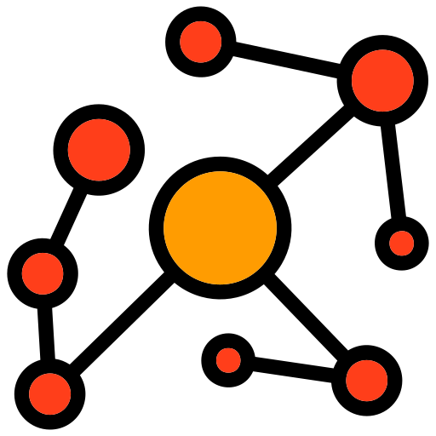

Graph-Based Scoring Module
Graph 1: Patient Journey Graph (symptoms over time)
Graph 2: Subgraph of knowledge graph centred on lung cancer
Performs graph matching to score:
Number and strength of symptom-gene paths
Temporal alignment with known disease progression
Outputs ranked gene-symptom explanations
Clinical Output
Patient-level report with:
Matched genes
Timeline + symptom evidence
Clear explanation for each match
Final decision is clinician-validated

Slide 7
Evaluation Metrics

