Slide 1
TAO
Facebook’s Distributed Data Store For Social Graph

Slide 2
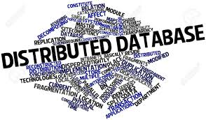
Agenda
Motivation
Data Model
API
Objects API
Associations API
Association Query API
Requirement
Architecture
Failure Handling
Critique About Paper
Conclusion

Slide 3
Motivation
Before TAO, Facebook’s web servers directly accessed MySQL to read or write the social graph, aggressively using Memcached as a lookaside cache. This makes engineers life complicated to write code for modifying graph
TAO implements a graph abstraction directly, allowing it to avoid some of the fundamental shortcomings of a lookaside cache architecture
A new abstraction of Objects & Associations was created, which allowed expressing a lot of actions on FB as objects and their associations
TAO read-optimized graph data store, which was built to handle a demanding Facebook workload

Slide 4
Data Model
Data model consists of two main entities
Object: (id) -> (otype, (key-> value)*)
Associations: (id1, atype, id2) -> (time, (key, value)*)
Example: Alice was at the Golden Gate Bridge with Bob
In the above example objects are:
Object 1: (id1 -> (USER, (name: Alice)
Object 2: (id2 -> (USER, (name: Bob)
Object 3: (id3 -> (LOCATION, (name: Golden Gate Bridge, location: <location>)
Object 4: (id4 -> (CHECKIN, some value) Associations are:
(id1, FRIEND, id2) -> (time, …) Alice and Bob associated as friend
(id3, CHECKINASSOCIATION, id4) -> (time, …) Golden gate location is associated with check-in using checking associations)

Slide 5
API
The API is simple by design
Most are intuitive to understand
TAO’s object API provides operations to allocate a new object and id, and to retrieve, update, or delete the object associated with an id
Association API
assoc_add(id1, atype, id2, time, (k→v)*): Add an association of type atype from id1 to id2
assoc_delete(id1, atype, id2): Delete the association of type atype from id1 to id2
assoc_change_type(id1, atype, id2, newtype) – Changes the association (id1, atype, id2) to (id1, newtype, id2), if (id1, atype, id2) exists

Slide 6
API Continue…
Association Query API
assoc_get(id1, atype, id2set, high?, low?): Returns assocications of atype between id1 and members of id2set, and creation time lies between [high,low][high,low].
assoc_count(id1, atype): Number of assocications from id1 of type atype.
assoc_range(id1, atype, pos, limit) – returns elements of the (id1, atype) association list with index i ∈ [pos,pos+limit).
assoc_time range(id1, atype, high, low, limit) – returns elements from the (id1, atype) association list, starting with the first association where time ≤ high, returning only edges where time ≥ low
TAO enforces a per-atype upper bound (typically 6,000) on the actual limit used for an association query.
This is also probably why the maximum number of friends you can have on FB is 5000.
Example:
“50 most recent comments on Alice’s checkin” ⇒ assoc_range(632, COMMENT, 0, 50)
“How many checkins at the GG Bridge?” ⇒ assoc_count(534, CHECKIN)

Slide 7
Requirements
On FB the aggregate consumption of content (reads), is far more than the aggregate content creation (writes). The read-write ratio to 500:1
The read availability is required to be very high
Each read request latency should be very low and cannot read cross data-center

Slide 8
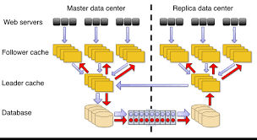
Architecture
Sharding/Data Distribution
Each object id contains an embedded shard id that identifies its hosting shard.
An association is stored in the shard belonging to its id1.
Consistency Semantics
“read-after-write” consistency semantics for writers, and eventual consistency for readers.
Storage Layer
The underlying DB is MySQL, and the TAO API is mapped to simple SQL queries.
Caching Layer
The caching layer consists of multiple cache servers that together form a tier.
A tier is collectively capable of responding to any TAO request
LRU eviction policy

Slide 9
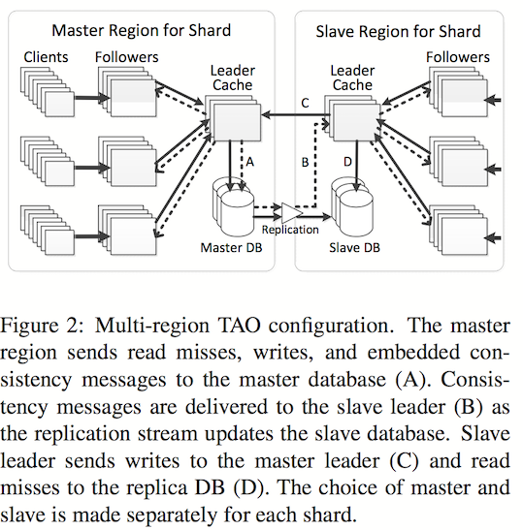
Scaling the caching servers
Multi Regions
TAO is setup with multiple regions, and user requests hit the regions closest to them
A region will consist multiple tiers, but only one tier will be a leader tier and the rest will be follower tiers
Leaders and Followers
The cache is spitted into two levels: a leader tier and multiple follower tiers.
Read request goes to follower first, read misses either goes to another follower tiers or to the leader
Write always goes to the leader and follower and slave updated asynchronously

Slide 10
Failure Handling
Network Failures
Aggressive timeouts and routing around them in case of lack of responses
Database Failures
If a master goes down, one of the slaves is promoted to the master role
A slave database failure can be addressed by going to the leader in the master region
Leader Failures
When a leader server fails, other servers in the leader tier are used for routing around it. Followers just send requests to a random leader in that tier.
Follower Failures
When a follower fails, other tiers can help with serving the shard
Each client is configured to have a primary and a backup follower tier

Slide 11
Critique About Paper
TAO is a geographically distributed eventually consistent graph store optimized for reads. Previous distributed systems works have explored relaxed consistency, graph databases, and read-optimized storage. To my knowledge, TAO is the first to combine all these techniques in a single system at large scale.
Eventual Consistency
Geographically Distributed Data Stores
Distributed Hash Tables
Hierarchical Connectivity
Structured Storage
Graph Processing

Slide 12
Conclusion
Geographically distributed caching servers and data stores
Highly scalable database, support billions read, and millions write per second
Cache and persistent store are separated
Allows those layers to be independently designed, scaled, and operated, and maximizes the reuse of components across our organization
Allows to choose different tradeoffs for efficiency and consistency at the two layers, and to use an idempotent cache invalidation strategy
Deployed at scale inside Facebook

