Slide 1
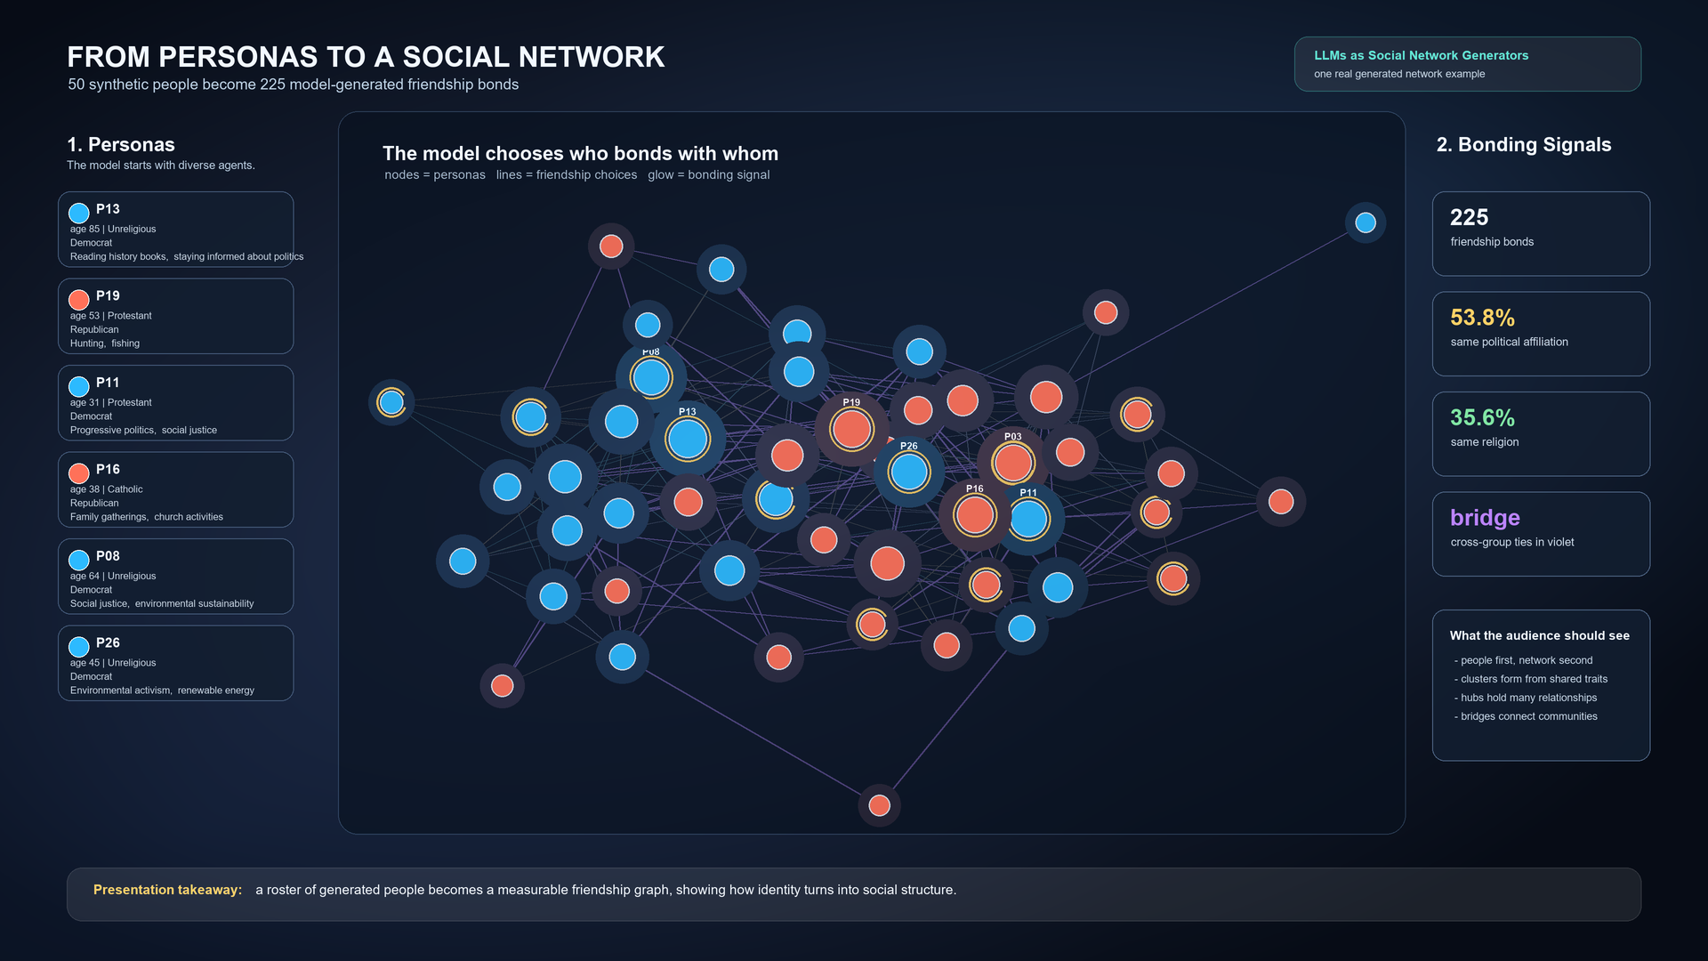
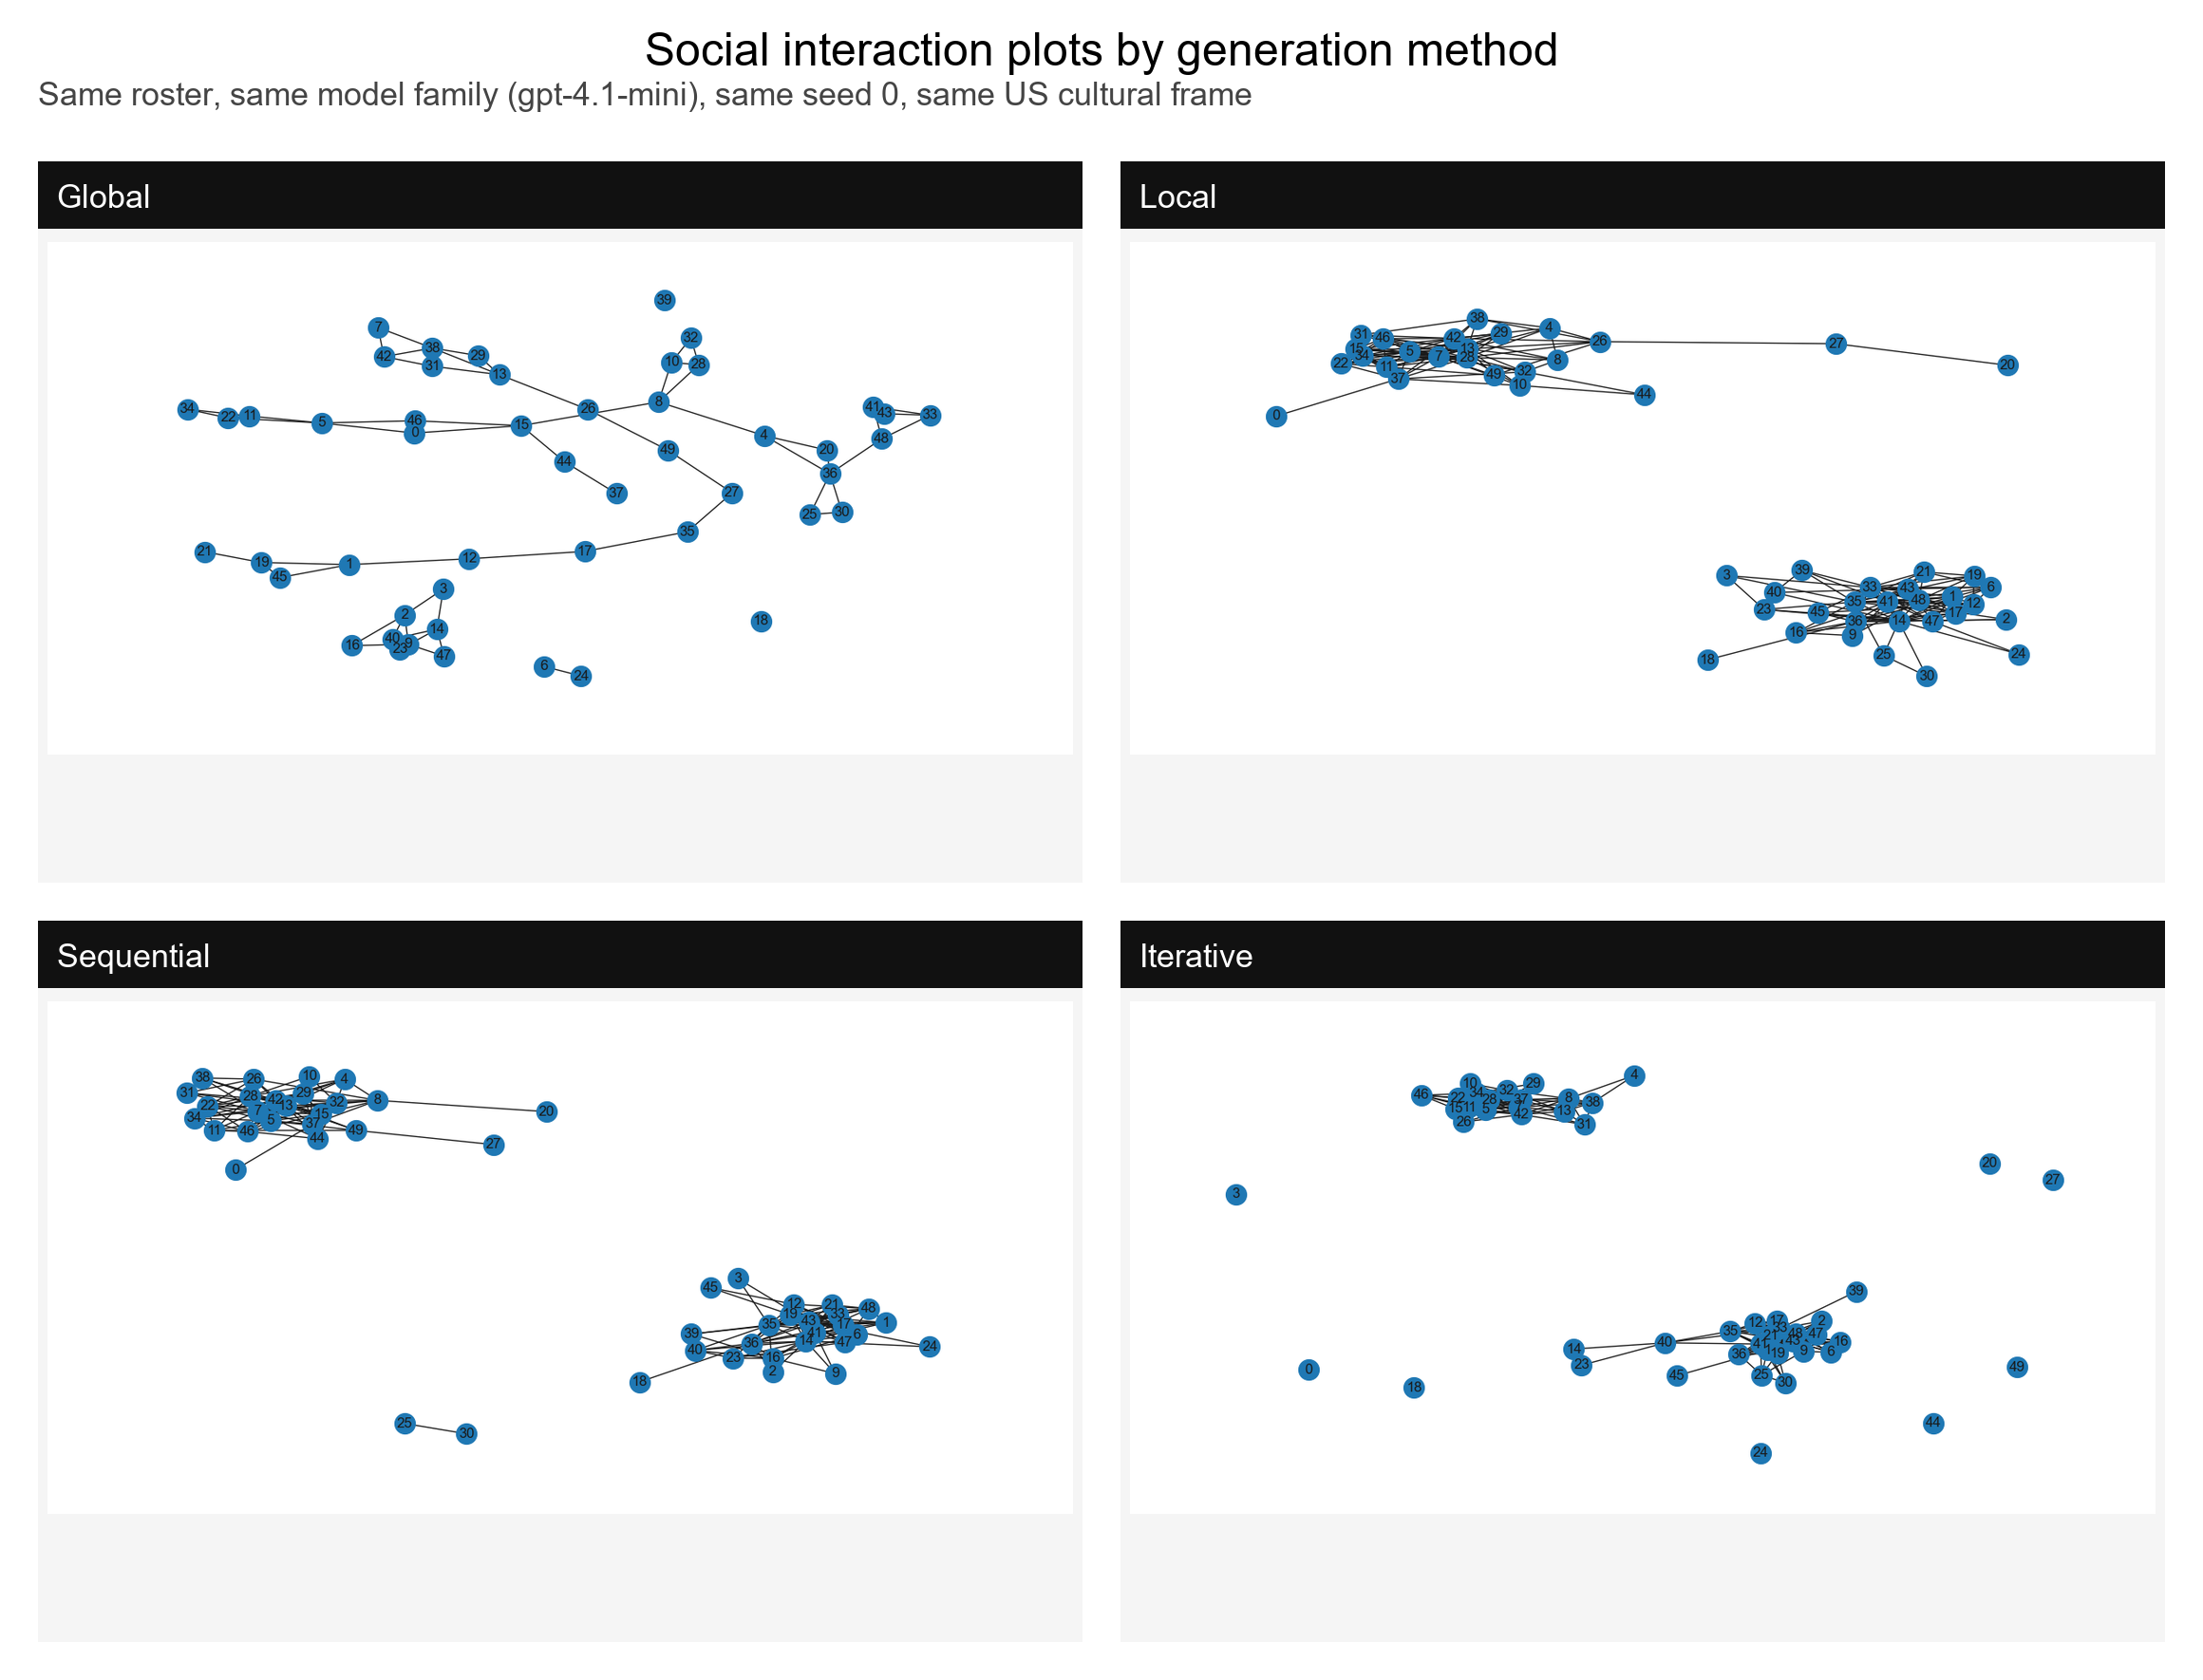
LLMs as Social Network Generators
How model choice, culture, prompt language, and generation method reshape synthetic friendship networks
50
4
fixed personas
generation methods
3 + older
Core claim
new GPT-4.1 family plus base-model context
LLMs can generate plausible social networks, but the final graph is shaped by prompt context, model choice, and generation procedure.

Slide 2
The Story In One Minute
From older model baselines to our controlled capstone extension.
Base repo
Older outputs
LLMs generated friendship graphs and compared homophily/topology against real networks.
Sequential baselines exist for GPT-3.5, GPT-4o, Llama 3.1, and Gemma2 variants.
Our extension
Final finding
We reused one fixed 50-person roster and varied culture, method, model, and prompt language.
Generated networks are structurally sensitive: political homophily dominates often, but culture, language, method, and model shift the result.
02

Slide 3
Why This Matters
Synthetic social networks are useful only if we understand their hidden assumptions.
LLM-generated agents are increasingly used for simulations, games, education, and social-science experiments.
But a network is more than a list of personas: the model decides who connects to whom.
Small prompt/model changes can shift homophily, density, connected components, and community structure.
So the research question is about reliability: when do generated social networks stay stable, and when do they change?
Presentation phrase
"The important output is not just 50 personas. It is the relationship structure the model builds between them."
03

Slide 4
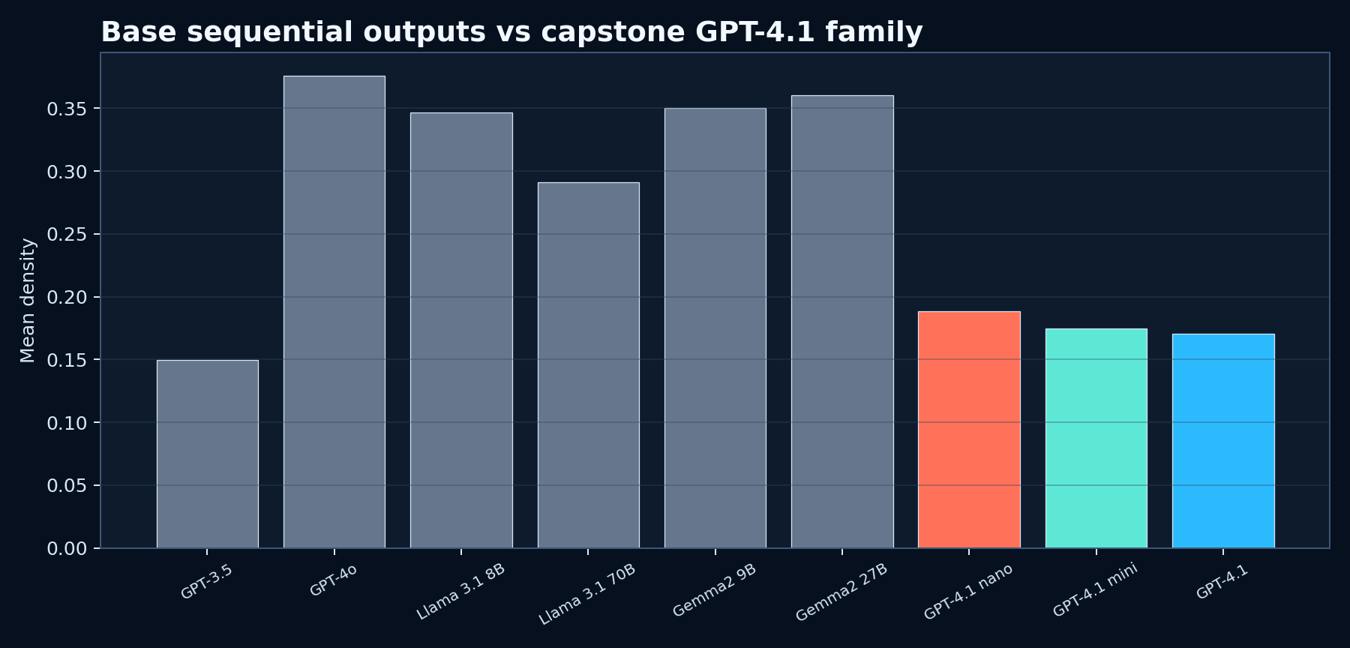
What Was Already In The Base Repository
Older work established the network-generation problem and produced baseline outputs.
Base / older model side
Original framing: LLMs generate social networks and can overestimate political homophily.
Existing sequential outputs: GPT-3.5, GPT-4o, Llama 3.1 8B/70B, and Gemma2 9B/27B.
Those outputs give comparison context, but not the full capstone matrix.
How our project differs
We converted the repo into a controlled study: same personas, multiple cultures, all four methods, multiple GPT-4.1 model sizes, and fixed-culture language experiments.
04

Slide 5
Our Contribution
What we added to the older repository.
Step 1
Made the repo runnable with OpenAI-only setup and repaired path/plotting issues.
Step 2
Added cultural context: US, India, Japan, Brazil with language fixed to English.
Step 3
Expanded from sequential to four methods: sequential, global, local, iterative.
Step 4
Added prompt-language study: English, Spanish, Hindi, Japanese with culture fixed to US.
Verification
Checked generated graph files, PNGs, homophily, metrics, node counts, and edge sanity.
05

Slide 6
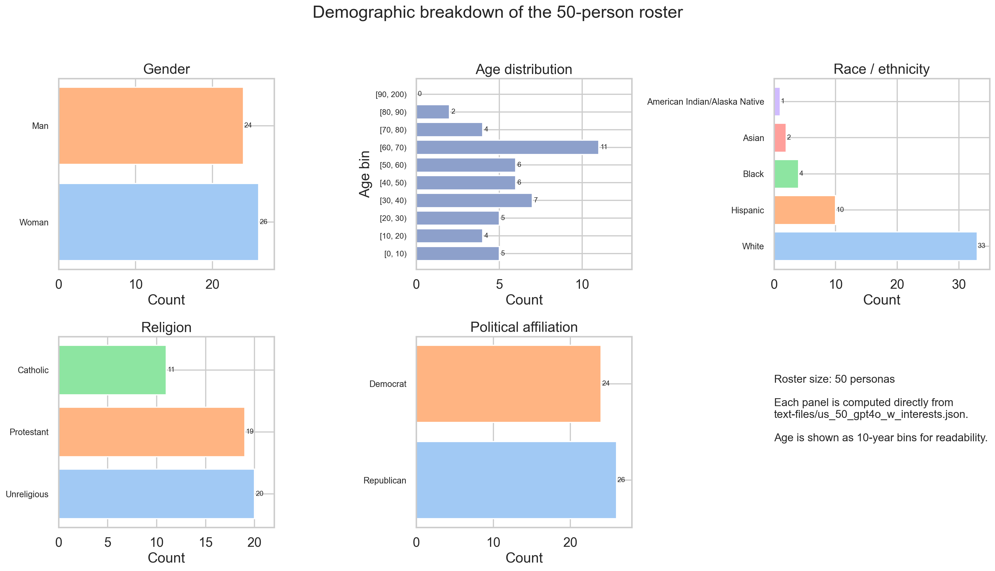
Dataset: The Same 50 Personas Everywhere
Using one fixed roster isolates the experimental variable.
Roster file: text-files/us_50_gpt4o_w_interests.json
Each persona includes gender, age, race/ethnicity, religion, political affiliation, and interests.
The same 50 personas are reused across all new studies.
That means differences are caused by prompt context, model, method, or language - not by changing the people.
06

Slide 7
Pipeline
How the project turns people into measurable networks.
1 Personas
2 Prompt
3 Network
4 Metrics
5 Answer
->
->
->
->
fixed 50-person roster
culture, language, method, model
.adj friendship graph
homophily + topology
four research questions
Homophily: do people connect more often to similar people than expected?
Topology: density, clustering, connected component size, modularity, path length.
Model divergence: edge distance between generated graphs under matched conditions.
07

Slide 8
Experiment Matrix
The capstone study is controlled but broad.
4
4
3
4
192
cultures: US, India, Japan, Brazil
methods: sequential, global, local, iterative
GPT-4.1 model sizes
prompt languages
verified generated graphs in Steps 2-4
Verification passed
Design logic
Step 2 cultural study: 24/24 graph conditions passed
Step 3 method expansion: 72/72 graph conditions passed
Step 4 language study: 96/96 graph conditions passed
RQ1-RQ3 combine sequential baseline with the method expansion.
RQ4 fixes culture to US, then varies prompt language.
All studies reuse the same 50-person roster.
08

Slide 9
The Four Generation Methods
Different prompting procedures create different graph structures.
Sequential
Global
People choose friends one at a time as the network grows.
The model proposes friendship pairs for the whole network at once.
Local
Iterative
Each focal person chooses friends from candidates without full sequential buildup.
The network is revised through add/drop style friendship updates.
09

Slide 10
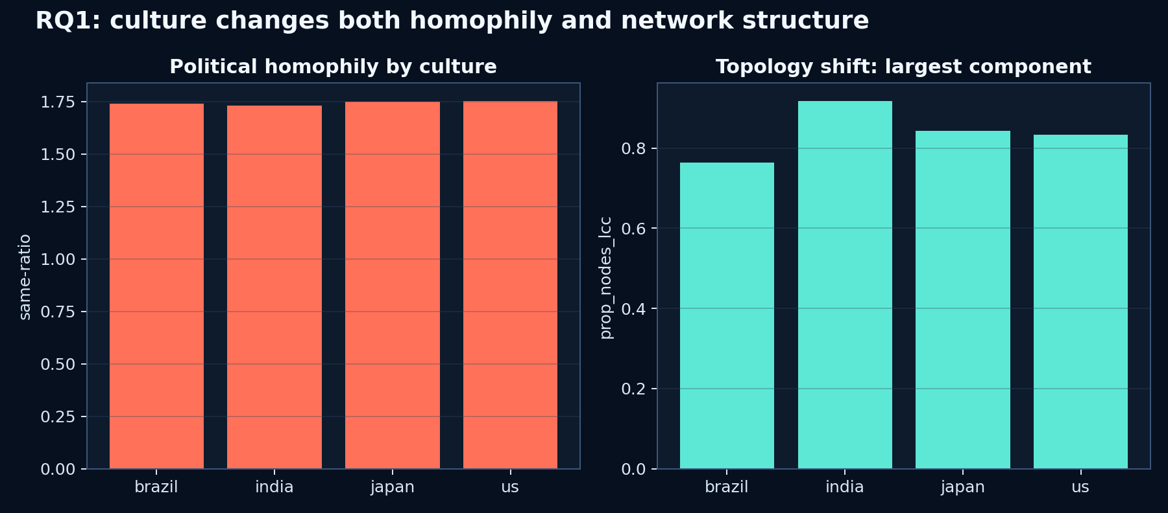
RQ1: Does Cultural Context Matter?
Yes. Holding language fixed to English, culture still changed homophily and topology.
Answer
Largest culture-driven homophily shift: political affiliation, same-ratio range 0.874.
Largest topology shift: proportion of nodes in the largest connected component, range 0.500.
Plain meaning: changing only the cultural frame changed who clustered with whom and how connected the graph became.
Presenter line
"Culture was not cosmetic. It changed the generated social structure even when the language stayed English."
10

Slide 11
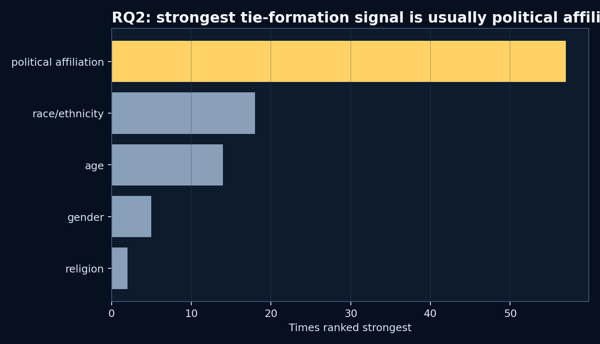
RQ2: Which Demographics Dominate Tie Formation?
Political affiliation is the strongest recurring signal, with an important global-method exception.
Across the English-language cultural study, political affiliation was the most frequent top-ranked homophily dimension.
Across the fixed-culture language study, political affiliation remained the most frequent strongest dimension.
After adding all methods, the result became more nuanced: global often elevated age, while local, sequential, and iterative more often elevated political affiliation.
Plain-language answer
Usually, the model formed friendships around political similarity more than the other demographic dimensions, but the prompting method can change which signal rises to the top.
11

Slide 12
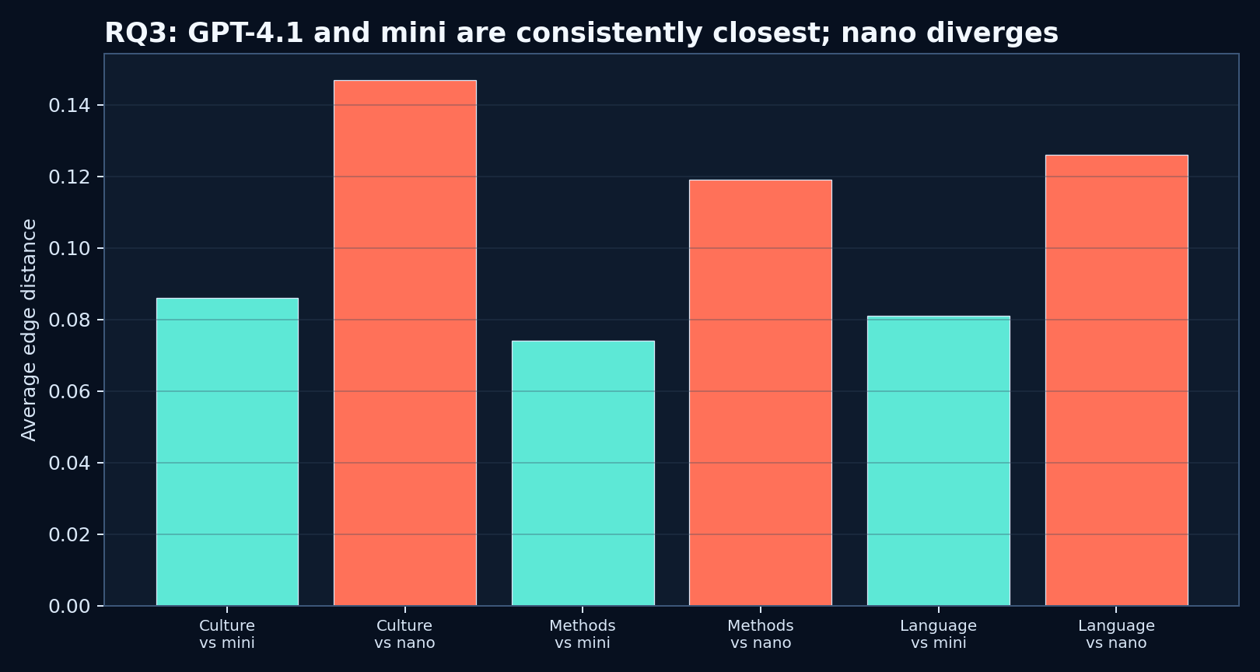
RQ3: Are Models Interchangeable?
No. Model size changed the generated edge set in a repeatable way.
Closest pair in cultural study: GPT-4.1 vs GPT-4.1-mini, edge distance 0.086.
Closest pair in method study: GPT-4.1 vs GPT-4.1-mini, edge distance 0.074.
Closest pair in language study: GPT-4.1 vs GPT-4.1-mini, edge distance 0.081.
Farthest pair in all three: GPT-4.1 vs GPT-4.1-nano.
Interpretation
Nano is the outlier. GPT-4.1 and GPT-4.1-mini stay closest across culture, method, and language studies.
12

Slide 13
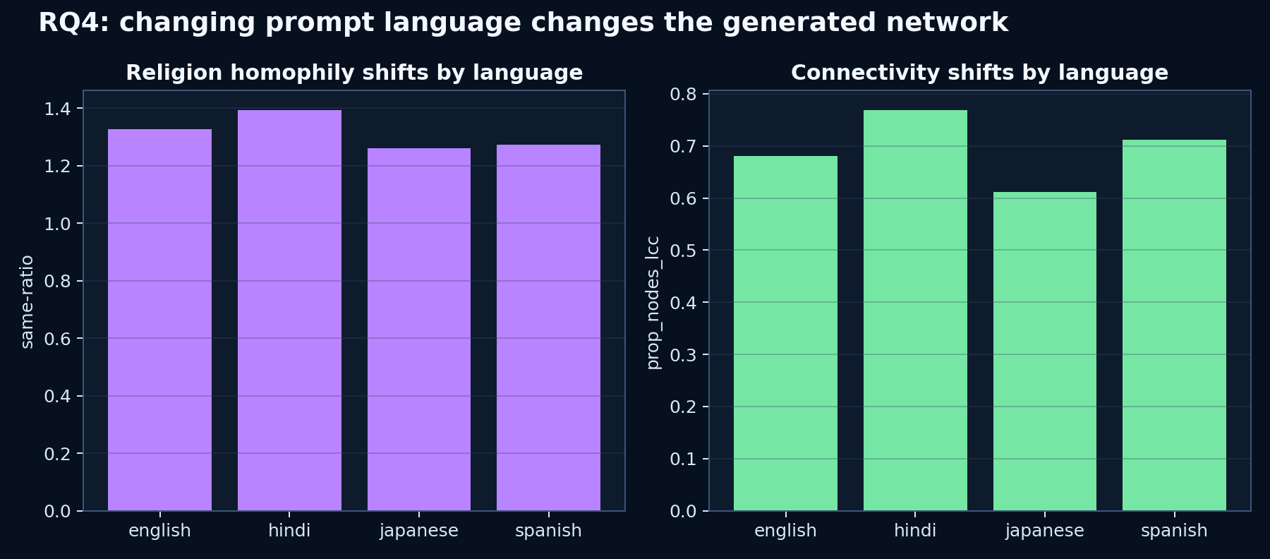
RQ4: Does Prompt Language Matter?
Yes. With culture fixed to US, language still changed homophily and topology.
Largest language-driven homophily shift: religion, range 1.502.
Largest topology shift: prop_nodes_lcc, range 0.740.
Closest language pair: Hindi vs Japanese, edge distance 0.079.
Farthest language pair: Japanese vs Spanish, edge distance 0.088.
Plain-language answer
Even when the people and culture stayed fixed, changing the language of the prompt changed the network that came out.
13

Slide 14
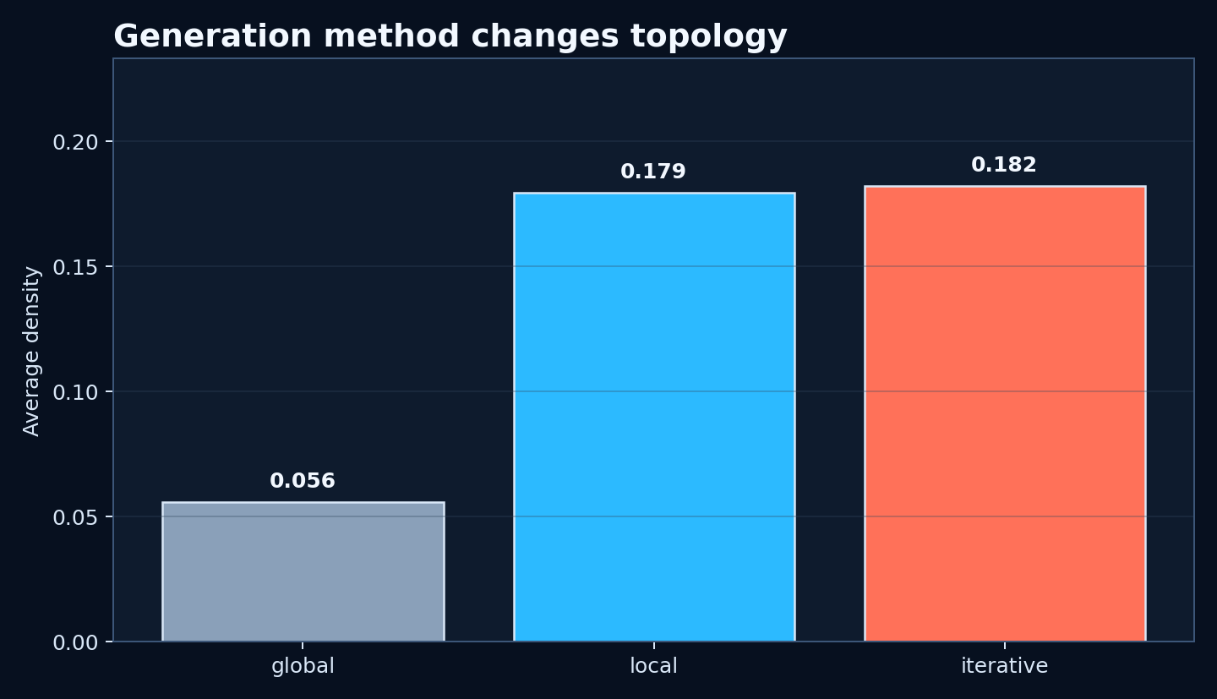
Method Effects
The generation procedure changes network density and connectedness.
Global is sparsest: average density 0.056.
Iterative is densest: average density 0.182.
Local is close to iterative: average density 0.179.
This means methods are not neutral wrappers around the same model; the asking procedure shapes the graph.
14

Slide 15
Live Demo Slide: Personas Become Bonds
Use this when presenting the visual animation.
Say this
First, the model receives 50 synthetic personas.
Then it chooses friendship bonds.
The final graph contains hubs, clusters, and bridge people.
So the project studies generated social interaction, not only generated identities.
Optional: play the MP4 animation after this slide.
15

Slide 16
Final Answers To The Research Questions
The shortest version to say out loud.
RQ1 Culture
Yes: culture changes both homophily and topology.
RQ2 Demographics
Political affiliation is usually the strongest tie-formation signal; global often elevates age.
RQ3 Models
The models are not interchangeable. GPT-4.1 and mini are closest; nano diverges most.
RQ4 Language
Yes: even with culture fixed, prompt language changes homophily and graph structure.
16

Slide 17
Limitations And Why They Matter
Shows you understand what the results do and do not prove.
These are synthetic networks, not real friendship networks.
The fixed 50-person roster is useful for control, but it is still one roster.
Two seeds per condition give repeatability evidence, but more seeds would strengthen estimates.
Prompt wording and model provider behavior can change over time.
The findings are best interpreted as model behavior under controlled prompts, not as claims about real human societies.
Strong closing sentence
The value of this project is that it measures those sensitivities instead of hiding them.
17

Slide 18
Conclusion
Generated networks are powerful, but they are not neutral.
Main takeaway
LLMs can create structurally plausible social networks, but culture, language, method, and model choice reshape who becomes connected to whom.
Base repo: established the network-generation problem with older model outputs.
Our work: extended it into a controlled capstone matrix.
Final result: the same personas can produce meaningfully different social structures depending on the experimental condition.
Q&A
18

