Slide 1
Linux Unit 3c

Slide 2
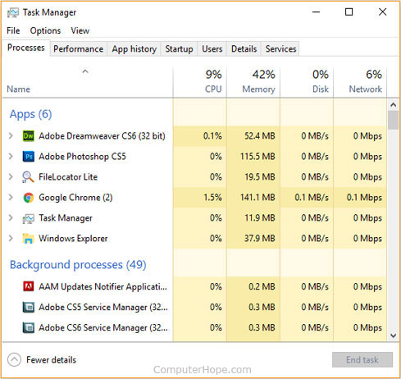
Looking at Processes
In windows, there is task manager
Displays programs running on a computer
CPU Usage
Memory Usage
Name

Slide 3
Looking at Processes: Linux
In Linux, every process is identified by a name AND a process identification number (PID)
They also use up CPU and RAM just like Windows
Because that’s how a computer works
There are several commands we can use to look at processes
top
ps aux
pstree

Slide 4
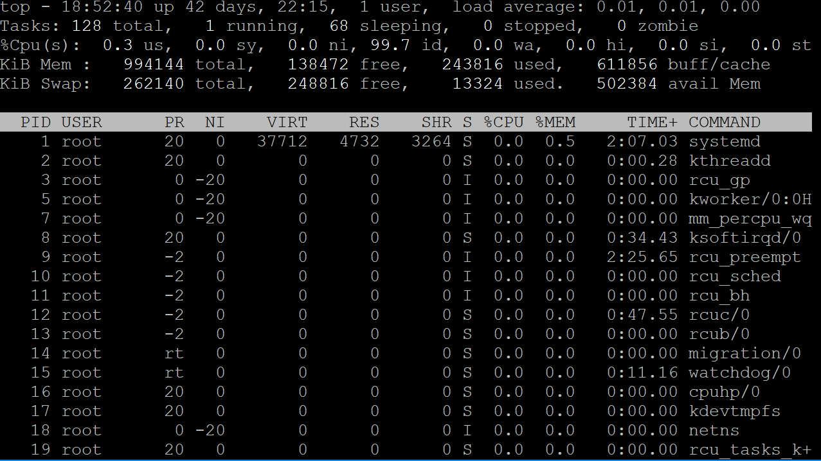
top
Nice Format for general overview
Bad for finding particular stuff
To use:
top
Exit by typing q

Slide 5
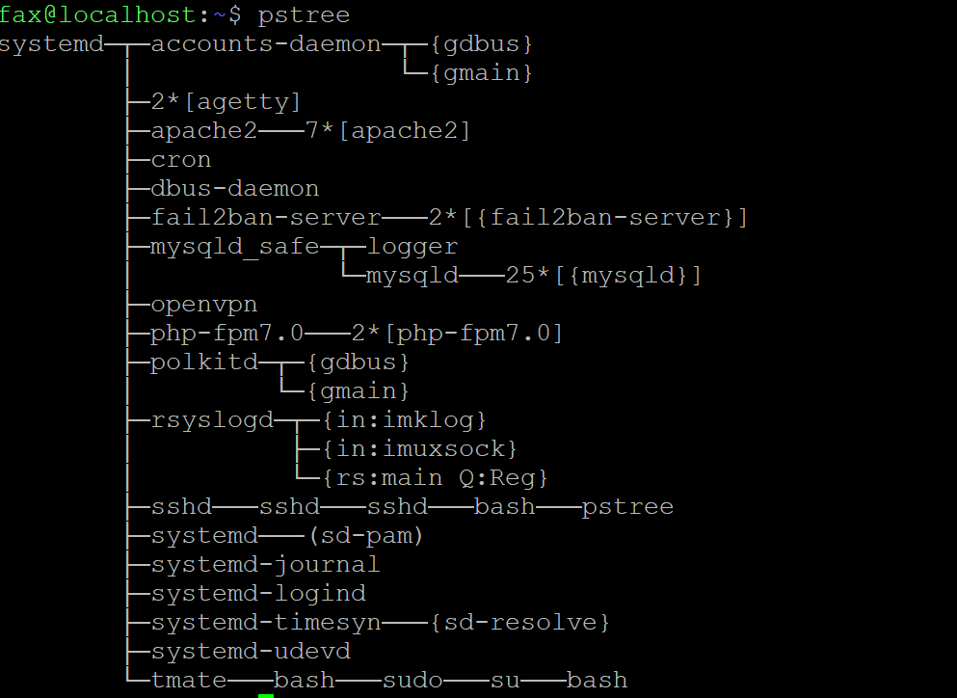
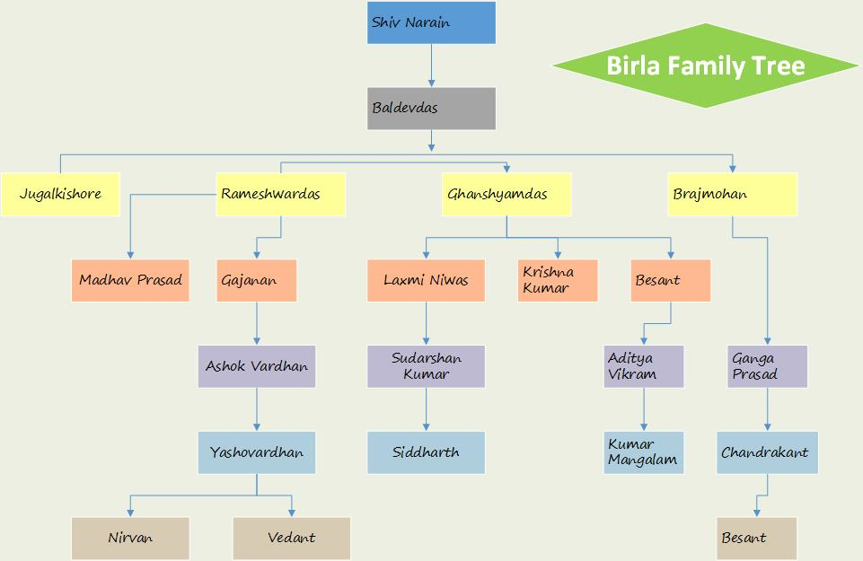
pstree
Shows a list of process and their parents,
kind of like a family tree

Slide 6
ps aux
Most useful for “finding stuff”
Displays raw list of processes
Combine with grep command
Syntax: command | grep “x”
Examples
cat file | grep “x”
ls | grep “file”
Try and find a process named “bash”

Slide 7
Startup
Crontab- runs commands on a schedule
Useful for scheduled updates/backups
Can also be used for evil, netcat listeners !!
/etc/crontab is the “system’s” crontab
Every user has their own crontab, who’s is the most important?
Edit with crontab –e

Slide 8
ssh
Server Auditing
/etc/ssh/sshd_config
Protocol
Port
PermitRootLogin
Client Usage
ssh user@ip-address

