Slide 1




Database Systems
AASTU CAFETERIA MEAL MANAGEMENT SYSTEM
prepared by group 6

Slide 2

Database systems
At Addis Ababa Science and Technology University, digital meal access systems such as student ID scanning are used to support cafeteria operations.
However, managing large amounts of meal-related data, transaction records, meal sessions, and menu information still requires a well structured database system.
The proposed Meal Management System is designed to improve the organization, storage, retrieval, and management of cafeteria data using both relational and non-relational databases.
The system aims to support efficient meal transaction recording, improve data consistency, and assist the university in generating accurate reports and managing cafeteria services more effectively.
INTRODUCTION

Slide 3
Database Systems
Design and implement a database system for AASTU meal management system that:
Manage student information
Record meal transactions
Manage meal sessions and menus
Reduce redundancy
Improve data consistency
Generate reports
Implement using MySQL and MongoDB
OBJECTIVES

Slide 4
Database Systems
Included:
Student information management
Meal session management
Menu management
Meal transaction recording
Report generation
MySQL and MongoDB implementation
SCOPE OF THE PROJECT

Slide 5
Database Systems
METHODOLOGY
& TOOLS
Methodology:
Requirement analysis
Database design
ER diagram creation
Normalization
Implementation
Testing
Documentation
Tools Used:
MySQL(MySQL Workbench)
MongoDB(MongoDB Compass)
Draw.io
GitHub

Slide 6
Database Systems
Functional requirements:
Store student information in the database
Record meal transactions every time the student uses the cafeteria
Manage menus and meal sessions
Generate reports
Maintain transaction history
SYSTEM REQUIREMENTS

Slide 7
Database Systems
Non functional requirements:
Data accuracy
Scalability
Reliability
Security
Efficient performance
SYSTEM REQUIREMENTS

Slide 8
Database Systems
DATABASE ENTITIES
entity name: STUDENT
has the following attributes:
student_id
student_name
department
year
entity name: MEAL_TRANSACTION
has the following attributes:
transaction_id
student_id
session_id
transaction_time
status

Slide 9
Database Systems
DATABASE ENTITIES
entity name: MEAL_SESSION
has the following attributes:
session_id
session_name
session_time
entity name: MENU
has the following attributes:
menu_id
session_id
food_name
menu_date

Slide 10
Database Systems
One student → many meal transactions(1:M)
One meal session → many meal transactions(1:M)
One meal session → many menu records(1:M)
RELATIONSHIP ANALYSIS

Slide 11
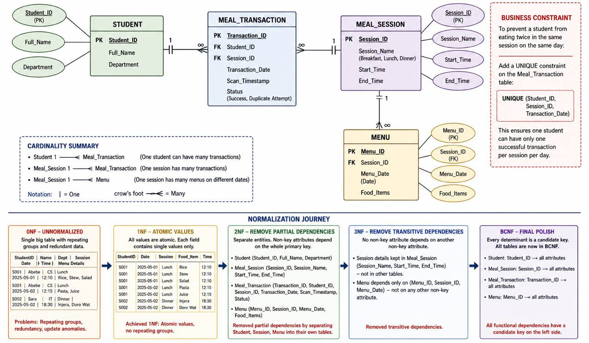
Database Systems
ER
DIAGRAM
to get a better look at the diagram please visit:
https://github.com/henacodes/AASTU-DB-Project-Group-6/blob/master/diagrams/ERD.jpg

Slide 12
Database systems
This database system was improve consistency and reduce redundancy:
1NF:- Atomic values
- No repeating groups
2NF:- Removed partial dependencies
3NF:- Removed transitive dependencies
BCNF:-Final polish(All determinants are candidate keys)
NORMALIZATION

Slide 13
Database systems
Testing:
Verified relationships
Tested queries
Validated reports
Checked data consistency
challenges
Relationship errors
Query optimization
Integrating MySQL and MongoDB
TESTING AND CHALLENGES

Slide 14
Database systems
This project focused on designing a Meal Management System that helps organize student meal information, transaction records, meal sessions, and menu data more efficiently. By using both MySQL and MongoDB, the system improves data organization, reduces redundancy, and supports accurate report generation for university cafeteria services.
CONCLUSION

Slide 15
Database systems
THANK YOU!!!

